Slide 1
Segmentation in ITK-SNAP
Daphne Laino and Danielle Roy

Slide 2
What is Segmentation?
Process of partitioning an image into segments
Segments are called superpixels
Superpixels are made up several pixels that have similar properties
Examples:
Color
Intensity
Texture

Slide 3
Why Segmentation?
The goal of segmentation is to simplify and/or change the representation of an image into something more meaningful and easier to analyze.
Applications:
Locate tumors
Measure tissue volumes
Computer-guided surgery
Diagnosis
Treatment planning
Study of anatomical structure

Slide 4
What is ITK-SNAP?
ITK-SNAP is a free software application used in 3D medical image segmentation.
Provides semi-automatic segmentation (snake tool).
Provides manual segmentation in three orthogonal planes.
Supports some color images.

Slide 5
Current Status
Done:
Segmentation in a tutorial
Some segmentation of image4
In progress:
SNAP theory research/discussion
Segmentation of assigned volume
Issues:
ITK-SNAP is not recognizing the file types of the assigned volumes

Slide 6
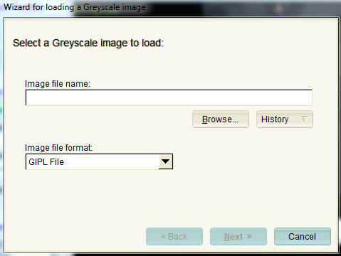
A Brief Tutorial for ITK-SNAP
First, the image file to be segmented needs to be loaded into ITK-SNAP
Be sure to select the proper file type in order for ITK-SNAP to recognize and open the file
Select an area in the file that you wish to segment

Slide 7
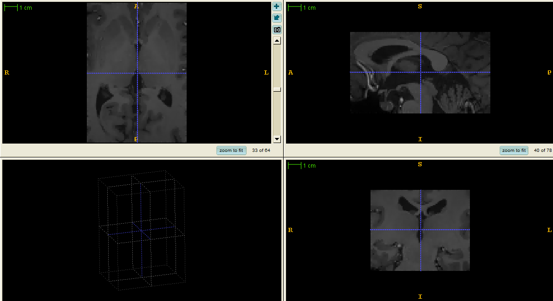
A File to be Segmented

Slide 8
The Toolbox
The toolbox is exactly what it sounds like: tools you will use to segment the image. For this segmentation, we will be using the Snake tool.

Slide 9
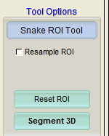
The Snake Tool
Here we will select Segment 3D
Choosing Reset will lose your hard work!
After selecting Segment 3D, we will go to image preprocessing

Slide 10
Image Preprocessing
Here, you can select the features to segment by: Intensity Regions or Image Edges.
For this Image, we will be using Image Edges
Select this option and click Preprocess Image

Slide 11
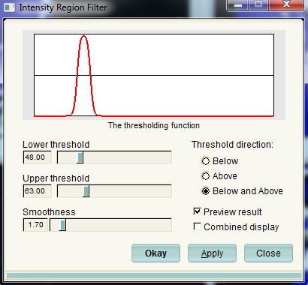
Intensity Region Filter
If you had selected Intensity Region Filter, you would come to this screen.
You can select your thresholds and smoothness here.
This is the filter we would use for image4.

Slide 12
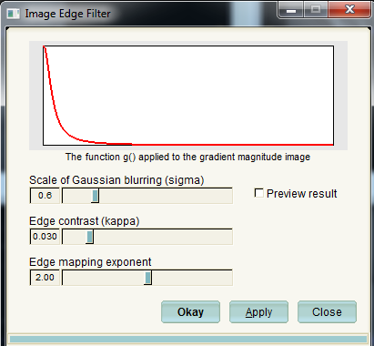
Image Edge Filter
Because we chose Image Edge Filter, this is the screen we SHOULD see.
Here, you select values for Gaussian blurring, Edge contrast, and Edge mapping.
Selecting the Preview result box will allow you to see the effects each change will have.

Slide 13
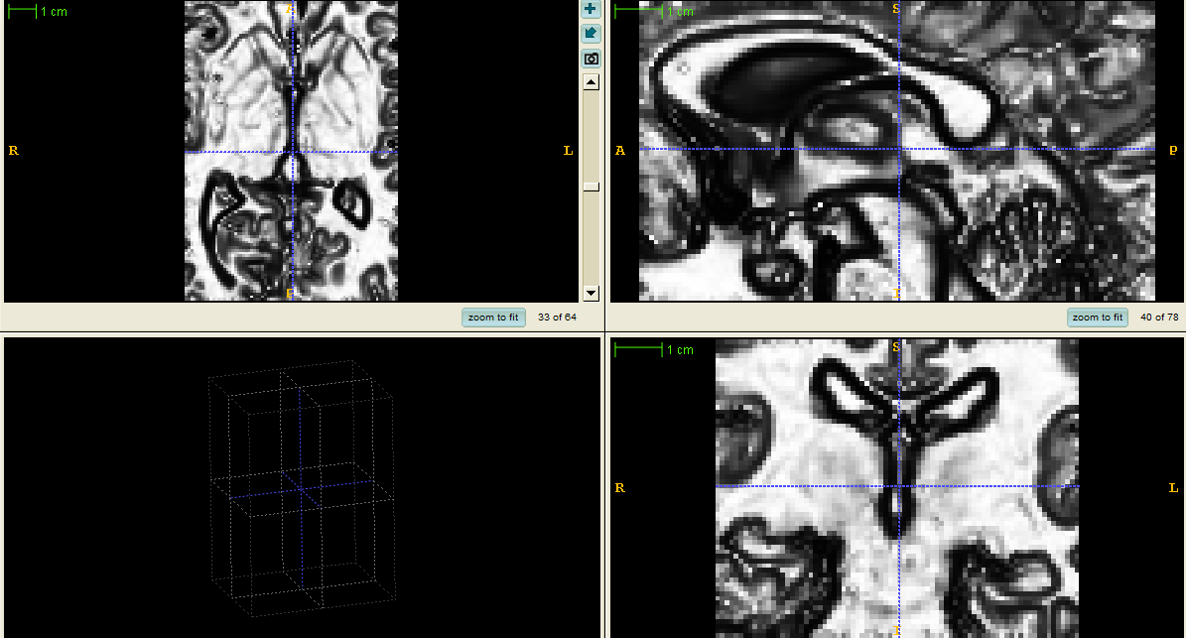
Preprocessed Image

Slide 14
Snake Initialization
In snake initialization, we will add “bubbles” which will mark areas of interest
You can select the radius of each bubble to adjust to the region of interest

Slide 15
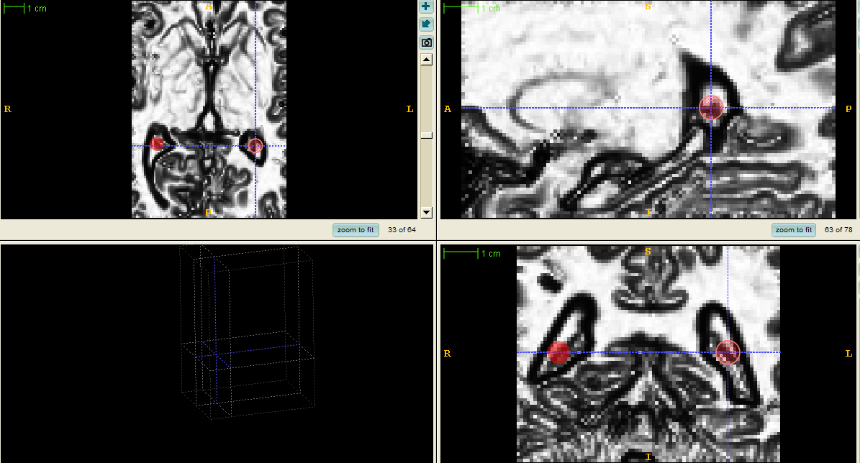
Bubbles on Image

Slide 16
Segmentation!
Here, you will set the parameters so that you can finally segment!
Once the parameters are set, you can hit the “play” button and let the automatic segmentation run.

Slide 17
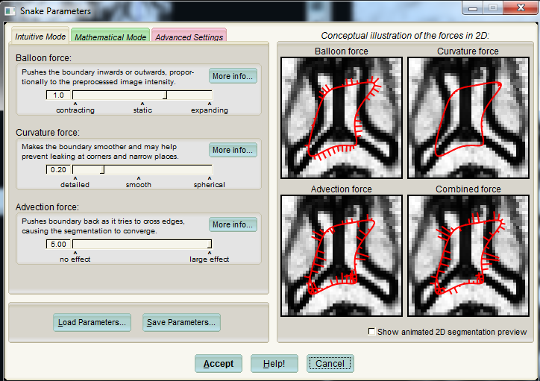
Set Parameter Screen

Slide 18
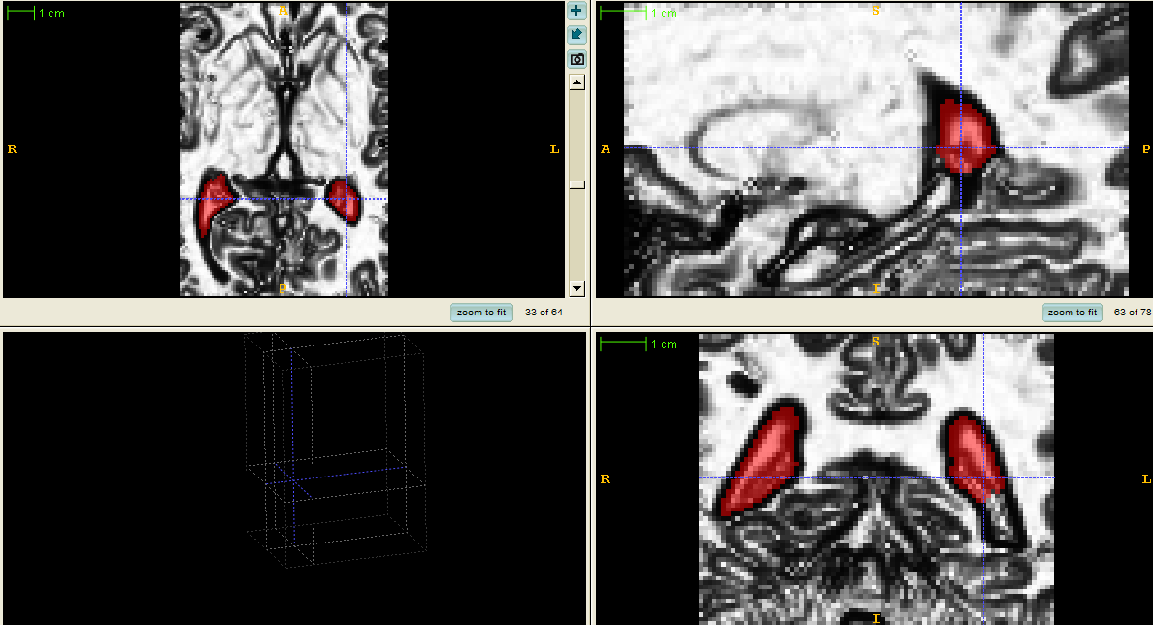
Segmented Image

Slide 19
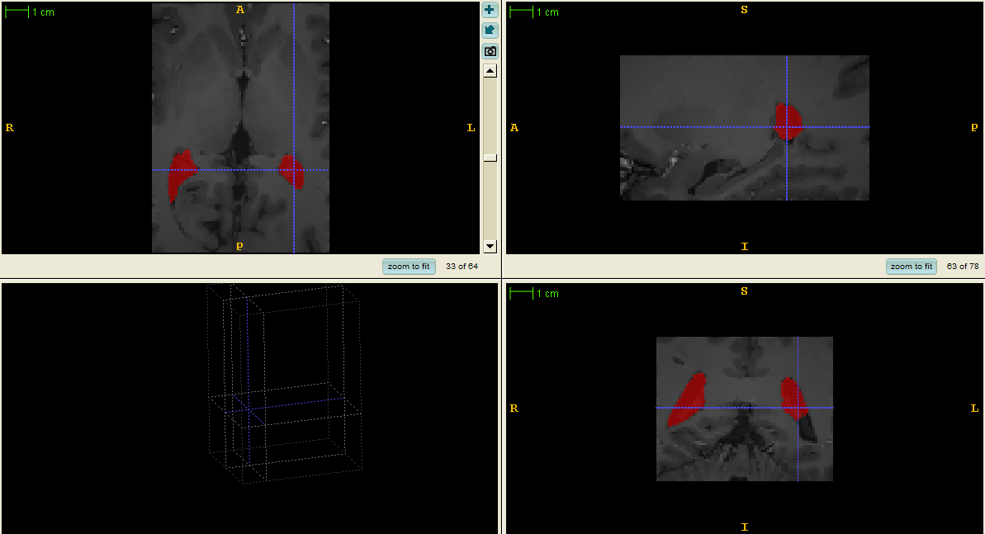
Final Segmented Image

