Slide 1
Title. Motion-compensated Inverse Radon Transformation using Deep Learning: a Medical application
Presenters. Haoran Chang, Ph.D. Candidate, FIT; and Debasis Mitra, Professor, FIT
Abstract. Radon Transform (RT), invented in 1917 by Johann Radon, has its use in medical imaging,
astronomy, Seismic imaging, and physics. RT and its inverse, IRT, transform an image between difference
spaces, as Fourier Transform (FT) and its inverse, IFT do. RT and FT are quite inter-related mathematically.
Many of the imaging applications of RT-IRT are affected by motions of the imaged object during data
acquisition. For example, RT allows non-invasive imaging of heart, but a heart beats too fast during
some of the imaging modalities with coarse timing-resolutions. While the issues of noise-removed
IRT is a subject of research and practice over a half-century, applications of Convolutional Neural
Network (CNN) in IRT is only recently being explored. In this work, we show how such a network
may correct for cardiac motion using IRT in image reconstruction that is solely based on CNN.
We compare our novel network against some existing paradigms of Deep Learning.
Key Words. Medical image Reconstruction; Motion Correction; Inverse Radon Transformation;
Deep Learning; Convolutional Encoder Decoder

Slide 2
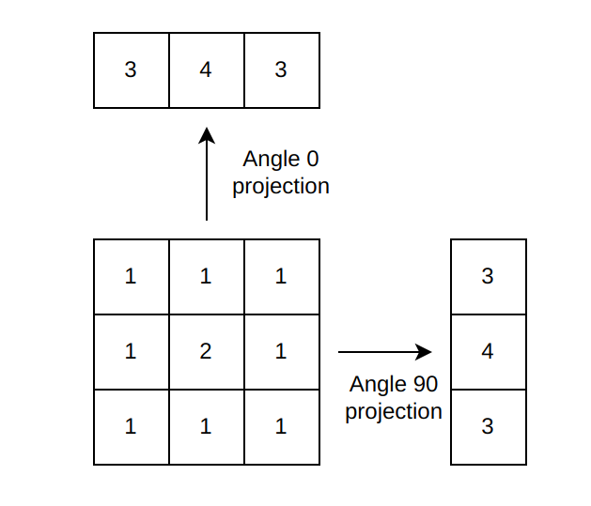
Radon Transform
Integral Projection

Slide 3
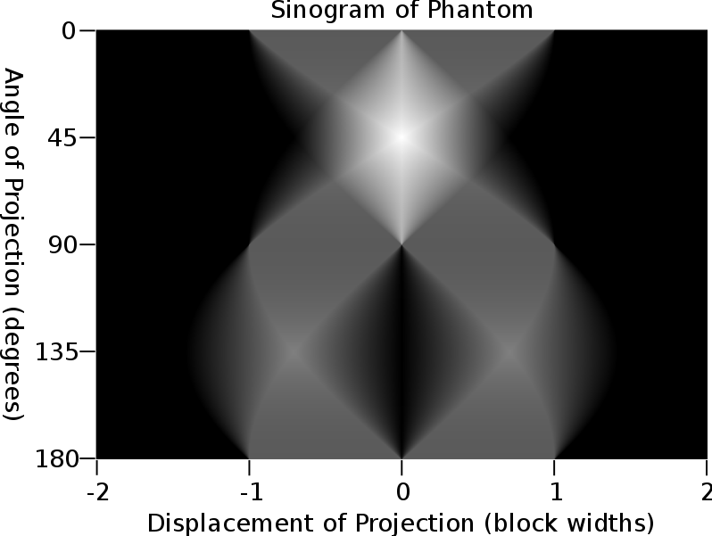
Radon Transform
Sinogram
Phantom
Radon Transform
From wiki page “Radon Transform”: https://en.wikipedia.org/wiki/Radon_transform

Slide 4
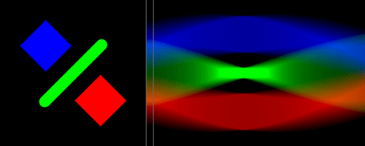
Radon Transform
Sinogram (Animation)
Horizontal projections through the shape result in an accumulated signal (middle bar). The sinogram on the right is generated by collecting many such projections as the shape rotates. Here, color is used to highlight which object is producing which part of the signal. Note how straight features, when aligned with the projection direction, result in stronger signals.
From wiki page “Radon Transform”: https://en.wikipedia.org/wiki/Radon_transform

Slide 5
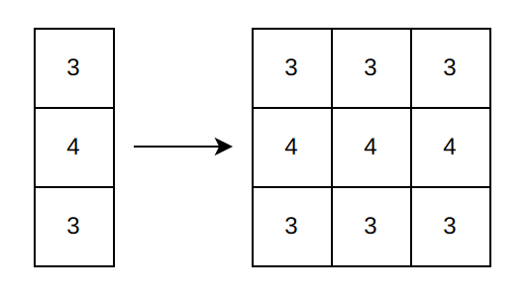
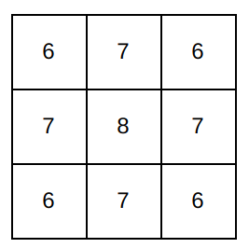
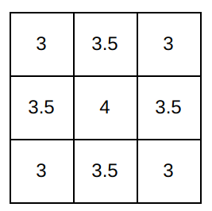
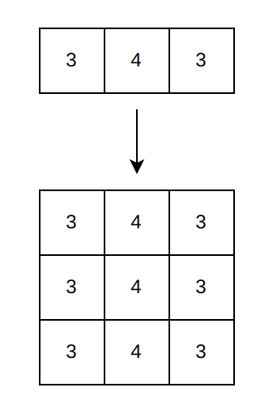
Inverse Radon Transform (Backprojection)
Divided by 2
(# of projections)

Slide 6
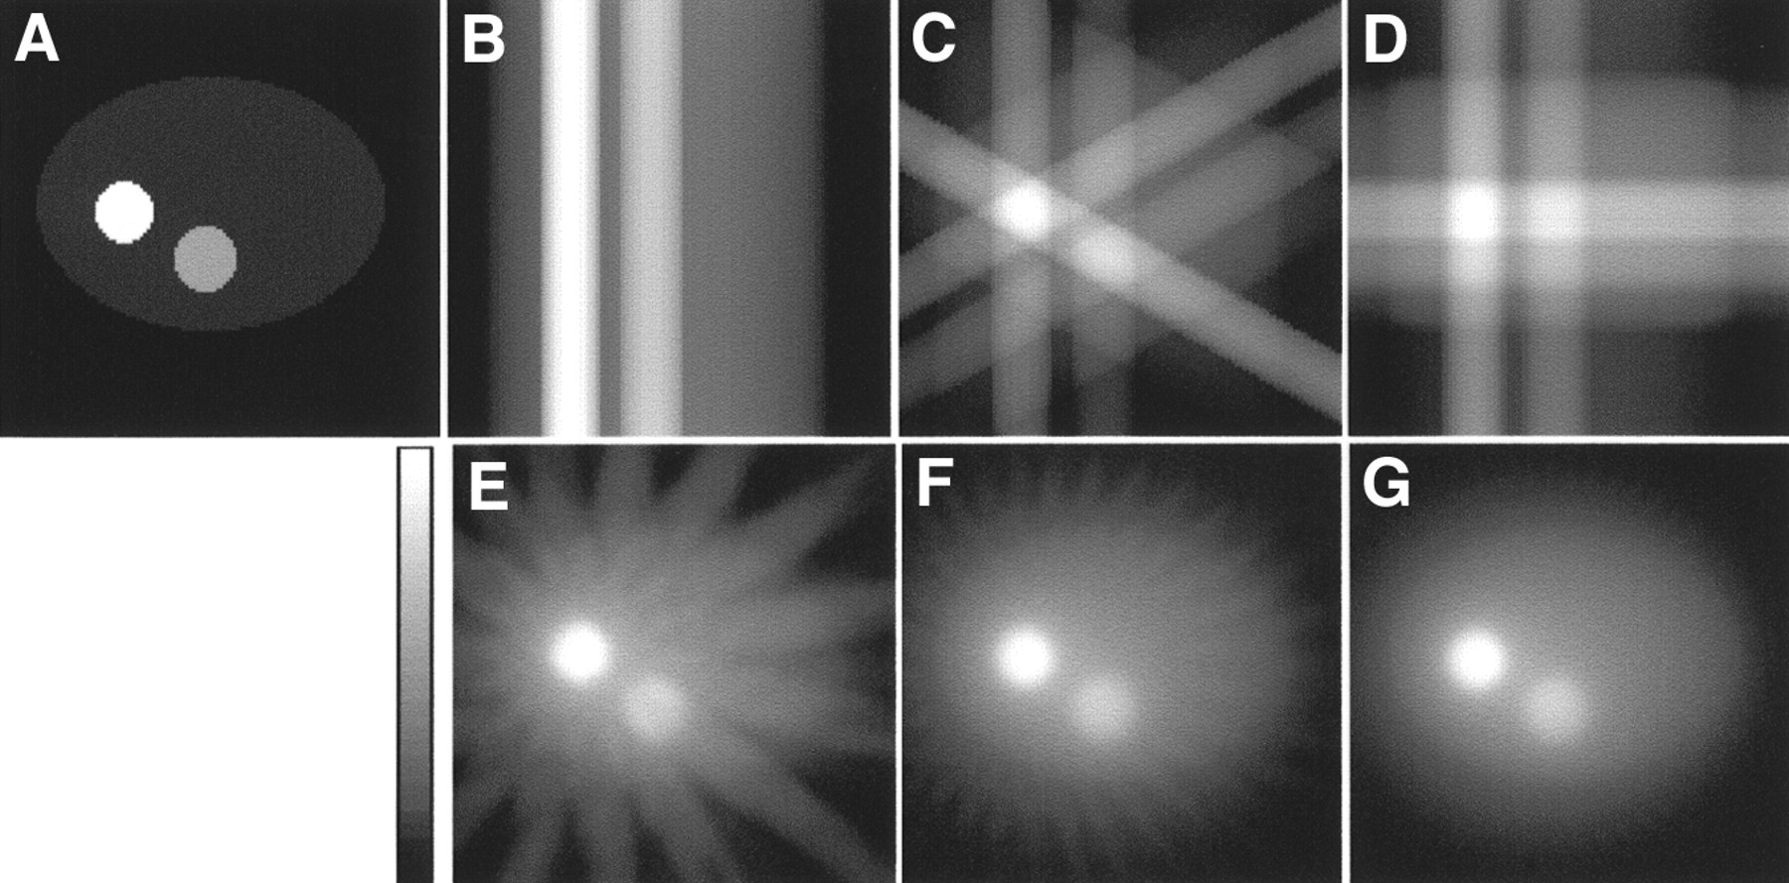
Inverse Radon Transform (Backprojection)
(A) Slice used to create projections. (B–G) 1, 3, 4, 16, 32, and 64 projections equally distributed over 360° are used to reconstruct slice using backprojection algorithm.
Figure from “Analytic and Iterative Reconstruction Algorithms in SPECT” by Philippe P. Bruyant

Slide 7
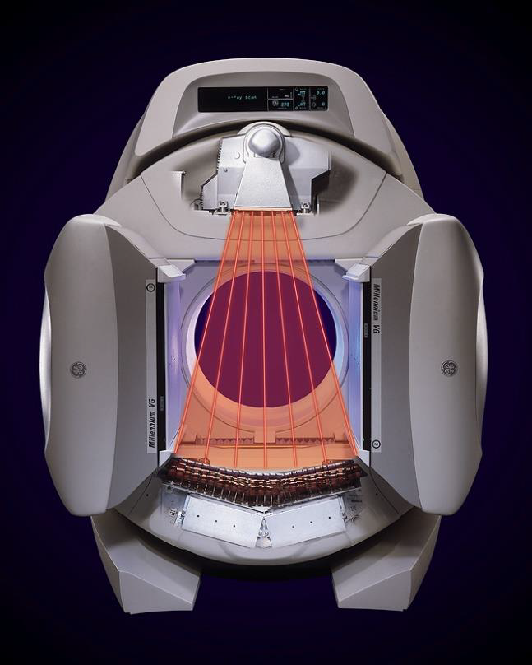
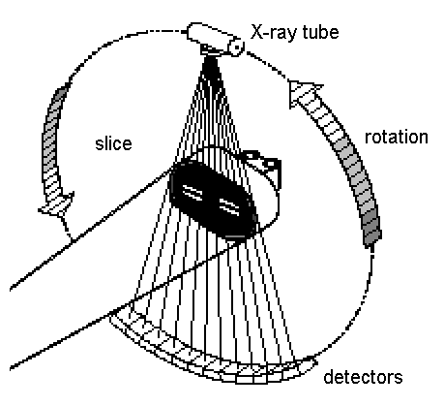
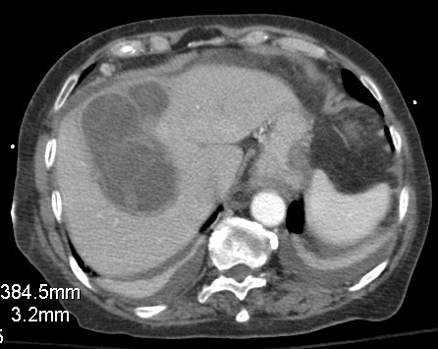
Computed Tomography: Absorption of X-ray Anatomical Imaging
20-40 keV

Slide 8
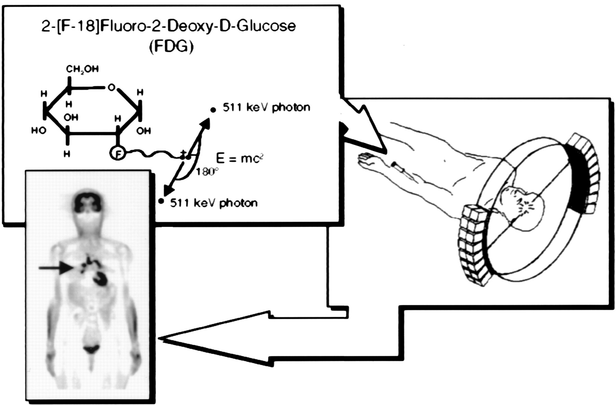
Emission Tomography: Functional Imaging
Source: ME Phelps, PNAS, 97(16) 9226–9233, 2000

Slide 9
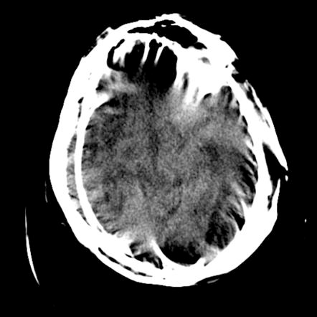
Problem we are addressing: How to Inverse Motion-added Radon Transform?
Motion types in medical imaging: Beating heart, Respiration, Patient motion, …
Creates blurriness in sinogram, and results in artifacts Reconstructed images

Slide 10
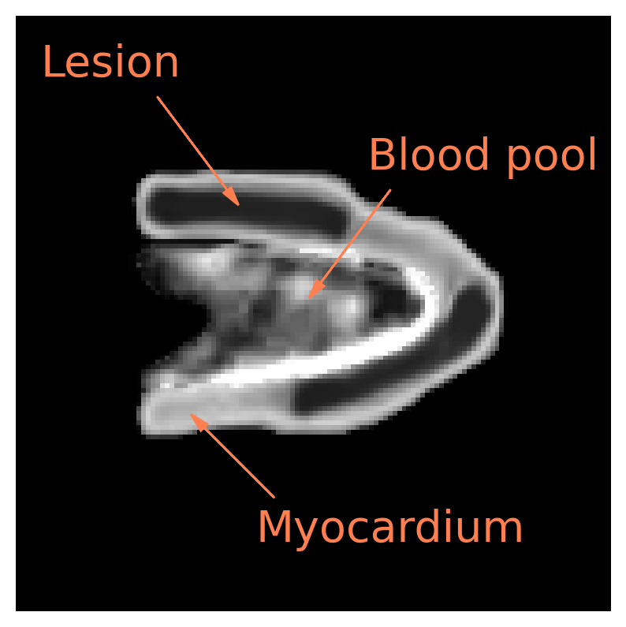
Data Preparation for Training and Validation for Deep Learning
Original Data - Pseudo Heart

Slide 11
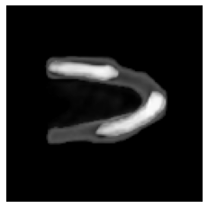
Data Preparation for Training and Validation
Augmentation - Randomly select some frames and perform affine transformations

Slide 12
Data Preparation for Training and Validation
Blurring - Affine motion

Slide 13
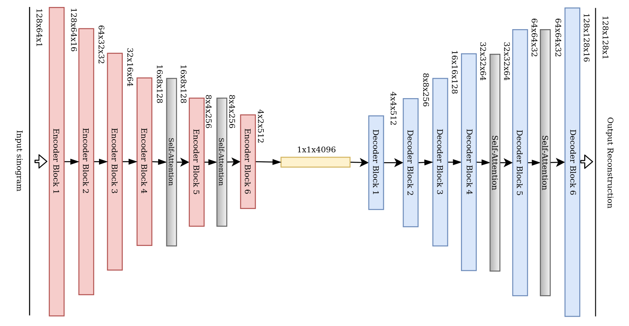
Neural Network Model for Image Reconstruction
Convolutional Encoder-Decoder with Self-Attention

Slide 14
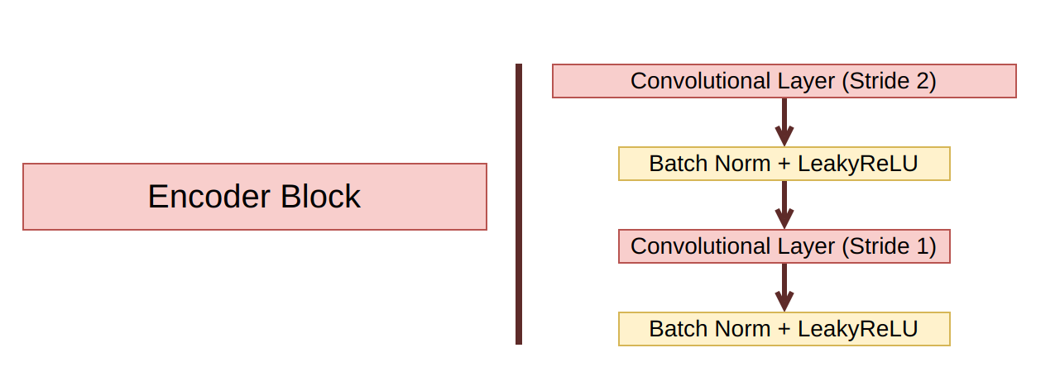
Neural Network Model
CEDA - Encoder Block

Slide 15
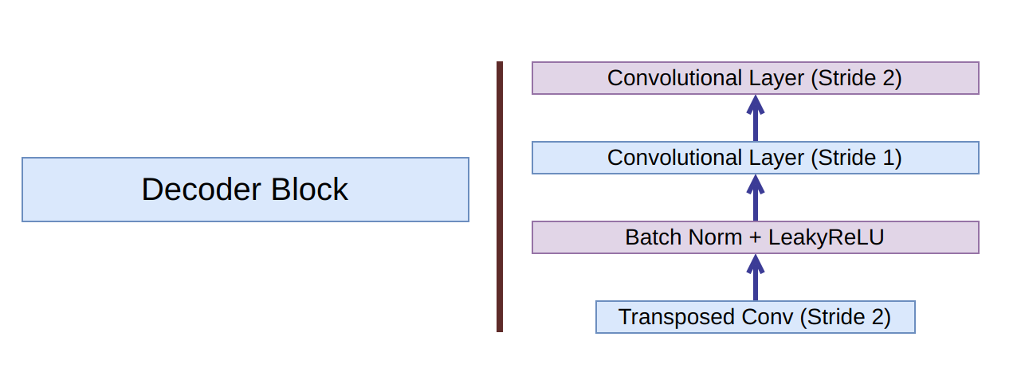
Neural Network Model
CEDA - Decoder Block

Slide 16
Conventional noise reduction with Deep Learning are performed by U-net

Slide 17
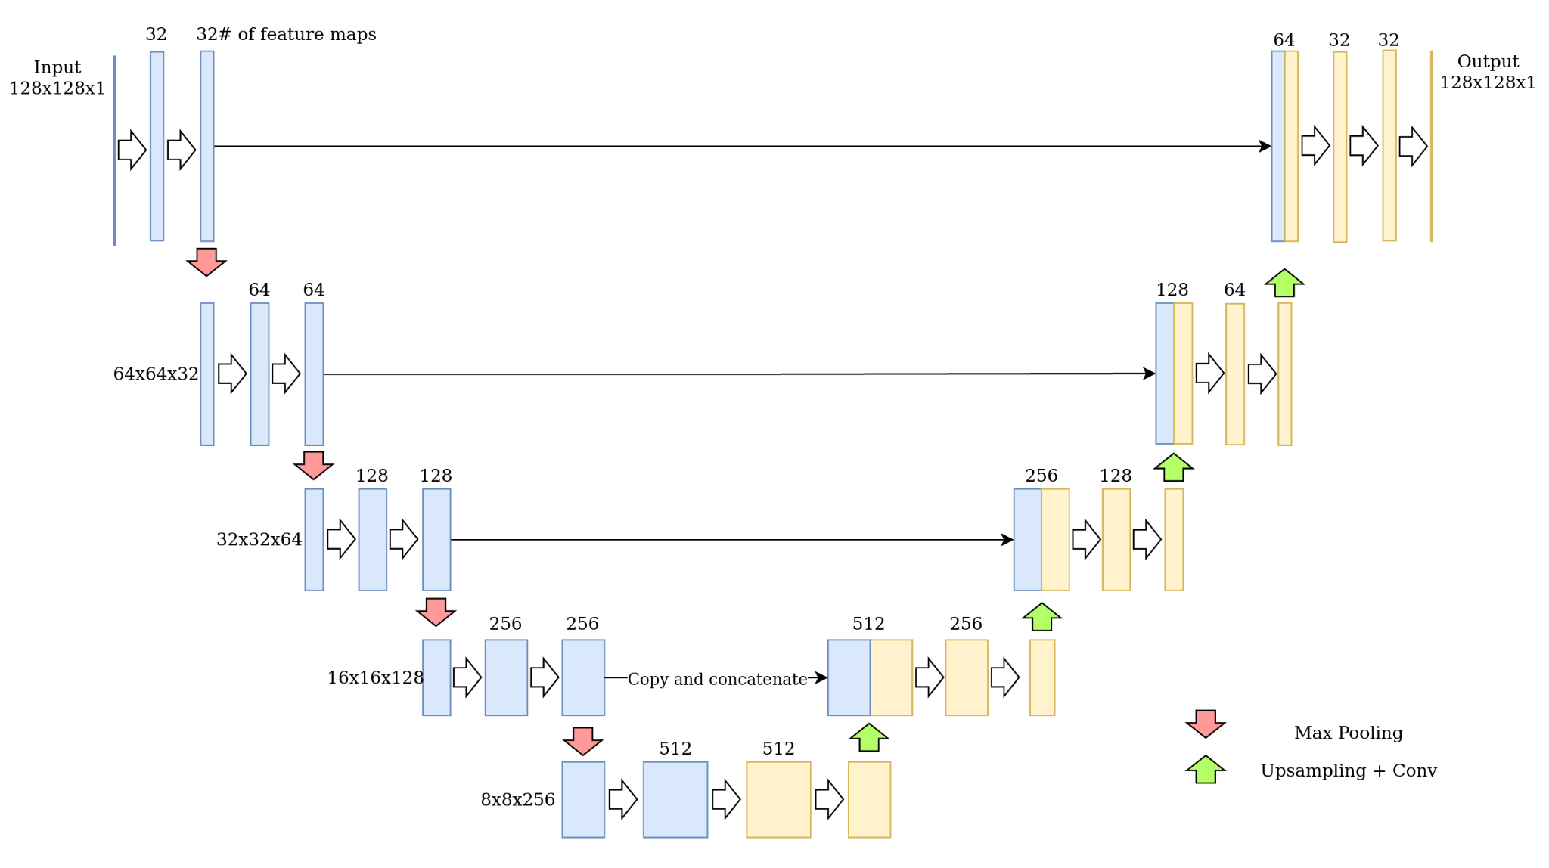
U-net Model for Noise-reduction
U-net (for comparison against ours)

Slide 18
Conventional noise reduction are performed by U-net
However, U-net maps from image-space to similar image-space

Slide 19
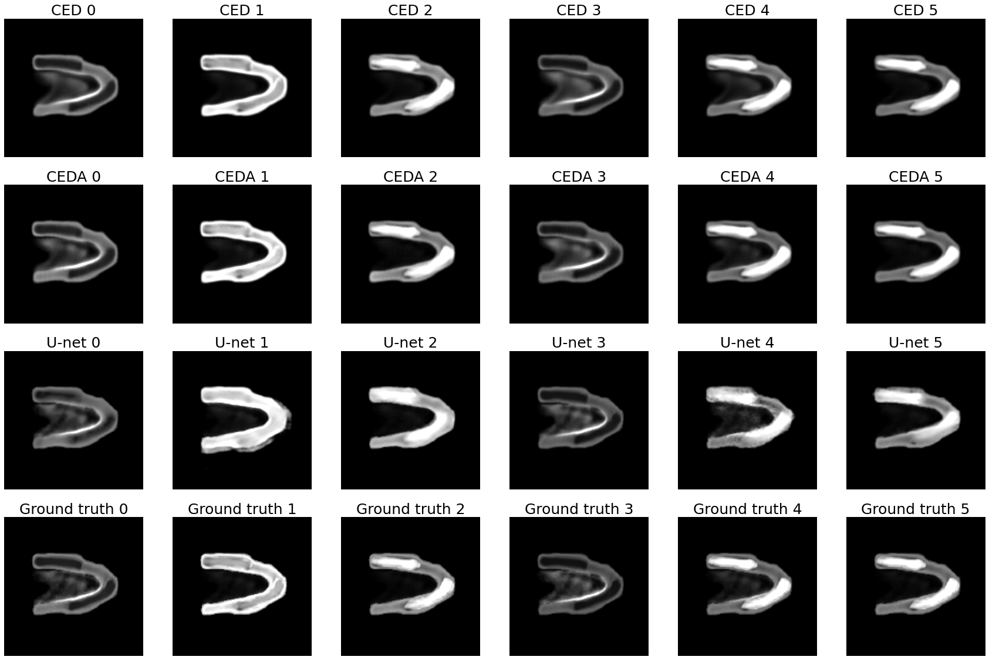
Result: reconstructions
Image-0 Image-1 Image-2 Image-3 Image-4 Image-5

Slide 20
Result: Comparison Metrics
Visual Information Fidelity (VIF)
Where:
I(x;y) - Mutual information between x and y
C - Reference image
E - Visual signal of C at the output of human visual system (HVS)
F - Visual signal of distorted C at the output of HVS

Slide 21
Result
Comparison
Visual Information Fidelity (VIF)

Slide 22
Result: Comparison Metrics
2. Signal-to-noise Ratio (SNR)
3. Contrast-to-noise Ratio (CNR)
µ is mean and
sigma is standard deviation
ROI region of interest (heart)

Slide 23
Result
Signal-to-noise Ratio (SNR)
Contrast-to-noise Ratio (CNR)

Slide 24
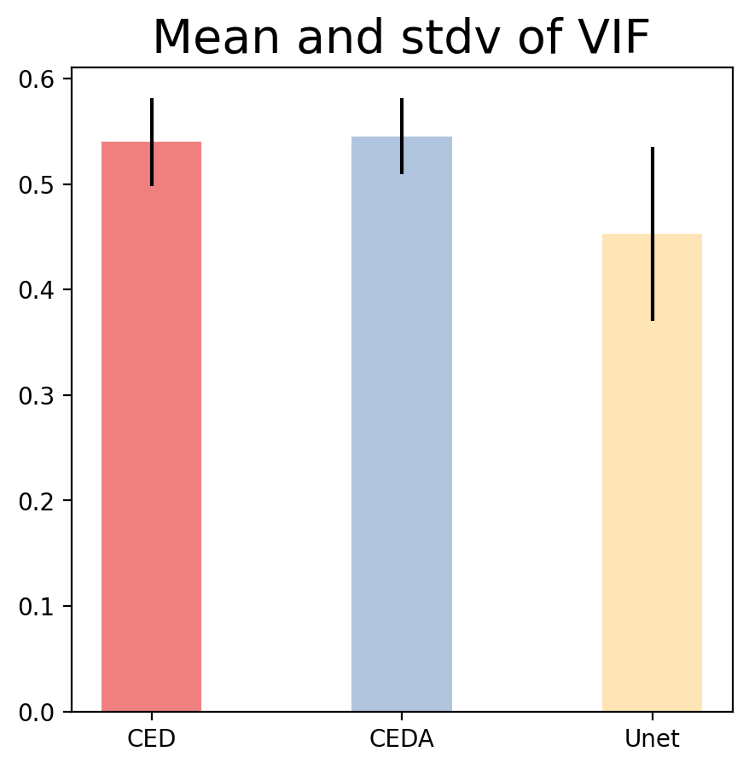
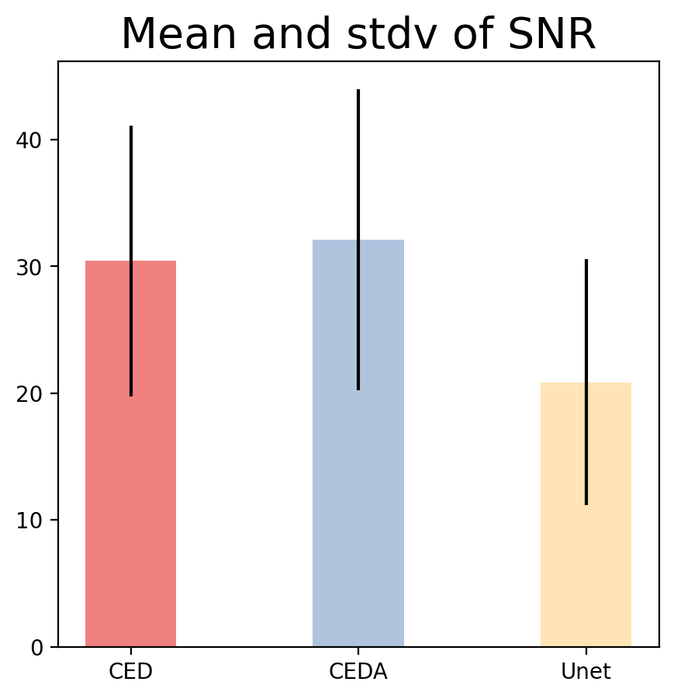
Result
Comparison (mean and stdv)
0.54±0.042
0.55±0.036
0.45±0.082
30.44±10.66
32.12±11.96
20.88±9.72

Slide 25
VIF:
44 out of 50 reconstructed images CEDA reconstruction is better than U-net denoising,
and 26 reconstructed images with CEDA is better than CED.

