Slide 1
Intro

Slide 2
Computer science involves:
(1) Problem definition (theorem/need/requirements/idea) and solution (proof/algorithm/code)
(2) Efficiency (steps/ time/ memory/ communication / power) of algorithm and code
(3) Accuracy of results (correctness of algo / approximate-algorithm/ validation / debug / numerical-accuracy)
(4) Good coding practice → Software engineering

Slide 3
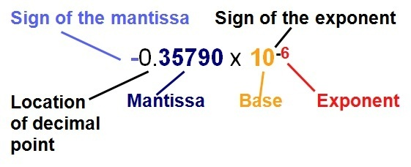

Slide 4
Roundoff error: difference between two closest numbers within mantissa = machine accuracy
It is NOT the smallest floating-point number of the machine = (mantissa=1, exponent=smallest)
Say, 0.00059 is round off to 0.0006
Truncation error: “discrete” approximation of “continuous” quantity
It is NOT roundoff error.
Related to Taylor series expansion: finite terms to approximate the value in “practical calculation”
It is deliberately derived approximate number.
https://autarkaw.org/2008/05/27/truncation-error-is-error-due-to-chopping-a-number-no-it-is-not/

Slide 5
Stability: iterative computations roundoff error may accumulate to produce wrong answer eventually
Algorithms are made “stable” when such roundoff errors are avoided

