Slide 1
Kriging
Valerie Kobzarenko & Stephen Butalla

Slide 2
Intro:
Inverse distance weight as well as Spline interpolation methods are deterministic interpolation
Directly based on surrounding measure values /mathematical formulas to determine smoothness.
Another ”family” of interpolation models is geostatistical
Based on statistical models (statistical relationships among its measured points
Includes autocorrelation
Provides a prediction surface with a measure of certain accuracy.

Slide 3
Kriging:
Used in soil science and geology
Originated in mining
Named after South African mining engineer Danie Krige.
Used it for gold ore distribution
**Unlike IDW where the unknown weight at I value depends on the distance, kriging depends on the distance at points as well as the overall spatial arrangement of the measure points
Notes:
Similar to IDW in that it measures surrounding weights to derive prediction at unmeasured location.

Slide 4
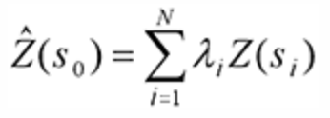
Kriging cont:
$$\sum_{i=1}^{N}{λ_{i}=1}$$
Z(s_{i}) is the measure value at the location i.
$λ_{i}$ is the unknown weight at the I value
S₀ is the prediction location
N is the number of measured values
Condition for weights for Ordinary Kriging: Weights need to add up to 1. Yet, in Kriging the weights can be positive or negative.
Error estimation: Normally error can be computed using the estimated value and the true value. Yet, the true value is not known, so in remediation, a stationary random function can be used with several random variables.
Notes:
Semi-parametric model

Slide 5
Kriging cont:
Key concept is the semi-variogram
The semi-variogram helps quantify autocorrelation by graphing the variance of all pairs according to the distance.
At a particular range becomes independent.
Sill- No more spatial autocorrelation/relationship between closeness of the points.

Slide 6
Semi-variogram
Semi-variance value is just half the square distance between values.
Spherical is most commonly used
Theoretically, when there is 0 separation (or lag = 0) the semi-variogram should also be 0. Yet, at small values semi-variogram exhibits a jump).
Nugget effect (the y-intercept)
Can be attributed to measurement errors
Notes:
User-defined model. One can use least-square, maximum likelihood and Bayesian methods for creating these.

Slide 7
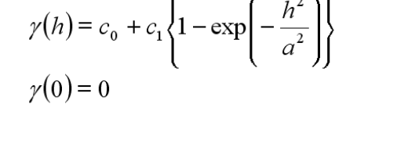
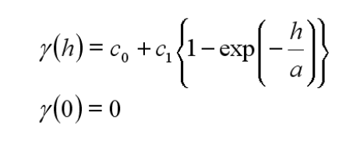
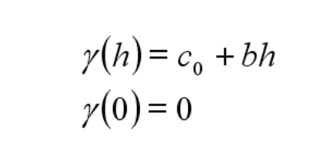
Models:
Spherical: where a is the range and c_{o} is the nugget variance
Gaussian:
Linear:
Exponential:

Slide 8
Assumptions for ordinary Kriging:
Stationarity- Joint probability across the distribution does not vary.
Parameters such as overall mean of the dataset, the range as well as the sill do not vary across the study space.
Isotropy- uniformity in all directions
Data needs to have normal distribution
Data does not have trends
Example of data collected from soil samples in field.
Notes:
Used often in time series, Big violation is a trend in the mean (due to presence of a unit root or due to a deterministic trend)

Slide 9
Checking for Stationarity:
One can generate a Voronoi map which symbolizes entropy (or the variation between neighbors or the standard deviation in order to see the randomness)
. What if data is not stationary?
Empirical Bayesian Kriging can treat local variance separately (basically does kriging locally and in different areas)
Notes:
Partitions plane into regions based on distance

Slide 10
Soil sample example
Trends present (e.g Blue is N-S and green is E-W) but these trends are not significant enough to cause issue.

Slide 11
Types of Kriging:
Universal kriging: Relaxes the assumption of stationarity
Allows the mean of the values to differ in a deterministic way in different locations.
Variance is held constant across the entire field
Often used in environmental exposure.
Block Kriging: Estimates the average values over some “gridded blocks” as opposed to single points.
Often have smaller prediction errors than for individual points.
Ordinary block concentration and regression block

Slide 12
Limitations:
“Expensive” method – O(N³) operations to digest the data
Takes O(N) operations for each interpolated value.
Takes O(N²) to provide accuracy estimate per value.
Accuracy limited when:
Number of samples is limited
Data is not spatially correlated
Data is limited in the spatial scope

Slide 13
Example:
Let’s estimate 5,5

Slide 14
Use Ordinary kriging
Estimation:
Minimum variance:

Slide 15
Example cont:
A is the matrix of the semi-variance between the pairs, b is the vector of semi variances between each data point and lambda is the vector of weight while $φ$ is the lagrangian for solving equations.
C₀ = 2.5, C₁ = 7.5, while the range a, is equal to 10.
So value @ 5,5 = weights * z
=4.3985
With estimation variance it is (weight*b) + $φ$
=4.2177 + (-.1544)
=4.0628
No bias since random stationary function used.

