Slide 1
Laplace Interpolation
CSE 5400
Joy Moore

Slide 2
concept

Slide 3
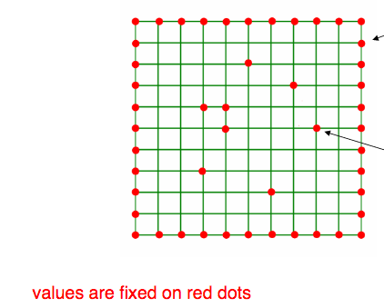
Concept (cont.)

Slide 4
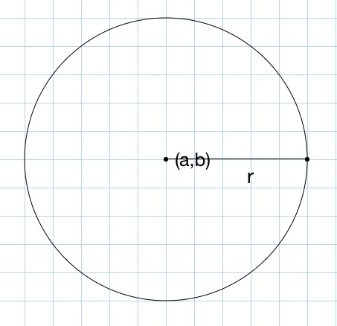
The mean value property

Slide 5
Mean value property (cont.)

Slide 6
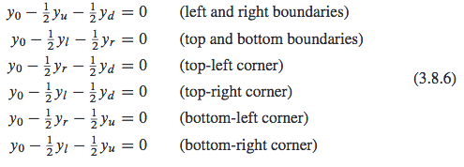
boundary conditions
Not all grid points have 4 points surrounding them
The edges of the grid have different equations

Slide 7
procedure
Replace grid points with missing data with 1.e99
Example: matrix with 5 tabulated data points and 4 missing ones:
In the constructor, the boolean vector mask stores 1 where there is a data point and 0 where there is a missing value.

Slide 8
atimes method
If mask[k] is 1, the interpolated function value is just the given function value at the tabulated points
If mask[k] is 0, the atimes method calls equations 3.8.4 and 3.8.6 to approximate the tabulated values.

Slide 9
uses
Laplace interpolation is useful for sparse systems, where most of the data points are missing.
For example, 90% of an image’s pixels can be removed, and Laplace interpolation does a fairly good job of restoring the image.

Slide 10
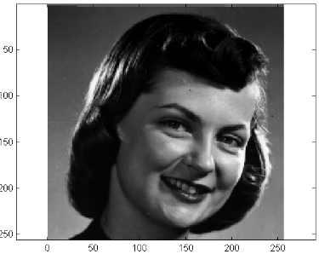
Original image

Slide 11
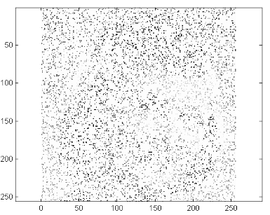
90% of pixels removed

Slide 12
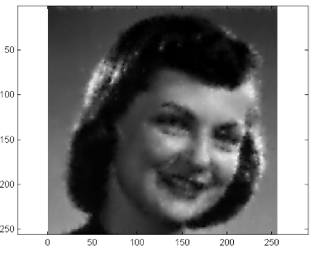
Restored picture

Slide 13
references
Press, William H., and William T. Vetterling. Numerical Recipes. Cambridge Univ. Press, 2007.
http://numerical.recipes/CS395T/lectures2010/2010_19_LaplaceInterpolation.pdf

