Slide 1
Cubic Spline Interpolation
Daniel Wall

Slide 2
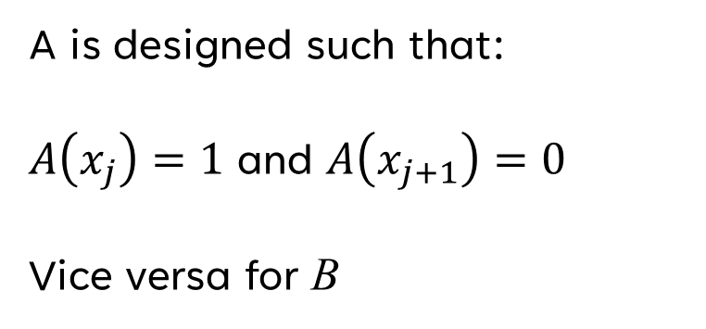
Linear Interpolation
Simple line drawn between each set of two points
Equation given by special case of Lagrange formula
A is designed such that:
$A\left(x_{j}\right)=1$ and $A\left(x_{j+1}\right)=0$
Vice versa for B

Slide 3
Finding the Cubic Spline
Suppose we were given values for the second derivative at each point: y_{j}’’, y_{j+1}’’
We could then choose a cubic polynomial such that its second derivative varies linearly between the points
Achieved by performing linear interpolation on the second derivative values

Slide 4
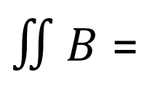
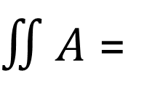
New cubic polynomial:
Where
Add new polynomial to eq. (3.3.1)
$∬A$ =
$∬B$ =

Slide 5
However, these second derivative values are not known
To find them, we can start by taking the derivative of y (3.3.3) and requiring that the first derivative always be continuous

Slide 6
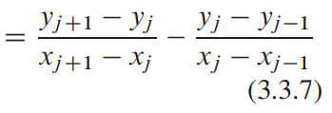
Making the first derivative continuous
Set dy/dx at x = x_{j} on the interval (x_{j – 1} , x_{j}) equal to
dy/dx at x = x_{j} on the interval (x_{j} , x_{j + 1})

Slide 7
Equations and unknowns
N – 2 linear equations (N – 1 intervals, N – 2 shared points between these intervals)
N unknowns (y’’ at each point)
Need two more conditions. Most commonly:
Set y₀’’ and/or y_{N-1}’’ equal to 0 (Natural cubic spline)
Set either y₀’’ or y_{N-1}’’ equal to values calculated from (3.3.5)
Estimate first derivatives at endpoints

Slide 8
The set of linear equations results in a tridiagonal matrix
Useful because it can be solved using the tridiagonal algorithm in O(N) operations

Slide 9
Rational Function Interpolation

Slide 10
Rational Interpolation
Rational interpolation is preferable to polynomial interpolation when there are poles (zeroes in the denominator)

Slide 11
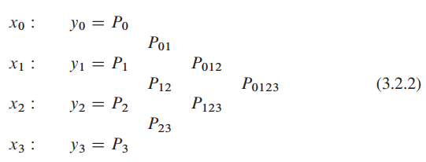
Bulirsch-Stoer algorithm
Neville’s algorithm
Similar to Neville’s algorithm (though denoted with R instead of P)

