Slide 1
Data Mining
Anomaly Detection
Lecture Notes for Chapter 10
Introduction to Data Mining
by
Tan, Steinbach, Kumar
© Tan,Steinbach, Kumar Introduction to Data Mining 4/18/2004 1

Slide 2
Anomaly/Outlier Detection
What are anomalies/outliers?
  The set of data points that are considerably different than the remainder of the data
Variants of Anomaly/Outlier Detection Problems
  Given a database D
    find all the data points x ∈ D with anomaly scores greater than some threshold t
    find all the data points x ∈ D having the top-k largest anomaly scores
    containing mostly normal (but unlabeled) data points, and a test point x, compute the anomaly score of x with respect to D
Applications:
  Credit card fraud detection, telecommunication fraud detection, network intrusion detection, fault detection

Slide 3
Causes of anomalies
Data from different classes
  Hawkins: differs so much from other observations
    Could be generated by a different mechanism
Natural Variation
  Some people are very tall/short/…
Data Measurement and Collection Errors

Slide 4
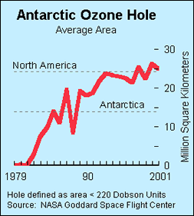
Importance of Anomaly Detection
Ozone Depletion History
In 1985 three researchers (Farman, Gardinar and Shanklin) were puzzled by data gathered by the British Antarctic Survey showing that ozone levels for Antarctica had dropped 10% below normal levels
Why did the Nimbus 7 satellite, which had instruments aboard for recording ozone levels, not record similarly low ozone concentrations?
The ozone concentrations recorded by the satellite were so low they were being treated as outliers by a computer program and discarded!
Sources:
http://exploringdata.cqu.edu.au/ozone.html
http://www.epa.gov/ozone/science/hole/size.html

Slide 5
Use of class labels
Class labels: normal, anomaly
Supervised AD
  Both class labels are available
  Not usually considered as AD — just Classification
Unsupervised AD
  No class labels
  Discussed in this chapter
Semi-supervised AD
  All training instances are known normal
  Generate an anomaly score for a test instance

Slide 6
Issues
Number of attributes used to define an anomaly
  2-foot tall is common, 200-pound heavy is common
  2-foot and 200-pound together is not common
Global versus local perspective
  6.5-foot is unusually tall, but not in basketball teams.
Degree/score of anomaly
Identify one at a time vs multiple at once
  One: masking—some anomalies hide the rest
  Multiple: swamping—some normal objects got lumped into the anomaly group
Evaluation
Efficiency

Slide 7
Anomaly Detection
Challenges
  How many outliers are there in the data?
  Method is unsupervised
    Validation can be quite challenging (just like for clustering)
  Finding needle in a haystack
Working assumption:
  There are considerably more “normal” observations than “abnormal” observations (outliers/anomalies) in the data

Slide 8
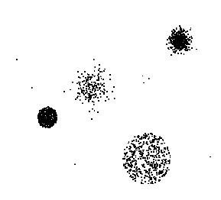
Anomaly Detection Schemes
General Steps
  Build a profile of the “normal” behavior
    Profile can be patterns or summary statistics for the overall population
  Use the “normal” profile to detect anomalies
    Anomalies are observations whose characteristics
    differ significantly from the normal profile
Types of anomaly detection
schemes
  Graphical & Statistical-based
  Distance-based
  Density-based
  Clustering-based

Slide 9
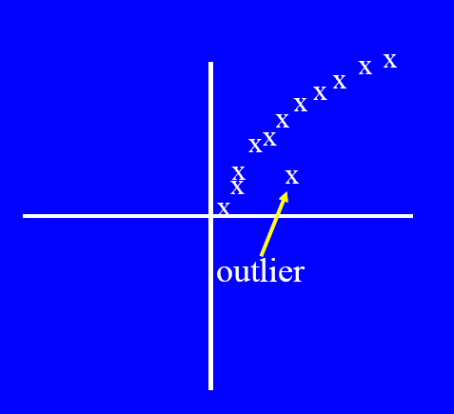
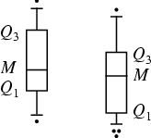
Graphical Approaches
Boxplot (1-D), Scatter plot (2-D), Spin plot (3-D)
Limitations
  Time consuming
  Subjective

Slide 10
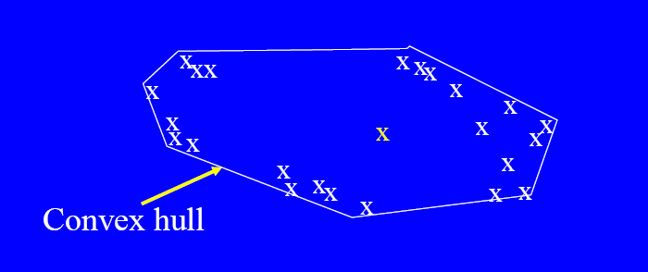
Convex Hull Method
Extreme points are assumed to be outliers
Use convex hull method to detect extreme values
What if the outlier occurs in the middle of the data?

Slide 11
Anomaly/Outlier Detection
Proximity-based (10.3)
Density-based (10.4)
Clustering-based (10.5)
Statistical (10.1)

Slide 12
Nearest-Neighbor Based Approach
Approach:
  Compute the distance between every pair of data points
  There are various ways to define outliers:
    fewer than p neighboring points within a distance d
    The top n whose distance to the kth nearest neighbor is greatest
    The top n whose average distance to the k nearest neighbors is greatest

Slide 13
Strengths and Weaknesses
Simple
O(m^2) time [m data points]
Sensitive to the choice of parameters
Cannot handle different densities

Slide 15
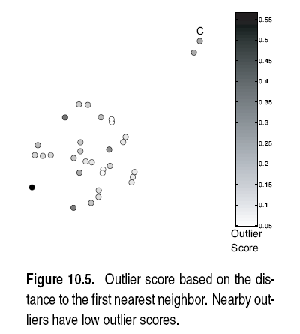

Slide 18
Outliers in Lower Dimensional Projection
In high-dimensional space, data is sparse and notion of proximity becomes meaningless
  Every point is an almost equally good outlier from the perspective of proximity-based definitions
Lower-dimensional projection methods
  A point is an outlier if in some lower dimensional projection, it is present in a local region of abnormally low density

Slide 19

Outliers in Lower Dimensional Projection
Divide each attribute into φ equal-depth intervals
  Each interval contains a fraction f = 1/φ of the records
Consider a k-dimensional cube created by picking grid ranges from k different dimensions
  If attributes are independent, we expect region to contain a fraction f^{k} of the records
  If there are N points, we can measure sparsity of a cube D as:
  Negative sparsity indicates cube contains smaller number of points than expected

Slide 20
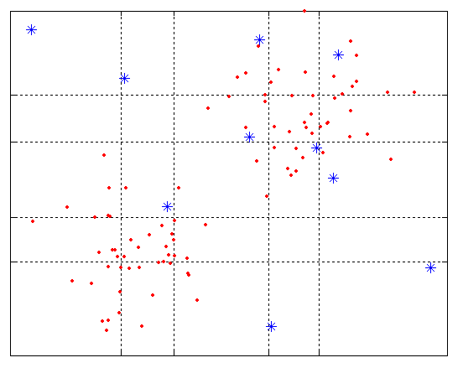
Example
N=100, φ = 5, f = 1/5 = 0.2, N × f² = 4

Slide 21
Anomaly/Outlier Detection
Proximity-based (10.3)
Density-based (10.4)
Clustering-based (10.5)
Statistical (10.1)

Slide 22
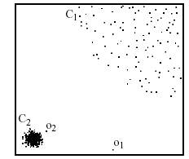
Handling different densities
Example from the original paper
p₂
×
p₁
×

Slide 23
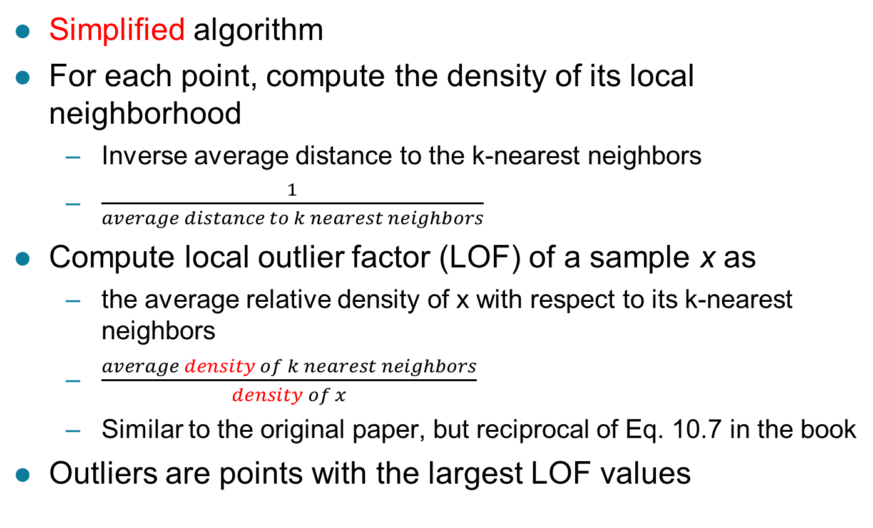
Density-based: LOF approach
Simplified algorithm
For each point, compute the density of its local neighborhood
  Inverse average distance to the k-nearest neighbors
  $\frac{1}{average distance to k nearest neighbors}$
Compute local outlier factor (LOF) of a sample x as
  the average relative density of x with respect to its k-nearest neighbors
  $\frac{average density of k nearest neighbors}{density of x}$
  Similar to the original paper, but reciprocal of Eq. 10.7 in the book
Outliers are points with the largest LOF values

Slide 24
Density-based: LOF approach
In the NN approach, p₂ is not considered as outlier, while LOF approach find both p₁ and p₂ as outliers
p₂
×
p₁
×

Slide 26
Strengths and weaknesses
Handles different densities
O(m^2)
Selecting k
  Vary k, use the max outlier score

Slide 27
Anomaly/Outlier Detection
Proximity-based (10.3)
Density-based (10.4)
Clustering-based (10.5)
Statistical (10.1)

Slide 28
Clustering-based
How would you use clustering algorithms for anomaly detection?

Slide 29
Distant small clusters
Cluster the data into groups
Choose points in small cluster as candidate outliers
Compute the distance between candidate points and non-candidate clusters.
    If candidate points are far from all other non-candidate points, they are outliers

Slide 30
Distant Small Clusters
Parameters:
  How small is small?
  How far is far?
Sensitive to number of clusters (k)
  When k is large, more “small” clusters

Slide 31
Strength of cluster membership
Outlier if not strongly belong to any cluster
  Prototype-based clustering
    Distance from centroid
  Density-based clustering
    Low density (noise points in DBSCAN)

Slide 32
Prototype based clustering
Strength of cluster membership
  Distance to centroid
  What if clusters have different densities

Slide 34
Prototype based clustering
Strength of cluster membership
  Distance to centroid
  What if clusters have different densities
    Ideas?

Slide 35

Prototype based clustering
Strength of cluster membership
  Distance to centroid
  What if clusters have different densities
    Relative distance to centroid
      $\frac{distance of object to centroid}{median distance of all objects to centroid in the cluster}$

Slide 37
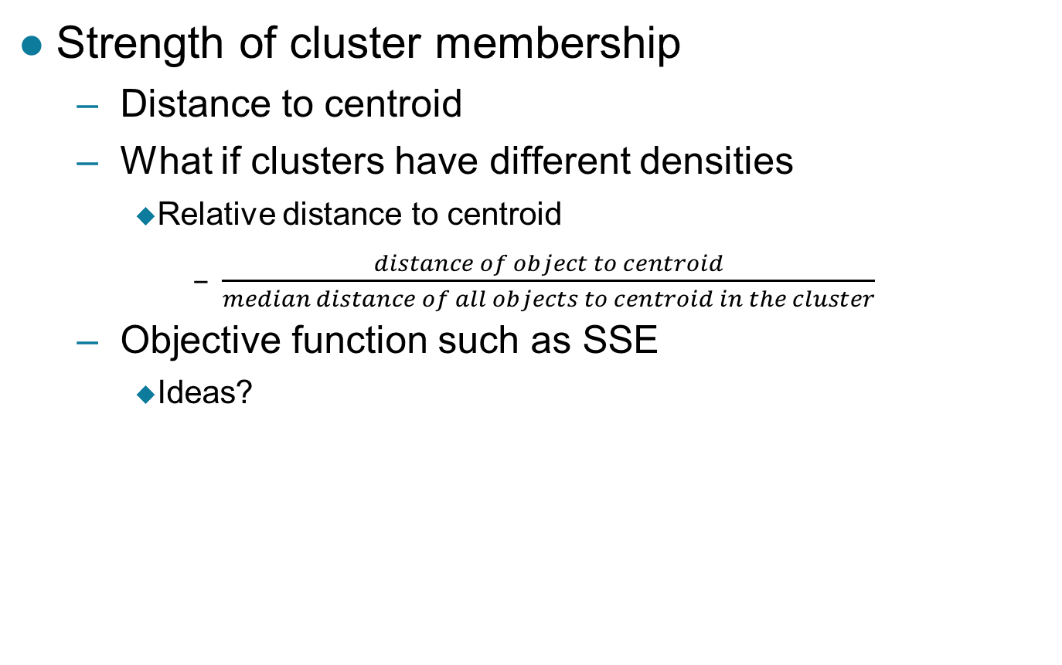
Prototype based clustering
Strength of cluster membership
  Distance to centroid
  What if clusters have different densities
    Relative distance to centroid
      $\frac{distance of object to centroid}{median distance of all objects to centroid in the cluster}$
  Objective function such as SSE
    Ideas?

Slide 38
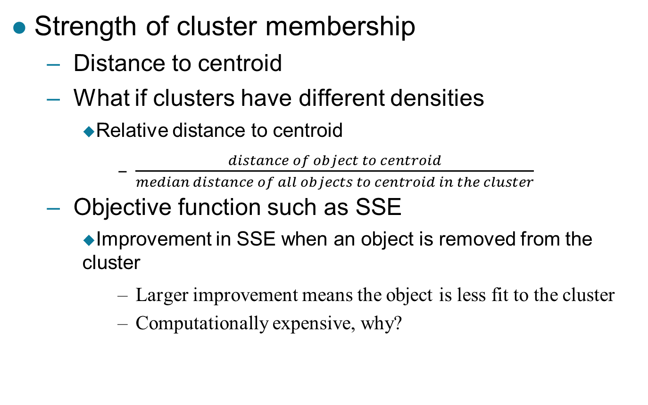
Prototype based clustering
Strength of cluster membership
  Distance to centroid
  What if clusters have different densities
    Relative distance to centroid
      $\frac{distance of object to centroid}{median distance of all objects to centroid in the cluster}$
  Objective function such as SSE
    Improvement in SSE when an object is removed from the cluster
      Larger improvement means the object is less fit to the cluster
      Computationally expensive, why?

Slide 39
Impact of Outliers to Initial Clustering
We cluster first
  But outliers affect clustering
Simple approach
  Cluster first
  Remove outliers
  Cluster again

Slide 40
Impact of Outliers to Initial Clustering
More sophisticated approach
  Special group of potential outliers
    don’t fit well in any cluster
  While clustering
    Add to group if an object doesn’t fit well
    Remove from group if an object fits well

Slide 41
Number of clusters to use
No simple answer
  Try different numbers
  Try more clusters
    Clusters are smaller
      More cohesive
      Detected outliers are more likely to be real outliers
      However, outliers can form small clusters

Slide 42
Strengths and weaknesses
Definition of clustering is complementary to outliers
Sensitive to number of clusters
Sensitive to the clustering algorithm

Slide 43
Anomaly/Outlier Detection
Proximity-based (10.3)
Density-based (10.4)
Clustering-based (10.5)
Statistical (10.1)

Slide 44
Statistical Approaches
Univariate (10.2.1)
Multivariate (10.2.2)
Mixture Model (10.2.3)

Slide 45
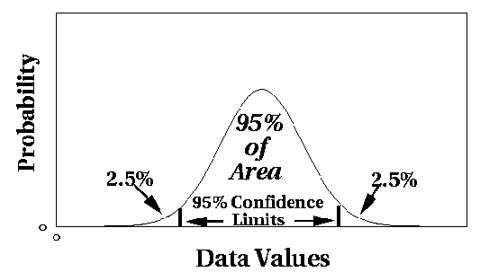
Univariate Distribution
Assume a parametric model describing the distribution of the data (e.g., normal distribution)
Apply a statistical test that depends on
  Data distribution
  Parameter of distribution (e.g., mean, variance)
  Number of expected outliers (confidence limit)

Slide 47
Grubbs’ Test
Detect outliers in univariate data
Assume data comes from normal distribution
Detects one outlier at a time, remove the outlier, and repeat
  H₀: There is no outlier in data
  H_{A}: There is at least one outlier
Grubbs’ test statistic:
Reject H₀ if:

Slide 48
Statistical Approaches
Univariate (10.2.1)
Multivariate (10.2.2)
Mixture Model (10.2.3)

Slide 49

Multivariate distribution
For example, for 2D,
  Parameters
    Mean
      ($\overline{x}$, $\overline{y})$
      (0, 0)
    Covariance matrix
      $\left[\begin{matrix}cov\left(x,x\right)=var(x) & cov(x,y) \\ cov(y,x) & cov\left(y,y\right)=var(y)\end{matrix}\right]$
      $\left[\begin{matrix}1 & 0.75 \\ 0.75 & 3\end{matrix}\right]$

Slide 50
Note the x and y axes don’t have the same scale

Slide 52
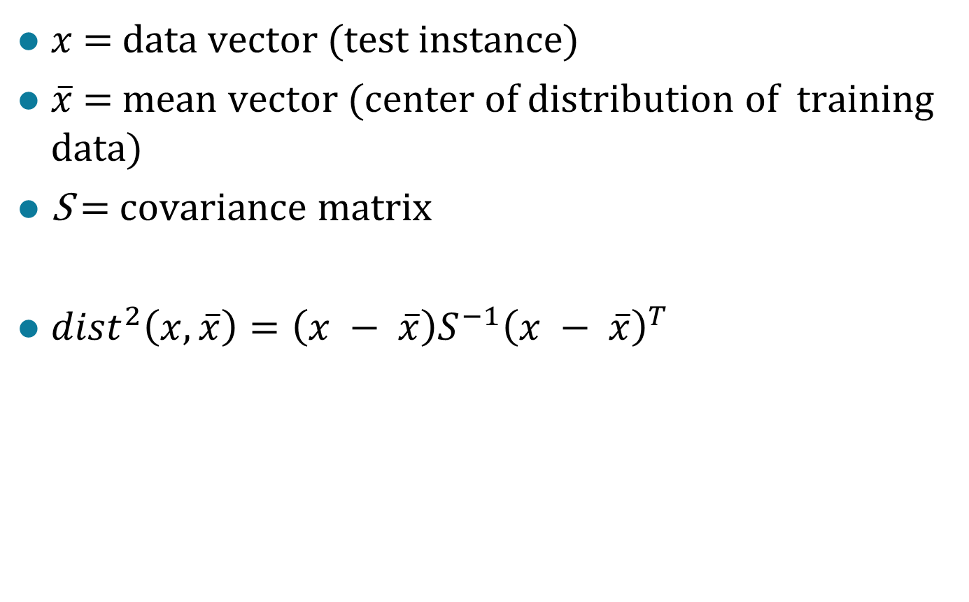
Mahalanobis Distance
$x$ = data vector (test instance)
$\overline{x}$ = mean vector (center of distribution of training data)
S = covariance matrix
${dist}^{2}\left(x,\overline{x}\right)=\left(x − \overline{x}\right)S^{−1}{\left(x − \overline{x}\right)}^{T}$

Slide 53
Statistical Approaches
Univariate (10.2.1)
Multivariate (10.2.2)
Mixture Model (10.2.3)

Slide 54
Mixture Model Approach
Assume the data set D contains samples from a mixture of two probability distributions:
  M (majority distribution)
  A (anomalous distribution)

Slide 55
Mixture Model Approach
Data distribution, D = (1 – λ) M + λ A
M is a probability distribution estimated from data
  Can be based on any modeling method (naïve Bayes, maximum entropy, etc)
A is initially assumed to be uniform distribution
Likelihood at time t:

Slide 56
Mixture Model Approach
General Algorithm:
  Initially, assume all the data points belong to M
  Let LL_{t}(D) be the log likelihood of D at time t
  For each point x_{t} that belongs to M, move it to A
    Let LL_{t+1} (D) be the new log likelihood.
    Compute the difference, Δ = LL_{t+1}(D) – LL_{t} (D)
      [correction from the book]
    If Δ > c (some threshold), then x_{t} is declared as an anomaly and moved permanently from M to A

Slide 57
Strengths and weaknesses
Grounded in statistics
Most of the tests are for a single attribute (univariate)
In many cases, data distribution may not be known
For high dimensional data, it may be difficult to estimate the true distribution

Slide 58
Evaluation of Anomaly Detection

Slide 59
Evaluation of Anomaly Detection
Accuracy is not appropriate for anomaly detection
  why?

Slide 60
Evaluation
Accuracy is not appropriate for anomaly detection
  Easy to get high accuracy--just predict normal
Ideas?

Slide 61
Evaluation
Accuracy is not appropriate for anomaly detection
  Easy to get high accuracy--just predict normal
We discussed these in Classification
  Cost matrix for different errors
  Precision and Recall (F measure)
  True-positive and false-positive rates
    Receiver Operating Characteristic (ROC) curve
      Area under the curve (AUC)

Slide 62
Base Rate Fallacy (Axelsson, 1999)
Diagnosing Disease
  Test is 99% accurate
    True-positive is 99%
    True-negative is 99%
Bad news
  Test is positive
Good news
  1 in 10,000 has the disease
Are you more likely to have the disease or not?

Slide 63


Base Rate Fallacy
Bayes theorem:
More generally:

Slide 64

Total Probability
$\sum_{i}{P(A_{i})}$ = 1
$P\left(B\right)$
$$=\sum_{i}{P(A_{i},B)}$$
$$= \sum_{i}{P\left(B | A_{i}\right)P(A_{i}})$$

Slide 65


Base Rate Fallacy
S=Disease; P=Test
Even though the test is 99% certain, your chance of having the disease is 1/100, because the population of healthy people is much larger than sick people

Slide 66
Base Rate Fallacy in Intrusion Detection
I: intrusive behavior,
¬I: non-intrusive behavior
A: alarm
¬A: no alarm
Detection rate (true positive rate): P(A|I)
False alarm rate (false positive rate): P(A|¬I)
Goal is to maximize both
  “Bayesian detection rate,” P(I|A) [precision]
  P(¬I|¬A)

Slide 67



Detection Rate vs False Alarm Rate
Suppose:
Then:
False alarm rate becomes more dominant if P(I) is very low

Slide 68
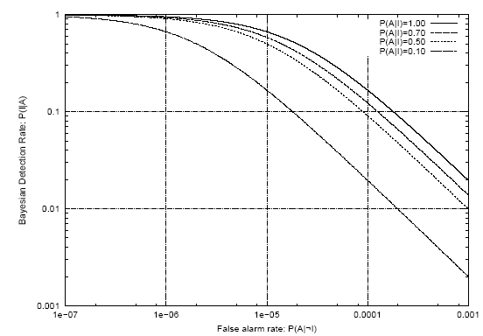
Detection Rate vs False Alarm Rate
Axelsson: We need a very low false alarm rate to achieve a reasonable Bayesian detection rate

