Slide 1
Data Mining
Classification: Basic Concepts, Decision Trees, and Model Evaluation
Lecture Notes for Chapter 4
Introduction to Data Mining
by
Tan, Steinbach, Kumar
© Tan,Steinbach, Kumar Introduction to Data Mining 4/18/2004 1

Slide 2
Classification: Definition
Given a collection of records (training set )
  Each record contains a set of attributes, one of the attributes is the class.
Find a model for class attribute as a function of the values of other attributes.
Goal: previously unseen records should be assigned a class as accurately as possible.
  A test set is used to determine the accuracy of the model. Usually, the given data set is divided into training and test sets, with training set used to build the model and test set used to validate it.

Slide 3
Illustrating Classification Task

Slide 4

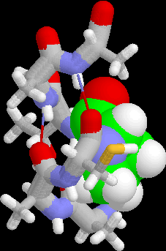
Examples of Classification Task
Predicting tumor cells as benign or malignant
Classifying credit card transactions
as legitimate or fraudulent
Classifying secondary structures of protein
as alpha-helix, beta-sheet, or random
coil
Categorizing news stories as finance,
weather, entertainment, sports, etc

Slide 5
Classification Techniques
Decision Tree based Methods
Rule-based Methods
Memory based reasoning
Neural Networks
Naïve Bayes and Bayesian Belief Networks
Support Vector Machines

Slide 6
Decision Trees
Sec. 4.3

Slide 7
Example of a Decision Tree
categorical
categorical
continuous
class
Splitting Attributes
Refund
Yes
No
NO
MarSt
Single, Divorced
Married
TaxInc
NO
< 80K
> 80K
NO
YES
Training Data
Model: Decision Tree

Slide 8
Another Example of Decision Tree
categorical
categorical
continuous
class
MarSt
Single, Divorced
Married
NO
Refund
Yes
No
NO
TaxInc
< 80K
> 80K
NO
YES
There could be more than one tree that fits the same data!

Slide 9
Decision Tree Classification Task
Decision Tree

Slide 10
Apply Model to Test Data
Test Data
Start from the root of tree.
Refund
Yes
No
NO
MarSt
Single, Divorced
Married
TaxInc
NO
< 80K
> 80K
NO
YES

Slide 11
Apply Model to Test Data
Test Data
Refund
Yes
No
NO
MarSt
Single, Divorced
Married
TaxInc
NO
< 80K
> 80K
NO
YES

Slide 12
Apply Model to Test Data
Test Data
Refund
Yes
No
NO
MarSt
Single, Divorced
Married
TaxInc
NO
< 80K
> 80K
NO
YES

Slide 13
Apply Model to Test Data
Test Data
Refund
Yes
No
NO
MarSt
Single, Divorced
Married
TaxInc
NO
< 80K
> 80K
NO
YES

Slide 14
Apply Model to Test Data
Test Data
Refund
Yes
No
NO
MarSt
Single, Divorced
Married
TaxInc
NO
< 80K
> 80K
NO
YES

Slide 15
Apply Model to Test Data
Test Data
Refund
Yes
No
NO
MarSt
Single, Divorced
Married
Assign Cheat to “No”
TaxInc
NO
< 80K
> 80K
NO
YES

Slide 16
Decision Tree Classification Task
Decision Tree

Slide 17
Decision Tree Induction
Many Algorithms:
  Hunt’s Algorithm (one of the earliest)
  CART
  ID3, C4.5
  SLIQ,SPRINT

Slide 18
General Structure of Hunt’s Algorithm
Let D_{t} be the set of training records that reach a node t
General Procedure:
  If D_{t} contains records that belong the same class y_{t}, then t is a leaf node labeled as y_{t}
  If D_{t} is an empty set, then t is a leaf node labeled by the default class, y_{d}
  If D_{t} contains records that belong to more than one class, use an attribute test to split the data into smaller subsets. Recursively apply the procedure to each subset.
D_{t}
?

Slide 19
Hunt’s Algorithm
Refund
Don’t
Cheat
Yes
No
Don’t
Cheat
Don’t
Cheat
Refund
Refund
Yes
No
Yes
No
Don’t
Cheat
Marital
Status
Don’t
Cheat
Marital
Status
Single,
Divorced
Single,
Divorced
Married
Married
Cheat
Don’t
Cheat
Taxable
Income
Don’t
Cheat
< 80K
>= 80K
Don’t
Cheat
Cheat

Slide 20
Tree Induction
Greedy strategy.
  Split the records based on an attribute test that optimizes certain criterion.
Issues
  Determine how to split the records
    How to specify the attribute test condition?
    How to determine the best split?
  Determine when to stop splitting

Slide 21
Tree Induction
Greedy strategy.
  Split the records based on an attribute test that optimizes certain criterion.
Issues
  Determine how to split the records
    How to specify the attribute test condition?
    How to determine the best split?
  Determine when to stop splitting

Slide 22
How to Specify Test Condition?
Depends on attribute types
  Nominal
  Ordinal
  Continuous
Depends on number of ways to split
  2-way split
  Multi-way split

Slide 23
Splitting Based on Nominal Attributes
Multi-way split: Use as many partitions as distinct values.
Binary split: Divides values into two subsets.
Need to find optimal partitioning.
CarType
Family
Luxury
Sports
CarType
CarType
{Sports, Luxury}
OR
{Family,
Luxury}
{Family}
{Sports}

Slide 24
Splitting Based on Ordinal Attributes
Multi-way split: Use as many partitions as distinct values.
Binary split: Divides values into two subsets.
Need to find optimal partitioning.
What about this split?
Size
Small
Large
Medium
Size
Size
{Small, Medium}
OR
{Medium,
Large}
{Large}
{Small}
Size
{Small, Large}
{Medium}

Slide 25
Splitting Based on Continuous Attributes
Different ways of handling
  Discretization to form an ordinal categorical attribute
    Static – discretize once at the beginning
    Dynamic – ranges can be found by equal interval bucketing, equal frequency bucketing
    (percentiles), or clustering.
  Binary Decision: (A < v) or (A ≥ v)
    consider all possible splits and find the best split
    can be more compute intensive

Slide 26
Splitting Based on Continuous Attributes

Slide 27
Tree Induction
Greedy strategy.
  Split the records based on an attribute test that optimizes certain criterion.
Issues
  Determine how to split the records
    How to specify the attribute test condition?
    How to determine the best split?
  Determine when to stop splitting

Slide 28
How to determine the Best Split
Before Splitting: 10 records of class 0,
10 records of class 1
Which test condition is the best?

Slide 29
How to determine the Best Split
Greedy approach:
  Nodes with homogeneous class distribution are preferred
Need a measure of node impurity:
Non-homogeneous,
High degree of impurity
Homogeneous,
Low degree of impurity

Slide 30
Measures of Node Impurity
Gini Index
Entropy
Misclassification error

Slide 31
How to Find the Best Split
Before Splitting:
M0
A?
B?
Yes
No
Yes
No
Node N1
Node N2
Node N3
Node N4
M1
M2
M3
M4
M12
M34
Gain = M0 – M12 vs M0 – M34

Slide 32
Measure of Impurity: GINI
Gini Index for a given node t :
    (NOTE: p( j | t) is the relative frequency of class j at node t).
  Maximum (1 - 1/n_{c}) when records are equally distributed among all classes, implying least interesting information
  Minimum (0.0) when all records belong to one class, implying most interesting information

Slide 33
Examples for computing GINI
P(C1) = 0/6 = 0 P(C2) = 6/6 = 1
Gini = 1 – P(C1)² – P(C2)² = 1 – 0 – 1 = 0
P(C1) = 1/6 P(C2) = 5/6
Gini = 1 – (1/6)² – (5/6)² = 0.278
P(C1) = 2/6 P(C2) = 4/6
Gini = 1 – (2/6)² – (4/6)² = 0.444

Slide 34
Splitting Based on GINI
Used in CART, SLIQ, SPRINT.
When a node p is split into k partitions (children), the quality of split is computed as,
where, n_{i} = number of records at child i,
n = number of records at node p.

Slide 35
Binary Attributes: Computing GINI Index
Splits into two partitions
Effect of Weighing partitions:
  Larger and Purer Partitions are sought for.
B?
Yes
No
Node N1
Node N2
Gini(N1)
= 1 – (5/6)² – (2/6)²
= 0.194
Gini(N2)
= 1 – (1/6)² – (4/6)²
= 0.528
Gini(Children)
= 7/12 * 0.194 +
5/12 * 0.528
= 0.333

Slide 36
Categorical Attributes: Computing Gini Index
For each distinct value, gather counts for each class in the dataset
Use the count matrix to make decisions
Multi-way split
Two-way split
(find best partition of values)

Slide 37
Continuous Attributes: Computing Gini Index
Use Binary Decisions based on one value
Several Choices for the splitting value
  Number of possible splitting values
  = Number of distinct values
Each splitting value has a count matrix associated with it
  Class counts in each of the partitions, A < v and A ≥ v
Simple method to choose best v
  For each v, scan the database to gather count matrix and compute its Gini index
  Computationally Inefficient! Repetition of work.

Slide 38
Continuous Attributes: Computing Gini Index...
For efficient computation: for each attribute,
  Sort the attribute on values
  Linearly scan these values, each time updating the count matrix and computing gini index
  Choose the split position that has the least gini index
Sorted Values
Split Positions
Why 55 and 220 are not needed?

Slide 39
Alternative Splitting Criteria based on INFO
Entropy at a given node t:
    (NOTE: p( j | t) is the relative frequency of class j at node t).
  Measures homogeneity of a node.
    Maximum (log n_{c}) when records are equally distributed among all classes implying least information
    Minimum (0.0) when all records belong to one class, implying most information
  Entropy based computations are similar to the GINI index computations

Slide 40
Examples for computing Entropy
P(C1) = 0/6 = 0 P(C2) = 6/6 = 1
Entropy = – 0 log 0 – 1 log 1 = – 0 – 0 = 0
P(C1) = 1/6 P(C2) = 5/6
Entropy = – (1/6) log₂ (1/6) – (5/6) log₂ (1/6) = 0.65
P(C1) = 2/6 P(C2) = 4/6
Entropy = – (2/6) log₂ (2/6) – (4/6) log₂ (4/6) = 0.92

Slide 41
Splitting Based on INFO...
Information Gain:
    Parent Node, p is split into k partitions;
    n_{i} is number of records in partition i
  Measures Reduction in Entropy achieved because of the split. Choose the split that achieves most reduction (maximizes GAIN)
  Used in ID3 and C4.5
  Disadvantage: Tends to prefer splits that result in large number of partitions, each being small but pure.

Slide 42
Splitting Based on INFO...
Gain Ratio:
    Parent Node, p is split into k partitions
    n_{i} is the number of records in partition i
  Adjusts Information Gain by the entropy of the partitioning (SplitINFO). Higher entropy partitioning (large number of small partitions) is penalized!
  Used in C4.5
  Designed to overcome the disadvantage of Information Gain

Slide 43
Splitting Criteria based on Classification Error
Classification error at a node t :
Measures misclassification error made by a node.
    Maximum (1 - 1/n_{c}) when records are equally distributed among all classes, implying least interesting information
    Minimum (0.0) when all records belong to one class, implying most interesting information

Slide 44
Examples for Computing Error
P(C1) = 0/6 = 0 P(C2) = 6/6 = 1
Error = 1 – max (0, 1) = 1 – 1 = 0
P(C1) = 1/6 P(C2) = 5/6
Error = 1 – max (1/6, 5/6) = 1 – 5/6 = 1/6
P(C1) = 2/6 P(C2) = 4/6
Error = 1 – max (2/6, 4/6) = 1 – 4/6 = 1/3

Slide 45
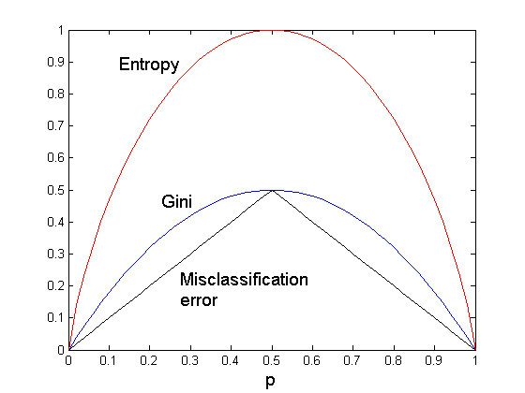
Comparison among Splitting Criteria
For a 2-class problem:

Slide 46
Misclassification Error vs Gini
A?
Yes
No
Node N1
Node N2
Gini(N1)
= 1 – (3/3)² – (0/3)²
= 0
Gini(N2)
= 1 – (4/7)² – (3/7)²
= 0.489
Gini(Children)
= 3/10 * 0
+ 7/10 * 0.489
= 0.342
Gini improves !!
Misclassification error didn’t change.

Slide 47
Attributes considered in subtrees
Categorical
  Color is in a multi-way node
    Do we want to consider Color in the subtrees?
Continuous
  Income > 40K is in a binary node
    Do we want to consider Income in the subtrees?

Slide 48
Tree Induction
Greedy strategy.
  Split the records based on an attribute test that optimizes certain criterion.
Issues
  Determine how to split the records
    How to specify the attribute test condition?
    How to determine the best split?
  Determine when to stop splitting

Slide 49
Stopping Criteria for Tree Induction
Stop expanding a node when all the records belong to the same class
Stop expanding a node when no records remain
Stop expanding a node when no attributes remain
Early termination (to be discussed later)

Slide 50
Example: C4.5
Simple depth-first construction.
Uses Information Gain
Sorts Continuous Attributes at each node.
Needs entire data to fit in memory.
Unsuitable for Large Datasets.
  Needs out-of-core sorting.

Slide 52
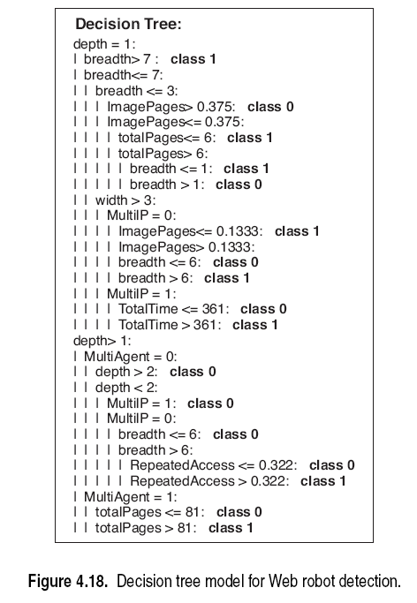

Slide 53
Characteristics of Decision Tree Induction
Nonparametric approach—no prior assumption of data distribution
Finding optimal decision tree is NP-complete—many algorithms use heuristics
Decision-tree learning algorithms are generally fast
When trees are smaller, they are easy to interpret
Expressive representation for learning discrete functions (not good for some boolean functions)
Robust to noise—more later

Slide 54
Characteristics Part 2
Redundant (correlated) attributes do not adversely affect the accuracy—only one of them is used
  However, irrelevant attributes could be a problem—more later
Recursive partitioning alg—data fragmentation, small amounts of data near the leaves
Subtree can be replicated--same tests in different parts of the tree

Slide 55
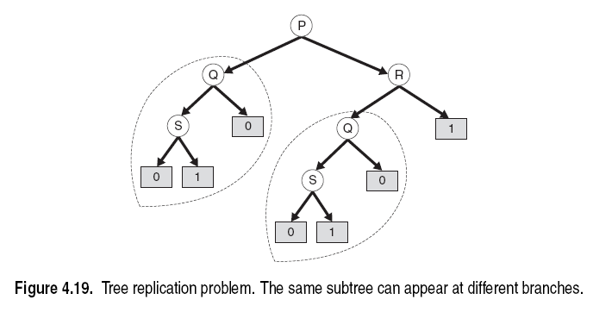

Slide 56
Characteristics Part 3
Decision boundary is rectilinear—only one attribute is used in each node
  Oblique decision tree
    More than one attribute in each node
    Explore possibilities in the algorithm, could be expensive
  Constructive induction
    Explore possibilities before the algorithm and select some composite attributes
    No change in the algorithm
Choice of impurity measure has little effect on accuracy

Slide 58
Overfitting and Other Issues
Sec. 4.4

Slide 59
Practical Issues of Classification
Underfitting and Overfitting
Missing Values
Costs of Classification

Slide 60
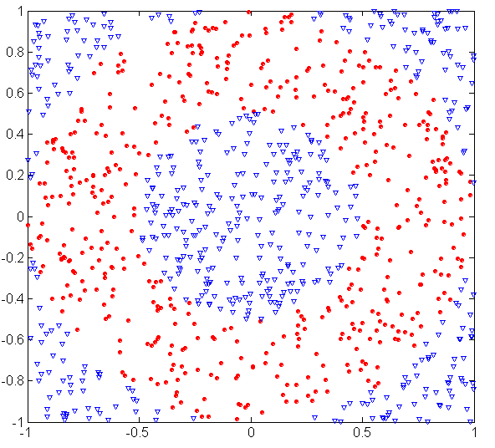
Underfitting and Overfitting (Example)
500 circular and 500 triangular data points.
Circular points:
0.5 ≤ sqrt(x₁²+x₂²) ≤ 1
Triangular points:
sqrt(x₁²+x₂²) > 0.5 or
sqrt(x₁²+x₂²) < 1

Slide 61
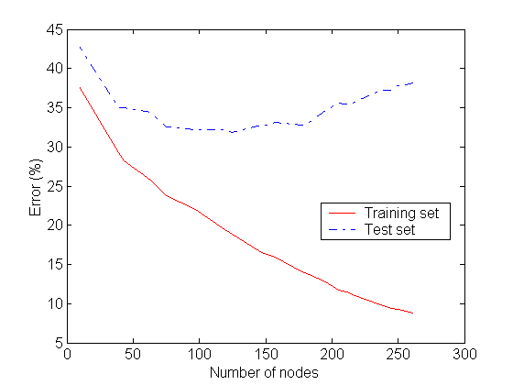
Underfitting and Overfitting
Overfitting
Underfitting: when model is too simple, both training and test errors are large

Slide 62
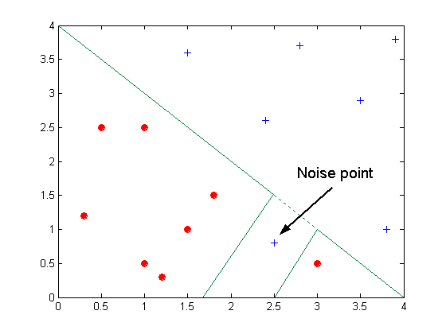
Overfitting due to Noise
Decision boundary is distorted by noise point

Slide 63
Overfitting due to insufficient examples
Name | Body Temp | Give Birth | 4-legged | Hibernates | Mammal ?
Salamander | Cold | N | Y | Y | N
Guppy | Cold | Y | N | N | N
Eagle | Warm | N | N | N | N
Poorwill | Warm | N | N | Y | N
Platypus | Warm | N | Y | Y | Y
Humans?

Slide 64
Notes on Overfitting
Overfitting results in decision trees that are more complex than necessary
Training error no longer provides a good estimate of how well the tree will perform on previously unseen records
Need new ways for estimating errors

Slide 65
Estimating Generalization Errors
Re-substitution errors: error on training (Σ e(t) )
Generalization errors: error on testing (Σ e’(t))
Methods for estimating generalization errors:
  Optimistic approach: e’(t) = e(t)
  Pessimistic approach:
    For each leaf node: e’(t) = (e(t)+0.5)
    Total errors: e’(T) = e(T) + N × 0.5 (N: number of leaf nodes)
    For a tree with 30 leaf nodes and 10 errors on training
    (out of 1000 instances):
    Training error = 10/1000 = 1%
    Generalization error = (10 + 30×0.5)/1000 = 2.5%
  Reduced error pruning (REP):
    uses validation data set to estimate generalization
    error

Slide 66
Occam’s Razor
Given two models of similar generalization errors, one should prefer the simpler model over the more complex model
For complex models, there is a greater chance that it was fitted accidentally by errors in data
Therefore, one should include model complexity when evaluating a model

Slide 67
Minimum Description Length (MDL)
Cost(Model,Data) = Cost(Data|Model) + Cost(Model)
  Cost is the number of bits needed for encoding.
  Search for the least costly model.
Cost(Data|Model) encodes the misclassification errors.
Cost(Model) uses node encoding (number of children) plus splitting condition encoding.

Slide 68
How to Address Overfitting
Pre-Pruning (Early Stopping Rule)
  Stop the algorithm before it becomes a fully-grown tree
  Typical stopping conditions for a node:
    Stop if all instances belong to the same class
    Stop if all the attribute values are the same
  More restrictive conditions:
    Stop if number of instances is less than some user-specified threshold
    Stop if class distribution of instances are independent of the features (e.g., using χ ² test)
    Stop if expanding the current node does not improve impurity
    measures (e.g., Gini or information gain).

Slide 69
How to Address Overfitting…
Post-pruning
  Grow decision tree to its entirety
  Trim the nodes of the decision tree in a bottom-up fashion
  If generalization error improves after trimming, replace sub-tree by a leaf node.
  Class label of leaf node is determined from majority class of instances in the sub-tree
  Can use MDL or validation set for post-pruning

Slide 70
Example of Post-Pruning
Training Error (Before splitting) = 10/30
Pessimistic error = (10 + 0.5)/30 = 10.5/30
Training Error (After splitting) = 9/30
Pessimistic error (After splitting)
= (9 + 4 × 0.5)/30 = 11/30
PRUNE!
Class = Yes | 20
Class = No | 10
Error = 10/30
Class = Yes | 8
Class = No | 4
Class = Yes | 3
Class = No | 4
Class = Yes | 4
Class = No | 1
Class = Yes | 5
Class = No | 1

Slide 71
Examples of Post-pruning
  Optimistic error?
  Pessimistic error?
  Reduced error pruning?
Case 1:
Don’t prune for both cases
C0: 11
C1: 3
C0: 2
C1: 4
Don’t prune case 1, prune case 2
Case 2:
Depends on validation set
C0: 14
C1: 3
C0: 2
C1: 2

Slide 72
Handling Missing Attribute Values
Missing values affect decision tree construction in three different ways:
  Affects how impurity measures are computed
  Affects how to distribute instance with missing value to child nodes
  Affects how a test instance with missing value is classified

Slide 73
Computing Impurity Measure
Before Splitting:
Entropy(Parent)
= -0.3 log(0.3)-(0.7)log(0.7) = 0.8813
Split on Refund:
Entropy(Refund=Yes) = 0
Entropy(Refund=No)
= -(2/6)log(2/6) – (4/6)log(4/6) = 0.9183
Entropy(Children)
= 0.3 (0) + 0.6 (0.9183) = 0.551
Gain = 0.9 × (0.8813 – 0.551) = 0.3303
Missing value

Slide 74
Distribute Instances
Refund
Yes
No
Probability that Refund=Yes is 3/9
Probability that Refund=No is 6/9
Assign record to the left child with weight = 3/9 and to the right child with weight = 6/9
Refund
Yes
No

Slide 75
Classify Instances
New record:
 | Married | Single | Divorced | Total
Class=No | 3 | 1 | 0 | 4
Class=Yes | 0 | 1+6/9 | 1 | 2.67
Total | 3 | 2.67 | 1 | 6.67
Refund
Yes
No
NO
MarSt
Single,
Divorced
Married
Probability that Marital Status
= Married is 3.67/6.67
Probability that Marital Status ={Single,Divorced} is 3/6.67
TaxInc
NO
< 80K
> 80K
NO
YES

Slide 76
Other Issues
Data Fragmentation
Search Strategy
Expressiveness
Tree Replication

Slide 77
Data Fragmentation
Number of instances gets smaller as you traverse down the tree
Number of instances at the leaf nodes could be too small to make any statistically significant decision

Slide 78
Search Strategy
Finding an optimal decision tree is NP-hard
The algorithm presented so far uses a greedy, top-down, recursive partitioning strategy to induce a reasonable solution
Other strategies?
  Bottom-up
  Bi-directional

Slide 79
Expressiveness
Decision tree provides expressive representation for learning discrete-valued function
  But they do not generalize well to certain types of Boolean functions
    Example: parity function:
      Class = 1 if there is an even number of Boolean attributes with truth value = True
      Class = 0 if there is an odd number of Boolean attributes with truth value = True
    For accurate modeling, must have a complete tree
Not expressive enough for modeling continuous variables
  Particularly when test condition involves only a single attribute at-a-time

Slide 80
Decision Boundary
Border line between two neighboring regions of different classes is known as decision boundary
Decision boundary is parallel to axes because test condition involves a single attribute at-a-time

Slide 81
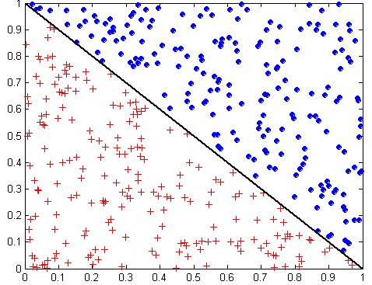
Oblique Decision Trees
x + y < 1
Class = +
Class =
Test condition may involve multiple attributes
More expressive representation
Finding optimal test condition is computationally expensive

Slide 82
Tree Replication
Same subtree appears in multiple branches

Slide 83
Evaluating a Model
Sec. 4.5

Slide 84
Model Evaluation
Metrics for Performance Evaluation
  How to evaluate the performance of a model?
Methods for Performance Evaluation
  How to obtain reliable estimates?

Slide 85
Model Evaluation
Metrics for Performance Evaluation
  How to evaluate the performance of a model?
Methods for Performance Evaluation
  How to obtain reliable estimates?

Slide 86
Metrics for Performance Evaluation
Focus on the predictive capability of a model
  Rather than how fast it takes to classify or build models, scalability, etc.
Confusion Matrix:
 | PREDICTED CLASS
ACTUAL CLASS |  | Class=Yes | Class=No
 | Class=Yes | a | b
 | Class=No | c | d
a: TP (true positive)
b: FN (false negative)
c: FP (false positive)
d: TN (true negative)

Slide 87
Metrics for Performance Evaluation…
Most widely-used metric:
 | PREDICTED CLASS
ACTUAL CLASS |  | Class=Yes | Class=No
 | Class=Yes | a (TP) | b (FN)
 | Class=No | c (FP) | d (TN)

Slide 88
Limitation of Accuracy
Consider a 2-class problem
  Number of Class 0 examples = 9990
  Number of Class 1 examples = 10

Slide 89
Limitation of Accuracy
Consider a 2-class problem
  Number of Class 0 examples = 9990
  Number of Class 1 examples = 10
If model predicts everything to be class 0, accuracy is 9990/10000 = 99.9 %
  Accuracy is misleading because model does not detect any class 1 example

Slide 90
Cost Matrix
 | PREDICTED CLASS
ACTUAL CLASS | C(i|j) | Class=Yes | Class=No
 | Class=Yes | C(Yes|Yes) | C(No|Yes)
 | Class=No | C(Yes|No) | C(No|No)
C(i|j): Cost of misclassifying class j example as class i

Slide 91
Computing Cost of Classification
Cost Matrix | PREDICTED CLASS
ACTUAL CLASS | C(i|j) | + | -
 | + | -1 | 100
 | - | 1 | 0
Model M₁ | PREDICTED CLASS
ACTUAL CLASS |  | + | -
 | + | 150 | 40
 | - | 60 | 250
Model M₂ | PREDICTED CLASS
ACTUAL CLASS |  | + | -
 | + | 250 | 45
 | - | 5 | 200
Accuracy = 80%
Cost = 3910
Accuracy = 90%
Cost = 4255

Slide 92
Cost vs Accuracy
Count | PREDICTED CLASS
ACTUAL CLASS |  | Class=Yes | Class=No
 | Class=Yes | a | b
 | Class=No | c | d
Accuracy is proportional to cost if
1. C(Yes|No)=C(No|Yes) = q
2. C(Yes|Yes)=C(No|No) = p
N = a + b + c + d
Accuracy = (a + d)/N
Cost = p (a + d) + q (b + c)
= p (a + d) + q (N – a – d)
= q N – (q – p)(a + d)
= N [q – (q-p) × Accuracy]
Cost | PREDICTED CLASS
ACTUAL CLASS |  | Class=Yes | Class=No
 | Class=Yes | p | q
 | Class=No | q | p

Slide 93
Cost-Sensitive Measures
 | PREDICTED CLASS
ACTUAL CLASS |  | Class=Yes | Class=No
 | Class=Yes | a (TP) [Y|Y] | b (FN) [N|Y]
 | Class=No | c (FP) [Y|N] | d (TN) [N|N]
Precision is biased towards C(Yes|Yes) & C(Yes|No)
Recall is biased towards C(Yes|Yes) & C(No|Yes)
F-measure is biased towards all except C(No|No)

Slide 94
True positive (Detection) & false positive (false alarm) rates
 | PREDICTED CLASS
ACTUAL CLASS |  | Class=Yes | Class=No
 | Class=Yes | a (TP) [Y|Y] | b (FN) [N|Y]
 | Class=No | c (FP) [Y|N] | d (TN) [N|N]

Slide 95
Model Evaluation
Metrics for Performance Evaluation
  How to evaluate the performance of a model?
Methods for Performance Evaluation
  How to obtain reliable estimates?

Slide 96
Methods for Performance Evaluation
How to obtain a reliable estimate of performance?
Performance of a model may depend on other factors besides the learning algorithm:
  Class distribution
  Cost of misclassification
  Size of training and test sets

Slide 97
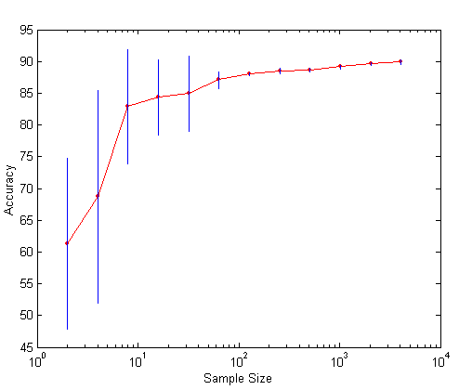
Learning Curve
Learning curve shows how accuracy changes with varying sample size
Requires a sampling schedule for creating learning curve:
  Arithmetic sampling
  (Langley, et al)
  Geometric sampling
  (Provost et al)
Effect of small sample size:
  Bias in the estimate
  Variance of estimate

Slide 98
Methods of Estimation
Holdout
  Reserve 2/3 for training and 1/3 for testing
Random subsampling
  Repeated holdout
Cross validation
  Partition data into k disjoint subsets
  k-fold: train on k-1 partitions, test on the remaining one
  Leave-one-out: k=n
Stratified sampling
  oversampling vs undersampling (certain classes)
Bootstrap
  Sampling with replacement (could have duplicates)

Slide 99
Comparing Models
Sec. 4.6

Slide 100
Model Evaluation
Metrics for Performance Evaluation
  How to evaluate the performance of a model?
Methods for Performance Evaluation
  How to obtain reliable estimates?
Methods for Model Comparison
  How to compare the relative performance among competing models?

Slide 101
ROC (Receiver Operating Characteristic)
Developed in 1950s for signal detection theory to analyze noisy signals
  Characterize the trade-off between positive hits and false alarms
ROC curve plots TP (on the y-axis) against FP (on the x-axis)
Performance of each classifier represented as a point on the ROC curve
  changing the threshold of algorithm, sample distribution or cost matrix changes the location of the point

Slide 102
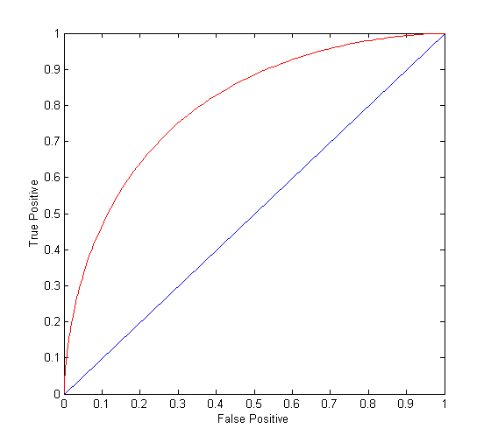
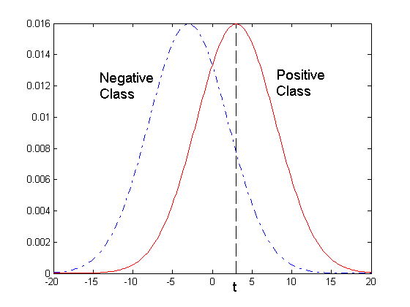
ROC Curve
- 1-dimensional data set containing 2 classes (positive and negative)
- any points located at x > t is classified as positive
At threshold t:
TP=0.5, FN=0.5, FP=0.12, TN=0.88

Slide 103
ROC Curve
(TP,FP):
(0,0): declare everything
to be negative class
(1,1): declare everything
to be positive class
(1,0): ideal
Diagonal line:
  Random guessing
  Below diagonal line:
    prediction is opposite of the true class

Slide 104
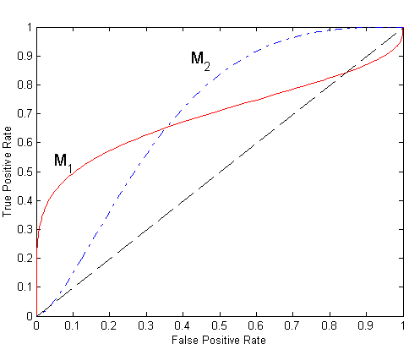
Using ROC for Model Comparison
No model consistently outperform the other
  M₁ is better for small FPR
  M₂ is better for large FPR
Area Under the ROC curve
  Ideal:
    Area = 1
  Random guess:
    Area = 0.5

Slide 105
How to Construct an ROC curve
Use classifier that produces posterior probability for each test instance P(+|A)
Sort the instances according to P(+|A) in decreasing order
Apply threshold at each unique value of P(+|A)
Count the number of TP, FP,
TN, FN at each threshold
TP rate, TPR = TP/(TP+FN)
FP rate, FPR = FP/(FP + TN)
Instance | P(+|A) | True Class
1 | 0.95 | +
2 | 0.93 | +
3 | 0.87 | -
4 | 0.85 | -
5 | 0.85 | -
6 | 0.85 | +
7 | 0.76 | -
8 | 0.53 | +
9 | 0.43 | -
10 | 0.25 | +

Slide 106
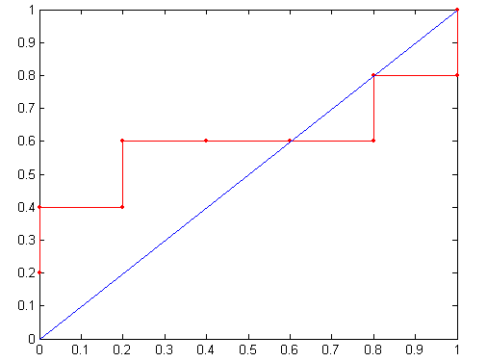
How to construct an ROC curve
Threshold >=
ROC Curve:

Slide 107
Test of Significance
Given two models:
  Model M1: accuracy = 85%, tested on 30 instances
  Model M2: accuracy = 75%, tested on 5000 instances
Can we say M1 is better than M2?
  How much confidence can we place on accuracy of M1 and M2?
  Can the difference in performance measure be explained as a result of random fluctuations in the test set?

Slide 108
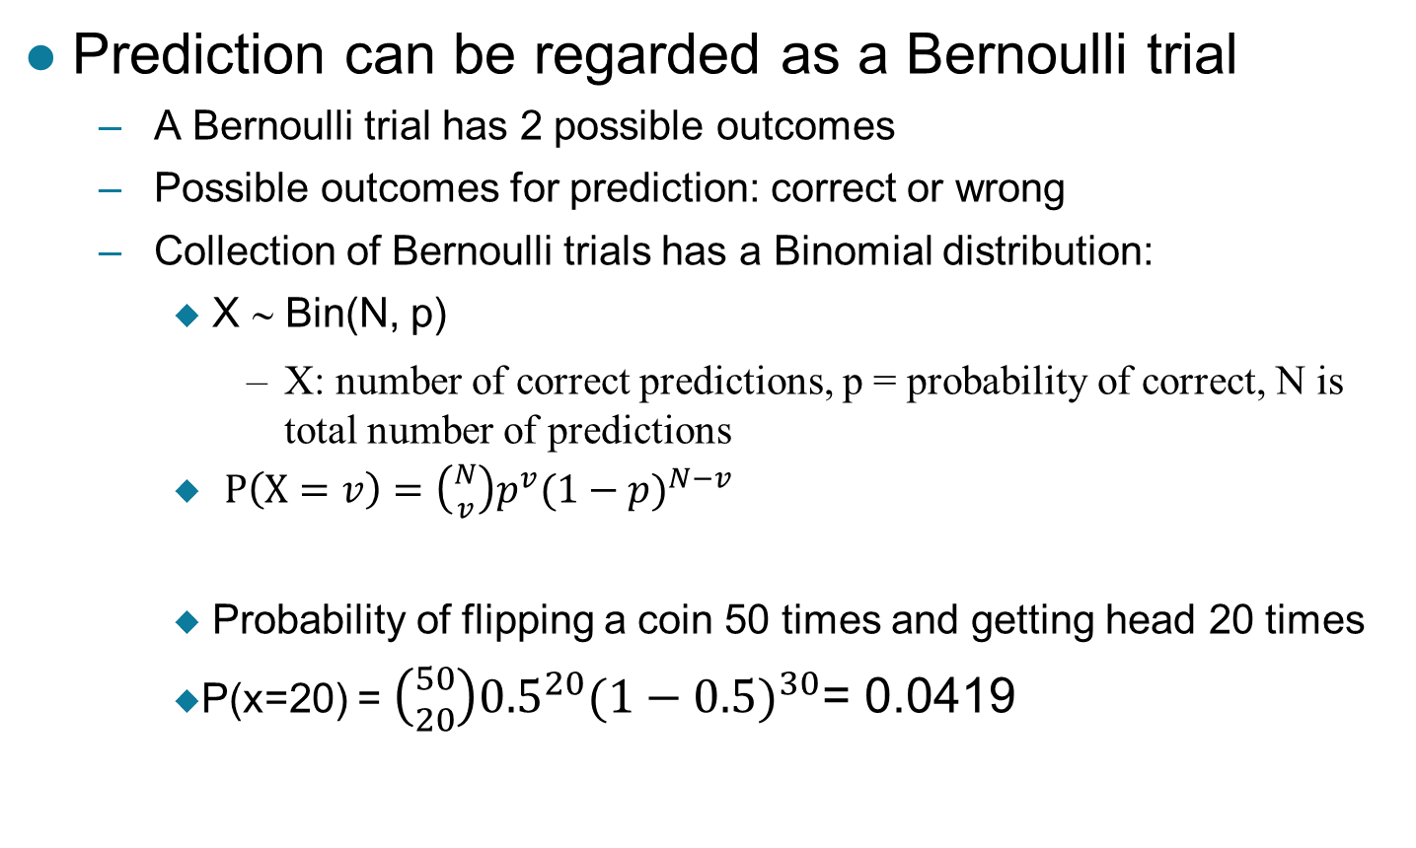
Confidence Interval for Accuracy
Prediction can be regarded as a Bernoulli trial
  A Bernoulli trial has 2 possible outcomes
  Possible outcomes for prediction: correct or wrong
  Collection of Bernoulli trials has a Binomial distribution:
    X ∼ Bin(N, p)
      X: number of correct predictions, p = probability of correct, N is total number of predictions
    $P\left(X=v\right)=\left({N \atop v}\right)p^{v}{(1−p)}^{N−v}$
    Probability of flipping a coin 50 times and getting head 20 times
    P(x=20) = $\left({50 \atop 20}\right){0.5}^{20}{(1−0.5)}^{30}$= 0.0419

Slide 109
Confidence Interval for Accuracy
Given
  x (# of correct predictions) or equivalently, acc=x/N, and
  N (# of test instances),
  Can we estimate
    P(acc is true accuracy of model)?
When N is large, can use normal distribution

Slide 110
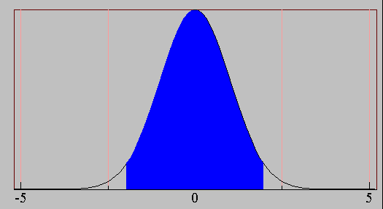
Confidence Interval for Accuracy
For large test sets (N > 30),
  acc has a normal distribution
  with mean p and variance
  p(1-p)/N
  Z = (acc – mean)/sqrt(var)
  Z ~ N(0,1)
Area = 1 - α
Z_{α/2}
Z_{1- α /2}

Slide 111
Confidence Interval for Accuracy
Area = 1 - α
Confidence Interval for acc:
Z_{α/2}
Z_{1- α /2}

Slide 112
Confidence Interval for Accuracy
Consider a model that produces an accuracy of 80% when evaluated on 100 test instances:
  N=100, acc = 0.8
  Let 1-α = 0.95 (95% confidence)
  From probability table, Z_{α/2}=1.96
1-α | Z
0.99 | 2.58
0.98 | 2.33
0.95 | 1.96
0.90 | 1.65
N | 50 | 100 | 500 | 1000 | 5000
p(lower) | 0.670 | 0.711 | 0.763 | 0.774 | 0.789
p(upper) | 0.888 | 0.866 | 0.833 | 0.824 | 0.811

Slide 113
Comparing Performance of 2 Models
Given two models, say M1 and M2, which is better?
  M1 is tested on D1 (size=n1), found error rate = e₁
  M2 is tested on D2 (size=n2), found error rate = e₂
  Assume D1 and D2 are independent
  If n1 and n2 are sufficiently large, then
  Approximate:

Slide 114
Comparing Performance of 2 Models
To test if performance difference is statistically significant: d = e1 – e2
  d ~ N(d_{t},σ_{t}) where d_{t} is the true difference
  Since D1 and D2 are independent, their variance adds up:
  At (1-α) confidence level,

Slide 115
An Illustrative Example
Given: M1: n1 = 30, e1 = 0.15
M2: n2 = 5000, e2 = 0.25
d = |e2 – e1| = 0.1 (2-sided test)
At 95% confidence level, Z_{α/2}=1.96
=> Interval contains 0 => difference may not be
statistically significant

Slide 116

Comparing Performance of 2 Algorithms
Each learning algorithm may produce k models:
  L1 may produce M11 , M12, …, M1k
  L2 may produce M21 , M22, …, M2k
If models are generated on the same data sets D1,D2, …, Dk (e.g., via cross-validation)
  For each set: compute d_{j} = e_{1j} – e_{2j}
  d_{j} has mean and variance σ_{d}
  Estimate:
$$\overline{d}$$
t distributed with
Confidence 1- α and
k-1 degrees of freedom
(Table 4.6)

Slide 117
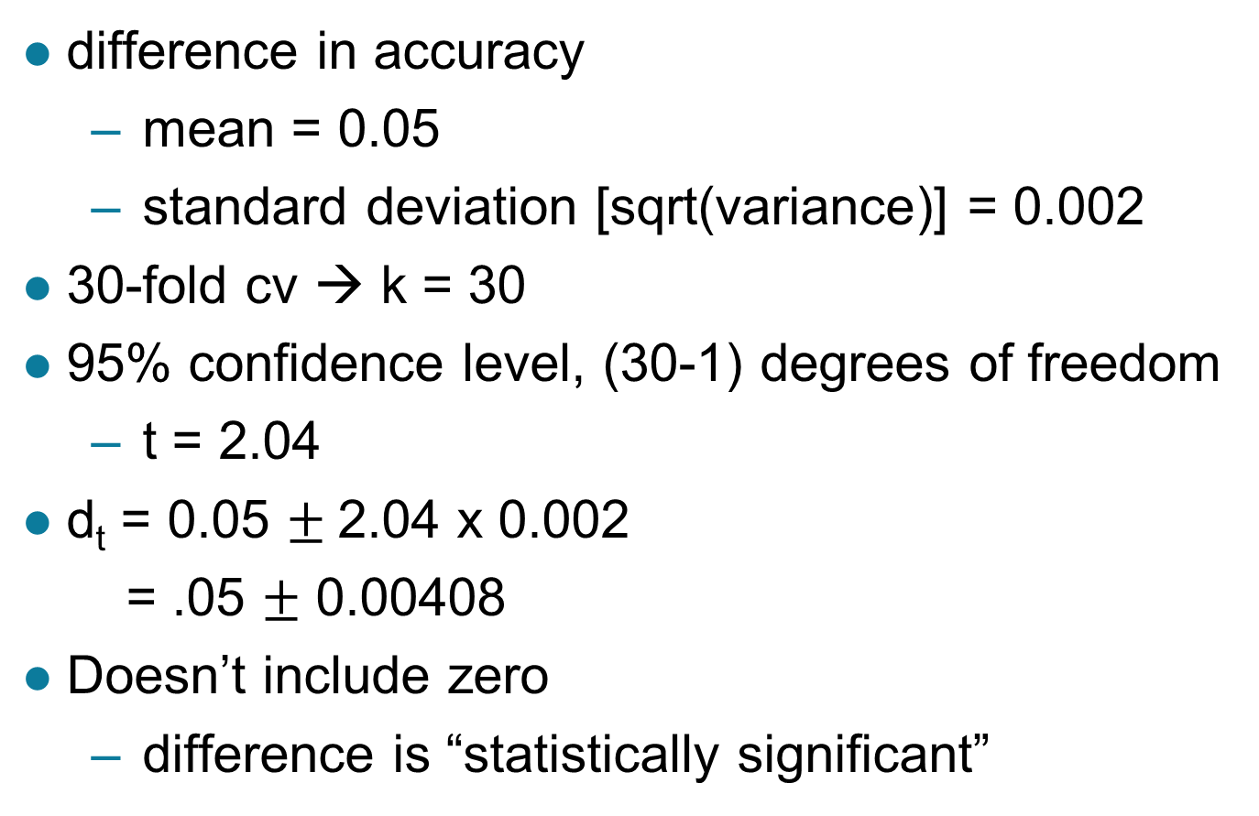
Comparing Performance of 2 Algorithms
difference in accuracy
  mean = 0.05
  standard deviation [sqrt(variance)] = 0.002
30-fold cv → k = 30
95% confidence level, (30-1) degrees of freedom
  t = 2.04
d_{t} = 0.05 $±$2.04 x 0.002
= .05 $±$ 0.00408
Doesn’t include zero
  difference is “statistically significant”

