Slide 1
Data Mining
Classification: Alternative Techniques
Lecture Notes for Chapter 5
Introduction to Data Mining
by
Tan, Steinbach, Kumar
© Tan,Steinbach, Kumar Introduction to Data Mining 1

Slide 2
Rule-Based Classifier
Classify records by using a collection of “if…then…” rules
Rule: (Condition) → y
  where
    Condition is a conjunctions of attributes
    y is the class label
  LHS: rule antecedent or condition
  RHS: rule consequent
  Examples of classification rules:
    (Blood Type=Warm) ∧ (Lay Eggs=Yes) → Birds
    (Taxable Income < 50K) ∧ (Refund=Yes) → Evade=No

Slide 3
Rule-based Classifier (Example)
R1: (Give Birth = no) ∧ (Can Fly = yes) → Birds
R2: (Give Birth = no) ∧ (Live in Water = yes) → Fishes
R3: (Give Birth = yes) ∧ (Blood Type = warm) → Mammals
R4: (Give Birth = no) ∧ (Can Fly = no) → Reptiles
R5: (Live in Water = sometimes) → Amphibians

Slide 4
Application of Rule-Based Classifier
A rule r covers an instance x if the attributes of the instance satisfy the condition of the rule
R1: (Give Birth = no) ∧ (Can Fly = yes) → Birds
R2: (Give Birth = no) ∧ (Live in Water = yes) → Fishes
R3: (Give Birth = yes) ∧ (Blood Type = warm) → Mammals
R4: (Give Birth = no) ∧ (Can Fly = no) → Reptiles
R5: (Live in Water = sometimes) → Amphibians
The rule R1 covers a hawk => Bird
The rule R3 covers the grizzly bear => Mammal

Slide 5
Rule Coverage and Accuracy
Coverage of a rule:
  Fraction of records that satisfy the antecedent of a rule
Accuracy of a rule:
  Fraction of records that satisfy both the antecedent and consequent of a rule
(Status=Single) → No
Coverage = 40%, Accuracy = 50%

Slide 6
How does Rule-based Classifier Work?
R1: (Give Birth = no) ∧ (Can Fly = yes) → Birds
R2: (Give Birth = no) ∧ (Live in Water = yes) → Fishes
R3: (Give Birth = yes) ∧ (Blood Type = warm) → Mammals
R4: (Give Birth = no) ∧ (Can Fly = no) → Reptiles
R5: (Live in Water = sometimes) → Amphibians
A lemur triggers rule R3, so it is classified as a mammal
A turtle triggers both R4 and R5
A dogfish shark triggers none of the rules

Slide 7
Characteristics of Rule-Based Classifier
Mutually exclusive rules
  Classifier contains mutually exclusive rules if the rules are independent of each other
  Every record is covered by at most one rule
Exhaustive rules
  Classifier has exhaustive coverage if it accounts for every possible combination of attribute values
  Each record is covered by at least one rule

Slide 8
From Decision Trees To Rules
Rules are mutually exclusive and exhaustive
Rule set contains as much information as the tree

Slide 9
Rules Can Be Simplified
Initial Rule: (Refund=No) ∧ (Status=Married) → No
Simplified Rule: (Status=Married) → No

Slide 10
Effect of Rule Simplification
Rules are no longer mutually exclusive
  A record may trigger more than one rule
  Solution?
    Ordered rule set
    Unordered rule set – use voting schemes
Rules are no longer exhaustive
  A record may not trigger any rules
  Solution?
    Use a default class

Slide 11
Ordered Rule Set
Rules are rank ordered according to their priority
  An ordered rule set is known as a decision list
When a test record is presented to the classifier
  It is assigned to the class label of the highest ranked rule it has triggered
  If none of the rules fired, it is assigned to the default class
R1: (Give Birth = no) ∧ (Can Fly = yes) → Birds
R2: (Give Birth = no) ∧ (Live in Water = yes) → Fishes
R3: (Give Birth = yes) ∧ (Blood Type = warm) → Mammals
R4: (Give Birth = no) ∧ (Can Fly = no) → Reptiles
R5: (Live in Water = sometimes) → Amphibians

Slide 12
Rule Ordering Schemes
Rule-based ordering
  Individual rules are ranked based on their quality
Class-based ordering
  Rules that belong to the same class appear together

Slide 13
Building Classification Rules
Direct Method:
    Extract rules directly from data
    e.g.: RIPPER, CN2, Holte’s 1R
Indirect Method:
    Extract rules from other classification models (e.g.
    decision trees, neural networks, etc).
    e.g: C4.5rules

Slide 14
Direct Method: Sequential Covering
Start from an empty rule
Grow a rule using the Learn-One-Rule function
Remove training records covered by the rule
Repeat Step (2) and (3) until stopping criterion is met

Slide 15
Example of Sequential Covering

Slide 16
Example of Sequential Covering…

Slide 17
Aspects of Sequential Covering
Rule Growing
Instance Elimination
Rule Evaluation
Stopping Criterion
Rule Pruning

Slide 18
Rule Growing
Two common strategies

Slide 19
Rule Growing (Examples)
CN2 Algorithm:
  Start from an empty conjunct: {}
  Add conjuncts that minimizes the entropy measure: {A}, {A,B}, …
  Determine the rule consequent by taking majority class of instances covered by the rule
RIPPER Algorithm:
  Start from an empty rule: {} => class
  Add conjuncts that maximizes FOIL’s information gain measure:
    R0: {} => class (initial rule)
    R1: {A} => class (rule after adding conjunct)
    Gain(R0, R1) = t [ log (p1/(p1+n1)) – log (p0/(p0 + n0)) ]
    where t: number of positive instances covered by both R0 and R1
    p0: number of positive instances covered by R0
    n0: number of negative instances covered by R0
    p1: number of positive instances covered by R1
    n1: number of negative instances covered by R1

Slide 20
Instance Elimination
Why do we need to eliminate instances?
  Otherwise, the next rule is identical to previous rule
  Incorrectly estimating accuracy of the next rule
Accuracy of R2 vs R3
  R1: 80%; R2: 70%; R3: 66.7%
    R2 > R3
  R1+R2: 76%; R1+ R3: 78.3%
    R3 > R2

Slide 21
Rule Evaluation
Metrics:
  Accuracy
n : Number of instances covered by rule (antecedent)
n_{c} : Number of instances correctly classified by rule (antecedent and consequent)
k : Number of classes
p : Prior probability

Slide 22
Prefer R1 or R2?
R1 covers
  50 positive examples
  5 negative examples
  Accuracy = 50/55 = 91%
R2 covers
  2 positive examples
  No negative examples
  Accuracy = 2/2 = 100%
What is the issue?

Slide 23
Rule Evaluation
Metrics:
  Accuracy
  Laplace
  M-estimate
n : Number of instances covered by rule (antecedent)
n_{c} : Number of instances correctly classified by rule (antecedent and consequent)
k : Number of classes
p : Prior probability

Slide 24
Prefer R1 or R2?
R1 covers
  50 positive examples
  5 negative examples
  Laplace = (50+1)/(55+2) = 89%
R2 covers
  2 positive examples
  No negative examples
  Laplace = (2+1)/(2+2) = 75%

Slide 25
Stopping Criterion
For growing a rule
  If adding a new conjunct to the antecedent doesn’t improve
For learning another rule
  No more training records
  If the most recent rule has large error
  If complexity of model and error don’t improve (e.g. MDL)

Slide 26
Rule Pruning
Similar to post-pruning of decision trees
Reduced Error Pruning:
  Remove one of the conjuncts in the rule
  Compare error rate on validation set before and after pruning
  If error improves, prune the conjunct

Slide 27
Summary of Direct Method
Grow a single rule
Prune the rule (if necessary)
Remove Instances from rule
Add rule to Current Rule Set
Repeat

Slide 28
Direct Method: RIPPER
For 2-class problem, choose one of the classes as positive class, and the other as negative class
  Learn rules for positive class
  Negative class will be default class
For multi-class problem
  Order the classes according to increasing class prevalence (fraction of instances that belong to a particular class)
  Learn the rule set for smallest class first, treat the rest as negative class
  Repeat with next smallest class as positive class

Slide 29
Direct Method: RIPPER
Growing a rule:
  Start from empty rule
  Add conjuncts as long as they improve FOIL’s information gain
  Stop when rule no longer covers negative examples
  Prune the rule immediately using incremental reduced error pruning
  Measure for pruning: v = (p-n)/(p+n)
    p: number of positive examples covered by the rule in
    the validation set
    n: number of negative examples covered by the rule in
    the validation set
  Pruning method: delete any final sequence of conditions that maximizes v

Slide 30
Direct Method: RIPPER
Building a Rule Set:
  Use sequential covering algorithm
    Finds the best rule that covers the current set of positive examples
    Eliminate both positive and negative examples covered by the rule
  Each time a rule is added to the rule set, compute the new description length
    stop adding new rules when the new description length is d bits longer than the smallest description length obtained so far

Slide 31
Direct Method: RIPPER
Optimize the rule set:
  For each rule r in the rule set R
    Consider 2 alternative rules:
      Replacement rule (r*): grow new rule from scratch
      Revised rule(r’): add conjuncts to extend the rule r
    Compare the rule set for r against the rule set for r*
    and r’
    Choose rule set that minimizes MDL principle
  Repeat rule generation and rule optimization for the remaining positive examples

Slide 32
Indirect Methods

Slide 33
Indirect Method: C4.5rules
Extract rules from an unpruned decision tree
For each rule, r: A → y,
  consider an alternative rule r’: A’ → y where A’ is obtained by removing one of the conjuncts in A
  Compare the pessimistic error rate for r against all r’s
  Prune if one of the r’s has lower pessimistic error rate
  Repeat until we can no longer improve generalization error

Slide 34
Indirect Method: C4.5rules
Instead of ordering the rules, order subsets of rules (class ordering)
  Each subset is a collection of rules with the same rule consequent (class)
  Compute description length of each subset
    Description length = L(error) + g L(model)
    g is a parameter that takes into account the presence of redundant attributes in a rule set
    (default value = 0.5)

Slide 35
Example

Slide 36
C4.5 versus C4.5rules versus RIPPER
C4.5rules:
(Give Birth=No, Can Fly=Yes) → Birds
(Give Birth=No, Live in Water=Yes) → Fishes
(Give Birth=Yes) → Mammals
(Give Birth=No, Can Fly=No, Live in Water=No) → Reptiles
( ) → Amphibians
RIPPER:
(Live in Water=Yes) → Fishes
(Have Legs=No) → Reptiles
(Give Birth=No, Can Fly=No, Live In Water=No)
→ Reptiles
(Can Fly=Yes,Give Birth=No) → Birds
() → Mammals

Slide 37
C4.5 versus C4.5rules versus RIPPER
C4.5 and C4.5rules:
RIPPER:

Slide 38
Advantages of Rule-Based Classifiers
As highly expressive as decision trees
Easy to interpret
Easy to generate
Can classify new instances rapidly
Performance comparable to decision trees

Slide 39
Nearest-neighbor Classifiers
Section 5.2

Slide 40
Instance-Based Classifiers
Store the training records
Use training records to
predict the class label of
unseen cases

Slide 41
Instance Based Classifiers
Examples:
  Rote-learner
    Memorizes entire training data and performs classification only if attributes of record match one of the training examples exactly
  Nearest neighbor
    Uses k “closest” points (nearest neighbors) for performing classification

Slide 42
Nearest Neighbor Classifiers
Basic idea:
  If it walks like a duck, quacks like a duck, then it’s probably a duck
Compute Distance
Test Record
Training Records
Choose k of the “nearest” records

Slide 43
Nearest-Neighbor Classifiers
Requires three things
  The set of stored records
  Distance Metric to compute distance between records
  The value of k, the number of nearest neighbors to retrieve
To classify an unknown record:
  Compute distance to other training records
  Identify k nearest neighbors
  Use class labels of nearest neighbors to determine the class label of unknown record (e.g., by taking majority vote)

Slide 44
Definition of Nearest Neighbor
K-nearest neighbors of a record x are data points that have the k smallest distance to x

Slide 45
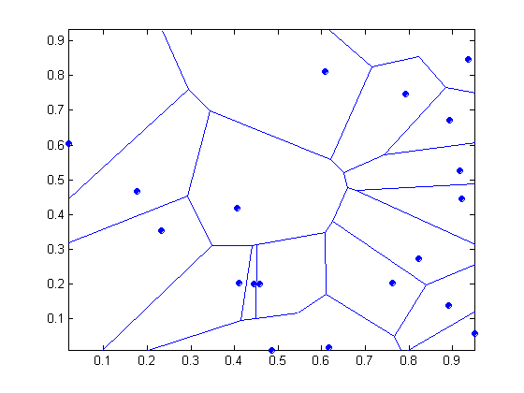
1 nearest-neighbor
Voronoi Diagram

Slide 46
Nearest Neighbor Classification
Compute distance between two points:
  Euclidean distance
Determine the class from nearest neighbor list
  take the majority vote of class labels among the k-nearest neighbors
  Weigh the vote according to distance
    weight factor, w = 1/d²

Slide 47
Nearest Neighbor Classification…
Choosing the value of k:
  If k is too small, sensitive to noise points
  If k is too large, neighborhood may include points from other classes

Slide 48
Nearest Neighbor Classification…
Scaling issues
  Attributes may have to be scaled to prevent distance measures from being dominated by one of the attributes
  Example:
    height of a person may vary from 1.5m to 1.8m
    weight of a person may vary from 90lb to 300lb
    income of a person may vary from $10K to $1M

Slide 49
Nearest Neighbor Classification…
Problem with Euclidean measure:
  High dimensional data
    curse of dimensionality
  Can produce counter-intuitive results
1 1 1 1 1 1 1 1 1 1 1 0
1 0 0 0 0 0 0 0 0 0 0 0
vs
0 1 1 1 1 1 1 1 1 1 1 1
0 0 0 0 0 0 0 0 0 0 0 1
d = 1.4142
d = 1.4142
    Solution: Normalize the vectors to unit length

Slide 50
Nearest neighbor Classification…
k-NN classifiers are lazy learners
  It does not build models explicitly
  Unlike eager learners such as decision tree induction and rule-based systems
  Classifying unknown records are relatively expensive

Slide 51
Example: PEBLS
PEBLS: Parallel Examplar-Based Learning System (Cost & Salzberg)
  Works with both continuous and nominal features
    For nominal features, distance between two nominal values is computed using modified value difference metric (MVDM)
  Each record is assigned a weight factor
  Number of nearest neighbor, k = 1

Slide 52
Example: PEBLS
Distance between nominal attribute values:
d(Single,Married)
= | 2/4 – 0/4 | + | 2/4 – 4/4 | = 1
d(Single,Divorced)
= | 2/4 – 1/2 | + | 2/4 – 1/2 | = 0
d(Married,Divorced)
= | 0/4 – 1/2 | + | 4/4 – 1/2 | = 1
d(Refund=Yes,Refund=No)
= | 0/3 – 3/7 | + | 3/3 – 4/7 | = 6/7
Class | Marital Status
 | Single | Married | Divorced
Yes | 2 | 0 | 1
No | 2 | 4 | 1
Class | Refund
 | Yes | No
Yes | 0 | 3
No | 3 | 4
i = class

Slide 53
Example: PEBLS
Distance between record X and record Y:
where:
w_{X} ≅ 1 if X makes accurate prediction most of the time
w_{X} > 1 if X is not reliable for making predictions

Slide 54
Bayesian Classifiers
Section 5.3

Slide 55
Bayes Classifier
A probabilistic framework for solving classification problems
Conditional Probability:
Bayes theorem:

Slide 56
Example of Bayes Theorem
Given:
  A doctor knows that meningitis causes stiff neck 50% of the time
  Prior probability of any patient having meningitis is 1/50,000
  Prior probability of any patient having stiff neck is 1/20
If a patient has stiff neck, what’s the probability he/she has meningitis?

Slide 57
Bayesian Classifiers
Consider each attribute and class label as random variables
Given a record with attributes (A₁, A₂,…,A_{n})
  Goal is to predict class C
  Specifically, we want to find the value of C that maximizes P(C| A₁, A₂,…,A_{n} )
Can we estimate P(C| A₁, A₂,…,A_{n} ) directly from data?

Slide 58
Bayesian Classifiers
Approach:
  compute the posterior probability P(C | A₁, A₂, …, A_{n}) for all values of C using the Bayes theorem
  Choose value of C that maximizes
  P(C | A₁, A₂, …, A_{n})
  Equivalent to choosing value of C that maximizes
  P(A₁, A₂, …, A_{n}|C) P(C)
How to estimate P(A₁, A₂, …, A_{n} | C )?

Slide 59
Naïve Bayes Classifier
Assume independence among attributes A_{i} when class is given:
  P(A₁, A₂, …, A_{n} |C) = P(A₁| C_{j}) P(A₂| C_{j})… P(A_{n}| C_{j})
  Can estimate P(A_{i}| C_{j}) for all A_{i} and C_{j}.
  New point is classified to C_{j} if P(C_{j}) Π P(A_{i}| C_{j}) is maximal.

Slide 60
(Absolute) Independence
P(smart | wearingGreenShirt)
  = P(smart)
P(A|B)
  = P(A) [if A & B are independent]
P(A,B)
  = P(A|B)*P(B)
  = P(A)*P(B) [if A & B are independent]

Slide 61
Conditional Independence
P(getA | study, smart)
  = P(getA | smart)
  Given smart, getA is cond ind of study
P(A|B,C)
  = P(A|C) [given C, A is cond ind of B]
P(A,B,C)
  = P(A|B,C)*P(B|C)*P(C) [Chain Rule]
  = P(A|C)*P(B|C)*P(C) [given C, A is cond ind of B]

Slide 62
Chain Rule
P(A, B, C)
  = P(A | B, C) * P(B | C) * P( C )
P(A, B, C)
  P( A | B, C) * P(B, C)
  P( A | B, C) * P(B | C) * P( C )

Slide 63
Conditional Independence
Given Y, X1 is cond ind of X2
  P(X1,X2 | Y)
    = P(X1,X2,Y) / P(Y)
    = P(X1|X2,Y) * P(X2|Y) * P(Y) / P(Y)
    = P(X1|Y)*P(X2|Y) [Given Y, X1 is cond ind of X2]
Given Y, X1 is cond ind of X2, X3, …
  P(X1, X2, X3 … | Y)
    = P(X1|Y) * P(X2|Y) * P(X3|Y) …
  Or P(A1, A2, A3 … | C)
    = P(A1|C) * P(A2|C) * P(A3|C) …

Slide 64
How to Estimate Probabilities from Data?
Class: P(C) = N_{c}/N
  e.g., P(No) = 7/10,
  P(Yes) = 3/10
For discrete attributes:
P(A_{i} | C_{k}) = |A_{ik}|/ N_{c}
  where |A_{ik}| is number of instances having attribute A_{i} and belongs to class C_{k}
  Examples:
  P(Status=Married|No) = 4/7
  P(Refund=Yes|Yes)=0
k

Slide 65
How to Estimate Probabilities from Data?
For continuous attributes:
  Discretize the range into bins
    one ordinal attribute per bin
    violates independence assumption
  Two-way split: (A < v) or (A > v)
    choose only one of the two splits as new attribute
  Probability density estimation:
    Assume attribute follows a normal distribution
    Use data to estimate parameters of distribution
    (e.g., mean and standard deviation)
    Once probability distribution is known, can use it to estimate the conditional probability P(A_{i}|c)
k

Slide 66
How to Estimate Probabilities from Data?
Normal distribution:
  One for each (A_{i},c_{i}) pair
For (Income, Class=No):
  If Class=No
    sample mean = 110
    sample variance = 2975

Slide 67
Example of Naïve Bayes Classifier
Given a Test Record:
P(X|Class=No) = P(Refund=No|Class=No)
× P(Married| Class=No)
× P(Income=120K| Class=No)
= 4/7 × 4/7 × 0.0072 = 0.0024
P(X|Class=Yes) = P(Refund=No| Class=Yes)
× P(Married| Class=Yes)
× P(Income=120K| Class=Yes)
= 1 × 0 × 1.2 × 10⁻⁹ = 0
Since P(X|No)P(No) > P(X|Yes)P(Yes)
Therefore P(No|X) > P(Yes|X)
=> Class = No

Slide 68
Naïve Bayes Classifier
If one of the conditional probability is zero, then the entire expression becomes zero
Probability estimation:
c: number of classes
p: prior probability
m: parameter

Slide 69
Example of Naïve Bayes Classifier
A: attributes
M: mammals
N: non-mammals
P(A|M)P(M) > P(A|N)P(N)
=> Mammals

Slide 70
Naïve Bayes (Summary)
Robust to isolated noise points
Handle missing values by ignoring the instance during probability estimate calculations
Robust to irrelevant attributes
Independence assumption may not hold for some attributes
  Use other techniques such as Bayesian Belief Networks (BBN)

Slide 71
Bayesian Belief Networks
Section 5.3.5

Slide 72
Bayesian Belief Network (BBN)
aka Bayesian Network
Network/graph of dependency among variables
  Directed acyclic graph (DAG)
  Table of P(node | parents)
In (a): C depends on A and B

Slide 73
Conditional Independence Property
Given its parent(s)
  a node is cond ind of its non-descendants
In (b): given C, A is cond ind of B
In (c): given y, x1 is cond ind of x2,…

Slide 74
Probability table at each node
X has no parents
  P(X)
X has one parent Y
  P(X|Y)
X has multiple parents Y1, Y2, … Yk
  P(X|Y1, Y2, … Yk)
Estimated from data

Slide 75
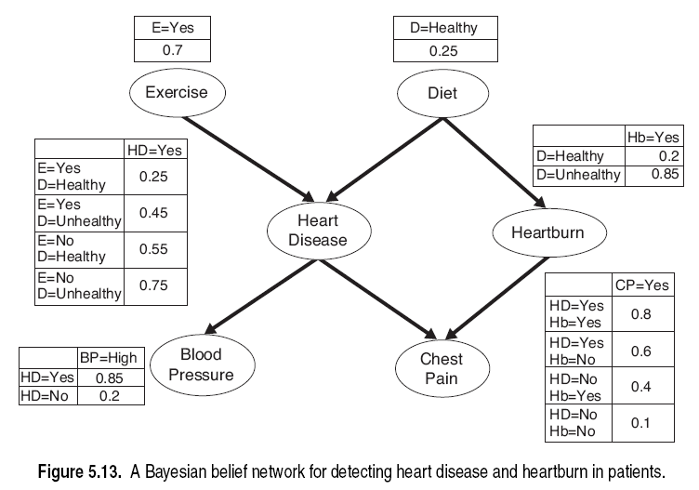
Tables/distributions are not complete, but missing values can be calculated

Slide 76

Full Joint Probability Distribution
n variables in BN
$$P\left(X_{1}{, X}_{2}{, …, X}_{n}\right)=\prod_{i}^{n}{P(X_{i}|Parents\left(X_{i}\right))}$$

Slide 77
Topology of Bayesian Network
Based on human domain knowledge
“Algorithm” 5.3
Given T = X1, X2, …
  from high to low order in dependency
  ie, effects before causes
While T is not empty
  Remove the first node V from T
  for each node W in T that affects V
    create an edge W → V
Output must be a DAG

Slide 78
Tables/distributions are not complete, but missing values can be calculated

Slide 79
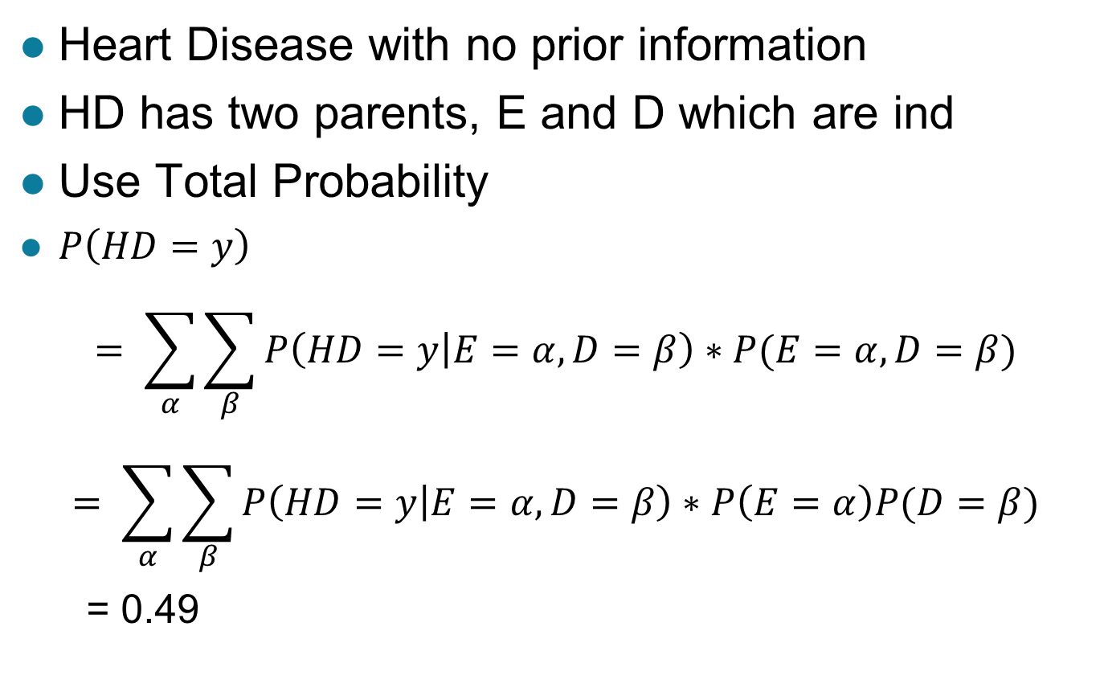
Inference using Bayesian Network
Heart Disease with no prior information
HD has two parents, E and D which are ind
Use Total Probability
$P\left(HD=y\right)$
$$= \sum_{α}{\sum_{β}{P\left(HD=y | E=α,D=β\right)∗P(E=α,D=β)}}$$
$$= \sum_{α}{\sum_{β}{P\left(HD=y | E=α,D=β\right)∗P\left(E=α\right)P(D=β)}}$$
= 0.49

Slide 80

Total Probability
$\sum_{i}{P(B_{i})}$ = 1
$P\left(A\right)$
$$=\sum_{i}{P(A,B_{i})}$$
$$= \sum_{i}{P\left(A | B_{i}\right)P(B_{i}})$$

Slide 81
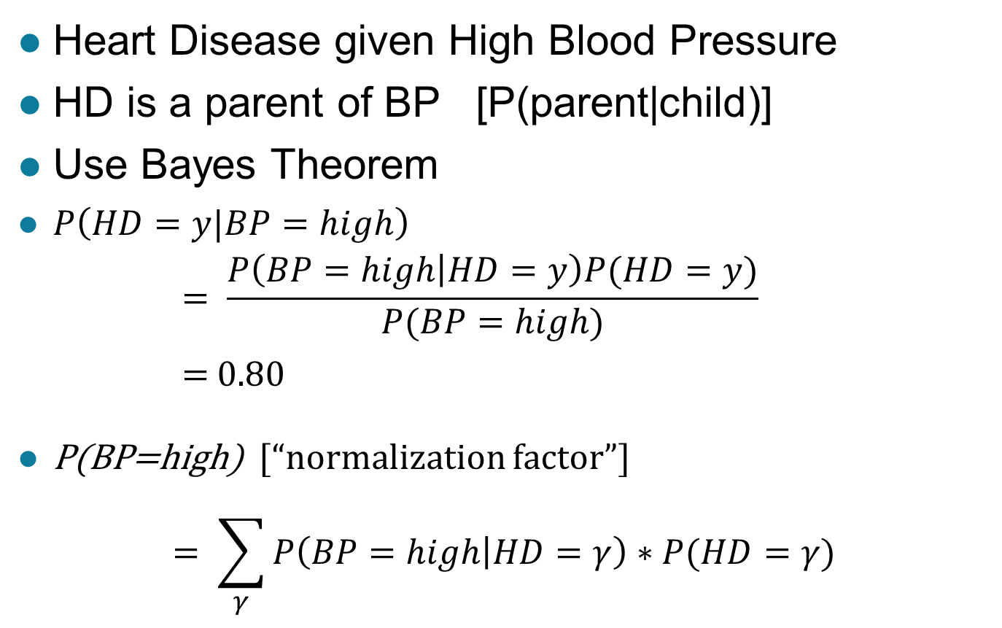
Inference using Bayesian Network
Heart Disease given High Blood Pressure
HD is a parent of BP [P(parent|child)]
Use Bayes Theorem
$P\left(HD=y|BP=high\right)$
      $$= \frac{P\left(BP=high | HD=y\right)P(HD=y)}{P(BP=high)}$$
      $=$ 0.80
P(BP=high) [“normalization factor”]
$$= \sum_{γ}{P\left(BP=high | HD=γ\right)∗P(HD=γ)}$$

Slide 82
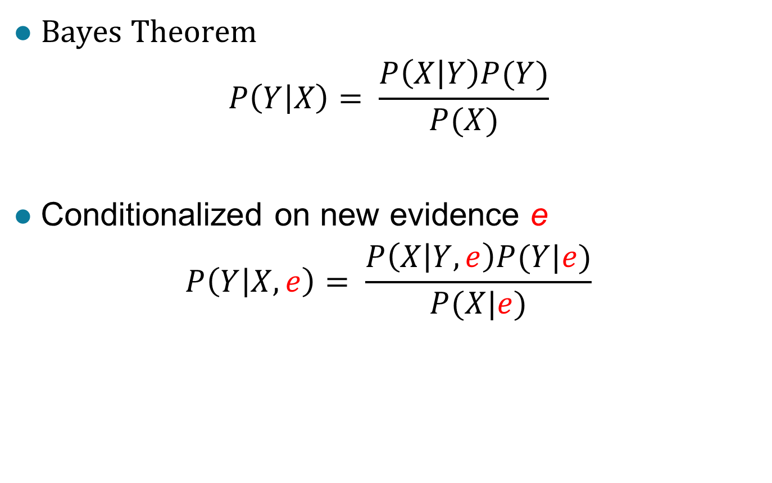
Adding new evidence
Bayes Theorem
$$P\left(Y | X\right)= \frac{P\left(X | Y\right)P(Y)}{P(X)}$$
Conditionalized on new evidence e
$$P\left(Y | X,e\right)= \frac{P\left(X | Y,e\right)P(Y|e)}{P(X|e)}$$

Slide 83

Add Healthy Diet and Regular Exercise
$P\left(HD=y|BP=high,D=healthy,E=y\right)$
$$= \frac{P\left(BP=high | HD=y,D=healthy,E=y\right)P(HD=y|D=Healty,E=y)}{P(BP=high|D=healthy,E=y)}$$

Slide 84
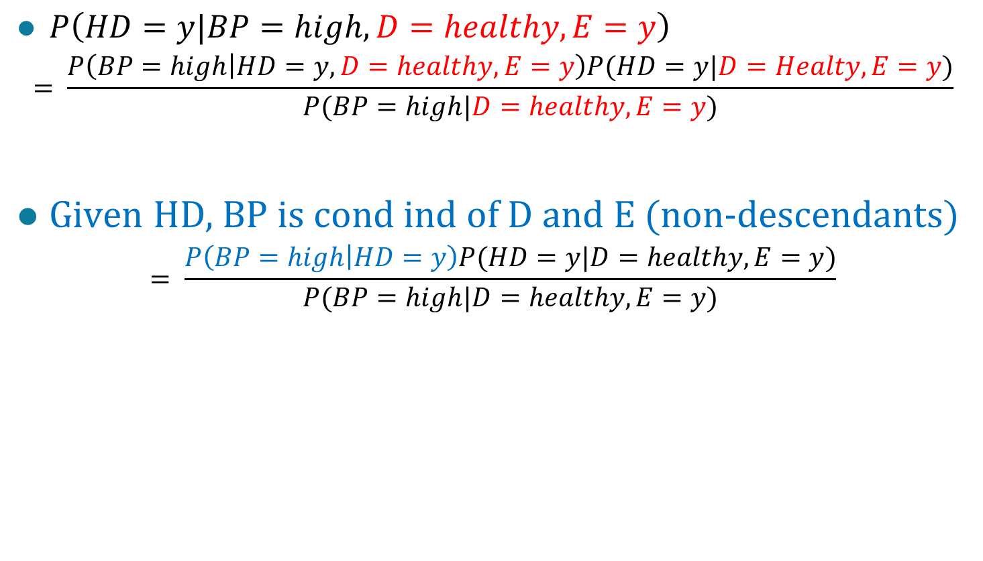
Add Healthy Diet and Regular Exercise
$P\left(HD=y|BP=high,D=healthy,E=y\right)$
$$= \frac{P\left(BP=high | HD=y,D=healthy,E=y\right)P(HD=y|D=Healty,E=y)}{P(BP=high|D=healthy,E=y)}$$
Given HD, BP is cond ind of D and E (non-descendants)
$$= \frac{P\left(BP=high | HD=y\right)P(HD=y|D=healthy,E=y)}{P(BP=high|D=healthy,E=y)}$$

Slide 85
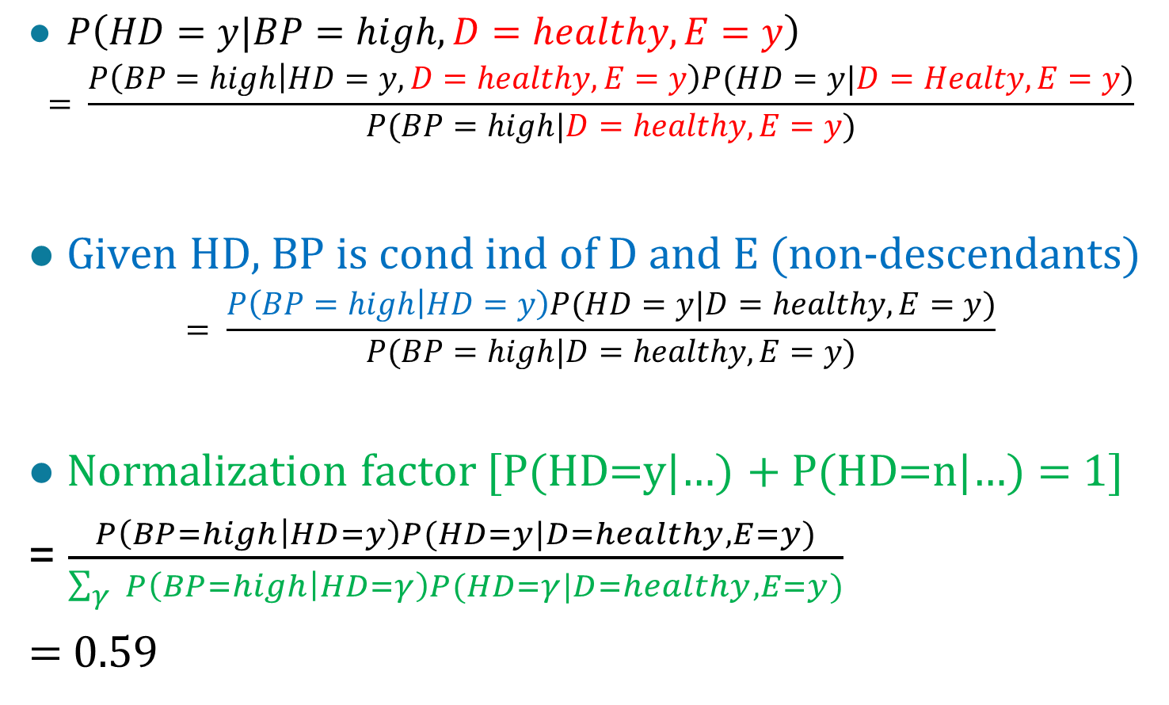
Add Healthy Diet and Regular Exercise
$P\left(HD=y|BP=high,D=healthy,E=y\right)$
$$= \frac{P\left(BP=high | HD=y,D=healthy,E=y\right)P(HD=y|D=Healty,E=y)}{P(BP=high|D=healthy,E=y)}$$
Given HD, BP is cond ind of D and E (non-descendants)
$$= \frac{P\left(BP=high | HD=y\right)P(HD=y|D=healthy,E=y)}{P(BP=high|D=healthy,E=y)}$$
Normalization factor [P(HD=y|…) + P(HD=n|…) = 1]
= $\frac{P\left(BP=high | HD=y\right)P(HD=y|D=healthy,E=y)}{\sum_{γ}{P\left(BP=high | HD=γ\right)P(HD=γ|D=healthy,E=y)}}$
= 0.59

Slide 87

Total Probability
$P\left(A|C\right)$
= $\frac{P\left(A,C\right)}{P(C)}$
= $\frac{\sum_{i}{P\left(A,C,B_{i}\right)P(B_{i})}}{P(C)}$
= $\frac{\sum_{i}{P\left(A|B_{i},C\right)P\left(B_{i} | C\right)P\left(C\right)P(B_{i})}}{P(C)}$
= $\sum_{i}{P\left({A|B}_{i},C\right)P\left(B_{i} | C\right)P(B_{i}})$

Slide 89
Artificial Neural Networks (ANN)
Output Y is 1 if at least two of the three inputs are equal to 1.

Slide 90
Artificial Neural Networks (ANN)

Slide 91
Artificial Neural Networks (ANN)
Model is an assembly of inter-connected nodes and weighted links
Output node sums up each of its input value according to the weights of its links
Compare output node against some threshold t
Perceptron Model
or

Slide 92
General Structure of ANN
Training ANN means learning the weights of the neurons

Slide 93
Algorithm for learning ANN
Initialize the weights (w₀, w₁, …, w_{k})
Adjust the weights in such a way that the output of ANN is consistent with class labels of training examples
  Objective function:
  Find the weights w_{i}’s that minimize the above objective function
    e.g., backpropagation algorithm (see lecture notes)

Slide 94
Support Vector Machines
Find a linear hyperplane (decision boundary) that will separate the data

Slide 95
Support Vector Machines
One Possible Solution

Slide 96
Support Vector Machines
Another possible solution

Slide 97
Support Vector Machines
Other possible solutions

Slide 98
Support Vector Machines
Which one is better? B1 or B2?
How do you define better?

Slide 99
Support Vector Machines
Find hyperplane maximizes the margin => B1 is better than B2

Slide 100
Support Vector Machines

Slide 101
Support Vector Machines
We want to maximize:
  Which is equivalent to minimizing:
  But subjected to the following constraints:
    This is a constrained optimization problem
      Numerical approaches to solve it (e.g., quadratic programming)

Slide 102
Support Vector Machines
What if the problem is not linearly separable?

Slide 103
Support Vector Machines
What if the problem is not linearly separable?
  Introduce slack variables
    Need to minimize:
    Subject to:

Slide 104
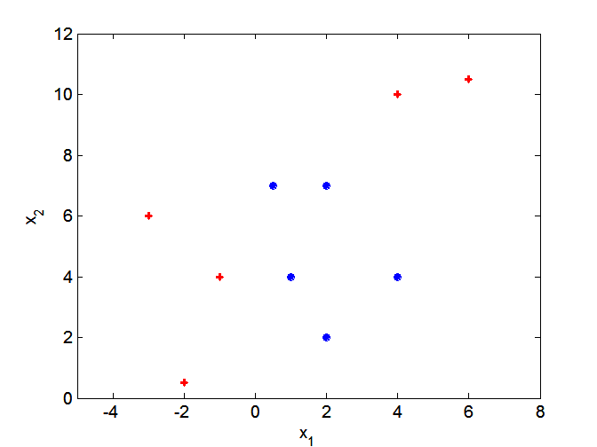
Nonlinear Support Vector Machines
What if decision boundary is not linear?

Slide 105
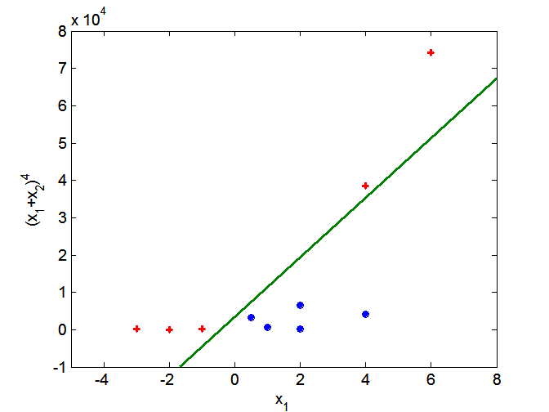
Nonlinear Support Vector Machines
Transform data into higher dimensional space

Slide 106
Ensemble Methods
Construct a set of classifiers from the training data
Predict class label of previously unseen records by aggregating predictions made by multiple classifiers

Slide 107
General Idea

Slide 108
Why does it work?
Suppose there are 25 base classifiers
  Each classifier has error rate, ε = 0.35
  Assume classifiers are independent
  Probability that the ensemble classifier makes a wrong prediction:

Slide 109
Examples of Ensemble Methods
How to generate an ensemble of classifiers?
  Bagging
  Boosting

Slide 110
Bagging
Sampling with replacement
Build classifier on each bootstrap sample
Each sample has probability (1 – 1/n)^{n} of being selected

Slide 111
Boosting
An iterative procedure to adaptively change distribution of training data by focusing more on previously misclassified records
  Initially, all N records are assigned equal weights
  Unlike bagging, weights may change at the end of boosting round

Slide 112
Boosting
Records that are wrongly classified will have their weights increased
Records that are classified correctly will have their weights decreased
Example 4 is hard to classify
Its weight is increased, therefore it is more likely to be chosen again in subsequent rounds

Slide 113
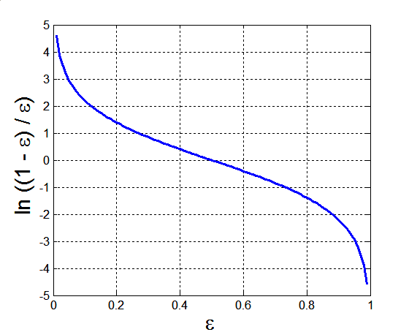
Example: AdaBoost
Base classifiers: C₁, C₂, …, C_{T}
Error rate:
Importance of a classifier:

Slide 114
Example: AdaBoost
Weight update:
If any intermediate rounds produce error rate higher than 50%, the weights are reverted back to 1/n and the resampling procedure is repeated
Classification:

Slide 115
Illustrating AdaBoost
Initial weights for each data point
Data points for training

Slide 116
Illustrating AdaBoost

