Slide 1
Data Mining
Association Analysis: Basic Concepts and Algorithms
Lecture Notes for Chapter 6
Introduction to Data Mining
by
Tan, Steinbach, Kumar
© Tan,Steinbach, Kumar Introduction to Data Mining 4/18/2004 1

Slide 2
Association Rule Mining
Given a set of transactions, find rules that will predict the occurrence of an item based on the occurrences of other items in the transaction
Market-Basket transactions
Example of Association Rules
{Diaper} → {Beer},
{Milk, Bread} → {Eggs,Coke},
{Beer, Bread} → {Milk},
Implication means co-occurrence, not causality!

Slide 3
Definition: Frequent Itemset
Itemset
  A collection of one or more items
    Example: {Milk, Bread, Diaper}
  k-itemset
    An itemset that contains k items
Support count (σ)
  Frequency of occurrence of an itemset
  E.g. σ({Milk, Bread,Diaper}) = 2
Support
  Fraction of transactions that contain an itemset
  E.g. s({Milk, Bread, Diaper}) = 2/5
Frequent Itemset
  An itemset whose support is greater than or equal to a minsup threshold

Slide 4
Definition: Association Rule
Association Rule
  An implication expression of the form X → Y, where X and Y are itemsets
  Example:
  {Milk, Diaper} → {Beer}
Rule Evaluation Metrics
  Support (s)
    Fraction of transactions that contain both X and Y
  Confidence (c)
    Measures how often items in Y
    appear in transactions that
    contain X
Example:

Slide 5
Association Rule Mining Task
Given a set of transactions T, the goal of association rule mining is to find all rules having
  support ≥ minsup threshold
  confidence ≥ minconf threshold
Brute-force approach:
  List all possible association rules
  Compute the support and confidence for each rule
  Prune rules that fail the minsup and minconf thresholds
  ⇒ Computationally prohibitive!

Slide 6
Mining Association Rules
Example of Rules:
{Milk,Diaper} → {Beer} (s=0.4, c=0.67)
{Milk,Beer} → {Diaper} (s=0.4, c=1.0)
{Diaper,Beer} → {Milk} (s=0.4, c=0.67)
{Beer} → {Milk,Diaper} (s=0.4, c=0.67)
{Diaper} → {Milk,Beer} (s=0.4, c=0.5)
{Milk} → {Diaper,Beer} (s=0.4, c=0.5)
Observations:
All the above rules are binary partitions of the same itemset:
{Milk, Diaper, Beer}
Rules originating from the same itemset have identical support but
can have different confidence
Thus, we may decouple the support and confidence requirements

Slide 7
Mining Association Rules
Two-step approach:
  Frequent Itemset Generation
    Generate all itemsets whose support ≥ minsup
  Rule Generation
    Generate high confidence rules from each frequent itemset, where each rule is a binary partitioning of a frequent itemset
Frequent itemset generation is still computationally expensive

Slide 8
  Frequent Itemset Generation
Section 6.2

Slide 9
Frequent Itemset Generation
Given d items, there are 2^{d} possible candidate itemsets

Slide 10
Frequent Itemset Generation
Brute-force approach:
  Each itemset in the lattice is a candidate frequent itemset
  Count the support of each candidate by scanning the database
  Match each transaction against every candidate
  Complexity ~ O(NMw) => Expensive since M = 2^{d} !!!

Slide 11
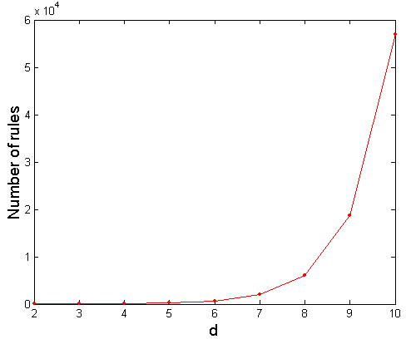
Computational Complexity
Given d unique items:
  Total number of itemsets = 2^{d}
  Total number of possible association rules:
If d=6, R = 602 rules

Slide 12
Frequent Itemset Generation Strategies
Reduce the number of candidates (M)
  Complete search: M=2^{d}
  Use pruning techniques to reduce M
Reduce the number of transactions (N)
  Reduce size of N as the size of itemset increases
  Used by DHP (direct hash and pruning) and vertical-based mining algorithms
Reduce the number of comparisons (NM)
  Use efficient data structures to store the candidates or transactions
  No need to match every candidate against every transaction

Slide 13
Frequent Itemset Generation
The Apriori Principle (6.2.1)
Frequent Itemset Generation in the Apriori Algorithm (6.2.1)
Candidate Generation and Pruning (6.2.3)
Support Counting (6.2.4)
Computational Complexity (6.2.5)

Slide 14
Reducing Number of Candidates
Apriori principle:
  If an itemset is frequent, then all of its subsets must also be frequent
Apriori principle holds due to the following property of the support measure:
  Support of an itemset never exceeds the support of its subsets
  This is known as the anti-monotone property of support

Slide 15
Illustrating Apriori Principle

Slide 16
Illustrating Apriori Principle
Found to be Infrequent
Pruned supersets

Slide 17
Frequent Itemset Generation
The Apriori Principle (6.2.1)
Frequent Itemset Generation in the Apriori Algorithm (6.2.1)
Candidate Generation and Pruning (6.2.3)
Support Counting (6.2.4)
Computational Complexity (6.2.5)

Slide 18
High-level Apriori Algorithm
Items (1-itemsets)
Pairs (2-itemsets)
(No need to generate
candidates involving Coke
or Eggs)
Minimum Support = 3
Triplets (3-itemsets)
If every subset is considered,
⁶C₁ + ⁶C₂ + ⁶C₃ = 41
With support-based pruning,
6 + 6 + 1 = 13

Slide 19
Apriori Algorithm
Method:
  Let k=1
  Generate frequent itemsets of length 1
  Repeat until no new frequent itemsets are identified
    Generate length (k+1) candidate itemsets from length k frequent itemsets (Sec 6.2.3)
    Prune candidate itemsets containing subsets of length k that are infrequent (Sec 6.2.3)
    Count the support of each candidate by scanning the DB (Sec 6.2.4)
    Eliminate candidates that are infrequent, leaving only those that are frequent

Slide 20
Frequent Itemset Generation
The Apriori Principle (6.2.1)
Frequent Itemset Generation in the Apriori Algorithm (6.2.1)
Candidate Generation and Pruning (6.2.3)
Support Counting (6.2.4)
Computational Complexity (6.2.5)

Slide 21
Candidate Generation and Pruning
Candidate Generation
  Generates new candidate k-itemsets
    Based on frequent (k-1)-itemsets found in previous iteration
Candidate Pruning
  Eliminate some of the candidate k-itemsets
    each (k-1)itemset must be frequent
      prune otherwise
    if {a,b,c} is frequent
      {a,b}, {b,c}, and {a,c} must be frequent, why?
      If one of them is not frequent, {a,b,c} is not frequent

Slide 22
Brute-Force Method
Generate all combinations
Prune candidates without the minimum support

Slide 23
Brute-force Method

Slide 24
F_{k-1} x F₁ Method

Slide 25

F_{k-1} x F₁ Method
How to avoid both:
{Beer, Diapers} $∪$ {Milk}
  = {Beer, Diapers, Milk}
{Diapers, Milk} $∪$ {Beer}
  = {Diapers, Milk, Beer}
which are the same?

Slide 26
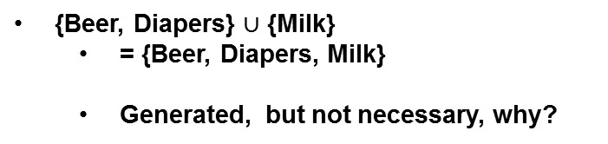
F_{k-1} x F₁ Method
{Beer, Diapers} $∪$ {Milk}
  = {Beer, Diapers, Milk}
  Generated, but not necessary, why?

Slide 27
F_{k-1} x F₁ Method
  Consider candidate {a,b,c}
    If {a,b,c} is frequent
      {a,b}, {b,c}, and {a,c} are frequent, why?
    So a is in two frequent 2-itemsets: {a,b} and {a,c}
      and so are b and c
Pruning:
  Each item must be in at least k-1 of the frequent (k-1) itemsets
  Consider candidate {a,b,c}
    a must be in at least two frequent 2-itemsets
    and b ... and c …

Slide 28
F_{k-1} x F₁ Method
In number of frequent 2-itemsets
  Beer → 1
  Bread → 2
  Diapers → 3
  Milk → 2
{Beer, Diapers, Milk} cannot be frequent
  pruned
  so did the other two

Slide 29
F_{k-1} x F_{k-1} Method

Slide 30

F_{k-1} x F_{k-1} Method
{a₁, a₂, …, a_{k-2 ,} a_{k-1}} $∪$ {b₁, b₂, …, b_{k-2 ,} b_{k-1}}
  if a₁ = b₁ , a₂ = b₂ , … , a_{k-2} = b_{k-2}
  but a_{k-1} $≠$b_{k-1}
  {a₁, a₂, …, a_{k-2,} a_{k-1,} b_{k-1}}

Slide 31
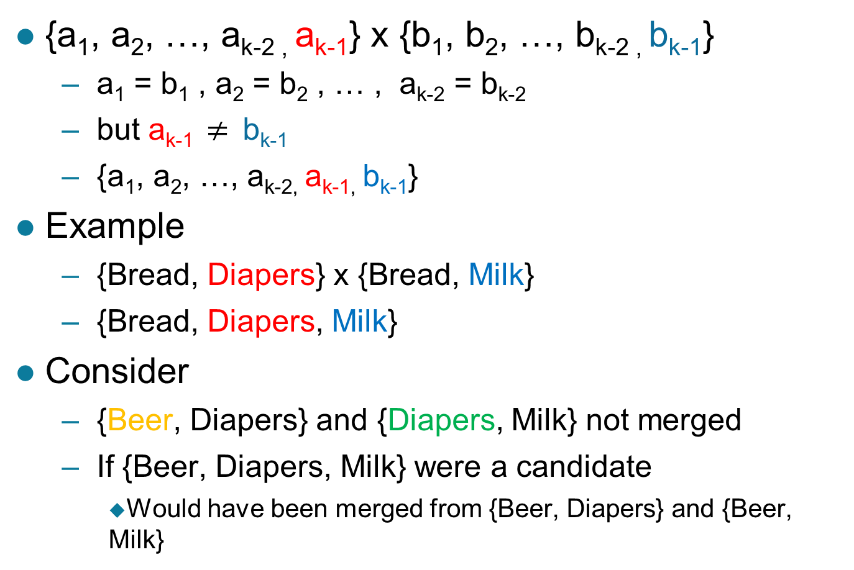
F_{k-1} x F_{k-1} Method
{a₁, a₂, …, a_{k-2 ,} a_{k-1}} x {b₁, b₂, …, b_{k-2 ,} b_{k-1}}
  a₁ = b₁ , a₂ = b₂ , … , a_{k-2} = b_{k-2}
  but a_{k-1} $≠$b_{k-1}
  {a₁, a₂, …, a_{k-2,} a_{k-1,} b_{k-1}}
Example
  {Bread, Diapers} x {Bread, Milk}
  {Bread, Diapers, Milk}
Consider
  {Beer, Diapers} and {Diapers, Milk} not merged
  If {Beer, Diapers, Milk} were a candidate
    Would have been merged from {Beer, Diapers} and {Beer, Milk}

Slide 32

F_{k-1} x F_{k-1} Method
{Bread, Diapers} $∪$ {Bread, Milk}
= {Bread, Diapers, Milk}

Slide 33
F_{k-1} x F_{k-1} Method
Pruning
  {a₁, a₂, …, a_{k-2,} a_{k-1,} b_{k-1}}
  Already checked, why?
    {a₁, a₂, …, a_{k-2,} a_{k-1} }
    {a₁, a₂, …, a_{k-2,} b_{k-1}}
  Need to check
    {a₁, a₂, …, a_{k-1,} b_{k-1}}
    …
    {a₁, …, a_{k-2,} a_{k-1,} b_{k-1}}
    { a₂, …, a_{k-2,} a_{k-1,} b_{k-1}}

Slide 34
F_{k-1} x F_{k-1} Method
Check {Diapers, Milk}
Also frequent
Not pruned

Slide 35
Frequent Itemset Generation
The Apriori Principle (6.2.1)
Frequent Itemset Generation in the Apriori Algorithm (6.2.1)
Candidate Generation and Pruning (6.2.3)
Support Counting (6.2.4)
Computational Complexity (6.2.5)

Slide 36
Reducing Number of Comparisons
Candidate counting:
  Scan the database of transactions to determine the support of each candidate itemset
  To reduce the number of comparisons, store the candidates in a hash structure
    Instead of matching each transaction against every candidate, match it against candidates contained in the hashed buckets

Slide 37
Generate Hash Tree
Consider 15 candidate itemsets of length 3:
{1 4 5}, {1 2 4}, {4 5 7}, {1 2 5}, {4 5 8}, {1 5 9}, {1 3 6}, {2 3 4}, {5 6 7}, {3 4 5}, {3 5 6}, {3 5 7}, {6 8 9}, {3 6 7}, {3 6 8}
You need:
Hash function
Max leaf size: max number of itemsets stored in a leaf node (if number of candidate itemsets exceeds max leaf size (e.g. 3), split the node)
Hash function
2 3 4
5 6 7
3,6,9
1,4,7
1 4 5
3 4 5
3 5 6
3 5 7
6 8 9
3 6 7
3 6 8
1 3 6
2,5,8
1 2 4
4 5 7
1 2 5
4 5 8
1 5 9

Slide 38
Association Rule Discovery: Hash tree
Hash Function
Candidate Hash Tree
n^{th} item in itemset
1st item in itemset
1,4,7
3,6,9
2,5,8
2 3 4
2nd item in itemset
5 6 7
1 4 5
1 3 6
3rd item in itemset
3 4 5
3 5 6
3 6 7
Hash on 1, 4 or 7
3 5 7
3 6 8
1 2 4
1 5 9
6 8 9
1 2 5
4 5 7
4 5 8

Slide 39
Association Rule Discovery: Hash tree
Hash Function
Candidate Hash Tree
n^{th} item in itemset
1st item in itemset
1,4,7
3,6,9
2,5,8
2 3 4
2nd item in itemset
5 6 7
1 4 5
1 3 6
3rd item in itemset
3 4 5
3 5 6
3 6 7
Hash on 2, 5 or 8
3 5 7
3 6 8
1 2 4
1 5 9
6 8 9
1 2 5
4 5 7
4 5 8

Slide 40
Association Rule Discovery: Hash tree
Hash Function
Candidate Hash Tree
n^{th} item in itemset
1st item in itemset
1,4,7
3,6,9
2,5,8
2 3 4
2nd item in itemset
5 6 7
1 4 5
1 3 6
3rd item in itemset
3 4 5
3 5 6
3 6 7
Hash on 3, 6 or 9
3 5 7
3 6 8
1 2 4
1 5 9
6 8 9
1 2 5
4 5 7
4 5 8

Slide 41
Subset Operation (enumeration visualization)
Given a transaction t, what are the possible subsets of size 3?

Slide 42
Subset Operation Using Hash Tree
1 2 3 5 6
transaction
Hash Function
1 +
2 3 5 6
2 +
3 5 6
1,4,7
3,6,9
3 +
5 6
2,5,8
2 3 4
5 6 7
1 4 5
1 3 6
3 4 5
3 5 6
3 6 7
3 5 7
3 6 8
1 2 4
1 2 5
1 5 9
6 8 9
4 5 7
4 5 8

Slide 43
Subset Operation Using Hash Tree
1 2 3 5 6
transaction
Hash Function
1 +
2 3 5 6
2 +
3 5 6
1,4,7
3,6,9
1 2 +
3 5 6
3 +
5 6
2,5,8
1 3 +
5 6
2 3 4
1 5 +
6
5 6 7
1 4 5
1 3 6
3 4 5
3 5 6
3 6 7
3 5 7
3 6 8
1 2 4
1 2 5
1 5 9
6 8 9
4 5 7
4 5 8

Slide 44
Subset Operation Using Hash Tree
1 2 3 5 6
transaction
Hash Function
1 +
2 3 5 6
2 +
3 5 6
1,4,7
3,6,9
1 2 +
3 5 6
3 +
5 6
2,5,8
1 3 +
5 6
2 3 4
1 5 +
6
5 6 7
1 4 5
1 3 6
3 4 5
3 5 6
3 6 7
3 5 7
3 6 8
1 2 4
1 2 5
1 5 9
6 8 9
4 5 7
4 5 8
Search 9 instead of 15 candidates for the transaction

Slide 45
Subset Operation Using Hash Tree
1 2 3 5 6
transaction
Hash Function
1 +
2 3 5 6
2 +
3 5 6
1,4,7
3,6,9
1 2 +
3 5 6
3 +
5 6
2,5,8
1 3 +
5 6
2 3 4
1 5 +
6
5 6 7
1 4 5
1 3 6
3 4 5
3 5 6
3 6 7
3 5 7
3 6 8
1 2 4
1 2 5
1 5 9
6 8 9
4 5 7
4 5 8
The transaction matches 3 candidate itemsets, increment support count for them

Slide 46
Frequent Itemset Generation
The Apriori Principle (6.2.1)
Frequent Itemset Generation in the Apriori Algorithm (6.2.1)
Candidate Generation and Pruning (6.2.3)
Support Counting (6.2.4)
Computational Complexity (6.2.5)

Slide 47
Factors Affecting Complexity
Choice of minimum support threshold
  lowering support threshold results in more frequent itemsets
  this may increase number of candidates and max length of frequent itemsets
Dimensionality (number of items) of the data set
  more space is needed to store support count of each item
  if number of frequent items also increases, both computation and I/O costs may also increase
Size of database
  since Apriori makes multiple passes, run time of algorithm may increase with number of transactions
Average transaction width
  transaction width increases with denser data sets
  This may increase max length of frequent itemsets and traversals of hash tree (number of subsets in a transaction increases with its width)

Slide 48
  Rule Generation
Section 6.3

Slide 49
Rule Generation
Given a frequent itemset L, find all non-empty subsets f ⊂ L such that f → L – f satisfies the minimum confidence requirement
  If {A,B,C,D} is a frequent itemset, candidate rules:
    ABC →D, ABD →C, ACD →B, BCD →A,
    A →BCD, B →ACD, C →ABD, D →ABC
    AB →CD, AC → BD, AD → BC, BC →AD,
    BD →AC, CD →AB,
If |L| = k, then there are 2^{k} – 2 candidate association rules (ignoring L → ∅ and ∅ → L)

Slide 50
Rule Generation
How to efficiently generate rules from frequent itemsets?
  Confidence of rules generated from the same itemset has an anti-monotone property
  e.g., L = {A,B,C,D}:
  c(ABC → D) ≥ c(AB → CD) ≥ c(A → BCD)
    Confidence is anti-monotone w.r.t. number of items on the RHS of the rule

Slide 51

Confidence-based Pruning
  X $→$ Y
  Confidence
      s(X $∪$ Y) / s(X)
  Given rules from the same itemset
      the numerator is the same, why?

Slide 52
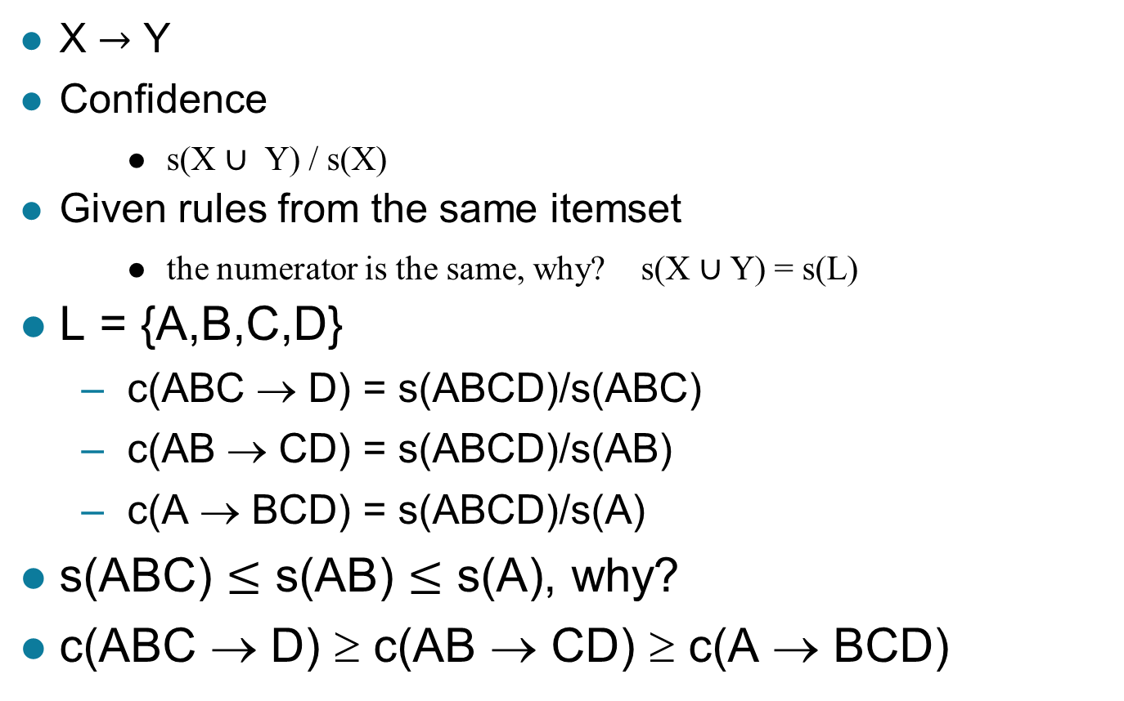
Confidence-based Pruning
  X $→$ Y
  Confidence
      s(X $∪$ Y) / s(X)
  Given rules from the same itemset
      the numerator is the same, why? s(X $∪$ Y) = s(L)
L = {A,B,C,D}
  c(ABC → D) = s(ABCD)/s(ABC)
  c(AB → CD) = s(ABCD)/s(AB)
  c(A → BCD) = s(ABCD)/s(A)
s(ABC) $≤$ s(AB) $≤$ s(A), why?
c(ABC → D) ≥ c(AB → CD) ≥ c(A → BCD)

Slide 53
Rule Generation in Apriori Algorithm
Lattice of rules
Search level by level
Increasing size in consequent

Slide 54
Rule Generation in Apriori Algorithm
Lattice of rules
Low Confidence Rule

Slide 55
Rule Generation in Apriori Algorithm
Lattice of rules
Low Confidence Rule
Pruned Rules

Slide 56
Rule Generation in Apriori Algorithm
Lattice of rules
ACD=>B & ABD=>C
Yields
AD=>BC
Low Confidence Rule
Pruned Rules

Slide 57
Rule Generation in Apriori Algorithm
Lattice of rules
AD=>BC & AC=>BD
Yields
A=>BCD
Low Confidence Rule
Pruned Rules

Slide 58
Rule Generation in Apriori Algorithm
Generally merge two rules that share the same prefix in the rule consequent
merge(CD=>AB,BD=>AC)
would produce the candidate
rule D => ABC
Prune rule D=>ABC if its
subset AD=>BC does not have
high confidence (parents CD=>AB and BD=> AC already have high confidence)

Slide 59
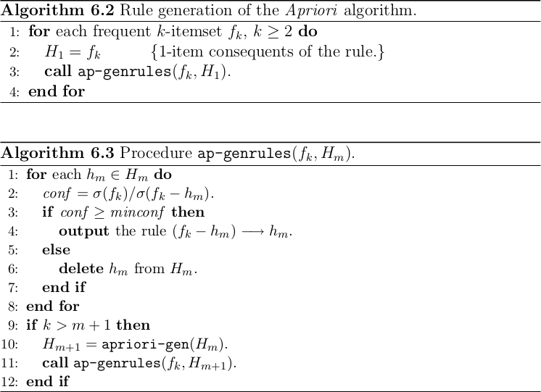
Rule Generation (updated Alg. 6.2 and 6.3)
(jeszysblog.wordpress.com, 2012)

Slide 60
Evaluation of Association Patterns
Section 6.7

Slide 61
Pattern Evaluation
Association rule algorithms tend to produce too many rules
  many of them are uninteresting or redundant
  Redundant if {A,B,C} → {D} and {A,B} → {D}
  have same support & confidence
Interestingness measures can be used to prune/rank the derived patterns
In the original formulation of association rules, support & confidence are the only measures used

Slide 62
Application of Interestingness Measure
Interestingness Measures

Slide 63
Computing Interestingness Measure
Given a rule X → Y, information needed to compute rule interestingness can be obtained from a contingency table
Contingency table for X → Y
 | Y | Y
X | f₁₁ | f₁₀ | f₁₊
X | f₀₁ | f₀₀ | f_{o+}
 | f₊₁ | f₊₀ | |T|
f₁₁: support of X and Y
f₁₀: support of X and Y
f₀₁: support of X and Y
f₀₀: support of X and Y
Used to define various measures
support, confidence, lift, Gini,
J-measure, etc.

Slide 64
Drawback of Confidence
 | Coffee | Coffee
Tea | 15 | 5 | 20
Tea | 75 | 5 | 80
 | 90 | 10 | 100
Association Rule: Tea → Coffee
Confidence= P(Coffee|Tea) = 0.75
but P(Coffee) = 0.9
Although confidence is high, rule is misleading
P(Coffee|Tea) = 0.9375

Slide 65
Statistical Independence
Population of 1000 students
  600 students know how to swim (S)
  700 students know how to bike (B)
  420 students know how to swim and bike (S,B)
  P(S∧B) = 420/1000 = 0.42
  P(S) × P(B) = 0.6 × 0.7 = 0.42
  P(S∧B) = P(S) × P(B) => Statistical independence
  P(S∧B) > P(S) × P(B) => Positively correlated
  P(S∧B) < P(S) × P(B) => Negatively correlated

Slide 66
Statistical-based Measures
Measures that take into account statistical dependence

Slide 67
Example: Lift/Interest
 | Coffee | Coffee
Tea | 15 | 5 | 20
Tea | 75 | 5 | 80
 | 90 | 10 | 100
Association Rule: Tea → Coffee
Confidence= P(Coffee|Tea) = 0.75
but P(Coffee) = 0.9
Lift = 0.75/0.9= 0.8333 (< 1, therefore is negatively associated)

Slide 68
Drawback of Lift/Interest
 | Y | Y
X | 10 | 0 | 10
X | 0 | 90 | 90
 | 10 | 90 | 100
 | Y | Y
X | 90 | 0 | 90
X | 0 | 10 | 10
 | 90 | 10 | 100
Statistical independence:
If P(X,Y)=P(X)P(Y) => Lift = 1

Slide 69
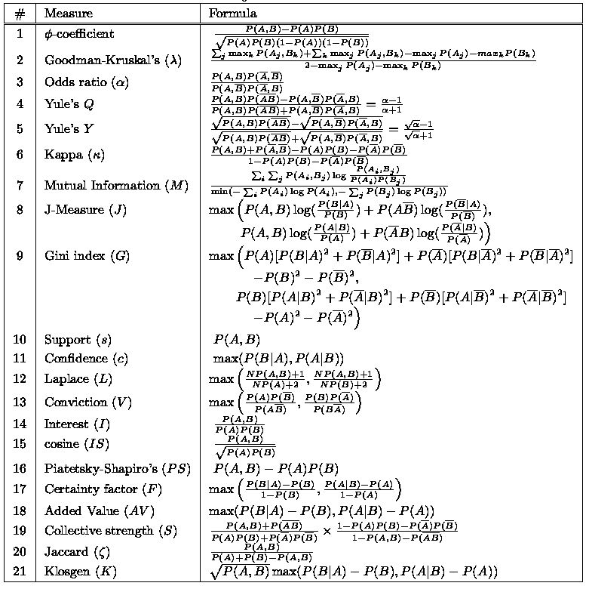
There are lots of measures proposed in the literature
Some measures are good for certain applications, but not for others
What criteria should we use to determine whether a measure is good or bad?

Slide 70
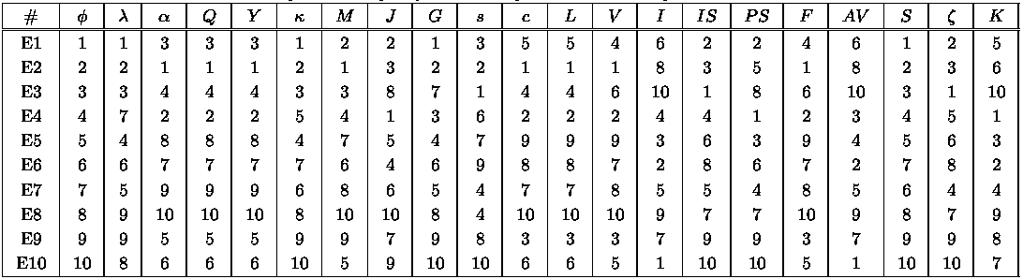
Comparing Different Measures
10 examples of contingency tables:
Rankings of contingency tables using various measures:

Slide 71
Properties of A Good Measure
Piatetsky-Shapiro:
3 properties a good measure M must satisfy:
  P1: M(A,B) = 0
    if A and B are statistically independent
  P2: M(A,B) increase monotonically
    with P(A,B)
    when P(A) and P(B) remain unchanged
  P3: M(A,B) decreases monotonically
    with P(A) [or P(B)]
    when P(A,B) and P(B) [or P(A)] remain unchanged

Slide 72
Different Measures have Different Properties (Tan et al, 2002)

Slide 73
Property under Variable Permutation (O1)
Does M(A,B) = M(B,A)?
Symmetric measures:
  support, lift, collective strength, cosine, Jaccard, etc
Asymmetric measures:
  confidence, conviction, Laplace, J-measure, etc

Slide 74
Property under Row/Column Scaling (O2)
Grade-Gender Example (Mosteller, 1968):
 | Male | Female
High | 2 | 3 | 5
Low | 1 | 4 | 5
 | 3 | 7 | 10
 | Male | Female
High | 4 | 30 | 34
Low | 2 | 40 | 42
 | 6 | 70 | 76
2x
10x
Mosteller:
Underlying association should be independent of
the relative number of male and female students
in the samples
Invariant measure (more desirable): odds ratio
Non-invariant measures: φ-coefficient , Cohen, IS, interest factor, collective strength

Slide 75
Property under Inversion (O3’)
 | B | ~B
A | p | q
~A | r | s
 | B | ~B
A | s | r
~A | q | p
M(A,B) is the same if p,s are swapped and r,q are swapped
Invariant measures: φ-coefficient , odds ratio, Cohen, and collective strength
non-invariant measures (more desirable): interest, IS, PS, Jaccard

Slide 76
Property under Inversion Operation (O3’)
Item ->
Transaction 1
.
.
.
.
Transaction N
Inversion Invariant Property: M(A,B) = M(C,D)

Slide 77
Example: φ-Coefficient (O3’)
φ-coefficient is analogous to correlation coefficient for continuous variables
 | Y | Y
X | 60 | 10 | 70
X | 10 | 20 | 30
 | 70 | 30 | 100
 | Y | Y
X | 20 | 10 | 30
X | 10 | 60 | 70
 | 30 | 70 | 100
φ Coefficient is the same for both tables

Slide 78
Property under Null Addition (O4)
Invariant if adding any k to s (both A and B don’t exist)
Invariant measures (more desirable):
  support, cosine, Jaccard, etc
Non-invariant measures:
  correlation, Gini, mutual information, odds ratio, etc

Slide 79
Different Measures have Different Properties (Tan et al, 2002)

Slide 81
Compact Representation of Frequent Itemsets
Section 6.4

Slide 82
Compact Representation of Frequent Itemsets
Some itemsets are redundant because they have identical support as their supersets
Number of frequent itemsets
Need a compact representation

Slide 83
Maximal Frequent Itemset
An itemset is maximal frequent if none of its immediate supersets is frequent
Maximal Itemsets
Infrequent Itemsets
Border

Slide 84
Closed Itemset
An itemset is closed if none of its immediate supersets has the same support as the itemset

Slide 85
Maximal vs Closed Itemsets
Transaction Ids
Not supported by any transactions

Slide 86
Maximal vs Closed Frequent Itemsets
Minimum support = 2
Closed but not maximal
Closed and maximal
# Closed = 9
# Maximal = 4

Slide 87
Maximal vs Closed Itemsets

Slide 88
Alternative Methods for Generating Frequent Itemsets
Section 6.5

Slide 89
Alternative Methods for Frequent Itemset Generation
Traversal of Itemset Lattice
  General-to-specific vs Specific-to-general

Slide 90
Alternative Methods for Frequent Itemset Generation
Traversal of Itemset Lattice
  Equivalent Classes

Slide 91
Alternative Methods for Frequent Itemset Generation
Traversal of Itemset Lattice
  Breadth-first vs Depth-first

Slide 92
Alternative Methods for Frequent Itemset Generation
Representation of Database
  horizontal vs vertical data layout

Slide 93
FP-Growth Algorithm
Section 6.6

Slide 94
FP-growth Algorithm
Use a compressed representation of the database using an FP-tree
Once an FP-tree has been constructed, it uses a recursive divide-and-conquer approach to mine the frequent itemsets

Slide 95
FP-tree construction
null
After reading TID=1:
A:1
B:1
After reading TID=2:
null
A:1
B:1
B:1
C:1
D:1

Slide 96
FP-Tree Construction
Transaction Database
null
A:7
B:3
B:5
C:3
C:1
D:1
Header table
D:1
C:3
E:1
D:1
E:1
D:1
E:1
D:1
Pointers are used to assist frequent itemset generation

Slide 97
FP-growth
null
Conditional Pattern base for D:
P = {(A:1,B:1,C:1),
(A:1,B:1),
(A:1,C:1),
(A:1),
(B:1,C:1)}
Recursively apply FP-growth on P
Frequent Itemsets found (with sup > 1):
AD, BD, CD, ACD, BCD
A:7
B:1
B:5
C:1
C:1
D:1
C:3
D:1
D:1
D:1
D:1

Slide 98
Tree Projection
Set enumeration tree:
Possible Extension: E(A) = {B,C,D,E}
Possible Extension: E(ABC) = {D,E}

Slide 99
Tree Projection
Items are listed in lexicographic order
Each node P stores the following information:
  Itemset for node P
  List of possible lexicographic extensions of P: E(P)
  Pointer to projected database of its ancestor node
  Bitvector containing information about which transactions in the projected database contain the itemset

Slide 100
Projected Database
Projected Database for node A:
Original Database:
For each transaction T, projected transaction at node A is T ∩ E(A)

Slide 101
ECLAT
For each item, store a list of transaction ids (tids)
TID-list

Slide 102
ECLAT
Determine support of any k-itemset by intersecting tid-lists of two of its (k-1) subsets.
3 traversal approaches:
  top-down, bottom-up and hybrid
Advantage: very fast support counting
Disadvantage: intermediate tid-lists may become too large for memory
∧
→

Slide 103
Support-based Pruning
Most of the association rule mining algorithms use support measure to prune rules and itemsets
Study effect of support pruning on correlation of itemsets
  Generate 10000 random contingency tables
  Compute support and pairwise correlation for each table
  Apply support-based pruning and examine the tables that are removed

Slide 104
Effect of Support-based Pruning

Slide 105
Effect of Support-based Pruning
Support-based pruning eliminates mostly negatively correlated itemsets

Slide 106
Effect of Support-based Pruning
Investigate how support-based pruning affects other measures
Steps:
  Generate 10000 contingency tables
  Rank each table according to the different measures
  Compute the pair-wise correlation between the measures

Slide 107
Effect of Support-based Pruning
Without Support Pruning (All Pairs)
Scatter Plot between Correlation & Jaccard Measure
Red cells indicate correlation between
the pair of measures > 0.85
40.14% pairs have correlation > 0.85

Slide 108
Effect of Support-based Pruning
0.5% ≤ support ≤ 50%
Scatter Plot between Correlation & Jaccard Measure:
61.45% pairs have correlation > 0.85

Slide 109
Effect of Support-based Pruning
0.5% ≤ support ≤ 30%
Scatter Plot between Correlation & Jaccard Measure
76.42% pairs have correlation > 0.85

Slide 110
Subjective Interestingness Measure
Objective measure:
  Rank patterns based on statistics computed from data
  e.g., 21 measures of association (support, confidence, Laplace, Gini, mutual information, Jaccard, etc).
Subjective measure:
  Rank patterns according to user’s interpretation
    A pattern is subjectively interesting if it contradicts the
    expectation of a user (Silberschatz & Tuzhilin)
    A pattern is subjectively interesting if it is actionable
    (Silberschatz & Tuzhilin)

Slide 111
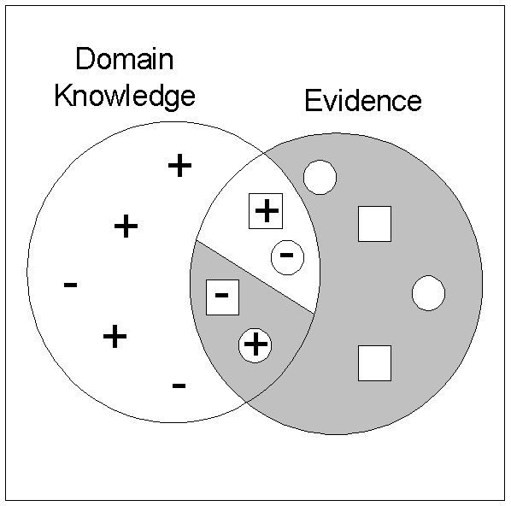
Interestingness via Unexpectedness
Need to model expectation of users (domain knowledge)
Need to combine expectation of users with evidence from data (i.e., extracted patterns)
+
Pattern expected to be frequent
-
Pattern expected to be infrequent
Pattern found to be frequent
Pattern found to be infrequent
+
-
Expected Patterns
-
+
Unexpected Patterns

Slide 112
Interestingness via Unexpectedness
Web Data (Cooley et al 2001)
  Domain knowledge in the form of site structure
  Given an itemset F = {X₁, X₂, …, X_{k}} (X_{i} : Web pages)
    L: number of links connecting the pages
    lfactor = L / (k × k-1)
    cfactor = 1 (if graph is connected), 0 (disconnected graph)
  Structure evidence = cfactor × lfactor
  Usage evidence
  Use Dempster-Shafer theory to combine domain knowledge and evidence from data

Slide 113
Effect of Skewed Support Distribution
Section 6.8

Slide 114
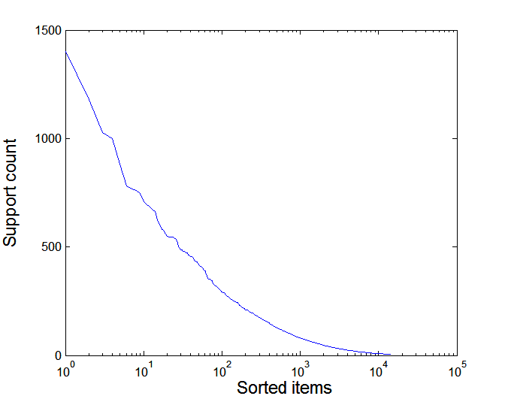
Effect of Support Distribution
Many real data sets have skewed support distribution
Support distribution of a retail data set

Slide 115
Effect of Support Distribution
How to set the appropriate minsup threshold?
  If minsup is set too high, we could miss itemsets involving interesting rare items (e.g., expensive products)
  If minsup is set too low, it is computationally expensive and the number of itemsets is very large
Using a single minimum support threshold may not be effective

Slide 116
Multiple Minimum Support
How to apply multiple minimum supports?
  MS(i): minimum support for item i
  e.g.: MS(Milk)=5%, MS(Coke) = 3%,
  MS(Broccoli)=0.1%, MS(Salmon)=0.5%
  MS({Milk, Broccoli}) = min (MS(Milk), MS(Broccoli))
  = 0.1%
  Challenge: Support is no longer anti-monotone
    Suppose: Support(Milk, Coke) = 1.5% and
    Support(Milk, Coke, Broccoli) = 0.5%
    {Milk,Coke} is infrequent but {Milk,Coke,Broccoli} is frequent

Slide 117
Multiple Minimum Support

Slide 118
Multiple Minimum Support

Slide 119
Multiple Minimum Support (Liu 1999)
Order the items according to their minimum support (in ascending order)
  e.g.: MS(Milk)=5%, MS(Coke) = 3%,
  MS(Broccoli)=0.1%, MS(Salmon)=0.5%
  Ordering: Broccoli, Salmon, Coke, Milk
Need to modify Apriori such that:
  L₁ : set of frequent items
  F₁ : set of items whose support is ≥ MS(1)
  where MS(1) is min_{i}( MS(i) )
  C₂ : candidate itemsets of size 2 is generated from F₁
  instead of L₁

Slide 120
Multiple Minimum Support (Liu 1999)
Modifications to Apriori:
  In traditional Apriori,
    A candidate (k+1)-itemset is generated by merging two
    frequent itemsets of size k
    The candidate is pruned if it contains any infrequent subsets
    of size k
  Pruning step has to be modified:
    Prune only if subset contains the first item
    e.g.: Candidate={Broccoli, Coke, Milk} (ordered according to
    minimum support)
    {Broccoli, Coke} and {Broccoli, Milk} are frequent but
    {Coke, Milk} is infrequent
      Candidate is not pruned because {Coke,Milk} does not contain
      the first item, i.e., Broccoli.

