Slide 1
Data Mining
Cluster Analysis: Advanced Concepts and Algorithms
Lecture Notes for Chapter 9
Introduction to Data Mining
by
Tan, Steinbach, Kumar
© Tan,Steinbach, Kumar Introduction to Data Mining 4/18/2004 1

Slide 2
Prototype-based Clustering
Fuzzy Clustering (9.2.1)
Clustering using Mixture Models (9.2.2)

Slide 3
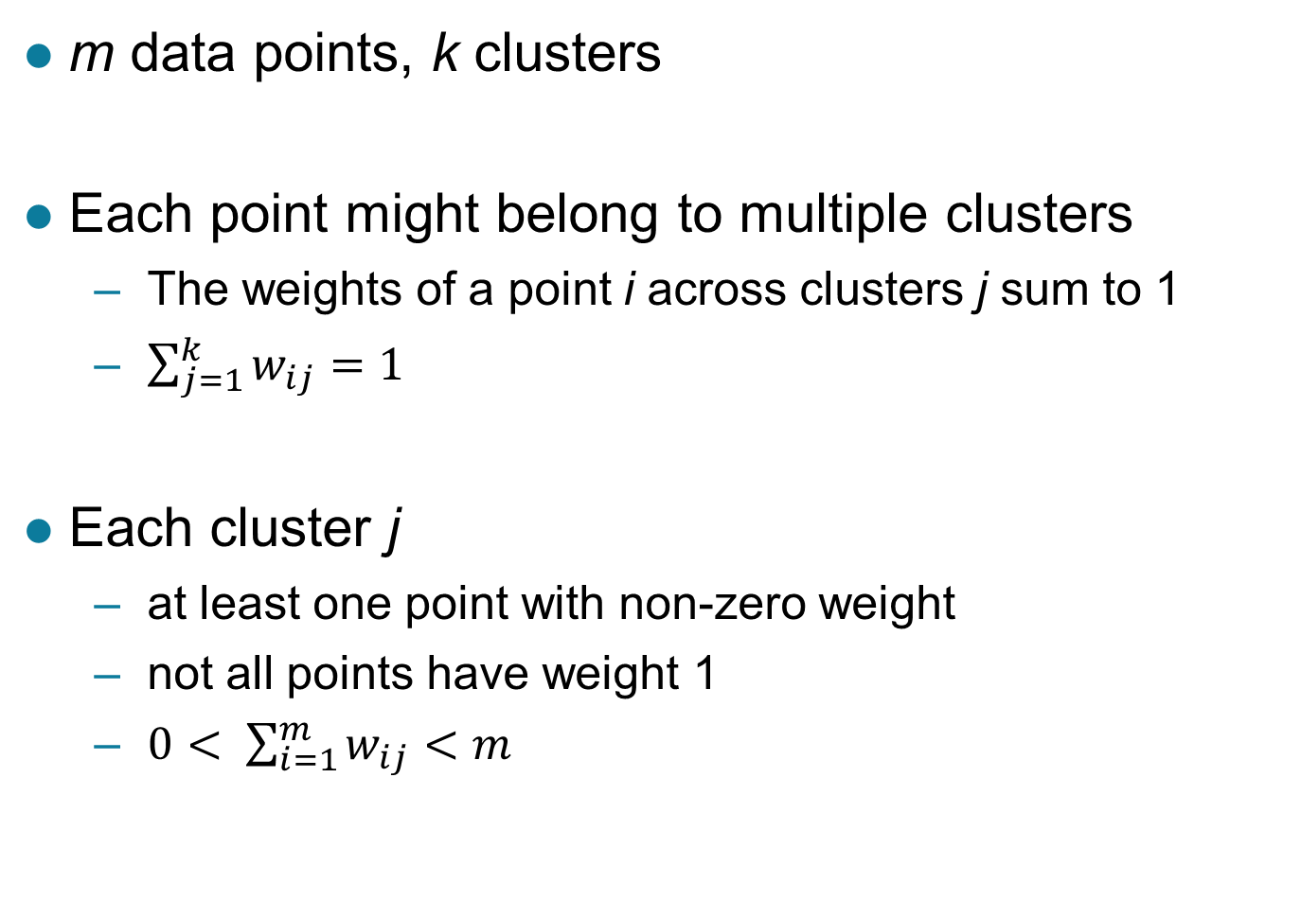
Fuzzy Clustering
m data points, k clusters
Each point might belong to multiple clusters
  The weights of a point i across clusters j sum to 1
  $\sum_{j=1}^{k}{w_{ij}=1}$
Each cluster j
  at least one point with non-zero weight
  not all points have weight 1
  $0< \sum_{i=1}^{m}{w_{ij}<m}$

Slide 4
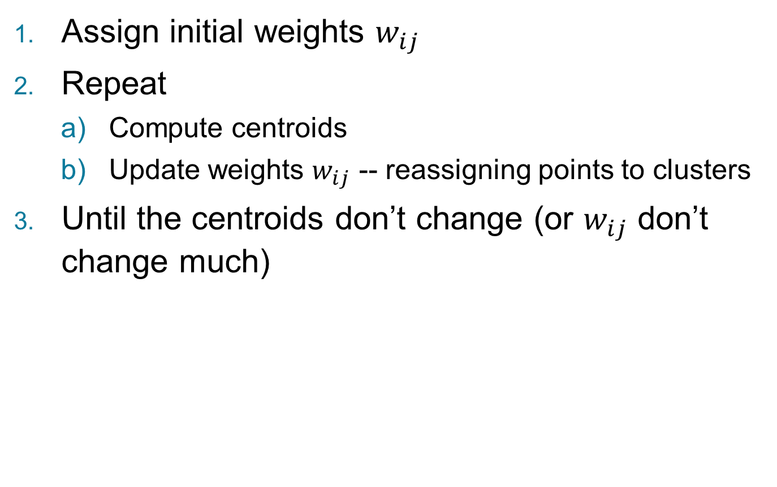
Fuzzy c-means Algorithm (FCM)
Assign initial weights $w_{ij}$
Repeat
  Compute centroids
  Update weights $w_{ij}$ -- reassigning points to clusters
Until the centroids don’t change (or $w_{ij}$ don’t change much)

Slide 5
Initialization of Weights
Random initialization

Slide 6
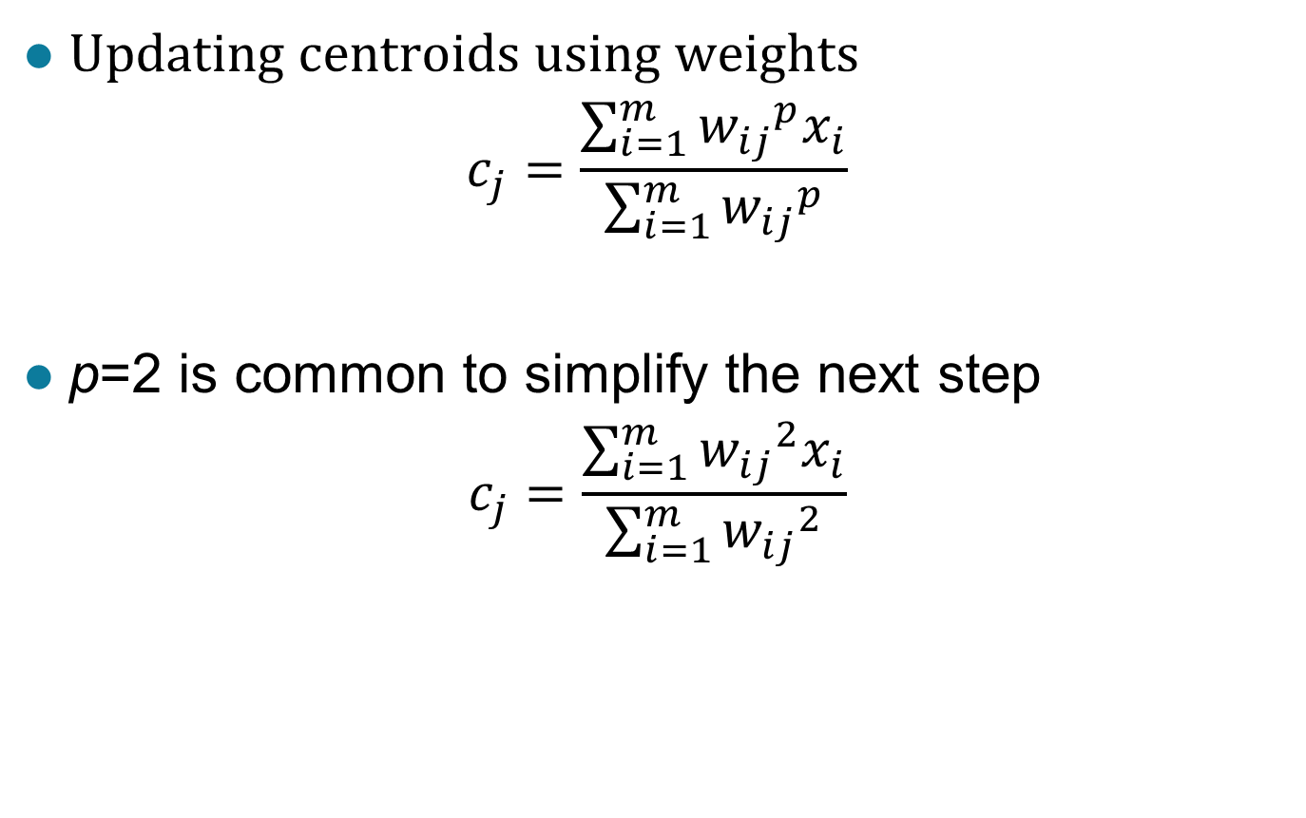
Computing Centroids
Updating centroids using weights
$$c_{j}=\frac{\sum_{i=1}^{m}{{w_{ij}}^{p}x_{i}}}{\sum_{i=1}^{m}{{w_{ij}}^{p}}}$$
p=2 is common to simplify the next step
$$c_{j}=\frac{\sum_{i=1}^{m}{{w_{ij}}^{2}x_{i}}}{\sum_{i=1}^{m}{{w_{ij}}^{2}}}$$

Slide 7
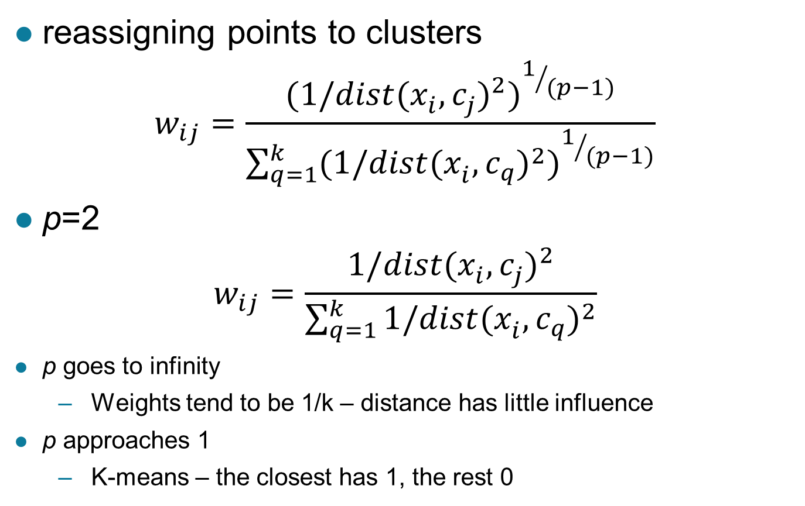
Updating Weights in Clusters
reassigning points to clusters
$$w_{ij}=\frac{{(1/{dist(x_{i}^{},c_{j}^{})}^{2})}^{1/{(p−1)}}}{\sum_{q=1}^{k}{{(1/{dist(x_{i}^{},c_{q}^{})}^{2})}^{1/{(p−1)}}}}$$
p=2
$$w_{ij}=\frac{1/{dist(x_{i}^{},c_{j}^{})}^{2}}{\sum_{q=1}^{k}{1/{dist(x_{i}^{},c_{q}^{})}^{2}}}$$
p goes to infinity
  Weights tend to be 1/k – distance has little influence
p approaches 1
  K-means – the closest has 1, the rest 0

Slide 9
Strengths and Weaknesses
Provides degree of cluster membership
Similar strengths and weaknesses as k-means
More computationally expensive

Slide 10
Prototype-based Clustering
Fuzzy Clustering (9.2.1)
Clustering using Mixture Models (9.2.2)

Slide 11
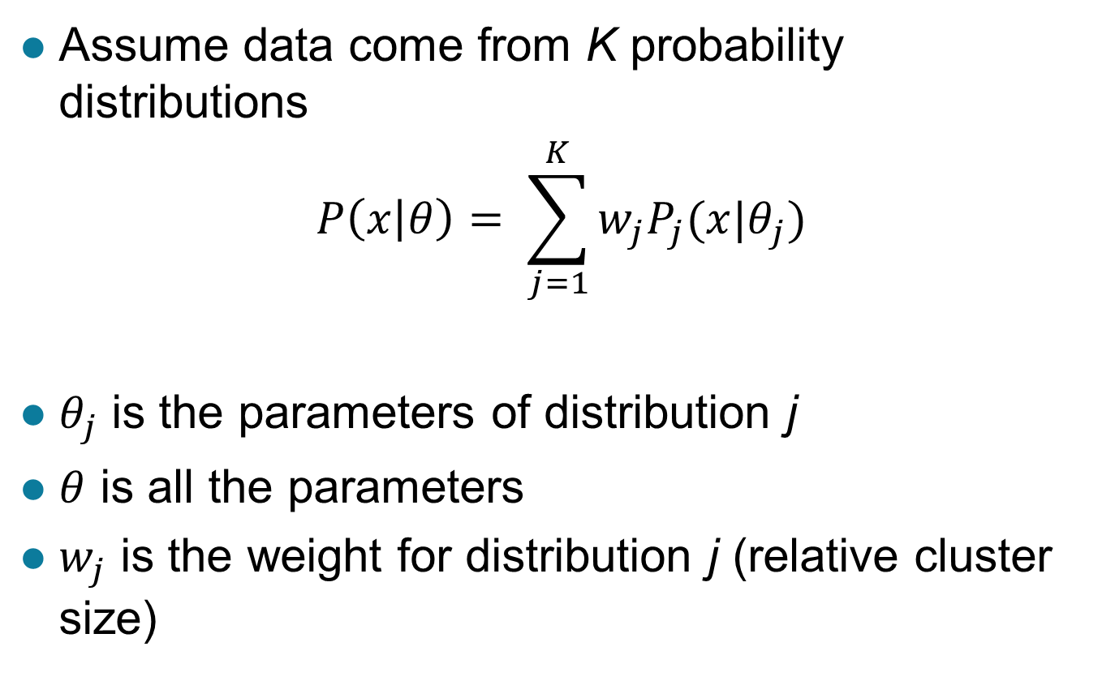
Mixture Models
Assume data come from K probability distributions
$$P\left(x | θ\right)= \sum_{j=1}^{K}{w_{j}P_{j}(x|θ_{j})}$$
$θ_{j}$ is the parameters of distribution j
$θ$ is all the parameters
$w_{j}$ is the weight for distribution j (relative cluster size)

Slide 12
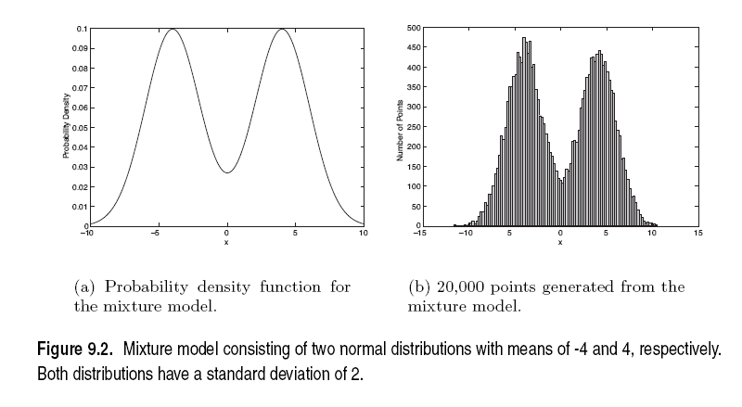

Sample Univariate Gaussian Mixture
$K=2, w_{1}= w_{2}=0.5$
Means = -4 and 4, standard deviation = 2

Slide 13
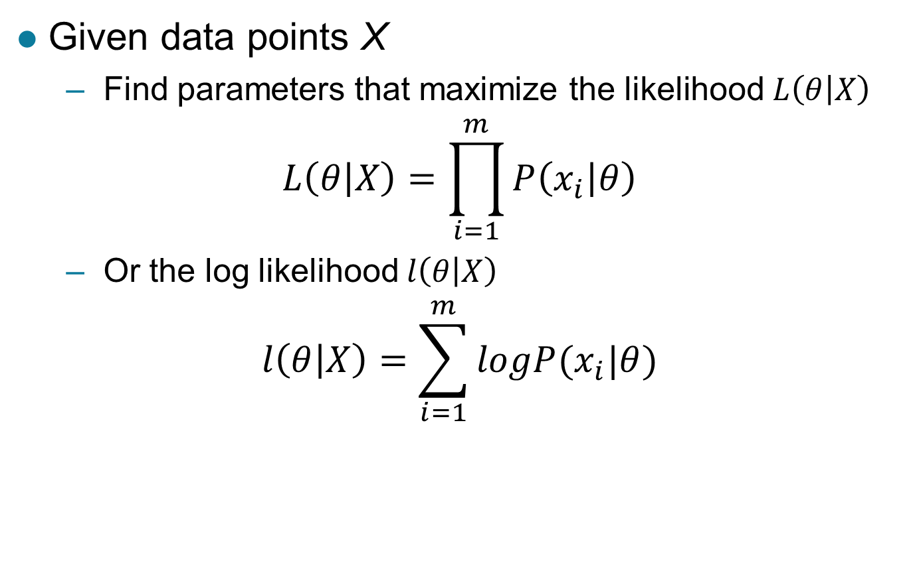
Maximum Likelihood Estimation of Parameters
Given data points X
  Find parameters that maximize the likelihood $L\left(θ | X\right)$
$$L\left(θ | X\right)=\prod_{i=1}^{m}{P\left(x_{i} | θ\right)}$$
  Or the log likelihood $l\left(θ | X\right)$
$$l\left(θ | X\right)=\sum_{i=1}^{m}{logP(x_{i}|θ)}$$

Slide 14
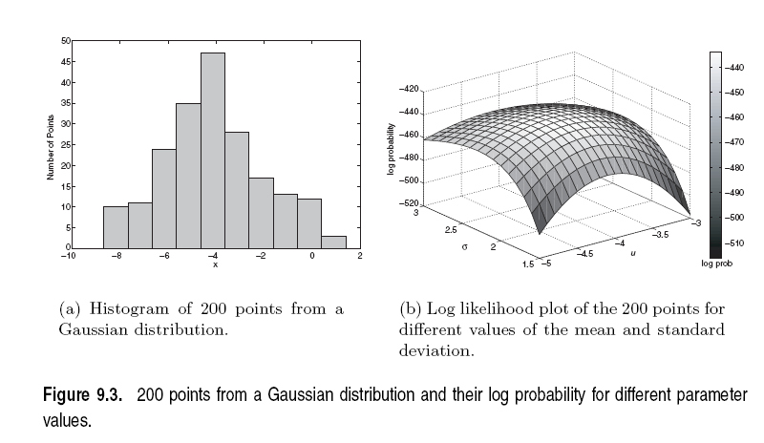
Example with Univariate Gaussian
Generate data with mean = -4, stdev = 2
Plot the log likelihood with different parameters
  Maximizes near -4 and 2

Slide 15

Clustering using Mixture Models
Given data and K (# of clusters)
  find the parameters of the K distributions
    E.g. mean and stdev (or variance) of normal distributions
  probabilistic cluster membership
    $P\left(c_{j} | x_{i},θ\right)$

Slide 16
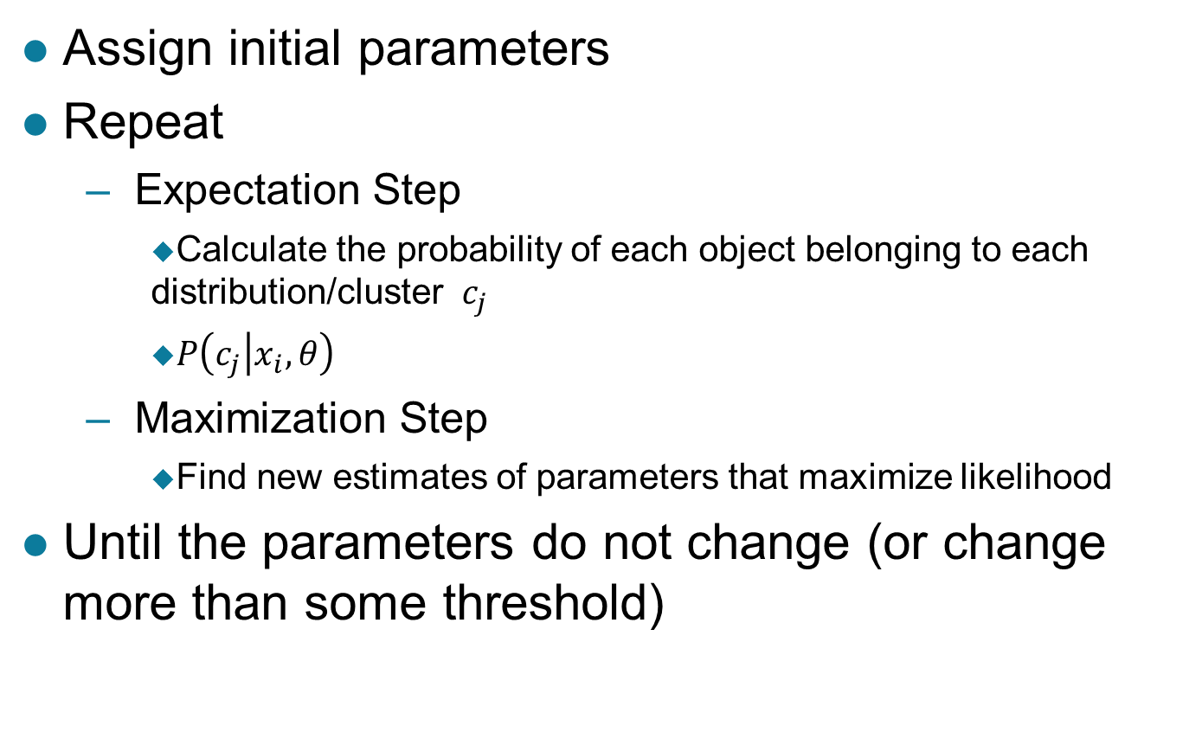
Expectation-Maximization (EM) Alg.
Assign initial parameters
Repeat
  Expectation Step
    Calculate the probability of each object belonging to each distribution/cluster $c_{j}$
    $P\left(c_{j} | x_{i},θ\right)$
  Maximization Step
    Find new estimates of parameters that maximize likelihood
Until the parameters do not change (or change more than some threshold)

Slide 17
EM and K-means
Similar to K-means
  K-means with Euclidean distance
    EM with spherical Gaussians with equal covariance matrices
Expectation Step
  Calculate the probability of object belonging to each cluster
    “Assign objects to clusters”
Maximization Step
  Find new estimates of parameters that maximize likelihood
    “calculate centroids”

Slide 18

Mixture of 2 Univariate Gaussian Dist.
$K=2$
Initialization:$w_{1}=w_{2}=0.5,σ_{1}=σ_{2}=2$
Expectation step:
$P\left(c_{j} | x_{i},θ\right)=\frac{w_{j}∗P(x_{i}|θ_{j})}{w_{1}∗P\left(x_{i} | θ_{1}\right)+w_{2}∗P(x_{i}|θ_{2})}$

Slide 19
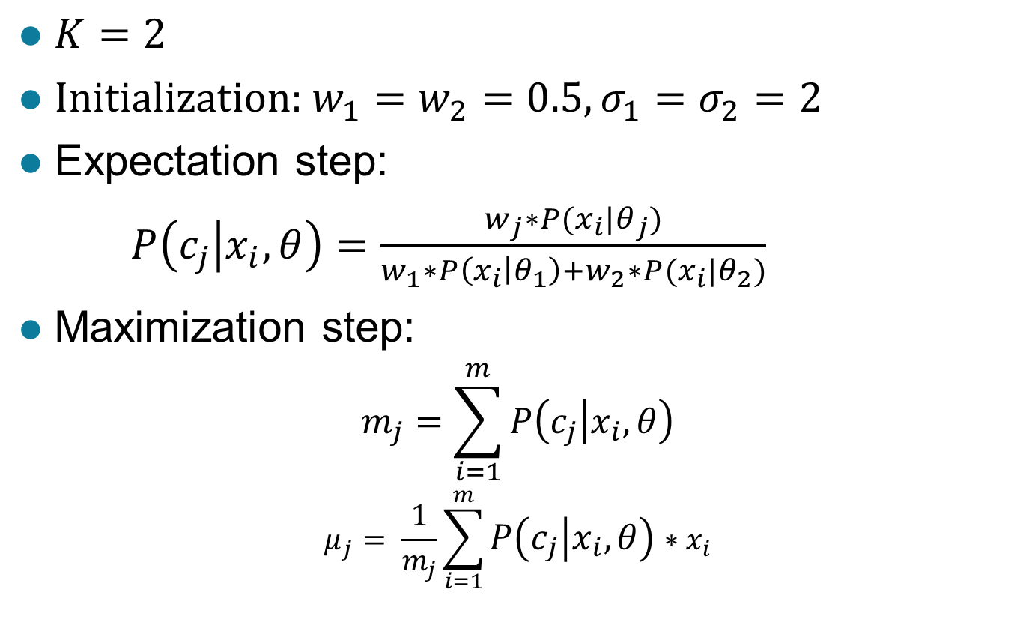
Mixture of 2 Univariate Gaussian Dist.
$K=2$
Initialization:$w_{1}=w_{2}=0.5,σ_{1}=σ_{2}=2$
Expectation step:
$P\left(c_{j} | x_{i},θ\right)=\frac{w_{j}∗P(x_{i}|θ_{j})}{w_{1}∗P\left(x_{i} | θ_{1}\right)+w_{2}∗P(x_{i}|θ_{2})}$
Maximization step:
$$m_{j}=\sum_{i=1}^{m}{P\left(c_{j} | x_{i},θ\right)}$$
$$μ_{j}= \frac{1}{m_{j}}\sum_{i=1}^{m}{P\left(c_{j} | x_{i},θ\right)∗x_{i}}$$

Slide 20
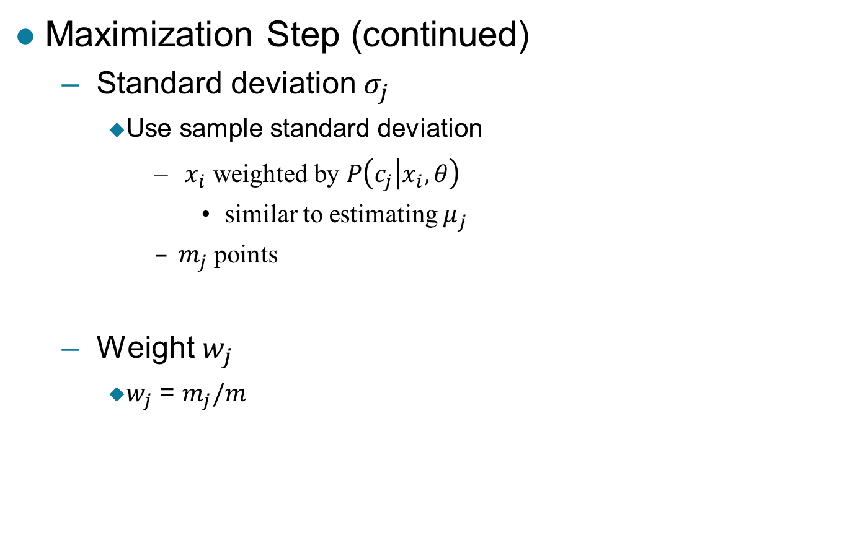
Estimating Other Parameters
Maximization Step (continued)
  Standard deviation $σ_{j}$
    Use sample standard deviation
      $x_{i}$ weighted by $P\left(c_{j} | x_{i},θ\right)$
        similar to estimating $μ_{j}$
      $m_{j}$ points
  Weight $w_{j}$
    $w_{j}$ = $m_{j}/m$

Slide 21
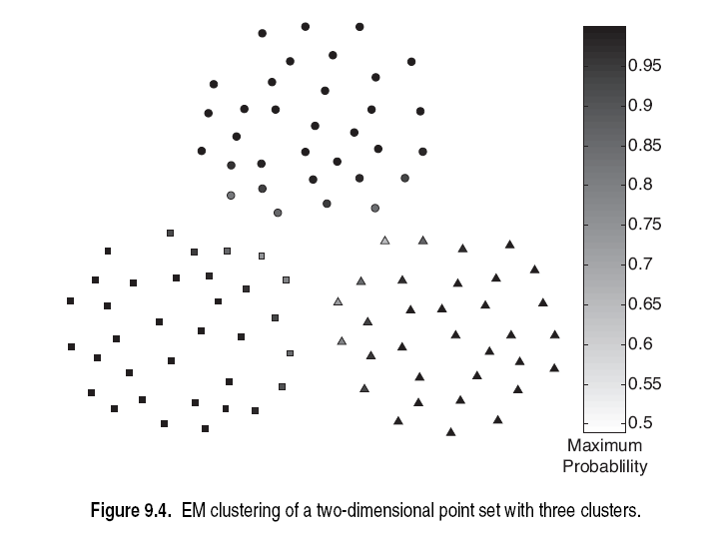

Slide 22
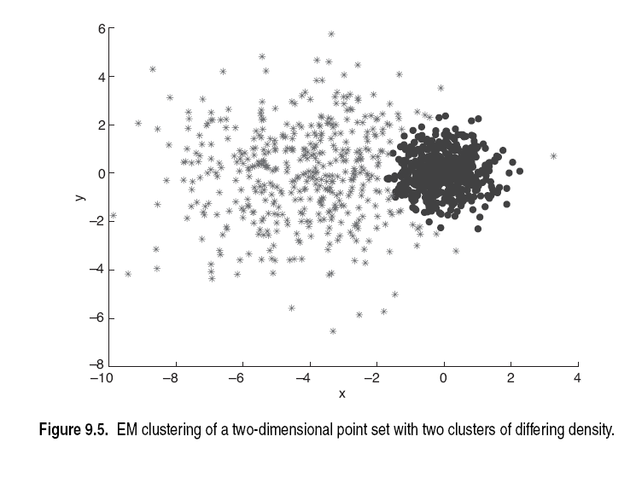

Slide 23
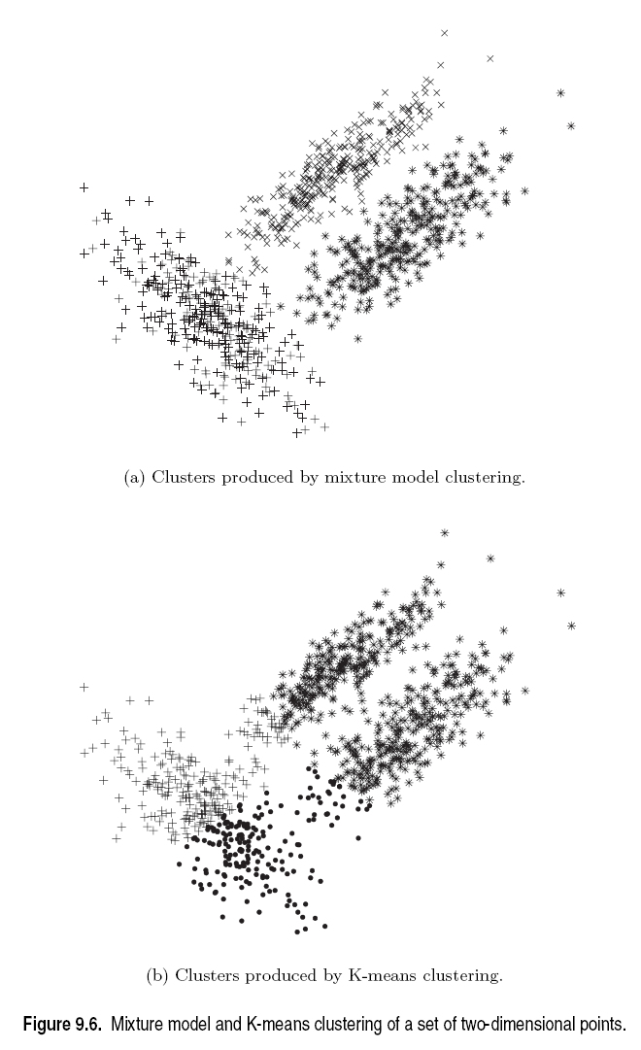

Slide 24
Strengths and Weaknesses
More general than k-means and fuzzy c-means
  Distributions of various types -> sizes and shapes
Easy to characterize models -> parameters
Slow
Cluster with few data points
K
Which probability distribution to use

Slide 26
Hierarchical Clustering: Revisited
Creates nested clusters
Agglomerative clustering algorithms vary in terms of how the proximity of two clusters are computed
    MIN (single link): susceptible to noise/outliers
    MAX/GROUP AVERAGE:
    may not work well with non-globular clusters
  CURE algorithm tries to handle both problems
Often starts with a proximity matrix
  A type of graph-based algorithm

Slide 28
CURE: Another Hierarchical Approach
Uses a number of points to represent a cluster
Representative points are found by selecting a constant number of points from a cluster and then “shrinking” them toward the center of the cluster
Cluster similarity is the similarity of the closest pair of representative points from different clusters
×
×

Slide 29
CURE
Shrinking representative points toward the center helps avoid problems with noise and outliers
CURE is better able to handle clusters of arbitrary shapes and sizes

Slide 30
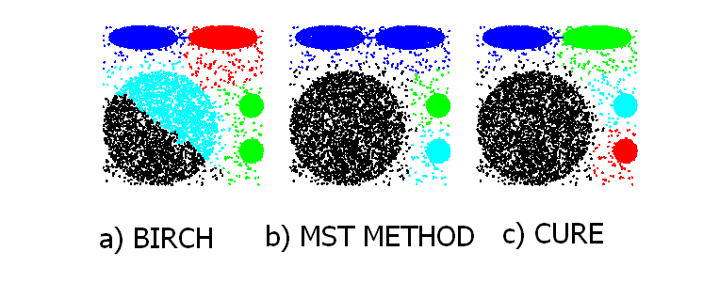
Experimental Results: CURE
Picture from CURE, Guha, Rastogi, Shim.

Slide 31
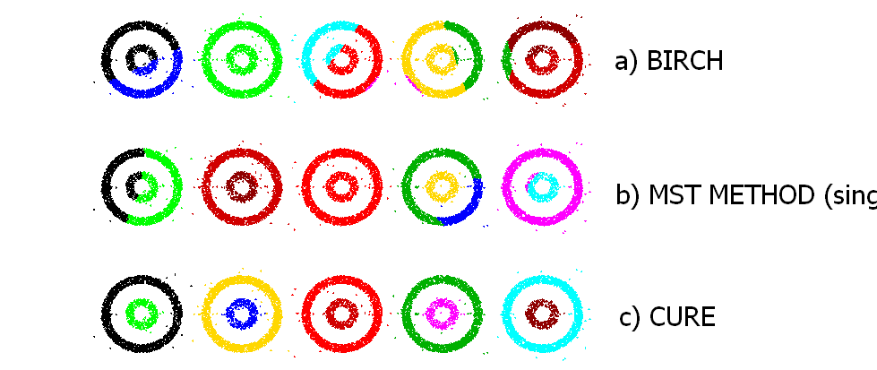
Experimental Results: CURE
(centroid)
(single link)
Picture from CURE, Guha, Rastogi, Shim.

Slide 32
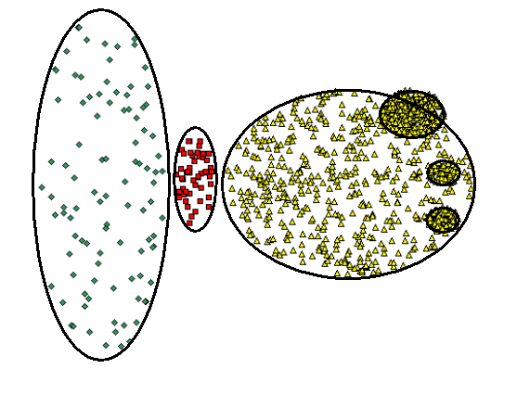
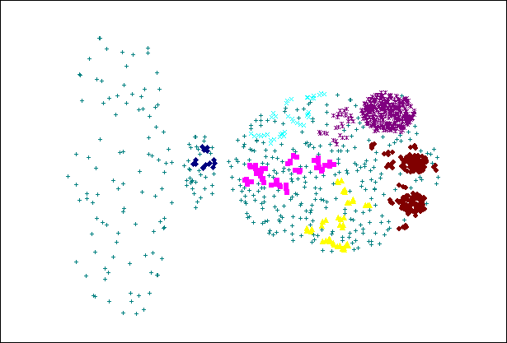
CURE Cannot Handle Differing Densities
Original Points
CURE

Slide 33
Graph-Based Clustering
Graph-Based clustering uses the proximity graph
  Start with the proximity matrix
  Consider each point as a node in a graph
  Each edge between two nodes has a weight which is the proximity between the two points
  Initially the proximity graph is fully connected
  MIN (single-link) and MAX (complete-link) can be viewed as starting with this graph
In the simplest case, clusters are connected components in the graph.

Slide 34
Graph-Based Clustering: Sparsification
The amount of data that needs to be processed is drastically reduced
  Sparsification can eliminate more than 99% of the entries in a proximity matrix
  The amount of time required to cluster the data is drastically reduced
  The size of the problems that can be handled is increased

Slide 35
Graph-Based Clustering: Sparsification …
Clustering may work better
  Sparsification techniques keep the connections to the most similar (nearest) neighbors of a point while breaking the connections to less similar points.
  The nearest neighbors of a point tend to belong to the same class as the point itself.
  This reduces the impact of noise and outliers and sharpens the distinction between clusters.
Sparsification facilitates the use of graph partitioning algorithms (or algorithms based on graph partitioning algorithms.
  Chameleon and Hypergraph-based Clustering

Slide 36
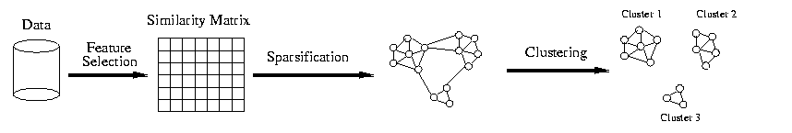
Sparsification in the Clustering Process

Slide 37
Limitations of Current Merging Schemes
Existing merging schemes in hierarchical clustering algorithms are static in nature
  MIN or CURE:
    merge two clusters based on their closeness (or minimum distance)
  GROUP-AVERAGE:
    merge two clusters based on their average connectivity

Slide 38
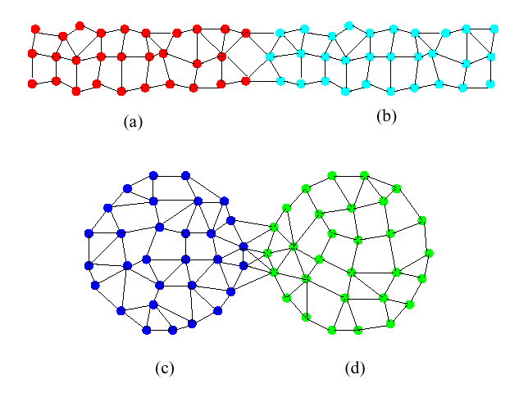
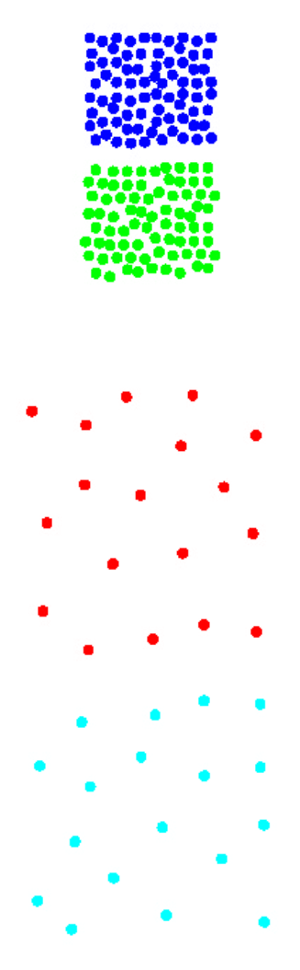
Limitations of Current Merging Schemes
(a)
(b)
(c)
(d)
Closeness schemes will merge (a) and (b)
Average connectivity schemes will merge (c) and (d)

Slide 39
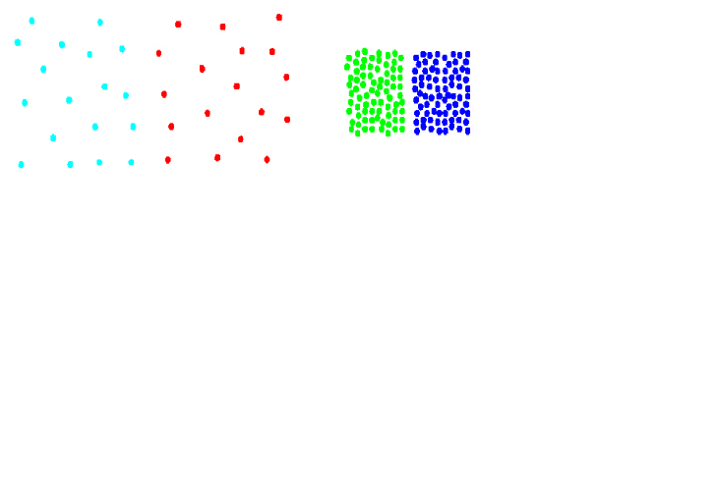
Chameleon: Clustering Using Dynamic Modeling
Adapt to the characteristics of the data set to find the natural clusters
Use a dynamic model to measure the similarity between clusters
  Main property is the relative closeness and relative inter-connectivity of the cluster
  Two clusters are combined if the resulting cluster shares certain properties with the constituent clusters
  The merging scheme preserves self-similarity
One of the areas of application is spatial data

Slide 40
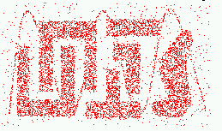
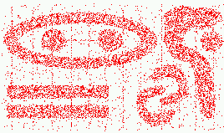
Characteristics of Spatial Data Sets
  Clusters are defined as densely populated regions of the space
  Clusters have arbitrary shapes, orientation, and non-uniform sizes
  Difference in densities across clusters and variation in density within clusters
  Existence of special artifacts (streaks) and noise
The clustering algorithm must address the above characteristics and also require minimal supervision.

Slide 41
Chameleon: Steps
Preprocessing Step:
Represent the Data by a Graph
  Given a set of points, construct the k-nearest-neighbor (k-NN) graph to capture the relationship between a point and its k nearest neighbors
  Concept of neighborhood is captured dynamically (even if region is sparse)
Phase 1: Use a multilevel graph partitioning algorithm on the graph to find a large number of clusters of well-connected vertices
  Each cluster should contain mostly points from one “true” cluster, i.e., is a sub-cluster of a “real” cluster

Slide 42
Chameleon: Steps …
Phase 2: Use Hierarchical Agglomerative Clustering to merge sub-clusters
  Two clusters are combined if the resulting cluster shares certain properties with the constituent clusters
  Two key properties used to model cluster similarity:
    Relative Interconnectivity: Absolute interconnectivity of two clusters normalized by the internal connectivity of the clusters
    Relative Closeness: Absolute closeness of two clusters normalized by the internal closeness of the clusters

Slide 43
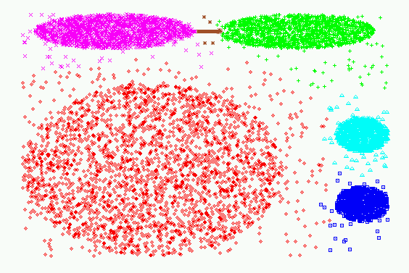
Experimental Results: CHAMELEON

Slide 44
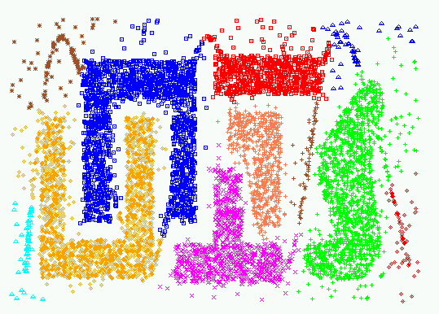
Experimental Results: CHAMELEON

Slide 45
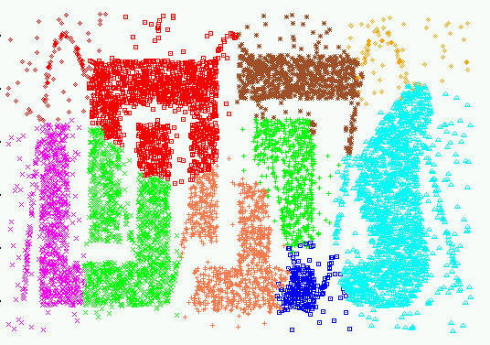
Experimental Results: CURE (10 clusters)

Slide 46
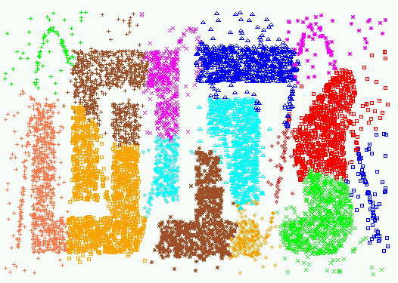
Experimental Results: CURE (15 clusters)

Slide 47
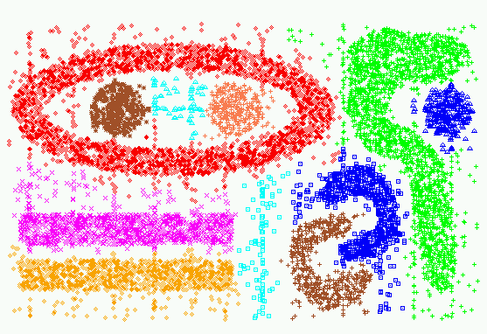
Experimental Results: CHAMELEON

Slide 48
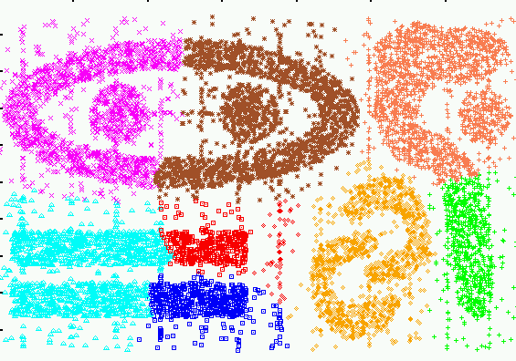
Experimental Results: CURE (9 clusters)

Slide 49
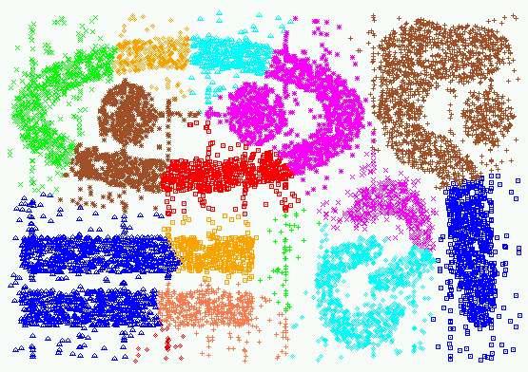
Experimental Results: CURE (15 clusters)

Slide 50
Shared Near Neighbor Approach
SNN graph: the weight of an edge is the number of shared neighbors between vertices given that the vertices are connected
i
j
i
j
4

Slide 51
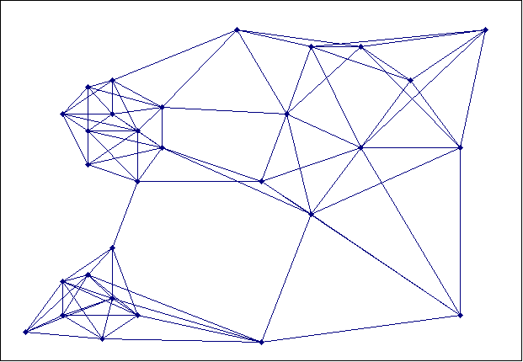
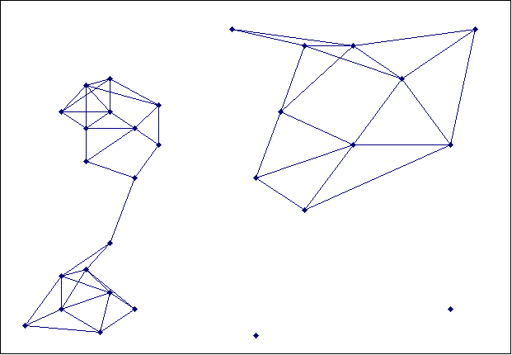
Creating the SNN Graph
Sparse Graph
Link weights are similarities between neighboring points
Shared Near Neighbor Graph
Link weights are number of Shared Nearest Neighbors

Slide 52
ROCK (RObust Clustering using linKs)
Clustering algorithm for data with categorical and Boolean attributes
  A pair of points is defined to be neighbors if their similarity is greater than some threshold
  Use a hierarchical clustering scheme to cluster the data.
Obtain a sample of points from the data set
Compute the link value for each set of points, i.e., transform the original similarities (computed by Jaccard coefficient) into similarities that reflect the number of shared neighbors between points
Perform an agglomerative hierarchical clustering on the data using the “number of shared neighbors” as similarity measure and maximizing “the shared neighbors” objective function
Assign the remaining points to the clusters that have been found

Slide 53
Jarvis-Patrick Clustering
First, the k-nearest neighbors of all points are found
  In graph terms this can be regarded as breaking all but the k strongest links from a point to other points in the proximity graph
A pair of points is put in the same cluster if
  any two points share more than T neighbors and
  the two points are in each others k nearest neighbor list
For instance, we might choose a nearest neighbor list of size 20 and put points in the same cluster if they share more than 10 near neighbors
Jarvis-Patrick clustering is too brittle

Slide 54
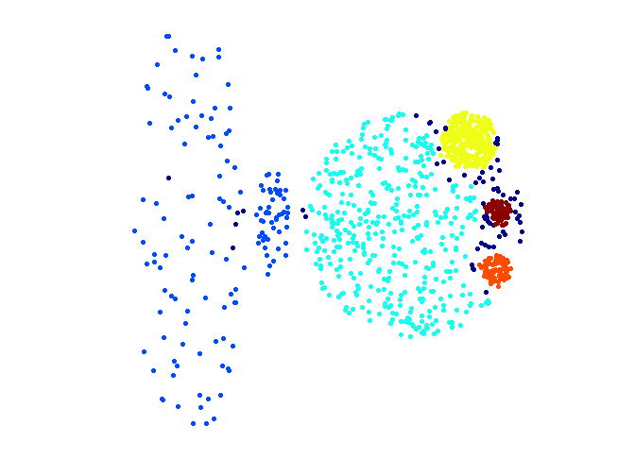
When Jarvis-Patrick Works Reasonably Well
Original Points
Jarvis Patrick Clustering
6 shared neighbors out of 20

Slide 55
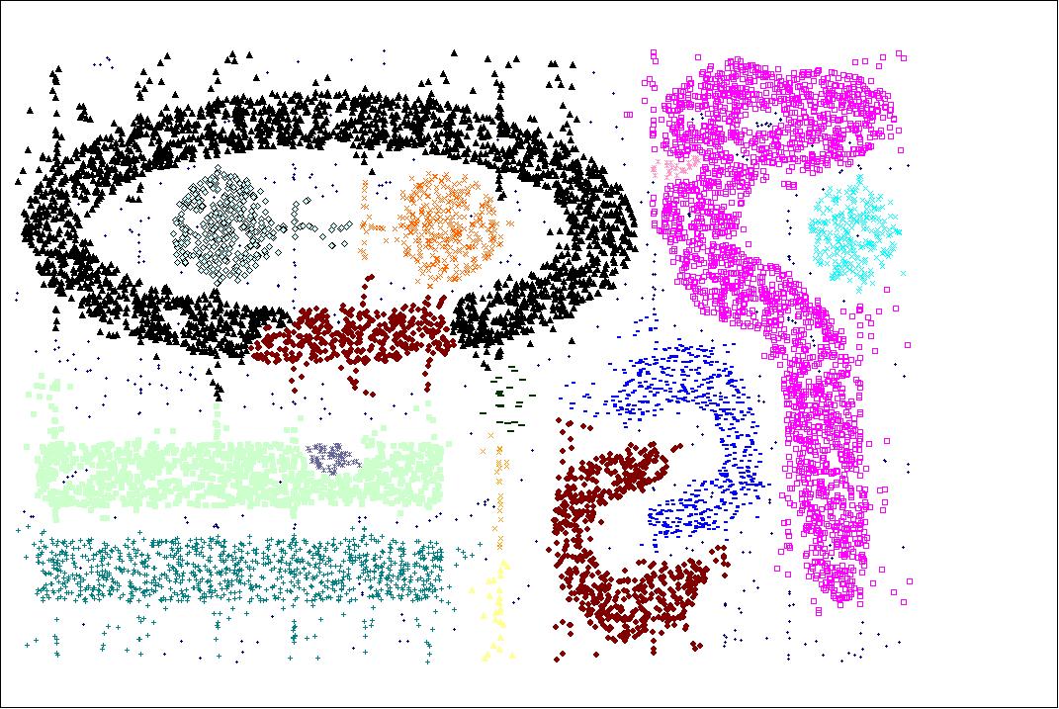
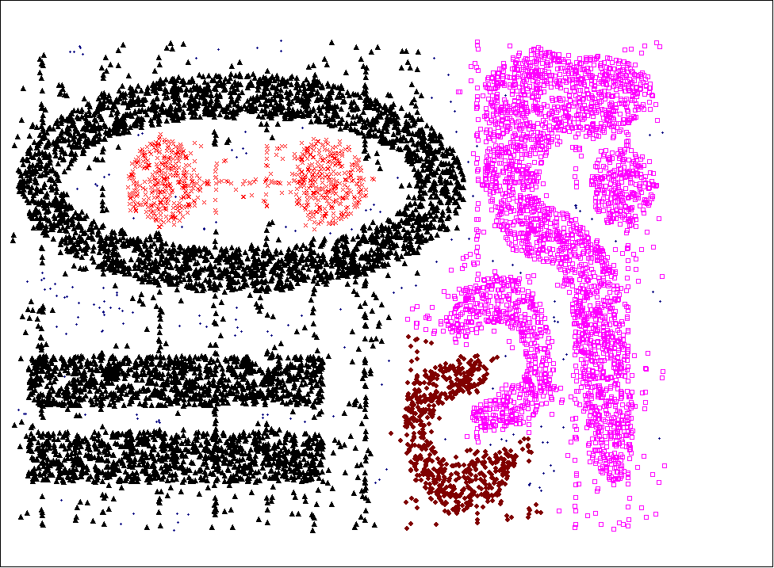
When Jarvis-Patrick Does NOT Work Well
Smallest threshold, T, that does not merge clusters.
Threshold of T - 1

Slide 56
SNN Clustering Algorithm
Compute the similarity matrix
This corresponds to a similarity graph with data points for nodes and edges whose weights are the similarities between data points
Sparsify the similarity matrix by keeping only the k most similar neighbors
This corresponds to only keeping the k strongest links of the similarity graph
Construct the shared nearest neighbor graph from the sparsified similarity matrix.
At this point, we could apply a similarity threshold and find the connected components to obtain the clusters (Jarvis-Patrick algorithm)
Find the SNN density of each Point.
Using a user specified parameters, Eps, find the number points that have an SNN similarity of Eps or greater to each point. This is the SNN density of the point

Slide 57
SNN Clustering Algorithm …
Find the core points
Using a user specified parameter, MinPts, find the core points, i.e., all points that have an SNN density greater than MinPts
Form clusters from the core points
If two core points are within a radius, Eps, of each other they are place in the same cluster
Discard all noise points
All non-core points that are not within a radius of Eps of a core point are discarded
Assign all non-noise, non-core points to clusters
This can be done by assigning such points to the nearest core point
(Note that steps 4-8 are DBSCAN)

Slide 58
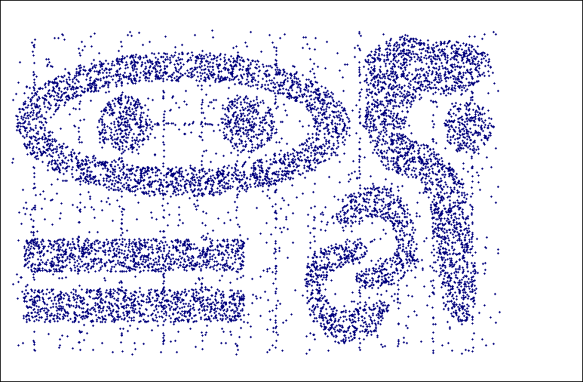
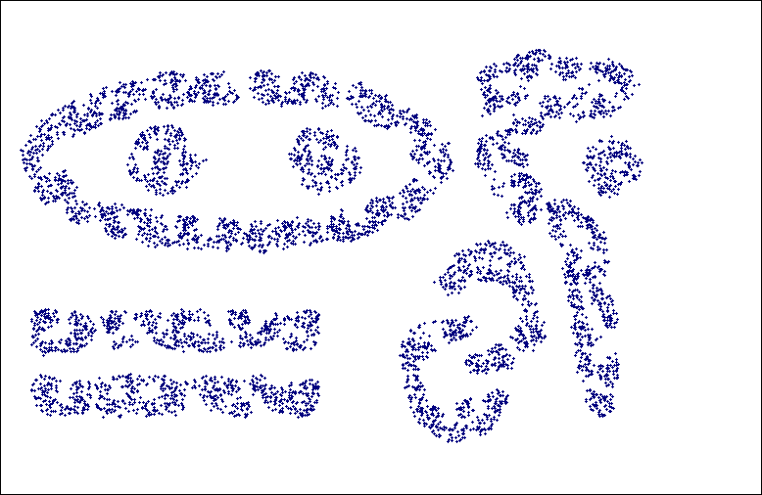
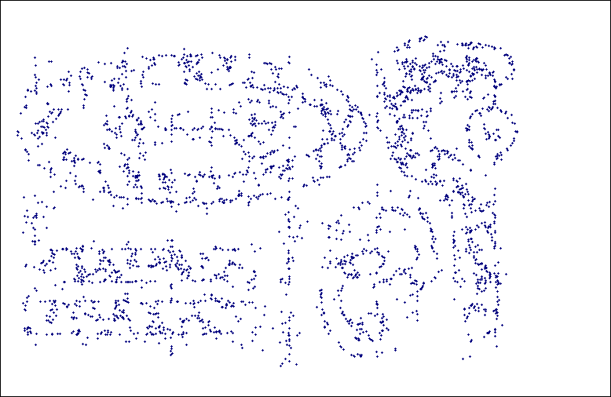
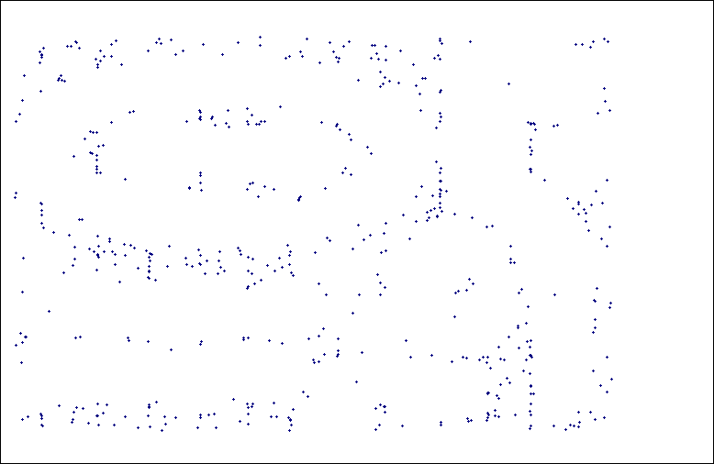
SNN Density
a) All Points b) High SNN Density
c) Medium SNN Density d) Low SNN Density

Slide 59
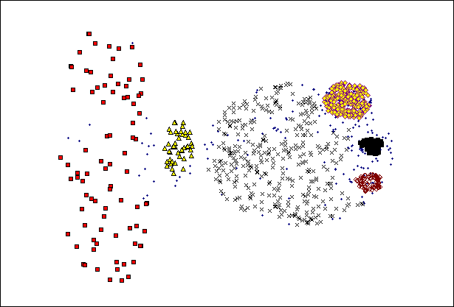
SNN Clustering Can Handle Differing Densities
Original Points
SNN Clustering

Slide 60
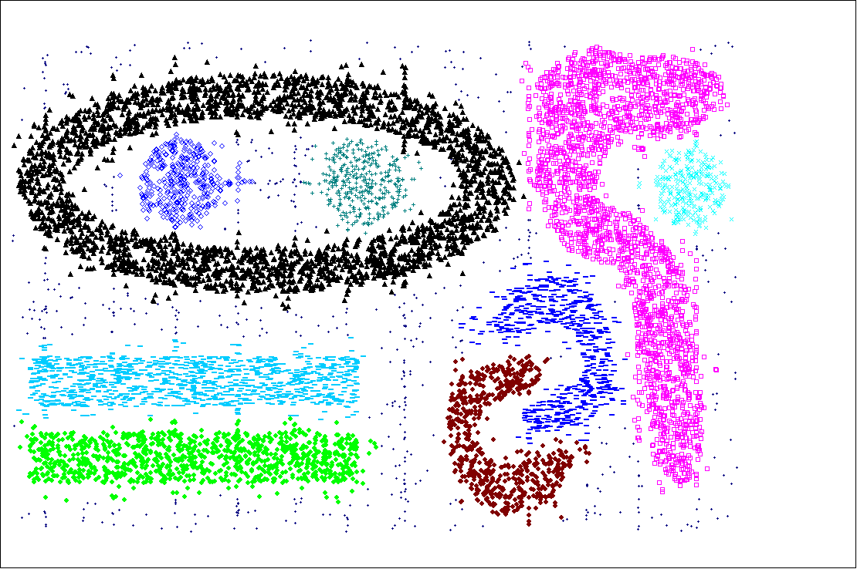
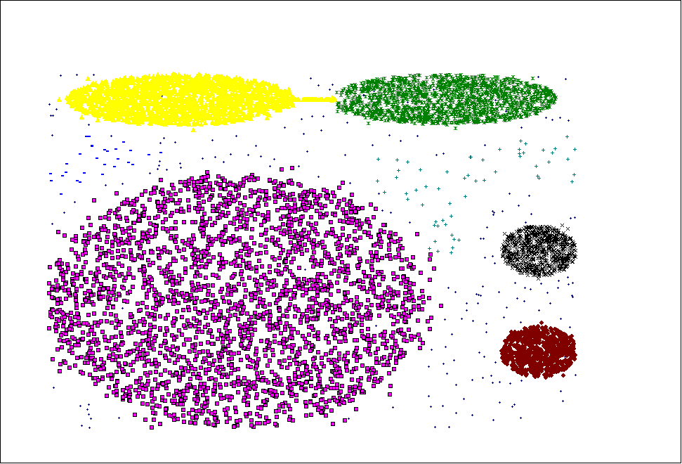
SNN Clustering Can Handle Other Difficult Situations

Slide 61
Finding Clusters of Time Series In Spatio-Temporal Data
SNN Clusters of SLP.
SNN Density of Points on the Globe.

Slide 62
Features and Limitations of SNN Clustering
Does not cluster all the points
Complexity of SNN Clustering is high
  O( n * time to find numbers of neighbor within Eps)
  In worst case, this is O(n²)
  For lower dimensions, there are more efficient ways to find the nearest neighbors
    R* Tree
    k-d Trees

