Slide 1



Presentation for use with the textbook Data Structures and Algorithms in Java, 6th edition, by M. T. Goodrich, R. Tamassia, and M. H. Goldwasser, Wiley, 2014
Analysis of Algorithms
Input
Algorithm
Output
© 2014 Goodrich, Tamassia, Goldwasser
Analysis of Algorithms
1

Slide 2
Running Time
Most algorithms transform input objects into output objects.
The running time of an algorithm typically grows with the input size.
Average case time is often difficult to determine.
We focus on the worst case running time.
  Easier to analyze
  Crucial to applications such as games, finance and robotics
© 2014 Goodrich, Tamassia, Goldwasser
Analysis of Algorithms
2

Slide 3
Imagine 2 lines at a store
Line A
  The maximum wait is 30 minutes
Line B
  The minimum wait is 30 seconds
© 2014 Goodrich, Tamassia, Goldwasser
Analysis of Algorithms
3

Slide 4
Imagine 2 lines at a store
Line A
  The maximum wait is 30 minutes
    Worst-case scenario
Line B
  The minimum wait is 30 seconds
    Best-case scenario
© 2014 Goodrich, Tamassia, Goldwasser
Analysis of Algorithms
4

Slide 5
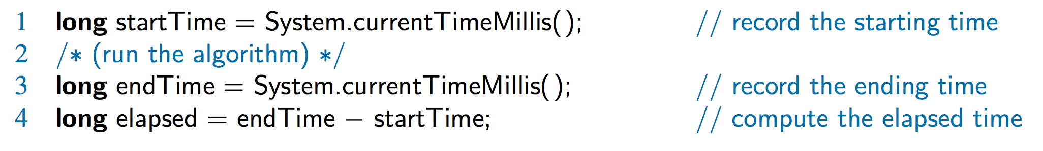
Experimental
Studies
Write a program implementing the algorithm
Run the program with inputs of varying size and composition, noting the time needed:
Plot the results
© 2014 Goodrich, Tamassia, Goldwasser
Analysis of Algorithms
5

Slide 6

Limitations of Experiments
implement the algorithm, which may be difficult
results may not be indicative of the running time on other inputs not included in the experiment.
compare two algorithms--same hardware and software environments must be used
© 2014 Goodrich, Tamassia, Goldwasser
Analysis of Algorithms
6

Slide 7
Theoretical Analysis
Uses a high-level description of the algorithm instead of an implementation
Characterizes running time as a function of the input size, n
Takes into account all possible inputs
independent of the hardware/software environment
© 2014 Goodrich, Tamassia, Goldwasser
Analysis of Algorithms
7

Slide 8
Pseudocode
High-level description of an algorithm
More structured than English prose
Less detailed than a program
Preferred notation for describing algorithms
Hides program design issues
© 2014 Goodrich, Tamassia, Goldwasser
Analysis of Algorithms
8

Slide 9
Pseudocode Details
Control flow
  if … then … [else …]
  while … do …
  repeat … until …
  for … do …
  Indentation replaces braces
Method declaration
Algorithm method (arg [, arg…])
Input …
Output …
Method call
method (arg [, arg…])
Return value
return expression
Expressions:
  Assignment
  Equality testing
n² Superscripts and other mathematical formatting allowed
© 2014 Goodrich, Tamassia, Goldwasser
Analysis of Algorithms
9

Slide 10
The Random Access Machine (RAM) Model
A RAM consists of
A CPU
An potentially unbounded bank of memory cells, each of which can hold an arbitrary number or character
Memory cells are numbered and accessing any cell in memory takes unit time
2
1
0
© 2014 Goodrich, Tamassia, Goldwasser
Analysis of Algorithms
10

Slide 11
Seven Important Functions (Time complexity classes)
Seven functions that often appear in algorithm analysis:
  Constant ≈ 1
  Logarithmic ≈ log n
  Linear ≈ n
  N-Log-N ≈ n log n
  Quadratic ≈ n²
  Cubic ≈ n³
  Exponential ≈ 2^{n}
In a log-log chart, the slope of the line corresponds to the growth rate
© 2014 Goodrich, Tamassia, Goldwasser
Analysis of Algorithms
11
Notes:
11

Slide 12
Log-log chart/plot
y = xª
log y = a log x
Slope is a
© 2014 Goodrich, Tamassia, Goldwasser
Analysis of Algorithms
12

Slide 13
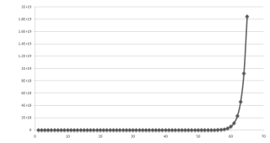
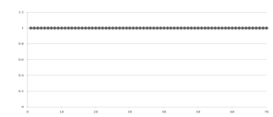
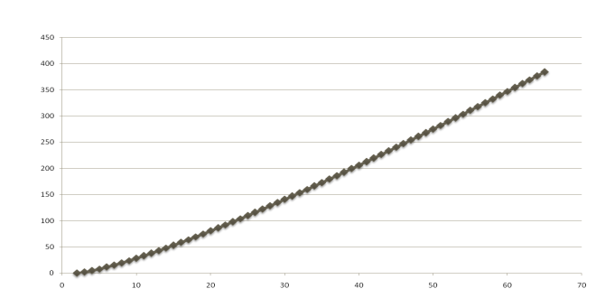
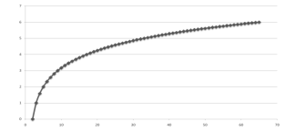
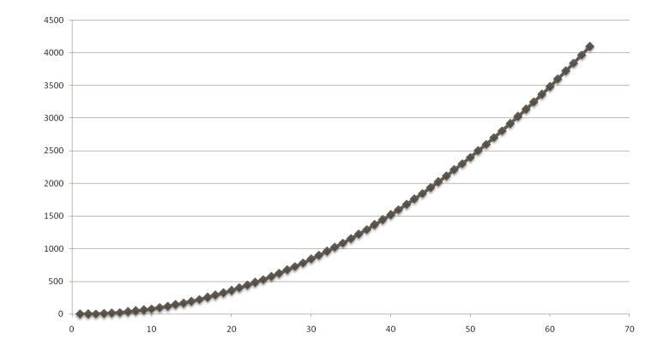
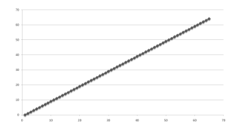
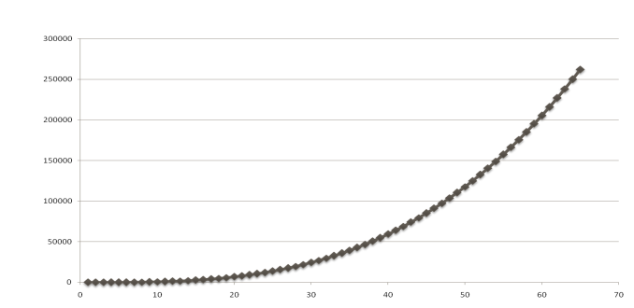
Slide by Matt Stallmann included with permission.
Functions Graphed
Using “Normal” Scale
g(n) = n lg n
g(n) = 1
g(n) = 2^{n}
g(n) = n²
g(n) = lg n
g(n) = n
g(n) = n³
© 2014 Goodrich, Tamassia, Goldwasser
Analysis of Algorithms
13

Slide 14
Primitive Operations
Basic computations performed by an algorithm
Identifiable in pseudocode
Largely independent from the programming language
Exact definition not important (we will see why later)
Assumed to take a constant amount of time in the RAM model
Examples:
  Evaluating an expression
  Assigning a value to a variable
  Indexing into an array
  Calling a method
  Returning from a method
© 2014 Goodrich, Tamassia, Goldwasser
Analysis of Algorithms
14

Slide 15
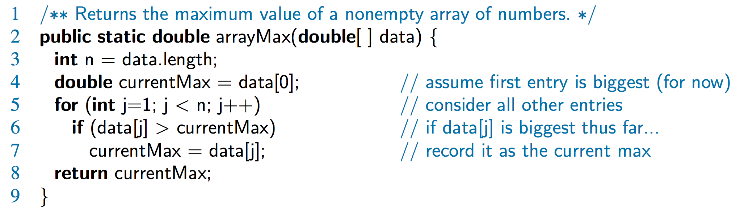
Counting Primitive Operations
determine the maximum number of primitive operations executed by an algorithm, as a function of the input size
Line 3: 2 ops, 4: 2 ops, 5: 2n ops,
6: 2n ops, 7: 0 to n ops, 8: 1 op
© 2014 Goodrich, Tamassia, Goldwasser
Analysis of Algorithms
15

Slide 16
Estimating Running Time
Algorithm arrayMax executes 5n + 5 primitive operations in the worst case, 4n + 5 in the best case. Define:
a = Time taken by the fastest primitive operation
b = Time taken by the slowest primitive operation
Let T(n) be running time of arrayMax. Then
a (4n + 5) ≤ T(n) ≤ b(5n + 5)
Hence, the running time T(n) is bounded by two linear functions
© 2014 Goodrich, Tamassia, Goldwasser
Analysis of Algorithms
16

Slide 17
Growth Rate of Running Time
Changing the hardware/ software environment
  Affects T(n) by a constant factor, but
  Does not alter the growth rate of T(n)
The linear growth rate of the running time T(n) is an intrinsic property of algorithm arrayMax
© 2014 Goodrich, Tamassia, Goldwasser
Analysis of Algorithms
17

Slide 18
Slide by Matt Stallmann included with permission.
Why Growth Rate Matters
if runtime is... | time for n + 1 | time for 2 n | time for 4 n
c lg n | c lg (n + 1) | c (lg n + 1) | c(lg n + 2)
c n | c (n + 1) | 2c n | 4c n
c n lg n | ~ c n lg n + c n | 2c n lg n + 2cn | 4c n lg n + 4cn
c n² | ~ c n² + 2c n | 4c n² | 16c n²
c n³ | ~ c n³ + 3c n² | 8c n³ | 64c n³
c 2^{n} | c 2 ^{n+1} | c 2 ^{2n} | c 2 ^{4n}
runtime
quadruples
when problem
size doubles
© 2014 Goodrich, Tamassia, Goldwasser
Analysis of Algorithms
18

Slide 19
Counting Key Operations
Comparison: line 6
Input size: n
How many comparisons?
© 2014 Goodrich, Tamassia, Goldwasser
Analysis of Algorithms
19

Slide 20
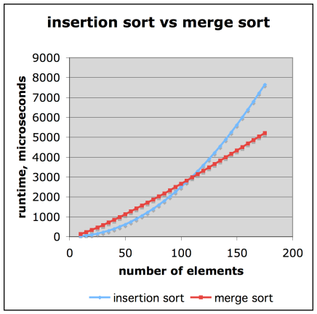
Slide by Matt Stallmann included with permission.
Comparison of Two Algorithms
insertion sort is
n² / 4
merge sort is
2 n lg n
sort a million items?
insertion sort takes
roughly 70 hours
while
merge sort takes
roughly 40 seconds
This is a slow machine, but if
100 x as fast then it’s 40 minutes
versus less than 0.5 seconds
© 2014 Goodrich, Tamassia, Goldwasser
Analysis of Algorithms
20

Slide 21
Constant Factors
The growth rate is not affected by
  constant factors or
  lower-order terms
Examples
  10²n + 10⁵ is a linear function
  10⁵n² + 10⁸n is a quadratic function
© 2014 Goodrich, Tamassia, Goldwasser
Analysis of Algorithms
21

Slide 22
Big-Oh Notation
Given functions f(n) and g(n), we say that f(n) is O(g(n)) if there are positive constants
c and n₀ such that
f(n) ≤ cg(n) for n ≥ n₀
© 2014 Goodrich, Tamassia, Goldwasser
Analysis of Algorithms
22

Slide 23
Big-Oh Notation
Given functions f(n) and g(n), we say that f(n) is O(g(n)) if there are positive constants
c and n₀ such that
f(n) ≤ cg(n) for n ≥ n₀
Example: 2n + 10 is O(n)
  2n + 10 ≤ cn
  10 ≤ cn - 2n
  10/(c − 2) ≤ n
  10≤ n (if c is 3)
  Pick c = 3 and n₀ = 10
© 2014 Goodrich, Tamassia, Goldwasser
Analysis of Algorithms
23

Slide 24
Big-Oh Notation
Given functions f(n) and g(n), we say that f(n) is O(g(n)) if there are positive constants
c and n₀ such that
f(n) ≤ cg(n) for n ≥ n₀
Example: 2n + 10 is O(n)
  2n + 10 ≤ cn
  10 ≤ cn - 2n
  10/(c − 2) ≤ n
  10≤ n (if c is 3)
  Pick c = 3 and n₀ = 10
What is the significance of c and n₀?
© 2014 Goodrich, Tamassia, Goldwasser
Analysis of Algorithms
24

Slide 25
Big-Oh Example
Example: the function n² is not O(n)
  n² ≤ cn
  n ≤ c
  The above inequality cannot be satisfied since c must be a constant
© 2014 Goodrich, Tamassia, Goldwasser
Analysis of Algorithms
25

Slide 26
More Big-Oh Examples
7n - 2
7n-2 is O(n)
need c > 0 and n₀ ≥ 1 such that 7 n - 2 ≤ c n for n ≥ n₀
this is true for c = 7 and n₀ = 1
© 2014 Goodrich, Tamassia, Goldwasser
Analysis of Algorithms
26

Slide 27
More Big-Oh Examples
7n - 2
7n-2 is O(n)
need c > 0 and n₀ ≥ 1 such that 7 n - 2 ≤ c n for n ≥ n₀
this is true for c = 7 and n₀ = 1
3 n³ + 20 n² + 5
3 n³ + 20 n² + 5 is O(n³)
need c > 0 and n₀ ≥ 1 such that 3 n³ + 20 n² + 5 ≤ c n³ for n ≥ n₀
this is true for c = 4 and n₀ = 21
© 2014 Goodrich, Tamassia, Goldwasser
Analysis of Algorithms
27

Slide 28
More Big-Oh Examples
7n - 2
7n-2 is O(n)
need c > 0 and n₀ ≥ 1 such that 7 n - 2 ≤ c n for n ≥ n₀
this is true for c = 7 and n₀ = 1
3 n³ + 20 n² + 5
3 n³ + 20 n² + 5 is O(n³)
need c > 0 and n₀ ≥ 1 such that 3 n³ + 20 n² + 5 ≤ c n³ for n ≥ n₀
this is true for c = 4 and n₀ = 21
3 log n + 5
3 log n + 5 is O(log n)
need c > 0 and n₀ ≥ 1 such that 3 log n + 5 ≤ c log n for n ≥ n₀
this is true for c = 8 and n₀ = 2
© 2014 Goodrich, Tamassia, Goldwasser
Analysis of Algorithms
28

Slide 29
Big-Oh and Growth Rate
The big-Oh notation gives an upper bound on the growth rate of a function
The statement “f(n) is O(g(n))” means that the growth rate of f(n) is no more than the growth rate of g(n)
We can use the big-Oh notation to rank functions according to their growth rate
 | f(n) is O(g(n))
g(n) grows more | Yes
f(n) grows more | No
Same growth | Yes
© 2014 Goodrich, Tamassia, Goldwasser
Analysis of Algorithms
29

Slide 30
Big-Oh Rules (short cut)
If is f(n) a polynomial of degree d, then f(n) is O(n^{d}), i.e.,
  Drop lower-order terms
  Drop constant factors
© 2014 Goodrich, Tamassia, Goldwasser
Analysis of Algorithms
30

Slide 31
Big-Oh Rules (short cut)
If is f(n) a polynomial of degree d, then f(n) is O(n^{d}), i.e.,
  Drop lower-order terms
  Drop constant factors
Use the smallest possible class of functions
  Say “2n is O(n)” instead of “2n is O(n²)”
    tighter upper bound
© 2014 Goodrich, Tamassia, Goldwasser
Analysis of Algorithms
31

Slide 32
Big-Oh Rules (short cut)
If is f(n) a polynomial of degree d, then f(n) is O(n^{d}), i.e.,
  Drop lower-order terms
  Drop constant factors
Use the smallest possible class of functions
  Say “2n is O(n)” instead of “2n is O(n²)”
    tighter upper bound
Use the simplest expression of the class
  Say “3n + 5 is O(n)” instead of “3n + 5 is O(3n)”
© 2014 Goodrich, Tamassia, Goldwasser
Analysis of Algorithms
32

Slide 33
Asymptotic Algorithm Analysis
The asymptotic analysis of an algorithm determines the running time in big-Oh notation
To perform the asymptotic analysis
  We find the worst-case number of key operations executed as a function of the input size
  We express this function with big-Oh notation
Example:
  We say that algorithm arrayMax “runs in O(n) time”
Since constant factors and lower-order terms are eventually dropped anyhow, we can disregard them when counting key operations
© 2014 Goodrich, Tamassia, Goldwasser
Analysis of Algorithms
33
Notes:
33

Slide 34
Computing Prefix Averages
two algorithms for prefix averages
The i-th prefix average of an array X is
  average of the first (i + 1) elements of X:
A[i] = (X[0] + X[1] + … + X[i])/(i+1)
Computing the array A of prefix averages of another array X has applications to financial analysis
© 2014 Goodrich, Tamassia, Goldwasser
Analysis of Algorithms
34

Slide 35
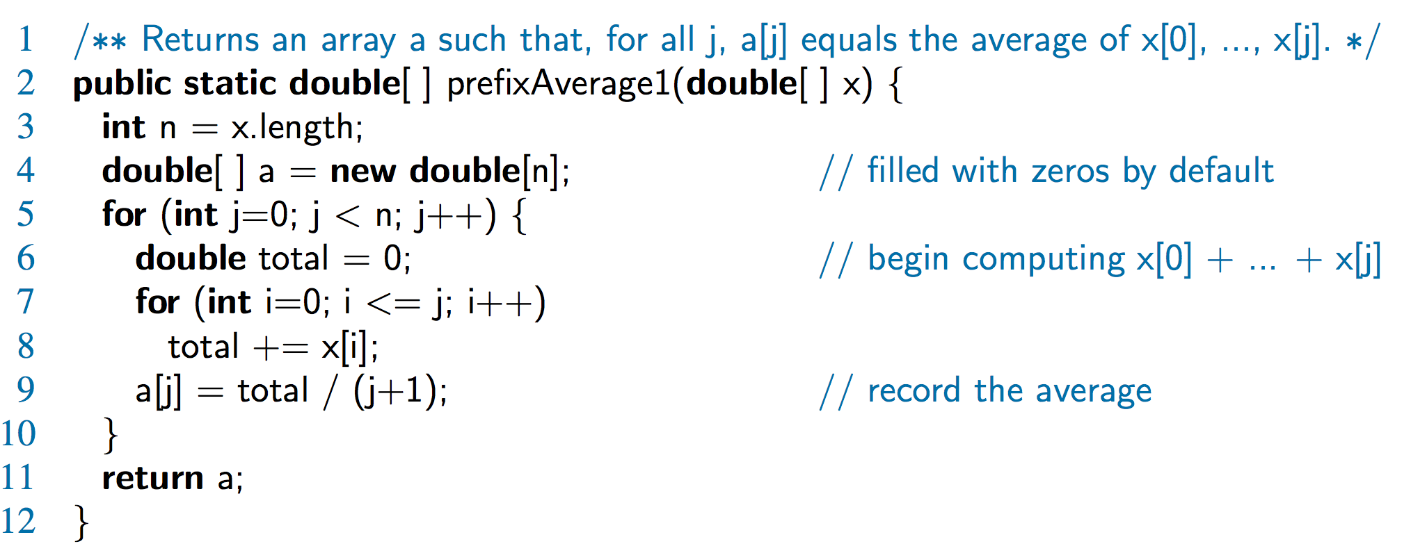
Prefix Averages (Quadratic)
The following algorithm computes prefix averages in quadratic time by applying the definition
What is the key operation?
How many?
© 2014 Goodrich, Tamassia, Goldwasser
Analysis of Algorithms
35

Slide 36
Arithmetic Progression
The running time of prefixAverage1 is
O(1 + 2 + …+ n)
The sum of the first n integers is n(n + 1) / 2
  There is a simple visual proof of this fact
Thus, algorithm prefixAverage1 runs in O(n²) time
© 2014 Goodrich, Tamassia, Goldwasser
Analysis of Algorithms
36

Slide 37
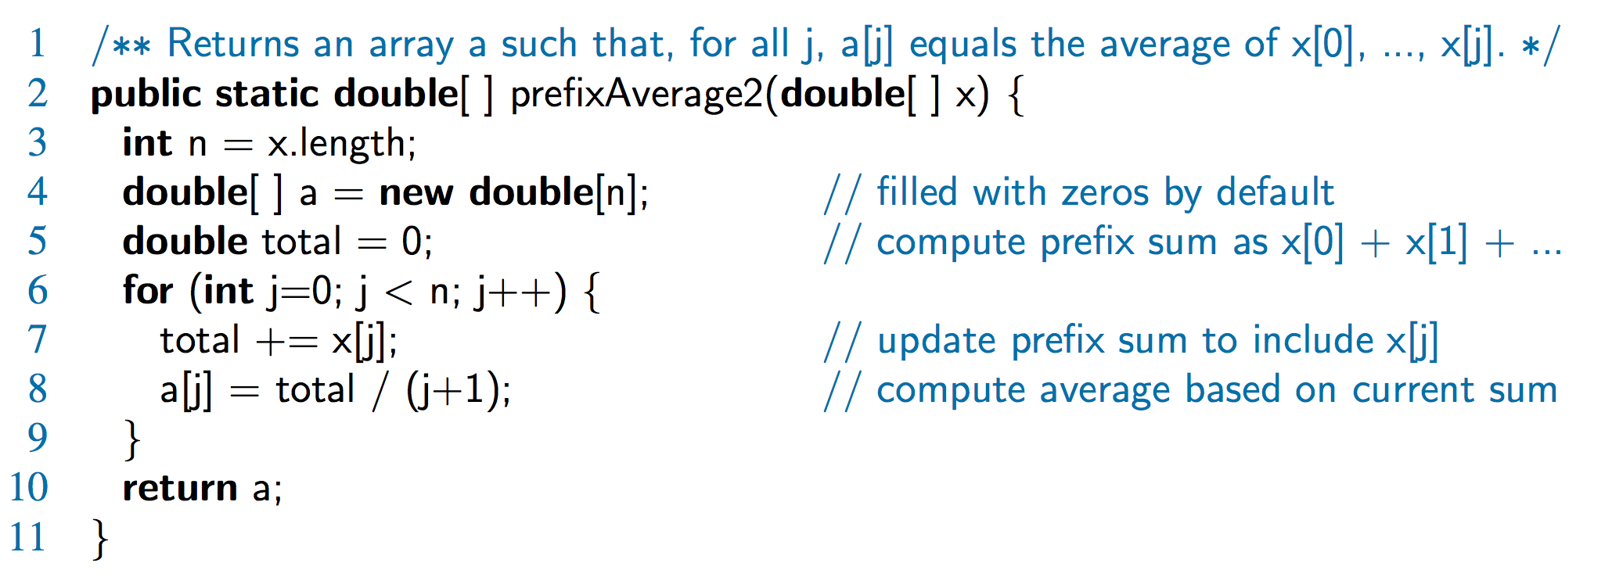
Prefix Averages 2 (Linear)
The following algorithm uses a running summation to improve the efficiency
What is the key operation?
How many?
Algorithm prefixAverage2 runs in O(n) time!
© 2014 Goodrich, Tamassia, Goldwasser
Analysis of Algorithms
37

Slide 38
Math you need to Review
Summations
Powers
Logarithms
Proof techniques
Basic probability
Properties of powers:
a^{(b+c)} = a^{b}a ^{c}
a^{bc} = (a^{b})^{c}
a^{b} /a^{c} = a^{(b-c)}
b = a ^{log}_{a}^{b}
b^{c} = a ^{c*log}_{a}^{b}
Properties of logarithms:
log_{b}(xy) = log_{b}x + log_{b}y
log_{b} (x/y) = log_{b}x - log_{b}y
log_{b}xa = alog_{b}x
log_{b}a = log_{x}a/log_{x}b
© 2014 Goodrich, Tamassia, Goldwasser
Analysis of Algorithms
38

Slide 39
Relatives of Big-Oh
big-Omega
  f(n) is Ω(g(n)) if there is a constant c > 0
  and an integer constant n₀ ≥ 1 such that
f(n) ≥ c g(n) for n ≥ n₀
© 2014 Goodrich, Tamassia, Goldwasser
Analysis of Algorithms
39

Slide 40
Relatives of Big-Oh
big-Omega
  f(n) is Ω(g(n)) if there is a constant c > 0
  and an integer constant n₀ ≥ 1 such that
f(n) ≥ c g(n) for n ≥ n₀
big-Theta
  f(n) is Θ(g(n)) if there are constants c’ > 0 and c’’ > 0 and an integer constant n₀ ≥ 1 such that
c’g(n) ≤ f(n) ≤ c’’g(n) for n ≥ n₀
© 2014 Goodrich, Tamassia, Goldwasser
Analysis of Algorithms
40

Slide 41
Intuition for Asymptotic Notation
big-Oh
  f(n) is O(g(n)) if f(n) is asymptotically less than or equal to g(n)
big-Omega
  f(n) is Ω(g(n)) if f(n) is asymptotically greater than or equal to g(n)
big-Theta
  f(n) is Θ(g(n)) if f(n) is asymptotically equal to g(n)
© 2014 Goodrich, Tamassia, Goldwasser
Analysis of Algorithms
41

Slide 42
Example Uses of the Relatives of Big-Oh
5n² is Ω(n²)
5n² is Ω(n²) if there is a constant c > 0 and an integer constant n₀ ≥ 1 such that 5n² ≥ c n² for n ≥ n₀
let c = 5 and n₀ = 1
© 2014 Goodrich, Tamassia, Goldwasser
Analysis of Algorithms
42
Notes:
42

Slide 43
Example Uses of the Relatives of Big-Oh
5n² is Ω(n²)
f(n) is Ω(g(n)) if there is a constant c > 0 and an integer constant n₀ ≥ 1 such that 5n² ≥ c n² for n ≥ n₀
let c = 5 and n₀ = 1
5n² is O(n²)
5n² is O(n) if there is a constant c > 0 and an integer constant n₀ ≥ 1 such that 5n² ≤ c’ n² for n ≥ n₀
let c’ = 5 and n₀ = 1
© 2014 Goodrich, Tamassia, Goldwasser
Analysis of Algorithms
43
Notes:
43

Slide 44
Example Uses of the Relatives of Big-Oh
5n² is Ω(n²)
f(n) is Ω(g(n)) if there is a constant c > 0 and an integer constant n₀ ≥ 1 such that 5n² ≥ c n² for n ≥ n₀
let c = 5 and n₀ = 1
5n² is O(n²)
5n² is Θ(n²)
5n² is O(n) if there is a constant c > 0 and an integer constant n₀ ≥ 1 such that 5n² ≤ c’ n² for n ≥ n₀
let c’ = 5 and n₀ = 1
5n² is Θ(n²) because 5n² is Ω(n²) and O(n²).
let c = 5, c’ = 5 and n₀ = 1
© 2014 Goodrich, Tamassia, Goldwasser
Analysis of Algorithms
44
Notes:
44

Slide 45
Example of Big-Oh and Relatives
2n + 10 is O(n)
  2n + 10 ≤ cn
  10 ≤ cn - 2n
  10/(c − 2) ≤ n
  10 ≤ n (if c is 3)
  let c = 3 and n₀ = 10
© 2014 Goodrich, Tamassia, Goldwasser
Analysis of Algorithms
45

Slide 46
Example of Big-Oh and Relatives
2n + 10 is O(n)
  2n + 10 ≤ cn
  10 ≤ cn - 2n
  10/(c − 2) ≤ n
  10 ≤ n (if c is 3)
  let c = 3 and n₀ = 10
2n + 10 is Ω(n)
  2n + 10 ≥ c’n
  10 ≥ 0 (if c’ is 2)
  let c’ = 2 and n₀ = 1
© 2014 Goodrich, Tamassia, Goldwasser
Analysis of Algorithms
46

Slide 47
Example of Big-Oh and Relatives
2n + 10 is O(n)
  2n + 10 ≤ cn
  10 ≤ cn - 2n
  10/(c − 2) ≤ n
  10 ≤ n (if c is 3)
  let c = 3 and n₀ = 10
2n + 10 is Ω(n)
  2n + 10 ≥ c’n
  2n + 10 ≥ n (if c’ is 1)
  n ≥ −10
  let c’ = 1 and n₀ = 1
2n + 10 is Θ(n)
  c = 3, c’ = 1
  n₀ = 10 (larger of the two n₀’s)
2n
© 2014 Goodrich, Tamassia, Goldwasser
Analysis of Algorithms
47

Slide 48
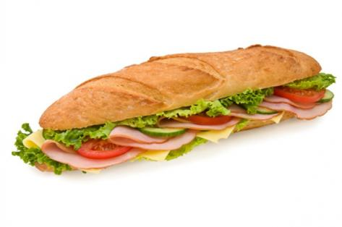
Summary
O(g(n)) [upper bound]
Original function
f(n) [time, space]
Ω(g(n)) [lower bound]
© 2014 Goodrich, Tamassia, Goldwasser
Analysis of Algorithms
48

Slide 49
Example of Big-Oh and Relatives
2n + 10 is O(n)
  2n + 10 ≤ cn
  10 ≤ cn - 2n
  10/(c − 2) ≤ n
  10 ≤ n (if c is 3)
  let c = 3 and n₀ = 10
2n + 10 is Ω(n)
  2n + 10 ≥ c’n
  10 ≥ 0 (if c’ is 2)
  let c’ = 2 and n₀ = 1
2n + 10 is Θ(n)
  c = 3, c’ = 2
  n₀ = 10 (larger of the two n₀’s)
2n
© 2014 Goodrich, Tamassia, Goldwasser
Analysis of Algorithms
49

