Slide 1
Singly Linked Lists
Presentation for use with the textbook Data Structures and Algorithms in Java, 6th edition, by M. T. Goodrich, R. Tamassia, and M. H. Goldwasser, Wiley, 2014

Slide 2
Singly Linked List
A singly linked list is a concrete data structure consisting of a sequence of nodes, starting from a head pointer
Each node stores
  element
  link to the next node
next
element
node
head
∅
A
B
C
D

Slide 3
Review: Objects in Java
… class Node
{
int data;
Node next;
}
…
Node myNode = new Node(…);
// Is myNode
// a. the created node, or
// b. a pointer to the created node?

Slide 4
Primitive types vs Objects
int x = 10, y = 20;
x = y;
// print x, y
Node a = new Node(10), b = new Node(20)
a = b;
// print a.data, b.data
What is the key difference?

Slide 5
Primitive type vs objects
int x = 10, y = 20;
x = y;
// print x, y
Node a = new Node(10),
b = new Node(20)
a = b;
// print a.data, b.data
What is the key difference?
Symbol | Memory address | Memory content
x |  | 10
y |  | 20
a
b

Slide 6
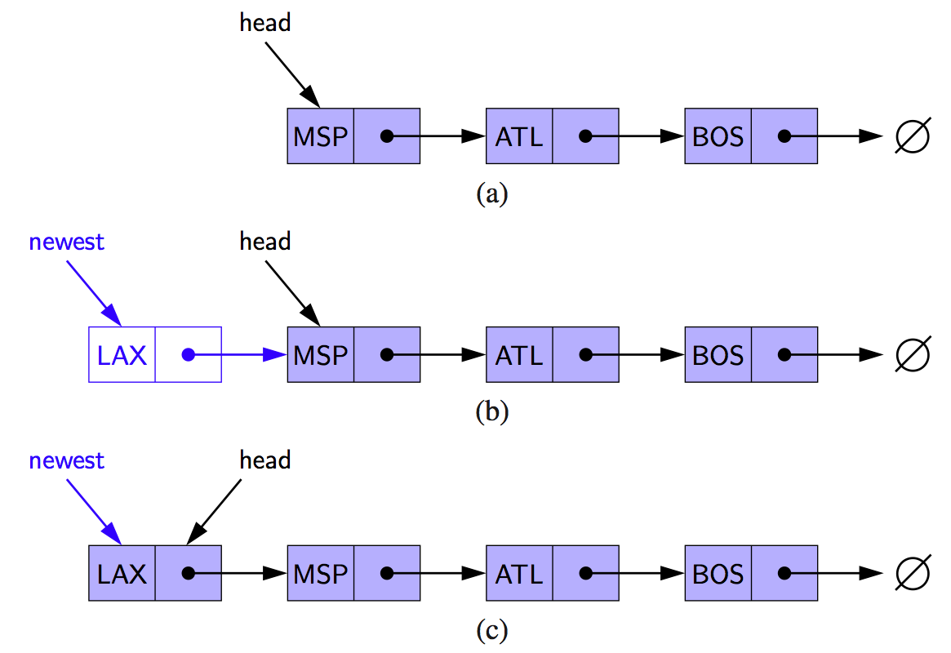
Inserting at the Head
Allocate new node
Insert new element
Have new node point to old head
Update head to point to new node

Slide 7
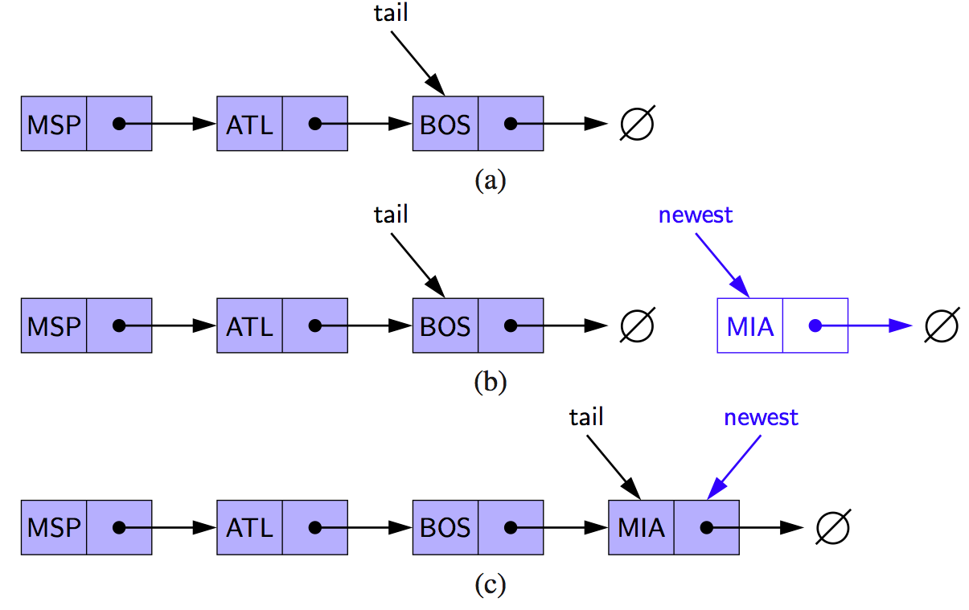
Inserting at the Tail
Allocate a new node
Insert new element
Have new node point to null
Have old last node point to new node
Update tail to point to new node

Slide 8
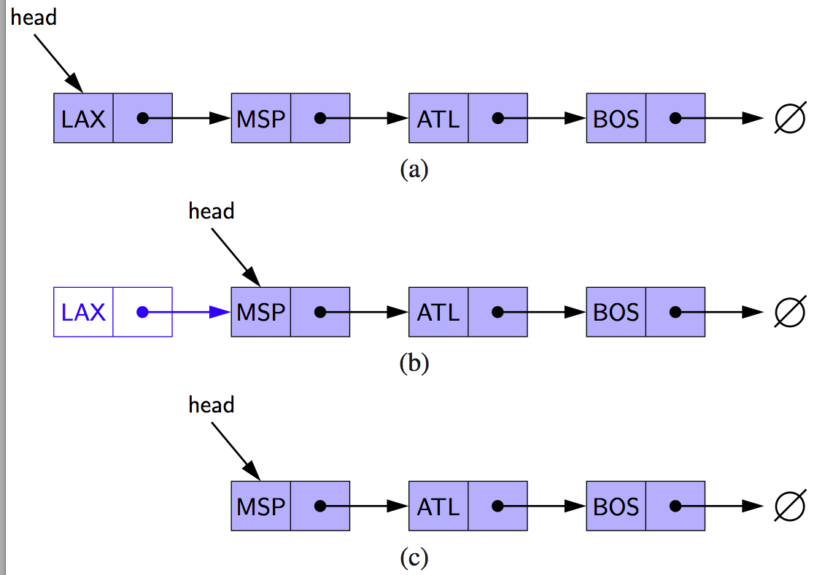
Removing at the Head
Update head to point to next node in the list
Allow garbage collector to reclaim the former first node

Slide 9
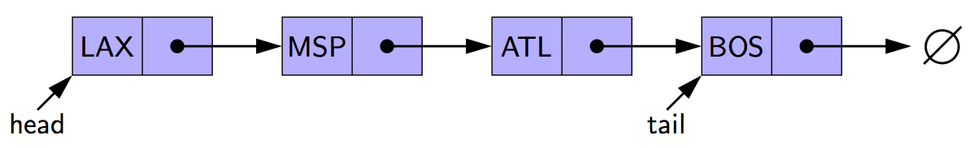
Removing at the Tail
Removing at the tail of a singly linked list is not efficient!
There is not a constant-time way to update the tail to point to the previous node

Slide 10
Arrays vs Linked Lists on some operations
“Faster” ~ a few steps
“Slower” >= N steps (N = # of items in the data structure)
 | Array (with size) | Linked List (with tail)
Insert item at the beginning | slower
Delete item at the beginning | slower
Insert item at the end | faster
Delete item at the end | faster

Slide 11
Arrays vs Linked Lists on some operations
“Faster” ~ a few steps
“Slower” >= N steps (N = # of items in the data structure)
 | Array (with size) | Linked List (with tail)
Insert item at the beginning | slower | faster
Delete item at the beginning | slower | faster
Insert item at the end | faster | faster
Delete item at the end | faster | slower

Slide 12
Arrays vs Linked Lists on some operations
“Faster” ~ a few steps
“Slower” >= N steps (N = # of items in the data structure)
 | Array (with size) | Linked List (with tail) | ?
Insert item at the beginning | slower | faster | faster
Delete item at the beginning | slower | faster | faster
Insert item at the end | faster | faster | faster
Delete item at the end | faster | slower | faster

Slide 13
Circularly Linked Lists

Slide 14
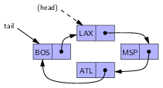
tail (but no head)

Slide 15
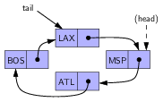
Rotation
What are the instructions?

Slide 16
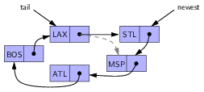
Insertion at (head)
(head)
What are the instructions?

