Slide 1
Presentation for use with the textbook Data Structures and Algorithms in Java, 6th edition, by M. T. Goodrich, R. Tamassia, and M. H. Goldwasser, Wiley, 2014
Queues
© 2014 Goodrich, Tamassia, Goldwasser
Queues
1
Notes:
Queues
1
9/15/2025

Slide 2
The Queue ADT
The Queue ADT stores arbitrary objects
Insertions and deletions follow the first-in first-out scheme (FIFO)
Insertions are at the rear of the queue and removals are at the front of the queue
© 2014 Goodrich, Tamassia, Goldwasser
Queues
2
Notes:
Queues
2
9/15/2025

Slide 3
Main queue operations
enqueue(object):
  inserts an element at the end of the queue
object dequeue():
  removes and returns the element at the front of the queue
© 2014 Goodrich, Tamassia, Goldwasser
Queues
3
Notes:
Queues
3
9/15/2025

Slide 4
Auxiliary queue operations
object first():
  returns the element at the front without removing it
integer size():
  returns the number of elements stored
boolean isEmpty():
  indicates whether no elements are stored
Boundary cases:
  Attempting the execution of dequeue or first on an empty queue returns null
© 2014 Goodrich, Tamassia, Goldwasser
Queues
4
Notes:
Queues
4
9/15/2025

Slide 5
Example
Operation Output Q
enqueue(5) – (5)
enqueue(3) – (5, 3)
dequeue() 5 (3)
enqueue(7) – (3, 7)
dequeue() 3 (7)
first() 7 (7)
dequeue() 7 ()
dequeue() null ()
isEmpty() true ()
enqueue(9) – (9)
enqueue(7) – (9, 7)
size() 2 (9, 7)
enqueue(3) – (9, 7, 3)
enqueue(5) – (9, 7, 3, 5)
dequeue() 9 (7, 3, 5)
© 2014 Goodrich, Tamassia, Goldwasser
Queues
5

Slide 6
Applications of Queues
Direct applications
  Waiting lists, bureaucracy
  Access to shared resources (e.g., printer)
  Multiprogramming
Indirect applications
  Auxiliary data structure for algorithms
  Component of other data structures
© 2014 Goodrich, Tamassia, Goldwasser
Queues
6

Slide 7
“Regular” Array
the first item on the queue is always the first item in the array
front rear
d | a | c | b
© 2014 Goodrich, Tamassia, Goldwasser
Queues
7

Slide 8
“Circular” Array
Use an array of size N in a circular fashion
Two variables keep track of the front and size
f index of the front element
sz number of stored elements
When the queue has fewer than N elements, array location r = (f + sz) mod N is the first empty slot past the rear of the queue
normal configuration
Q
0
1
2
f
r
wrapped-around configuration
Q
0
1
2
r
f
© 2014 Goodrich, Tamassia, Goldwasser
Queues
8

Slide 9
Can we use a linked list to implement a queue?
What are the tradeoffs?
© 2014 Goodrich, Tamassia, Goldwasser
Queues
9

Slide 10
Queue Operations
Algorithm size()
return sz
Algorithm isEmpty()
return (sz == 0)
Q
0
1
2
f
r
Q
0
1
2
r
f
© 2014 Goodrich, Tamassia, Goldwasser
Queues
10

Slide 11
Queue Operations (cont.)
Algorithm enqueue(o)
if size() = N then
throw IllegalStateException
else
r ← (f + sz) mod N
Q[r] ← o
sz ← (sz + 1)
Operation enqueue throws an exception if the array is full
This exception is implementation-dependent
Q
0
1
2
f
r
Q
0
1
2
r
f
© 2014 Goodrich, Tamassia, Goldwasser
Queues
11

Slide 12
Queue Operations (cont.)
Note that operation dequeue returns null if the queue is empty
Algorithm dequeue()
if isEmpty() then
return null
else
o ← Q[f]
f ← (f + 1) mod N
sz ← (sz − 1)
return o
Q
0
1
2
f
r
Q
0
1
2
r
f
© 2014 Goodrich, Tamassia, Goldwasser
Queues
12

Slide 13
Worst-case time complexity
N items on the queue
Operation | “Regular” Array | “Circular” Array | Linked List (with tail)
enqueue
dequeue
© 2014 Goodrich, Tamassia, Goldwasser
Queues
13

Slide 14
Worst-case time complexity
N items on the queue
Operation | “Regular” Array | “Circular” Array | Linked List (with tail)
enqueue | O(1) | O(1) | O(1)
dequeue | O(N) | O(1) | O(1)
© 2014 Goodrich, Tamassia, Goldwasser
Queues
14

Slide 15
queue
Array
(f, sz)
Linked list
(head, tail)
enqueue
dequeue
enqueue
dequeue
© 2014 Goodrich, Tamassia, Goldwasser
Queues
15

Slide 16
Queue Interface in Java
Java interface corresponding to our Queue ADT
Assumes that first() and dequeue() return null if queue is empty
public interface Queue<E> {
int size();
boolean isEmpty();
E first();
void enqueue(E e);
E dequeue();
}
© 2014 Goodrich, Tamassia, Goldwasser
Queues
16

Slide 17
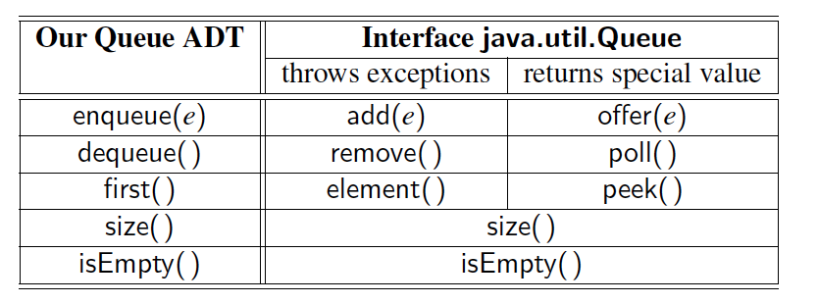
Comparison to java.util.Queue
Our Queue methods and corresponding methods of java.util.Queue:
© 2014 Goodrich, Tamassia, Goldwasser
Queues
17

Slide 18
Application: Round Robin Schedulers
We can implement a round robin scheduler using a queue Q by repeatedly performing the following steps:
  e = Q.dequeue()
  Service element e
  Q.enqueue(e)
Queue
Dequeue
Enqueue
Shared
Service
© 2014 Goodrich, Tamassia, Goldwasser
Queues
18

