Slide 1
Priority Queues
Presentation for use with the textbook Data Structures and Algorithms in Java, 6th edition, by M. T. Goodrich, R. Tamassia, and M. H. Goldwasser, Wiley, 2014

Slide 2
Priority Queue ADT
Main methods
  insert(k, v)
  inserts an entry with key k and value v
  removeMin()
  removes and returns the entry with smallest key, or null if the the priority queue is empty

Slide 3
Priority Queue ADT
A priority queue stores a collection of entries
Each entry is a pair (key, value)

Slide 4
Priority Queue ADT
Additional methods
  min()
  returns, but does not remove, an entry with smallest key, or null if the the priority queue is empty
  size()
  isEmpty()
Applications:
  Standby flyers
  Auctions
  Stock market

Slide 5
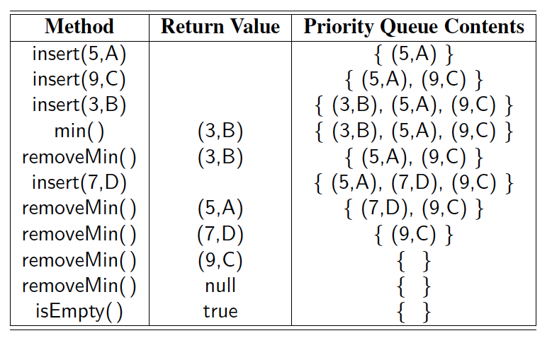
Example
A sequence of priority queue methods:

Slide 6
Total Order Relations
Keys in a priority queue can be arbitrary objects on which an order is defined
Two distinct entries in a priority queue can have the same key
Mathematical concept of total order relation ≤
  Comparability property: either x ≤ y or y ≤ x
  Antisymmetric property:
  x ≤ y and y ≤ x ⇒ x = y
  Transitive property:
  x ≤ y and y ≤ z ⇒ x ≤ z

Slide 7
Entry ADT
An entry in a priority queue is simply a key-value pair
Priority queues store entries to allow for efficient insertion and removal based on keys
Methods:
  getKey: returns the key for this entry
  getValue: returns the value associated with this entry
As a Java interface:
  /**
  * Interface for a key-value
  * pair entry
  **/
  public interface Entry<K,V> {
  K getKey();
  V getValue();
  }

Slide 8
Comparator ADT
Encapsulates the action of comparing two objects according to a given total order relation
A generic priority queue uses an auxiliary comparator
External to the keys being compared
Primary method of the Comparator ADT
compare(x, y): returns an integer i such that
  i < 0 if a < b,
  i = 0 if a = b
  i > 0 if a > b
  An error occurs if a and b cannot be compared.

Slide 9
Example Comparator
Lexicographic comparison of 2-D points:
/** Comparator for 2D points under the standard lexicographic order. */
public class Lexicographic implements Comparator {
int xa, ya, xb, yb;
public int compare(Object a, Object b) throws ClassCastException {
xa = ((Point2D) a).getX();
ya = ((Point2D) a).getY();
xb = ((Point2D) b).getX();
yb = ((Point2D) b).getY();
if (xa != xb)
return (xb - xa);
else
return (yb - ya);
}
}
Point objects:
/** Class representing a point in the plane with integer coordinates */
public class Point2D {
protected int xc, yc; // coordinates
public Point2D(int x, int y) {
xc = x;
yc = y;
}
public int getX() {
return xc;
}
public int getY() {
return yc;
}
}

Slide 10
Sequence-based Priority Queue
Implementation with an unsorted array
Implementation with a sorted array
4
5
2
3
1
1
2
3
4
5

Slide 11
Time Complexity
 | unsorted | sorted
Insert(entry)
RemoveMin() [min()]

Slide 12
Worst-case Time Complexity
 | unsorted | sorted
Insert(entry) | O(1) | O(N)—array [log N to find the spot, but N moves] O(N)—linked list
RemoveMin() [min()] | O(N) | O(1) [array—descending order]

