Slide 1
Graphs
Presentation for use with the textbook Data Structures and Algorithms in Java, 6th edition, by M. T. Goodrich, R. Tamassia, and M. H. Goldwasser, Wiley, 2014
1843
ORD
SFO
802
337
1743
LAX
1233
DFW

Slide 2
Graphs
A graph is a pair (V, E), where
  V is a set of nodes, called vertices
  E is a collection of pairs of vertices, called edges
  Vertices and edges are positions and store elements
Example:
  A vertex represents an airport and stores the three-letter airport code
  An edge represents a flight route between two airports and stores the mileage of the route
849
PVD
1843
ORD
142
SFO
802
LGA
337
1743
1387
HNL
2555
1099
LAX
1233
DFW
1120
MIA

Slide 3
Edge Types
Directed edge
  ordered pair of vertices (u,v)
  first vertex u is the origin
  second vertex v is the destination
  e.g., a flight
Undirected edge
  unordered pair of vertices (u,v)
  e.g., a flight route
Directed graph
  all the edges are directed
  e.g., flight network
Undirected graph
  all the edges are undirected
  e.g., route network
flight
AA 1206
ORD
PVD
849
miles
ORD
PVD

Slide 4
Applications
Electronic circuits
  Printed circuit board
  Integrated circuit
Transportation networks
  Highway network
  Flight network
Computer networks
  Local area network
  Internet
  Web
Databases
  Entity-relationship diagram

Slide 5
Terminology
End vertices (or endpoints) of an edge
  U and V are the endpoints of a
Edges incident on a vertex
  a, d, and b are incident on V
Adjacent vertices
  U and V are adjacent
Degree of a vertex
  X has degree 5
Not used in this course
  Parallel edges
    h and i are parallel edges
  Self-loop
    j is a self-loop
V
a
b
h
j
U
d
X
Z
c
e
i
W
g
f
Y

Slide 6
Terminology (cont.)
Path
  sequence of alternating vertices and edges
  begins with a vertex
  ends with a vertex
  each edge is preceded and followed by its endpoints
Simple path
  path such that all its vertices and edges are distinct
Examples
  P₁=(V,b,X,h,Z) is a simple path
  P₂=(U,c,W,e,X,g,Y,f,W,d,V) is a path that is not simple
V
a
b
P₁
d
U
X
Z
P₂
h
c
e
W
g
f
Y

Slide 7
Terminology (cont.)
Cycle
  circular sequence of alternating vertices and edges
  each edge is preceded and followed by its endpoints
Simple cycle
  cycle such that all its vertices and edges are distinct
Examples
  C₁=(V,b,X,g,Y,f,W,c,U,a,↵) is a simple cycle
  C₂=(U,c,W,e,X,g,Y,f,W,d,V,a,↵) is a cycle that is not simple
V
a
b
d
U
X
Z
C₂
h
e
C₁
c
W
g
f
Y

Slide 8
Properties
Property 1
  Σ_{v} deg(v) = 2m
  Proof: each edge is counted twice
Property 2
  In an undirected graph with no self-loops and no parallel edges
  m ≤ n (n − 1)/2
  Proof: (n−1) + (n-2) + … +1
What is the bound for a directed graph?
Notation
  n number of vertices
  m number of edges
  deg(v) degree of vertex v
Example
  n = 4
  m = 6
  deg(v) = 3

Slide 9
Vertices and Edges
A graph is a collection of vertices and edges.
A Vertex
  stores an arbitrary element provided by the user (e.g., an airport code)
  We assume it supports a method, element(), to retrieve the stored element.
An Edge
  stores an associated object (e.g., a flight number, travel distance, cost), retrieved with the element( ) method.

Slide 10
Graph ADT
getAdjacentVertices(v)
  Given vertex v, return adjacent vertices
areAdjacent(u,v)
  Are vertices u and v adjacent?
…

Slide 11
Representing a Graph
Linked lists
Arrays

Slide 12
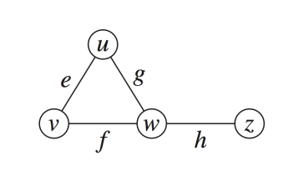
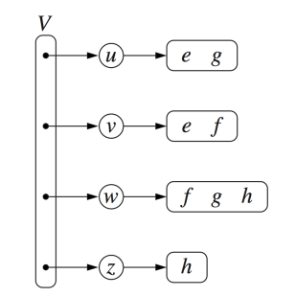
Adjacency Lists
for each vertex
  sequence of vertices
  Sequence of vertices with edge information
v
w
u
w
u
v
z
w

Slide 13
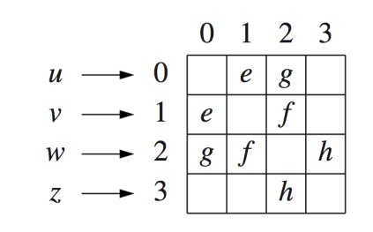
Adjacency Matrix
2D-array array
Content
  Edge struct for edge
  Null for no edge
Content
  1 for edge
  0 for no edge

Slide 14
Time/Space Complexity in Big-O
N vertices
assuming the index of a vertex is known
 | Adjacency Lists | Adjacency Matrix
Space
getAdjacentVertices(v)
areAdjacent(u,v)

Slide 15
Time/Space Complexity in Big-O
N vertices
assuming the index of a vertex is known
 | Adjacency Lists | Adjacency Matrix
Space | O( N² ) | O( N² )
getAdjacentVertices(v) | O(N) | O(N)
areAdjacent(u,v) | O(N) | O(1)

Slide 16
Time/Space Complexity for Sparse Graphs
Each vertex is adjacent to some (not many) other vertices [e.g. Social network]
Max degree is d (<< N)
 | Adjacency Lists | Adjacency Matrix
Space
getAdjacentVertices(v)
areAdjacent(u,v)

Slide 17
Time/Space Complexity for Sparse Graphs
Each vertex is adjacent to some (not many) other vertices
Max degree is d (<< N)
 | Adjacency Lists | Adjacency Matrix
Space | O(dN) | O( N² )
getAdjacentVertices(v) | O(d) | O(N)
areAdjacent(u,v) | O(d) | O(1)

Slide 18
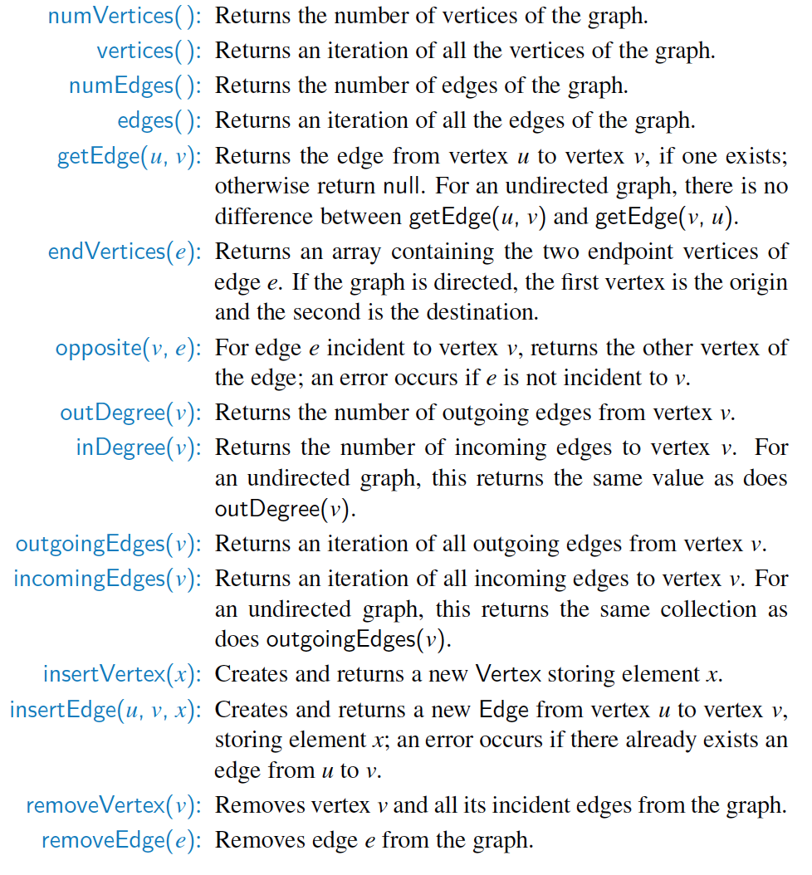
Graph ADT
areAdjacent(u,v)
Is similar to
getEdge(u,v)
Similar to
getAdjacentVertices()

Slide 19
Skipping the rest

Slide 20
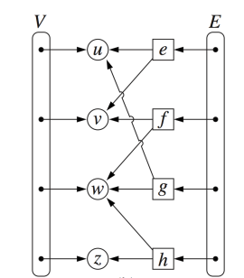
Edge List Structure
Vertex object
  element
  reference to position in vertex sequence
Edge object
  element
  origin vertex object
  destination vertex object
  reference to position in edge sequence
Vertex sequence
  sequence of vertex objects
Edge sequence
  sequence of edge objects

Slide 21
Complexity in big-O
n vertices, m edges no parallel edges no self-loops | Edge List | Adjacency List | Adjacency Matrix
Space
incidentEdges(v)
areAdjacent (v, w)
insertVertex(v)
insertEdge(v, w, x) | *
removeVertex(v) | *
removeEdge(e) | *
* Assuming locating an edge or vertex is constant time

Slide 22
Complexity in big-O
n vertices, m edges no parallel edges no self-loops | Edge List | Adjacency List | Adjacency Matrix
Space | n + m
incidentEdges(v) | m
areAdjacent (v, w) | m
insertVertex(v) | 1
insertEdge(v, w, x) | 1*
removeVertex(v) | m*
removeEdge(e) | 1*
* Assuming locating an edge or vertex is constant time

Slide 23
Adjacency List Structure
Incidence sequence for each vertex
  sequence of references to edge objects of incident edges
Augmented edge objects
  references to associated positions in incidence sequences of end vertices
Vertices or edges in each list

Slide 24
Complexity in big-O
n vertices, m edges deg(v) is degree of v | Edge List | Adjacency List | Adjacency Matrix
Space | n + m
incidentEdges(v) | m
areAdjacent (v, w) | m
insertVertex(v) | 1
insertEdge(v, w, x) | 1
removeVertex(v) | m
removeEdge(e) | 1
deg(v): Assuming the size of each list is known

Slide 25
Complexity in big-O
n vertices, m edges deg(v) is degree of v | Edge List | Adjacency List | Adjacency Matrix
Space | n + m | n + m
incidentEdges(v) | m | deg(v)
areAdjacent (v, w) | m | min(deg(v), deg(w))
insertVertex(v) | 1 | 1
insertEdge(v, w, x) | 1 | 1
removeVertex(v) | m | deg(v)
removeEdge(e) | 1 | 1*
*Assuming location of edge is known

Slide 26

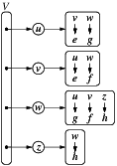
Adjacency Map
Similar to Adjacency List
  each list is replaced with a map
  key is vertex
  areAdjacent(u,v) is O(1)
  More space

Slide 27
Adjacency Matrix Structure
Edge list structure
Augmented vertex objects
  Integer key (index) associated with vertex
2D-array adjacency array
  Reference to edge object for adjacent vertices
  Null for non nonadjacent vertices
The “old fashioned” version just has 0 for no edge and 1 for edge

Slide 28

Complexity in big-O
n vertices, m edges deg(v) is degree of v | Edge List | Adjacency List | Adjacency Matrix
Space | n + m | n + m
incidentEdges(v) | m | deg(v)
areAdjacent (v, w) | m | min(deg(v), deg(w))
insertVertex(v) | 1 | 1
insertEdge(v, w, x) | 1 | 1
removeVertex(v) | m | deg(v)
removeEdge(e) | 1 | 1

Slide 29
Complexity in big-O
n vertices, m edges deg(v) is degree of v | Edge List | Adjacency List | Adjacency Matrix
Space | n + m | n + m | n²
incidentEdges(v) | m | deg(v) | n
areAdjacent (v, w) | m | min(deg(v), deg(w)) | 1
insertVertex(v) | 1 | 1 | n²
insertEdge(v, w, x) | 1 | 1 | 1
removeVertex(v) | m | deg(v) | n²
removeEdge(e) | 1 | 1 | 1

