Slide 1
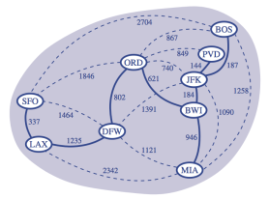
Presentation for use with the textbook Data Structures and Algorithms in Java, 6th edition, by M. T. Goodrich, R. Tamassia, and M. H. Goldwasser, Wiley, 2014
Minimum Spanning Trees
Minimum Spanning Trees
1
Notes:
Minimum Spanning Tree
11/10/2023 9:22 AM
1

Slide 2
Minimum Spanning Trees
Spanning subgraph
  Subgraph of a graph G containing all the vertices of G
Spanning tree
  Spanning subgraph that is itself a (free) tree
Minimum spanning tree (MST)
  Spanning tree of a weighted graph with minimum total edge weight
Applications
  Communications networks
  Transportation networks
ORD
10
1
PIT
DEN
6
7
9
3
DCA
4
STL
8
5
2
DFW
ATL
Minimum Spanning Trees
2

Slide 3
Prim-Jarnik’s Algorithm
Similar to Dijkstra’s algorithm
pick an arbitrary vertex s to start
  grow the MST as a cloud of vertices
store with each vertex v label d(v)
  smallest weight of an edge connecting v to a vertex in the cloud
At each step:
  add to the cloud the vertex u outside the cloud with the smallest distance label
  update the labels of the vertices adjacent to u
Minimum Spanning Trees
3

Slide 4
Example
∞
2
7
D
B
4
8
9
∞
2
5
F
C
8
8
3
E
A
7
7
0
Minimum Spanning Trees
4

Slide 5
Example
∞
2
7
D
B
4
8
9
∞
2
5
F
C
8
8
3
E
A
7
7
0
7
2
7
D
B
4
5
9
∞
2
5
F
C
8
8
3
E
A
7
7
0
Minimum Spanning Trees
5

Slide 6
Example
∞
7
2
7
D
7
D
2
B
4
B
8
9
∞
9
4
∞
2
5
F
5
5
C
2
F
8
C
8
8
3
3
E
8
A
7
E
0
7
A
7
7
0
7
2
7
D
B
4
5
9
∞
2
5
F
C
8
8
3
E
A
7
7
0
Minimum Spanning Trees
6

Slide 7
Example
∞
7
2
7
D
2
7
D
B
4
B
4
8
9
∞
5
9
∞
2
5
F
2
5
F
C
8
C
8
8
3
8
3
E
E
A
7
7
A
7
7
0
0
7
7
2
7
D
7
D
B
4
2
B
4
5
9
∞
9
4
2
5
F
5
5
C
2
F
8
C
8
8
3
3
E
8
A
7
E
0
7
A
7
7
0
Minimum Spanning Trees
7

Slide 8
Example (contd.)
7
2
7
D
B
4
5
9
4
2
5
F
C
8
8
3
E
A
7
3
7
0
7
D
2
B
4
5
9
4
2
5
F
C
8
8
3
E
A
7
3
0
Minimum Spanning Trees
8

Slide 9
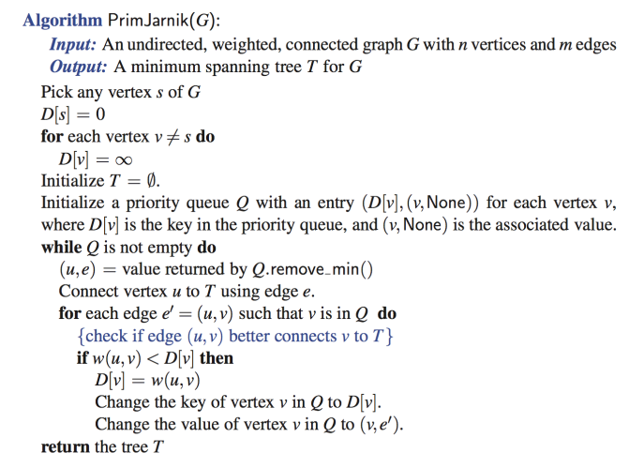
Prim-Jarnik Pseudo-code
//no parent edge
//u is new vertex in the cloud
//for each neighbor v of u
Minimum Spanning Trees
9

Slide 10
Analysis
Similar to Dijkstra’s algorithm
n insertions to Q
  O(n log n) [O(n) bottom-up heap construction]
n removeMin operations with Q
  O(n log n)
m replaceKey operations with Q
  O(m log n)
Total: O((n + m) log n)
Minimum Spanning Trees
10

Slide 11
Kruskal’s Algorithm
Discuss some properties that the algorithm uses
Minimum Spanning Trees
11

Slide 12
Cycle Property
Cycle Property:
  Let T be a minimum spanning tree of a weighted graph G
  Let e be an edge of G that is not in T and
  Let C be the cycle formed by adding e to T
  For every edge f of C, weight(f) ≤ weight(e)
f
8
4
C
9
2
6
3
e
8
7
7
Minimum Spanning Trees
12

Slide 13
Cycle Property
Cycle Property:
  Let T be a minimum spanning tree of a weighted graph G
  Let e be an edge of G that is not in T and
  Let C be the cycle formed by adding e to T
  For every edge f of C, weight(f) ≤ weight(e)
Proof:
  By contradiction
  If weight(f) > weight(e) we can get a spanning tree of smaller weight by replacing e with f
f
8
4
C
9
2
6
3
e
8
7
7
Replacing f with e yields
a better spanning tree
f
8
4
C
9
2
6
3
e
8
7
7
Minimum Spanning Trees
13

Slide 14
Partition Property
U
V
f
7
Partition Property:
  Consider a partition of the vertices of G into subsets U and V
  Let e be an edge of minimum weight across the partition
  There is a minimum spanning tree of G containing edge e
4
9
2
5
8
8
e
3
6
Minimum Spanning Trees
14

Slide 15
Partition Property
U
V
f
7
Partition Property:
  Consider a partition of the vertices of G into subsets U and V
  Let e be an edge of minimum weight across the partition
  There is a minimum spanning tree of G containing edge e
Proof:
  Let T be an MST of G
  If T does not contain e, consider the cycle C formed by e with T and let f be an edge of C across the partition
  By the cycle property,
  weight(f) ≤ weight(e)
  Thus, weight(f) = weight(e)
  We obtain another MST by replacing f with e
4
9
2
5
8
8
e
3
6
Replacing f with e yields
another MST
U
V
f
7
4
9
2
5
8
8
e
3
6
Minimum Spanning Trees
15

Slide 16
Kruskal’s Approach
Maintain a partition of the vertices into clusters(clouds)
  Initially, single-vertex clusters
  Keep an MST for each cluster
  Merge “closest” clusters and their MSTs
A priority queue stores the edges outside clusters
  Key: weight; Element: edge
At the end of the algorithm
  One cluster and one MST
Minimum Spanning Trees
16

Slide 17
Example
G
B
8
4
9
E
6
1
5
F
C
11
3
2
7
D
H
A
10
Campus Tour
17

Slide 18
Example
G
B
8
4
9
E
6
1
5
F
C
11
3
2
7
D
H
A
10
G
B
8
4
9
E
6
1
5
F
C
11
3
2
7
D
H
A
10
Campus Tour
18

Slide 19
Example
G
G
B
8
8
4
B
4
9
E
6
9
E
6
1
5
F
1
5
F
C
11
3
C
11
3
2
2
7
D
H
7
H
A
D
10
A
10
G
B
8
4
9
E
6
1
5
F
C
11
3
2
7
D
H
A
10
Campus Tour
19

Slide 20
Example
G
G
B
8
8
4
B
4
9
E
6
9
E
6
1
5
F
1
5
F
C
11
3
C
11
3
2
2
7
D
H
7
H
A
D
10
A
10
G
G
B
8
B
8
4
4
9
E
6
9
E
6
1
5
F
1
5
F
C
11
3
C
11
3
2
2
7
D
H
7
H
D
A
10
A
10
Campus Tour
20

Slide 21
Example (contd.)
G
B
8
4
9
E
6
1
5
F
C
11
3
2
7
D
H
A
10
Campus Tour
21

Slide 22
Example (contd.)
G
B
8
4
9
E
6
1
5
F
C
11
3
2
7
D
H
A
10
G
B
8
4
9
E
6
1
5
F
C
11
3
2
7
D
H
A
10
Campus Tour
22

Slide 23
Example (contd.)
G
G
B
8
8
4
B
4
9
E
6
9
E
6
1
5
F
1
5
F
C
11
3
C
11
3
2
2
7
D
H
7
H
A
D
10
A
10
two steps
G
B
8
4
9
E
6
1
5
F
C
11
3
2
7
D
H
A
10
Campus Tour
23

Slide 24
Example (contd.)
G
G
B
8
8
4
B
4
9
E
6
9
E
6
1
5
F
1
5
F
C
11
3
C
11
3
2
2
7
D
H
7
H
D
A
10
A
10
two steps
four steps
G
G
B
8
B
8
4
4
9
E
6
9
E
6
1
5
F
1
5
F
C
11
3
C
11
3
2
2
7
D
H
7
H
D
A
10
A
10
Campus Tour
24

Slide 25
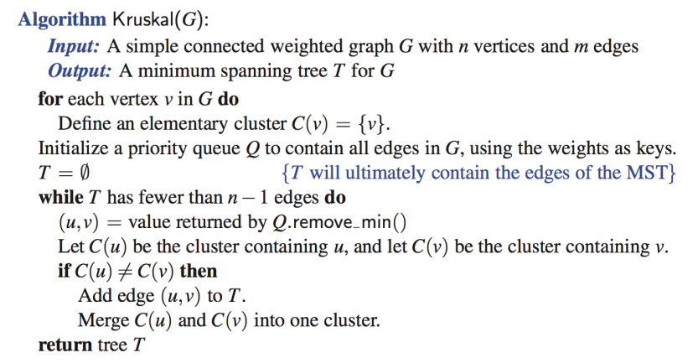
Kruskal’s Algorithm
Minimum Spanning Trees
25

Slide 26
Analysis of Kruskal’s Algorithm
m insertions into Q (priority queue)
m removeMin operations from Q
Clustering the vertices
Minimum Spanning Trees
26

Slide 27
Data structure for a partition
a collection of disjoint sets, with operations:
  makeSet(u): create a set consisting of u
  find(u): return the set storing u
  union(A, B): replace set A with their union
Minimum Spanning Trees
27

Slide 28
List-based Partition
Each set is stored in a sequence
Each element has a reference back to the set
  find(u)
    returns the set of which u is a member
    O(1) time
  union(A,B)
    move the elements of the smaller set to the sequence of the larger set
      and update their references
Minimum Spanning Trees
28

Slide 29
Union operations
When doing a union
  move elements from the smaller set to the larger set
  Each time an element is moved
    it goes to a set of size at least double its old set
  Thus, each element can be moved at most O(log n) times
n vertices (n-1 unions)
  Each vertex is moved at most O(log n) times
  O(n log n)
Union-Find
29

Slide 30
Partition-Based Implementation
Priority Queue operations: O(m log n)
  m insertions: O(m log m) [O(m) bottom-up heap]
  m removeMin operations: O(m log m)
  m = O(n^2)
  O(log m) = O(log n^2) = O(2 log n) = O(log n)
  O(m log m) = O(m log n)
Minimum Spanning Trees
30

Slide 31
Partition-Based Implementation
Priority Queue operations: O(m log n)
  m insertions: O(m log m) [O(m) bottom-up heap]
  m removeMin operations: O(m log m)
  m = O(n^2)
  O(log m) = O(log n^2) = O(2 log n) = O(log n)
  O(m log m) = O(m log n)
Union-Find operations: O(m + n log n)
  2m find operations: O(m)
  n - 1 union operations: O(n log n)
Total: O( m log n + m + n log n)
  O((n+ m) log n)
Minimum Spanning Trees
31

Slide 32
Complexity of MST algorithms
 | Prim-Jarnik | Kruskal
Time complexity | O( (n+m) log n ) | O( (n+m) log n )
 | Easier to implement | Easier conceptually
Minimum Spanning Trees
32

Slide 33
Skipping the rest
Minimum Spanning Trees
33

Slide 34
Baruvka’s Algorithm (Exercise)
Like Kruskal’s Algorithm, Baruvka’s algorithm grows many clusters at once and maintains a forest T
Each iteration of the while loop halves the number of connected components in forest T
The running time is O(m log n)
Algorithm BaruvkaMST(G)
T ← V {just the vertices of G}
while T has fewer than n − 1 edges do
for each connected component C in T do
Let edge e be the smallest-weight edge from C to another component in T
if e is not already in T then
Add edge e to T
return T
Minimum Spanning Trees
34

Slide 35
Slide by Matt Stallmann included with permission.
Example of Baruvka’s
Algorithm (animated)
2
4
3
8
5
8
9
4
7
4
9
3
1
6
6
6
5
4
2
4
3
8
5
9
4
7
3
1
6
6
5
4
Minimum Spanning Trees
35
Notes:
35

