Slide 1
Shortest Paths
Presentation for use with the textbook Data Structures and Algorithms in Java, 6th edition, by M. T. Goodrich, R. Tamassia, and M. H. Goldwasser, Wiley, 2014
0
8
A
4
2
8
7
2
1
3
B
C
D
5
3
9
8
2
E
F
5

Slide 2
Weighted Graphs
weighted graph
  each edge has an associated numerical value -- weight of the edge
Edge weights may represent, distances, costs, etc.
Example:
  In a flight route graph, the weight of an edge represents the distance in miles between the endpoint airports
849
PVD
1843
ORD
142
SFO
802
LGA
1743
1205
337
1387
HNL
2555
1099
LAX
1233
DFW
1120
MIA

Slide 3
Shortest Paths
Given a weighted graph and two vertices u and v,
  find a path of minimum total weight between u and v
  Length of a path is the sum of the weights of its edges.
Example:
  Shortest path between Providence and Honolulu
Applications
  Internet packet routing
  Flight reservations
  Driving directions
849
PVD
1843
ORD
142
SFO
802
LGA
1743
1205
337
1387
HNL
2555
1099
LAX
1233
DFW
1120
MIA

Slide 4
Shortest Path Properties
Property 1:
A subpath of a shortest path is itself a shortest path
Property 2:
There is a tree of shortest paths from a start vertex to all the other vertices
Example:
Tree of shortest paths from Providence
849
PVD
1843
ORD
142
SFO
802
LGA
1743
1205
337
1387
HNL
2555
1099
LAX
1233
DFW
1120
MIA

Slide 5
Dijkstra’s Algorithm
The distance of a vertex v from a vertex s
  the length of a shortest path between s and v
from a given start vertex s
  computes the distances of all the vertices
Assumptions:
  the graph is connected
  the edges are undirected
  the edge weights are nonnegative

Slide 6
Dijkstra’s Algorithm
grow a “cloud” of vertices
  beginning with s and eventually covering all the vertices
store with each vertex v a label d(v)
  the distance of v from s in the subgraph consisting of the cloud and its adjacent vertices
At each iteration
  add to the cloud the vertex u outside the cloud with the smallest distance label, d(u)
  update d(u) of the vertices adjacent to u

Slide 7
Edge Relaxation
Consider an edge e = (u,z) such that
  u is the vertex most recently added to the cloud
  z is not in the cloud
The relaxation of edge e updates distance d(z) as follows:
d(z) ← min{d(z), d(u) + weight(e)}
d(u) = 50
10
d(z) = 75
u
e
s
z
d(u) = 50
10
d(z) = 60
u
e
s
z

Slide 8
Example
d(z)
0
8
A
4
2
8
7
2
1
4
B
C
D
∞
3
9
∞
2
E
F
5

Slide 9
Example
d(z)
0
8
A
4
2
8
7
2
1
4
B
C
D
∞
3
9
∞
2
E
F
5
0
8
A
4
2
8
7
2
1
3
B
C
D
5
3
9
11
2
E
F
5

Slide 10
Example
d(z)
0
0
8
A
4
8
A
4
2
2
8
7
2
1
4
8
7
2
1
3
B
C
D
B
C
D
∞
3
9
∞
5
3
9
8
2
E
F
5
2
E
F
5
0
8
A
4
2
8
7
2
1
3
B
C
D
5
3
9
11
2
E
F
5

Slide 11
Example
d(z)
0
0
8
A
4
8
A
4
2
2
8
7
2
1
4
8
7
2
1
3
B
C
D
B
C
D
∞
3
9
∞
5
3
9
8
2
E
F
5
2
E
F
5
0
0
8
A
4
8
A
4
2
2
8
7
2
1
3
7
7
2
1
3
B
C
D
B
C
D
5
3
9
11
5
3
9
8
2
E
F
5
2
E
F
5

Slide 12
Example (cont.)
d(z)
0
8
A
4
2
7
7
2
1
3
B
C
D
5
3
9
8
2
E
F
5
0
8
A
4
2
7
7
2
1
3
B
C
D
5
3
9
8
2
E
F
5

Slide 13
Example (cont.)
d(z)
0
8
A
4
2
7
7
2
1
3
B
C
D
5
3
9
8
2
E
F
5
0
0
8
A
4
8
A
4
2
2
7
7
2
1
3
7
2
3
B
C
D
B
7
C
1
D
5
3
9
8
5
3
9
8
2
E
F
5
2
E
F
5

Slide 14
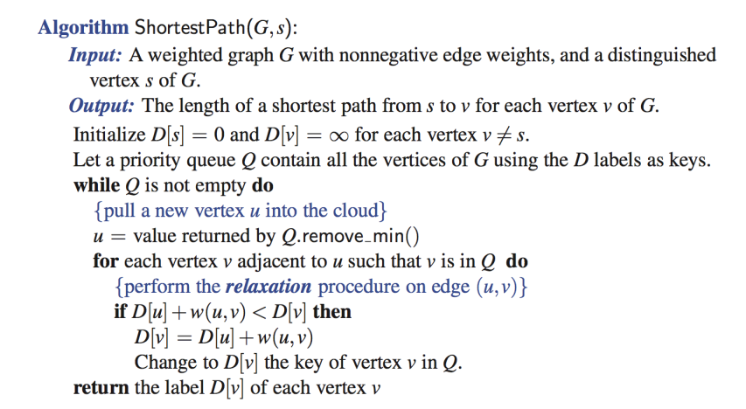
Dijkstra’s Algorithm

Slide 15
Dijkstra’s Algorithm
Calculates the distance of shortest paths from the starting vertex
How do we find the shortest paths?

Slide 16
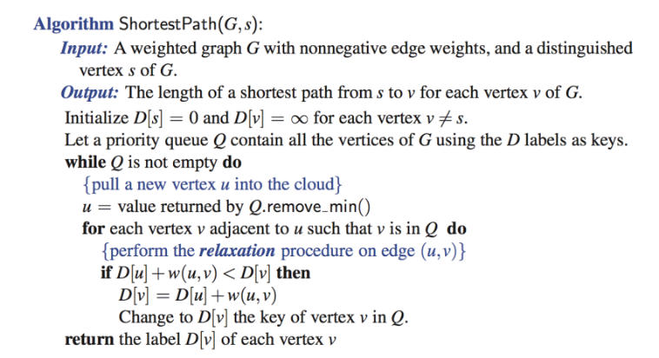
Dijkstra’s Algorithm
What would you add to the alg to find paths?

Slide 17
Example
Parent[v]
0
8
A
4
2
8
2
4
A
A
B
7
C
1
D
∞
3
A
9
∞
2
E
F
5

Slide 18
Example
Parent[v]
0
8
A
4
2
8
2
4
A
A
B
7
C
1
D
∞
3
A
9
∞
2
E
F
5
0
8
A
4
2
8
7
2
1
3
A
B
C
D
C
5
3
A
9
11
2
E
F
5
C
C

Slide 19
Example
Parent[v]
0
0
8
A
4
8
A
4
2
2
8
2
4
A
8
2
3
A
B
7
C
1
D
B
7
C
1
D
A
C
∞
3
A
9
∞
5
3
A
9
8
2
E
F
5
2
E
F
5
C
D
0
8
A
4
2
8
7
2
1
3
A
B
C
D
C
5
3
A
9
11
2
E
F
5
C
C

Slide 20
Example
Parent[v]
0
0
8
A
4
8
A
4
2
2
8
2
4
A
8
2
3
A
B
7
C
1
D
B
7
C
1
D
A
C
∞
3
A
9
∞
5
3
A
9
8
2
E
F
5
2
E
F
5
C
D
0
0
8
A
4
8
A
4
2
2
8
7
2
1
3
7
7
2
1
3
A
B
C
D
C
E
B
C
D
C
3
A
9
3
A
9
5
11
5
8
2
E
F
5
2
E
F
5
C
C
C
D

Slide 21
Example (cont.)
Parent[v]
0
8
A
4
2
7
7
2
1
3
E
B
C
D
C
3
A
9
5
8
2
E
F
5
C
D
0
8
A
4
2
7
7
2
1
3
E
B
C
D
C
5
3
A
9
8
2
E
F
5
D
C

Slide 22
Example (cont.)
Parent[v]
0
8
A
4
2
7
7
2
1
3
E
B
C
D
C
3
A
9
5
8
2
E
F
5
C
D
0
0
8
A
4
8
A
4
2
2
7
2
3
7
7
2
1
3
B
7
C
1
D
E
B
C
D
E
C
C
3
A
9
5
3
A
9
8
5
8
2
5
2
E
F
5
E
F
D
C
C
D

Slide 23
Dijkstra’s Algorithm
What would you add to the alg to find paths?

Slide 24
Analysis of Dijkstra’s Algorithm
n insertions into Q (priority queue)
n calls to the removeMin method on Q
m calls to the replaceKey method on Q (updating d(v))

Slide 25
Analysis of Dijkstra’s Algorithm
n insertions into Q (priority queue)
  O(n log n) [O(n) bottom-up heap construction]
n calls to the removeMin method on Q
  O(n log n)
m calls to the replaceKey method on Q (updating d(v))
  Adaptable priority queue
  O(m log n)
Total: O((m+n) log n)

Slide 26
Why Dijkstra’s Algorithm Works
adds vertices into the cloud by choosing the vertex v with the smallest D[v] (“greedy method”)
  Choose v over d and c in the figure
Ie, claiming v
  can be reached in the shortest path via only vertices in the cloud
  cannot be reached shorter using vertices outside the cloud
20
d
D[d]=25
D[v]=15
b
v
d(b)=5
5
d(a)=10
a
c
D[v] is calculated by alg
d(v) is true shortest distance
10
D[c] = 20

Slide 27
Why Dijkstra’s Algorithm Works
Proof by contradiction:
  Assume there is a shorter path via other vertices outside the cloud
    Ie, v should not be added to the cloud
  Since all the vertices have a larger D value
    Reaching v via other vertices outside the cloud will be longer
    contradiction reached
20
d
D[d]=25
D[v]=15
b
v
d(b)=5
5
d(a)=10
a
c
D[v] is calculated by alg
d(v) is true shortest distance
10
D[c] = 20

Slide 28
Why It Doesn’t Work for Negative-Weight Edges
Choose v over c and d
claiming v
  can be reached in the shortest path via only vertices in the cloud
  cannot be reached shorter using vertices outside the cloud
Ideas?
20
d
D[d]=25
D[v]=15
b
v
d(b)=5
5
d(a)=10
a
c
D[v] is calculated by alg
d(v) is true shortest distance
10
D[c] = 20

Slide 29
Why It Doesn’t Work for Negative-Weight Edges
Choose v over c and d
claiming v
  Can be reached in the shortest path via only vertices in the cloud
  cannot be reached shorter using vertices outside the cloud [false!]
if the path from c to v has a negative total weight
  For example, -10
  a -> c-> v (D[v]=10) is shorter than a -> v (D[v] = 15)
20
d
D[d]=25
D[v]=15
b
v
d(b)=5
5
-10
d(a)=10
a
c
D[v] is calculated by alg
d(v) is true shortest distance
10
D[c] = 20

Slide 30
Skipping the rest

Slide 31
Bellman-Ford Algorithm
(not in book)
Works even with negative-weight edges
Must assume directed edges (for otherwise we would have negative-weight cycles)
Iteration i finds all shortest paths that use i edges.
Running time: O(nm).
Can be extended to detect a negative-weight cycle if it exists
  How?
Algorithm BellmanFord(G, s)
for all v ∈ G.vertices()
if v = s
setDistance(v, 0)
else
setDistance(v, ∞)
for i ← 1 to n − 1 do
  for each e ∈ G.edges()
  { relax edge e }
  u ← G.origin(e)
  z ← G.opposite(u,e)
  r ← getDistance(u) + weight(e)
  if r < getDistance(z)
  setDistance(z,r)

Slide 32
Bellman-Ford Example
Nodes are labeled with their d(v) values
8
0
4
8
0
4
-2
-2
7
1
8
7
-2
1
4
∞
∞
∞
∞
∞
∞
3
9
3
9
-2
∞
∞
5
-2
∞
∞
5
8
0
4
8
0
4
-2
-2
5
8
7
-2
1
4
-1
5
7
-2
1
-1
1
3
9
3
9
-2
6
9
5
-2
4
5
∞
∞
1
9

Slide 33
DAG-based Algorithm
(not in book)
Algorithm DagDistances(G, s)
for all v ∈ G.vertices()
if v = s
setDistance(v, 0)
else
setDistance(v, ∞)
{ Perform a topological sort of the vertices }
for u ← 1 to n do {in topological order}
  for each e ∈ G.outEdges(u)
  { relax edge e }
  z ← G.opposite(u,e)
  r ← getDistance(u) + weight(e)
  if r < getDistance(z)
  setDistance(z,r)
Works even with negative-weight edges
Uses topological order
Doesn’t use any fancy data structures
Is much faster than Dijkstra’s algorithm
Running time: O(n+m).

Slide 34
DAG Example
Nodes are labeled with their d(v) values
1
1
8
0
4
8
0
4
-2
-2
3
7
2
1
4
3
8
7
2
-2
1
4
4
∞
∞
∞
∞
∞
∞
3
9
3
9
-5
∞
∞
5
-5
∞
∞
5
6
5
6
5
1
1
8
0
4
8
0
4
-2
-2
3
5
7
2
1
4
-1
3
7
2
1
4
8
-2
4
5
-2
-1
3
9
3
9
-5
1
7
5
-5
0
4
5
∞
∞
1
7
6
5
6
5
(two steps)

