Slide 1

Input matrix:
https://www.mathportal.org/linear-algebra/matrices/gauss-jordan.php

Slide 2

Input matrix:
Create:

Slide 3
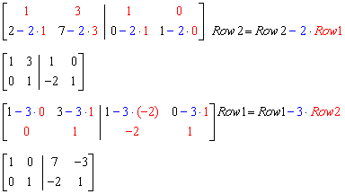
Input matrix:
Iterate:
Create:

Slide 4

Input matrix:
Iterate:
Inverse is:

Slide 5

Input matrix:
https://www.mathportal.org/linear-algebra/matrices/gauss-jordan.php

Slide 6
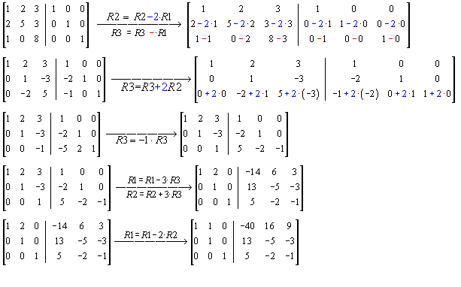
Input matrix:
Iterate:
⬅ Output

Slide 7
Iteration steps:
How to chose row-pairs to compute

Slide 8
h := 1 /* Initialization of the pivot row */
k := 1 /* Initialization of the pivot column */
while h ≤ m and k ≤ n
/* Find the k-th pivot: */
i_max := argmax (i = h ... m, abs(A[i, k]))
if A[i_max, k] = 0
/* No pivot in this column, pass to next column */
k := k+1
else
swap rows(h, i_max)
/* Do for all rows below pivot: */
for i = h + 1 ... m:
f := A[i, k] / A[h, k]
/* Fill with zeros the lower part of pivot column: */
A[i, k] := 0
/* Do for all remaining elements in current row: */
for j = k + 1 ... n:
A[i, j] := A[i, j] - A[h, j] * f
/* Increase pivot row and column */
h := h+1
k := k+1
https://en.wikipedia.org/wiki/Gaussian_elimination#Finding_the_inverse_of_a_matrix

