Slide 1
Modeling of Data

Slide 2
Basic Bayes theorem
Bayes theorem relates the conditional probabilities of two events A, and B:
A might be a hypothesis and B might be some data.
so that P(A|B) expresses the probability of a hypothesis, given the data.

Slide 3
Least Squares as a Maximum Likelihood Estimator
Suppose we have
N points of data
M adjustable parameters
The goal is to fit data points to the model.

Slide 4
Least Squares as a Maximum Likelihood Estimator
The model predicts a functional relationship between the measured independent and dependent variables.
We want to find values for parameters , such that:
is minimized.

Slide 5
Chi Square fitting
suppose that each data point y_{i} has a measurement error that is independently random and distributed as a normal (Gaussian) distribution around the “true” model y(x)
And suppose that the standard deviations of these normal distributions are the same for all points.
Then the probability of the data set is the product of the probabilities of each point.
…..(1)

Slide 6
Chi Square fitting
The most probable model, then, is the one that maximizes equation (1) or, equivalently, minimizes the negative of its logarithm,

Slide 7
Chi Square fitting
Since N, , and are all constants, minimizing this equation is equivalent to minimizing

Slide 8
Fitting Data to a Straight Line
fitting a set of N data points to a
straight-line model
using the chi-square
Assume that the uncertainty associated with each measurement yi is known

Slide 9
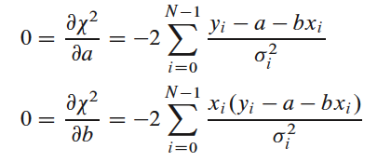
Fitting Data to a Straight Line
Taking derivatives of with respect to a; b vanish:

Slide 10
Fitting Data to a Straight Line
Define these sums:
to simplify the questions to :

Slide 11
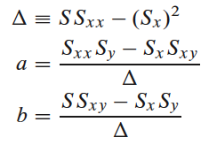
Fitting Data to a Straight Line
The solution of these two equations in two unknowns is calculated as:

Slide 12
Estimate the probable uncertainties
Each data point contribute to a bit of uncertainty to the parameters.
the variance in the value of any function is

Slide 13
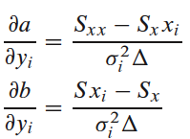
Estimate the probable uncertainties
For the straight line, the derivatives of a and b with respect to y_{i} can be directly evaluated from the solution:
Summing over the points:

