Slide 1
Chapter 3. Interpolation and Extrapolation
Hui Pan, Yunfei Duan

Slide 2
possible problem in physical measurement
Sometimes know the value of a function f(x) at a set of points, but we don’t have an analytic expression for f(x) that lets us calculate its value at an arbitrary point.

Slide 3
Interpolation and Extrapolation
Estimate f(x) for arbitrary x by, in some sense, drawing a smooth curve through the x_{i}. If the desired x is in between the largest and smallest of the x_{i}’s the problem is called interpolation. Otherwise it is called extrapolation.

Slide 4
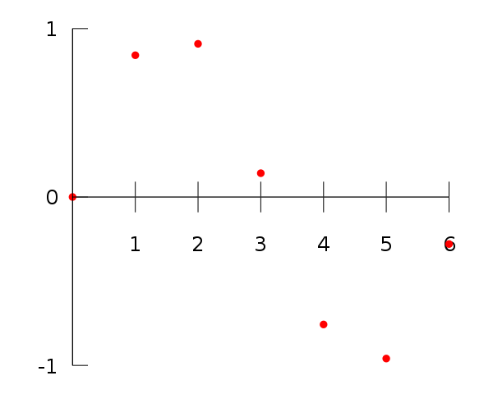
x | F(x)
0 | 0
1 | 0.8415
2 | 0.9093
3 | 0.1411
4 | -0.7568
5 | -0.9589
6 | -0.2794
For example, suppose we have a table like this, which gives some values of an unknown function f. Interpolation provides a means of estimating the function at intermediate points, such as x = 2.5.¹
1: from wiki: http://en.wikipedia.org/wiki/Interpolation

Slide 5
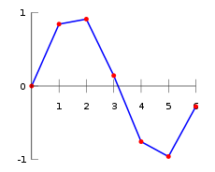
Linear interpolation
Since 2.5 is midway between 2 and 3, it is reasonable to take f(2.5) midway between f(2) = 0.9093 and f(3) = 0.1411, which yields 0.5252.

Slide 6
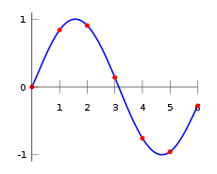
Polynomial interpolation
f(x) = -0.001521x⁶ – 0.003130x⁵ + 0.07321x⁴ – 0.3577x³ + 0.2255x² + 0.9038x
Substituting x = 2.5, we find that f(2.5) = 0.5965.

Slide 7
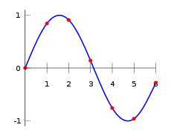
Spline interpolation
Spline interpolation uses low-degree polynomials in each of the intervals, and chooses the polynomial pieces such that they fit smoothly together. The resulting function is called a spline.
The natural cubic spline interpolating the points in the table above is given:
In this case we get f(2.5) = 0.5972.

Slide 8
Different between interpolation and function approximation
Interpolation: Given the function f at points not of your own choosing.
Function approximation: Allowed to compute the function f at any desired points for the purpose of developing your approximation.

Slide 9
Two steps for the conceptually interpolation process:
Fit an interpolation function to the data points provided.
Evaluate that interpolating function at a target point x.

Slide 10
Disadvantages for the above two-stage method:
Less efficient.
More susceptible to round-off error.
Many practical schemes start at a nearby point f(xi), and then add a sequence of (hopefully) decreasing corrections, as information from other nearby f(xi)’s is incorporated.

Slide 11
The order of the interpolation:
The number of points – 1 used in an interpolation scheme.
Increasing the order does not necessarily increase the accuracy, especially in polynomial interpolation.
adding points close to the desired point usually does help, but a finer mesh implies a larger table of values, which is not always available.

Slide 12
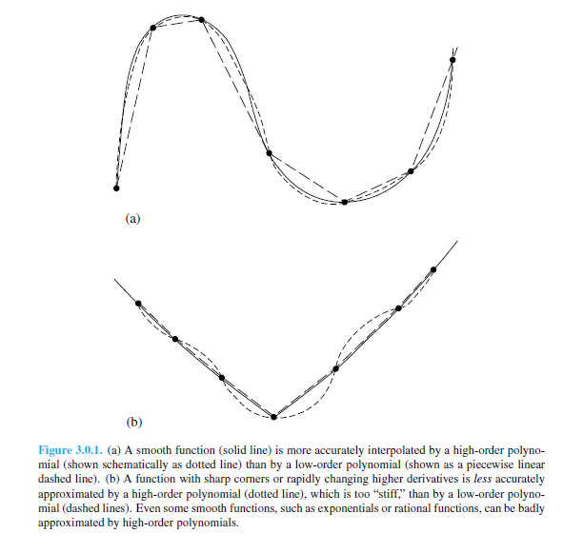

Slide 13
Searching an Ordered Table:
Given an array x_{j ,} j = 0, …, N – 1, with the monotonically increasing or monotonically decreasing , and given an integer M <= N, and a number , find an interger j₁₀such that x is among the x_{j10}, …, x_{j10+M-1}. x should lies between x_{m} and x_{m+1}, where
$M= j_{10}+\left[\frac{M −2}{2}\right]$
Bisection is the best way to solve the problem.

Slide 14
Search with Correlated Values:
Not good to do a full bisection when interpolation routines are called multiply times.
Hunt method starts with a random position in the table. It first “hunts,” either up or down, in increments of 1, then 2, then 4, etc., until the desired value is bracketed. It then bisects in the bracketed interval.

Slide 15
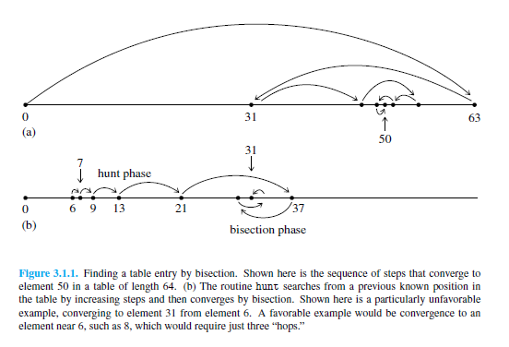

Slide 16
hunt algorithm
Function hunt( double x)
{
//check xx[] is monotonic increasing or decreasing
//define jl as start point, ju as end point, inc as increment value
//move to right side if true.
if(x >= xx[jl])
{
for(;;) {
//update ju equal to jl plus increment value
//if ju >= n-1 or x < xx[ju], break;
//else update jl equal to ju, and increment * 2
}
} else {
for(;;) {
//update jl equal to jl minus increment value
//if jl <= 0 or x >= xx[jl], break;
//else update ju equal to jl, and increment * 2
}
}
bisection algorithm;
}

Slide 17
Cubic Spline Interpolation
We start from a set of points [x_{i} , y_{i}] for i = 0, 1, …, n for the function y = f(x). The cubic spine interpolation is a piecewise continuous curve, passing through each of the values in the table.
Spline of degree k = 3
The domain of s is an interval [a, b]
S, S’, S’’ are all continuous functions on [a, b]

Slide 18
S₀(x) , x $∈$[x₀, x₁]
S(x) = S₁(x) , x $∈$[x₁, x₂]
…
S_{n-1}(x) , x $∈$[x_{n-1}, x_{n}]
S_{i}(x) is a cubic polynomial that will be used on the subinterval [x_{i}, x_{i+1}].

Slide 19
There is a separate cubic polynomial for each interval [x_{j-1}, x_{j}], each with its own coefficients:
S(x) = s_{j}(x) = a_{j}x³ + b_{j}x² + c_{j}x + d_{j} x $∈$ (x_{j—1}, x_{j}), j = 1,2,…n
4 coefficients with n subintervals = 4n equations
There are 4_{n-2} conditions
Interpolation conditions
Continuity conditions

Slide 20
Set one or both of y₀’’ and y_{N-1}’’ equal to 0. S’’(x₀) = 0, S’’(x_{n}) = 0.
Set either of y₀’’ andy_{N-1}’’ to values calculate from first derivative function so as to make the first derivative of the interpolating function have a specified value on either or both boundaries.

Slide 21
The gold of cubic spline interpolation:
Smooth in the first derivative
Continuous in the second derivative.
Thus means :
s(x_{j} – 0) = s(x_{j} + 0)
s’(x_{j} – 0) = s’(x_{j} + 0) j = 1,2, …, n - 1
s’’(x_{j} – 0) = s(x_{j} + 0)

Slide 22
Assuming s’’(x_{i}) = M_{i} (i = 0, 1, 2, …, n). Because s(x) is third degree polynomial between x_{i} and x_{i+1}, so s’’(x)is first degree polynomial in [x_{i} , x_{i+1}], which is:
$$s^{′′′}\left(x\right)= \frac{M_{i+1}−M_{i}}{x_{i+1}− x_{i}} ∀x∈[x_{i}, x_{i+1}]$$

Slide 23
Taylor series:
So, we can get :
Let x = x_{i + 1}

Slide 24
We can get the same result between [x_{i – 1}, x_{i} ]

