Slide 1
Animation and CS
Philip Chan

Slide 2
Animation
Hand-drawn
  Early Disney movies

Slide 3
Animation
Hand-drawn
  Early Disney movies
Computer-drawn
  Pixar movies

Slide 4
Animation
A sequence of drawings
  Shown to the audience quickly
    “flip book”

Slide 5
A simple animation
A stick figure kicking a ball
What are the basic shapes that you need?

Slide 6
A simple animation
A stick figure kicking a ball
What are the basic shapes that you need?
  lines
  circles

Slide 7
Drawing a Line

Slide 8
Drawing a Line
Input
  Starting point: (x1, y1)
  Ending point: (x2, y2)
Output
  A line from (x1,y1) to (x2, y2)
How?

Slide 9
Drawing a Line
Same as plotting an equation on graph paper

Slide 10
Drawing a Line
Same as plotting an equation on graph paper
Given an equation: y = f(x)

Slide 11
Drawing a Line
Same as plotting an equation on graph paper
Given an equation: y = f(x)
  Determine the x interval (domain)
  Sample x values
  Calculate the corresponding y values (range)
  Plot the (x, y) pairs

Slide 12
Equation for a Line
What is the equation for a line?

Slide 13
Equation for a Line
What is the equation for a line?
  y = mx + b
  What is m?
  What is b?

Slide 14
Equation for a Line
  Given (x1, y1) [start] and (x2, y2) [end]?
    How to determine m and b?

Slide 15
Finding Slope m
(x2, y2)
(x1, y1)

Slide 16
Finding Slope m
(x2, y2)
?
(x1, y1)

Slide 17
Finding Slope m
(x2, y2)
y2-y1
(x1, y1)
?

Slide 18
Finding Slope m
(x2, y2)
  m = rise / run
y2-y1
(x1, y1)
x2-x1

Slide 19
Finding Slope m
(x2, y2)
  m = rise / run
  m = (y2 – y1) / (x2 – x1)
y2-y1
(x1, y1)
x2-x1

Slide 20
Finding y-intercept b
  y = mx + b
  Plug in the calculated m and given (x1,y1)
    y1 = m*x1 + b
  Solve for b

Slide 21
Finding y-intercept b
  y = mx + b
  Plug in the calculated m and given (x1,y1)
    y1 = m*x1 + b
  Solve for b
    b = ?

Slide 22
Finding y-intercept b
  y = mx + b
  Plug in the calculated m and given (x1,y1)
    y1 = m*x1 + b
  Solve for b
    b = y1 - m*x1

Slide 23
Calculating Slope
m = slope = (y2 – y1) / (x2 – x1)
Could have a problem?

Slide 24
Calculating Slope
m = slope = (y2 – y1) / (x2 – x1)
Could have a problem?
x2 – x1 could be zero
Division by zero!
What kind of line is that?

Slide 25
Vertical Lines
x1 is the same as x2
Don’t need the equation
Change y values from y1 to y2
  Without changing x

Slide 26
Equation for a Line -- Summary
  Given (x1, y1) [start] and (x2, y2) [end]
  y = mx + b
  m = (y2 – y1) / (x2 – x1)
    If x2 and x1 are not the same
  b = y1 - m*x1

Slide 27
Drawing a Line (reminder)
Same as plotting an equation on graph paper
Given an equation: y = f(x)
  Determine the x interval (domain)
  Sample x values
  Calculate the corresponding y values (range)
  Plot the (x, y) pairs

Slide 28
Algorithm Summary
If not a vertical line
  Find equation for the line
    By calculating slope (m) and y-intercept (b)
  For each x value from x1 to x2 (domain)
    Calculate corresponding y value
    Plot the (x, y) pair
Else
  For each y value from y1 to y2
    Plot the (x, y) pair

Slide 29
Drawing a Circle

Slide 30
Drawing a Circle
Input
  Center (a, b)
  Radius r
Output
  A circle centered at (a,b) with radius r

Slide 31
Drawing a Circle
Similar to a line
  Find the equation
  Sample x values
    Calculate the corresponding y values
    Plot the (x,y) pairs

Slide 32
Equation for a Circle
(x,y)
r
(a,b)

Slide 33
Equation for a Circle
(x,y)
r
(a,b)

Slide 34
Equation for a Circle
(x,y)
r
(a,b)
?

Slide 35
Equation for a Circle
(x,y)
r
?
(a,b)
x-a

Slide 36
Equation for a Circle
(x,y)
r
y-b
(a,b)
x-a

Slide 37

Equation for a Circle
$${(x−a)}^{2}+{(y−b)}^{2}=r^{2}$$
(x,y)
r
y-b
(a,b)
x-a

Slide 38

Equation for a Circle
${(x−a)}^{2}+{(y−b)}^{2}=r^{2}$
  We want to sample x and get y values
    Solve for y

Slide 39

Equation for a Circle
${(x−a)}^{2}+{(y−b)}^{2}=r^{2}$
  We want to sample x and get y values
    Solve for y
${(y−b)}^{2}=r^{2}−{(x−a)}^{2}$

Slide 40
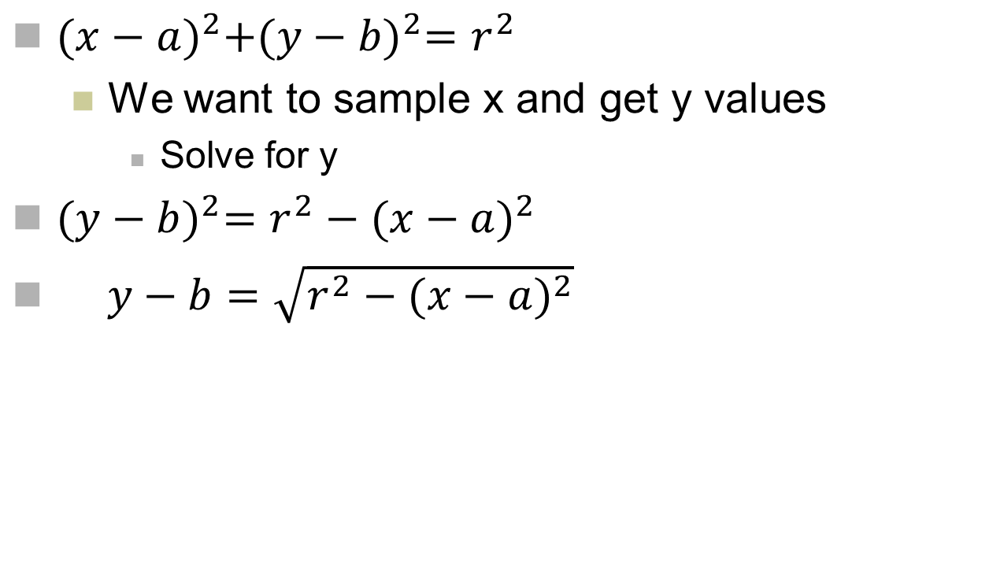
Equation for a Circle
${(x−a)}^{2}+{(y−b)}^{2}=r^{2}$
  We want to sample x and get y values
    Solve for y
${(y−b)}^{2}=r^{2}−{(x−a)}^{2}$
$y−b=\sqrt{r^{2}−{(x−a)}^{2}}$

Slide 41
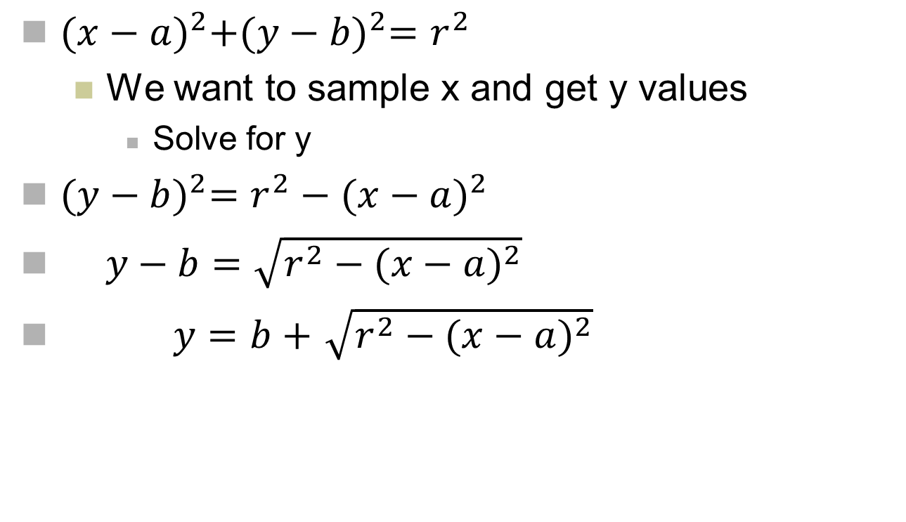
Equation for a Circle
${(x−a)}^{2}+{(y−b)}^{2}=r^{2}$
  We want to sample x and get y values
    Solve for y
${(y−b)}^{2}=r^{2}−{(x−a)}^{2}$
$y−b=\sqrt{r^{2}−{(x−a)}^{2}}$
$y=b+$ $\sqrt{r^{2}−{(x−a)}^{2}}$

Slide 42
Domain of x Values
(x,y)
r
y-b
(?,?)
(?,?)
(a,b)
x-a

Slide 43
Domain of x Values
(x,y)
r
y-b
(a-r, b)
(a+r, b)
(a,b)
x-a

Slide 44

Each x Value has Two y Values
$y=b+$ $\sqrt{r^{2}−{(x−a)}^{2}}$
(x,y)
r
y-b
(a-r, b)
(a+r, b)
(a,b)
x-a

Slide 45

Each x Value has Two y Values
$y=b+ \sqrt{r^{2}−{(x−a)}^{2}}$
$y=b± \sqrt{r^{2}−{(x−a)}^{2}}$

Slide 46
Algorithm Summary
For each x value from a-r to a+r (domain)
  Calculate the corresponding two y values
    Using the equation for a circle
  Plot the two (x,y) pairs

Slide 47
Drawing a Filled Circle

Slide 48
Fill the Circle with a Color
Ideas?

Slide 49
Fill the Circle with a Color
How would you systematically fill it by hand?

Slide 50
Fill the Circle with a Color
Hint: you have two y values for each x

Slide 51
Algorithm Summary
For each x value from a-r to a+r (domain)
  Calculate the corresponding two y values (y1 and y2)
    Using the equation for a circle
  Draw vertical line between (x,y1) and (x,y2)

Slide 52
Drawing a Moving Ball

Slide 53
Drawing a Moving Ball
Basic ideas for moving a ball?

Slide 54
Drawing a Moving Ball
Drawing the ball in a different location for each frame/image
Sequence of images
  flipbook

Slide 55
Moving a Ball in a Straight Line
Input
  Center of ball and starting point (x1,y1)
  Radius of ball r
  Ending point (x2, y2)
Output
  Moving a ball with radius r
    from (x1, x2) to (x2, y2)

Slide 56
Moving a Ball in a Straight Line
Redraw the ball
  At a different center
  Along a straight line
    Using the equation for a line

Slide 57
Two Approaches to a Moving Ball
Multiple pictures
  Each picture is different
    Ball at different locations

Slide 58
Two Approaches to a Moving Ball
Multiple pictures
  Each picture is different
    Ball at different locations
One picture
  Edit the picture
    Ball at different locations

Slide 59
Two Approaches to a Moving Ball
Multiple pictures
  Each picture is different
    Ball at different locations
One picture
  Edit the picture
    Ball at different locations
Tradeoffs?
  When the picture has only a moving ball

Slide 60
Two Approaches to a Moving Ball
Multiple pictures
  Each picture is different
    Ball at different locations
One picture
  Edit the picture
    Ball at different locations
Tradeoffs?
  When the picture has only a moving ball
  When the picture has many stationary objects (e.g. buildings), and only one moving ball

Slide 61
Algorithm Summary (using only one picture)
At each (x,y) along a straight line from (x1,y1) to (x2,y2)
  Draw a filled circle centered at (x,y)
  Show the picture
  Delay/sleep for some time
    Why?
  Erase the filled circle centered at (x,y)
    Why?
    How?

