Slide 1
Health and CS
Philip Chan

Slide 2
DNA, Genes, Proteins
What is the relationship among
  DNA
  Genes
  Proteins
  ?

Slide 3
DNA, Genes, Proteins
What is the relationship among
  DNA
  Genes
  Proteins
  ?
Some DNA regions are called genes
  Which are blueprints for making proteins

Slide 4
Gene expression
How “active” the gene is
Measuring gene expression can help characterize diseases

Slide 5
Cancer Subtypes
  Why do we want to find subtypes?
For each cancer patient
  We measure gene expression
  How can we find out cancer subtypes?

Slide 6
Problem Formulation
Input
  Expression levels (values) of each gene
    Multiple patients
  Number of subtypes (clusters)
Output
  Cancer subtypes (clusters)

Slide 7
Clustering
Ideas?

Slide 8
Clusters (Subtypes)
Clusters
  Similar within a cluster
  Different across clusters
We need to define distance (similarity)
  Between two patients in terms of gene expression

Slide 9
Distance Function
a and b: two patients
a_{i} and b_{i}: expression level of gene i

Slide 10
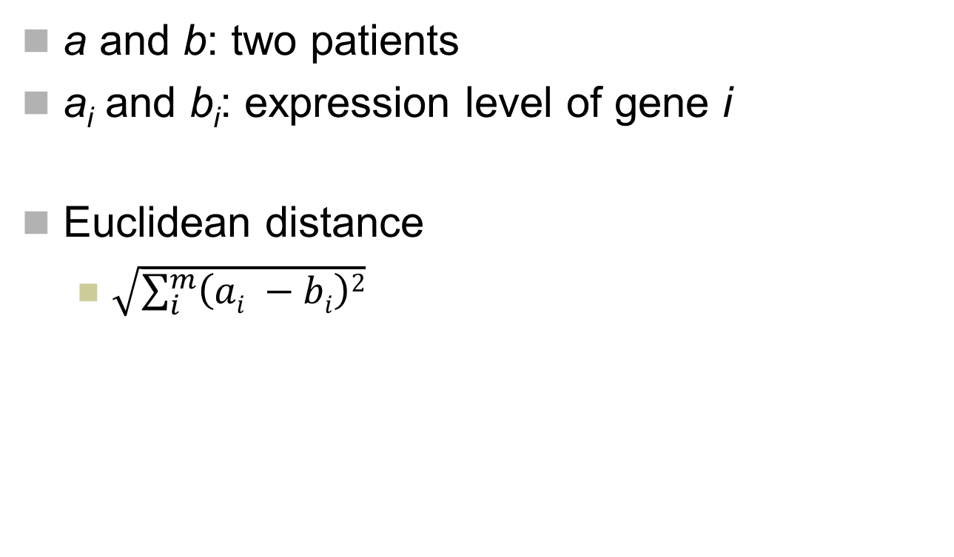
Distance Function
a and b: two patients
a_{i} and b_{i}: expression level of gene i
Euclidean distance
  $\sqrt{\sum_{i}^{m}{\left(ai −bi\right)2}}$

Slide 11
K-means Clustering Algorithm
Pick k random patients as centroids
Assign each patient to the cluster with the closest centroid
Repeat
  Calculate the centroid for each cluster
  Assign each patient to the cluster with the closest centroid
  Until no changes in cluster membership

Slide 12
Calculating Centroid
Let centroid_{i}
  the expression of gene i of the centroid
centroid_{i} = avg. expression of gene i in the cluster

Slide 13
Animation
http://shabal.in/visuals/kmeans/1.html

