Slide 1
Photography and CS
Philip Chan

Slide 2
Film vs Digital Camera
What is the difference?

Slide 3
Film vs Digital Camera
Film camera
  Light alters the chemical composition of the film
  The film is used as a template to print on light sensitive paper
  The film can only be used once

Slide 4
Film vs Digital Camera
Digital camera
  Light is converted into electronic signals
  Recorded as numbers/bits on a storage device (e.g. memory, SD card)
  Can be transmitted across electronic devices
  Storage device can be reused many times

Slide 5
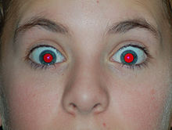
Red Eyes
Why taking pictures with a flash can result in “red eyes?”
http://en.wikipedia.org/wiki/Red-eye_effect

Slide 6
Why Red Eyes
The pupil of your eyes dilates in a darker environment
  To let in more light
    To see better

Slide 7
Why Red Eyes
The pupil of your eyes dilates in a darker environment
  To let in more light
    To see better
Flash light illuminates the retina
  Blood vessels on retina
    red

Slide 8
Reducing Red Eyes
How?

Slide 9
Reducing Red Eyes
Before taking the picture
  Flashing twice (one before, one during)
  Why?

Slide 10
Reducing Red Eyes
Before taking the picture
  Flashing twice (one before, one during)
  Why?
After taking the picture
  Editing the picture

Slide 11
Reducing Red Eye by Editing Picture—Problem Formulation
Given
  A picture
Provide
  A picture with reduced red eyes.

Slide 12
Idea
Find red eyes
Replace them with some other color

Slide 13
Finding Red Eyes
How?

Slide 14
Picture/image
Each picture has (a table of) pixels
  Each pixel has a color
    Each color has 3 values (red, green, blue)
      Each value is from 0 to 255
(red, green, blue)

Slide 15
Finding Red Eyes
Find red pixels
  (255, 0, 0)

Slide 16
Finding Red Eyes
Find red pixels
  (255, 0, 0)
  (254, 0, 0) ?

Slide 17
Finding Red Eyes
Find red pixels
  (255, 0, 0)
  (254, 0, 0) ?
  (255, 1, 1) ?

Slide 18
Finding Red Eyes
Find red pixels
  (255, 0, 0)
  (254, 0, 0) ?
  (255, 1, 1) ?
  (254, 0 ,1) ?

Slide 19
Red Intensity
Red > green, red > blue

Slide 20
Red Intensity
Red > green, red > blue
Red > average of green and blue

Slide 21
Red Intensity
Red > green, red > blue
Red > average of green and blue
  By how much?

Slide 22

Red Intensity
Red intensity = $\frac{red}{(green+blue)/2}$
Red intensity > threshold

Slide 23
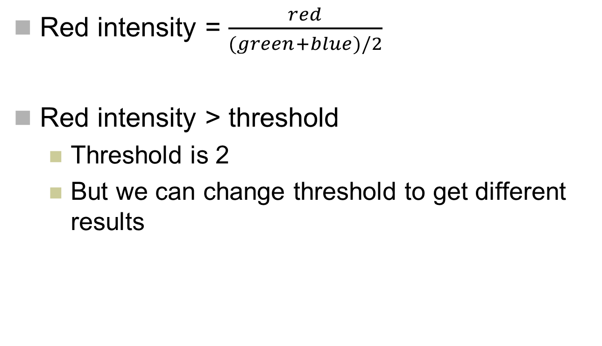
Red Intensity
Red intensity = $\frac{red}{(green+blue)/2}$
Red intensity > threshold
  Threshold is 2
  But we can change threshold to get different results

Slide 24
Idea
Find red eyes
Replace them with some other color

Slide 25
Replace by What Color?

Slide 26
Replace by What Color?
Black?
White?
Brown?
Yellow?

Slide 27
Replace by What Color?
Black?
White?
Brown?
Yellow?
More natural color?

Slide 28
Replace by What Color?
Hint: each pixel has 3 values
  (red, green, blue)

Slide 29
Replace by What Color?
Hint: each pixel has 3 values
  (red, green, blue)
Keep green and blue values
  Replace red value
    By what?

Slide 30
Replace by What Color?
Hint: each pixel has 3 values
  (red, green, blue)
Keep green and blue values
  Replace red value
    By what?
      0
      More natural?

Slide 31
Replace by What Color?
Hint: each pixel has 3 values
  (red, green, blue)
Keep green and blue values
  Replace red value
    By what?
      0
      More natural
        average of green and blue

Slide 32
Summary of Algorithm
Find pixels that have Red Intensity > threshold
  Threshold can be ?

Slide 33
Summary of Algorithm
Find pixels that have Red Intensity > threshold
  Threshold can be 2

Slide 34
Summary of Algorithm
Find pixels that have Red Intensity > threshold
  Threshold can be 2
Replace those pixels with a “natural” color

Slide 35
Summary of Algorithm
Find pixels that have Red Intensity > threshold
  Threshold can be 2
Replace those pixels with a “natural” color
  Red = (green + blue) / 2
  Green and blue remain the same

