Slide 1

Testbed for Vulnerability Analysis of Health IoT & Smart Mobile Devices
Research & Education Testbed
Dr. Abdullah Aydeger
Dr. Sneha Sudhakaran
Device funding : FIT SEED grant

Slide 2
Motivation
Rapid growth of Health IoT devices
Sensitive medical data
Increased cyber-physical attack surface
Need reproducible vulnerability testbeds

Slide 3
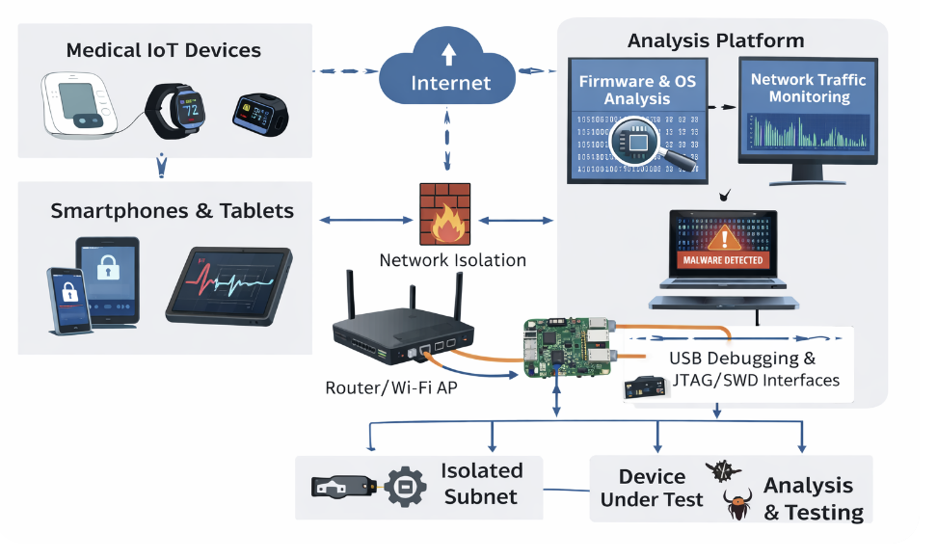
Experiment Workflow to setup testbed in Lab
Attack injection, Behavior monitoring, Forensic artifact collection
Lab: L3Harris Center for Assured Information IoT lab

Slide 4
Final Deliverable will be
1. Testbed created in Lab
2. A computer system that guides students to do vulnerability analysis on Healthcare Iot devices

Slide 5
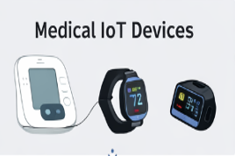
Target Devices
Pulse oximeters
Blood pressure monitors
Smartwatches
Mobile phones (Android/iOS)

Slide 6
Threat Model
Malware & ransomware
Firmware tampering
Bluetooth/Wi-Fi attacks
Data leakage & privacy violations
Supply chain threats

Slide 7
Testbed Architecture focus
Device Layer
Network Layer
Host Analysis Layer
Cloud & App Layer
Monitoring & Control

Slide 8
Hardware Setup
Health IoT devices
Smartphones
Wi-Fi/Bluetooth routers
USB/JTAG interfaces
Isolated lab network

Slide 9
Students can select which component they wish to focus when creating testbed and analysis
Medical IoT
Software Stack | Network Testbed | Firmware & OS Analysis

Slide 10
Software Stack
Android Debug Bridge (ADB)
Frida
Wireshark & tcpdump
Firmware extraction tools
Memory forensics tools like Volatility, binwalk

Slide 11
Network Testbed
Isolated VLAN
MITM proxy
Packet capture
Traffic replay
Attack injection

Slide 12
Firmware & OS Analysis
Firmware dumping
Static analysis
Dynamic runtime monitoring
Root/jailbreak environments

Slide 13
Outcomes
Vulnerability reports
Datasets
Reproducible labs
Student & researcher training

