Slide 1
Java O-O Program Visualizer/Animator
Dr. David Luginbuhl, dluginbuhl@fit.edu, LSA 208

Slide 2
Goal: Create a program that visualizes how a Java program constructs and uses objects
Students in early Java courses sometimes struggle with the concepts of classes and objects
Hypothesis: A system that animates the process of object instantiation and results of method invocations would be helpful for increasing understanding of O-O concepts
Memory diagrams → Holliday/Luginbuhl
8/18/25
2

Slide 3
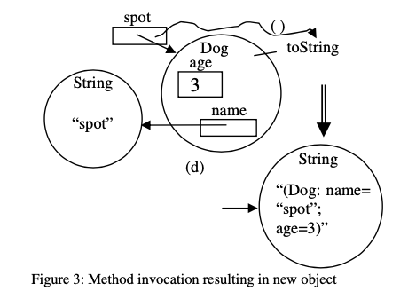
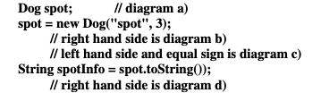
Basic idea: use Memory Diagrams to step through object creation and use
8/18/25
3

Slide 4
Possible extension
Given a program, have user draw the diagrams and assess how well user did…
Others?
8/18/25

Slide 5
References …
Holliday, Luginbuhl, “A Guide to Using Memory Diagrams,” Western Carolina University
  https://agora.cs.wcu.edu/~holliday/teaching/LectureNotes/150/MemoryDiagramGuide.pdf
Holliday, Luginbuhl, “Using Memory Diagrams When Teaching a Java-Based CS1,” Proceedings of the 41st Annual ACM Southeast Conference
  https://www.researchgate.net/profile/Mark-Holliday-2/publication/242406239_Using_Memory_Diagrams_When_Teaching_a_Java-Based_CS1/links/0c96052b8ef4e9e9b7000000/Using-Memory-Diagrams-When-Teaching-a-Java-Based-CS1.pdf
Holliday, Luginbuhl, “CS1 Assessment Using Memory Diagrams,” Proceedings of 35th SIGCSE Tech Symposium on CS Education
  https://dl.acm.org/doi/pdf/10.1145/971300.971373
You can look for other approaches to memory diagrams as well
8/18/25
4

Slide 6

Finite State Machine
Visualizer
Finite State Machine Understandinator`
Dr. David Luginbuhl, dluginbuhl@fit.edu, LSA 208
This Photo by Unknown Author is licensed under CC BY-SA

Slide 7
Goal: Create a program that helps students visualize and understand finite state machines
Abstract concepts made real
A system already exists – JFLAP
  https://www.jflap.org/
  I’d like to see a more ”modern” version with some additional flairs and ”better” visualizations (not necessarily as comprehensive, though why not?)
  Focused on DFAs/NFAs/e-NFAs
  Key component – minimization/distinguishability of strings (see next slides)
    This approach (on following slides) is not part of JFLAP
8/18/25
2

Slide 8
Consider the following situation
You are given a black box and are told it contains a DFA with very few states
  DFA accepts some language in (0+1)*
The black box has an input slot and two lights: green and red.
  Green means string accepted; red means rejected
You are given the following strings to try in the black box
  ε, 0, 1, 10, 11, 100, 110
100

Slide 9
Black Box Results
Your black box tells you the following strings are accepted
  ε, 0, 10, 100
You also learn the following strings are rejected
  1, 11, 110
Try to determine the smallest number of states possible in the machine
???

