Slide 1
Basic CPS Attack & Defense Testbed
CYBER-PHYSICAL SYSTEM (CPS) ATTACK AND DEFENSE TESTBED USING ALLEN-BRADLEY, SIEMENS, AND MODICON INDUSTRIAL IOT DEVICES
TEAM:
2–4 CSE STUDENTS
FACULTY ADVISOR
Sneha Sudhakaran and Abdullah Aydeger
ssudhakaran@fit.edu
aaydeger@fit.edu
Lab: IoT Lab, Room 222 L3Harris Center for Assured Information

Slide 2
Introduction
Background
• Critical infrastructure increasingly depends on Industrial Control Systems (ICS).
• PLCs, HMIs, SCADA, Industrial Ethernet, and IoT devices are attractive cyber targets.
• Universities need realistic, safe environments for cybersecurity education and research.
Goal
Develop a modular CPS security testbed supporting realistic attack and defense experimentation.

Slide 3
Current Industrial Systems
Target Platforms
• Allen-Bradley ControlLogix / CompactLogix
• Siemens S7 PLCs
• Schneider Modicon PLCs
• Industrial Ethernet (EtherNet/IP, PROFINET, Modbus TCP)
• HMI and SCADA Workstations
Current Challenges
• Expensive commercial testbeds
• Limited reproducibility
• Lack of standardized educational environments

Slide 4
Opportunities / Problems
• LACK OF AFFORDABLE MULTI-VENDOR CPS LABORATORIES
• LIMITED DATASETS FOR ICS CYBER RESEARCH
• MINIMAL HANDS-ON CYBERSECURITY TRAINING
• NEED FOR REALISTIC RED-TEAM/BLUE-TEAM EXERCISES
• NEED FOR REPRODUCIBLE BENCHMARKING

Slide 5
Proposed Opportunities
Opportunity 1
Multi-vendor industrial cybersecurity research platform
Opportunity 2
Safe attack emulation without impacting production systems
Opportunity 3
Dataset generation for AI-driven ICS security research

Slide 6
Core Features
Feature 1
Integrated Allen-Bradley, Siemens and Modicon network
Feature 2
Attack Framework
• MITM
• Replay
• Modbus attacks
• PLC logic manipulation
• DoS
Feature 3
Defense Framework
• Network monitoring
• IDS
• Behavioral anomaly detection
• AI-assisted detection

Slide 7
Users
Primary Users
• Researchers
• Students

Slide 8
Technical Architecture: We will have an dedicated attack and defense computer
Industrial Devices
↓
Industrial Switch
↓
SCADA/HMI
↓
Attack Workstation
↓
Defense Server
↓
Logging + Dataset Repository
Supports attack replay, detection, and validation.

Slide 9
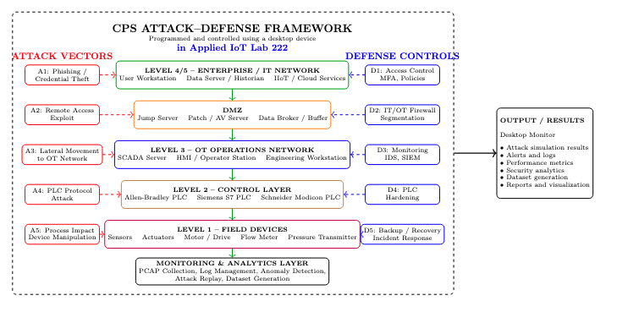

Slide 10
Research Outcomes
Expected Deliverables
• Modular CPS security laboratory
• Educational exercises
• Benchmark datasets
• AI-enabled attack detection
• Publications and grant proposals
• Industry collaboration platform

Slide 11
References
Ahmed, I., Roussev, V., Johnson, W. E., Senthivel, S., & Sudhakaran, S. (2016).
A SCADA system testbed for cybersecurity and forensic research and pedagogy. In Proceedings of the 2nd Annual Industrial Control System Security Workshop (pp. 1–9)

