Slide 1
Federated Learning of Medical Image Reconstruction

Slide 2
Background
This image represents a slice of the human body.
In medical contexts, we want to see inside this slice.
But how do we take a “photo” of this?
Fig: Analytic and Iterative Reconstruction Algorithms in SPECT, Philippe P. Bruyant, PhD
<number>

Slide 3
Background
We administer a gamma-emitter-labeled pharmaceutical to the patient.
We use a gamma camera that can detect radioactivity stemming from the body.
We rotate this camera around the body to get multiple angles of view.
Fig: Analytic and Iterative Reconstruction Algorithms in SPECT, Philippe P. Bruyant, PhD
<number>

Slide 4
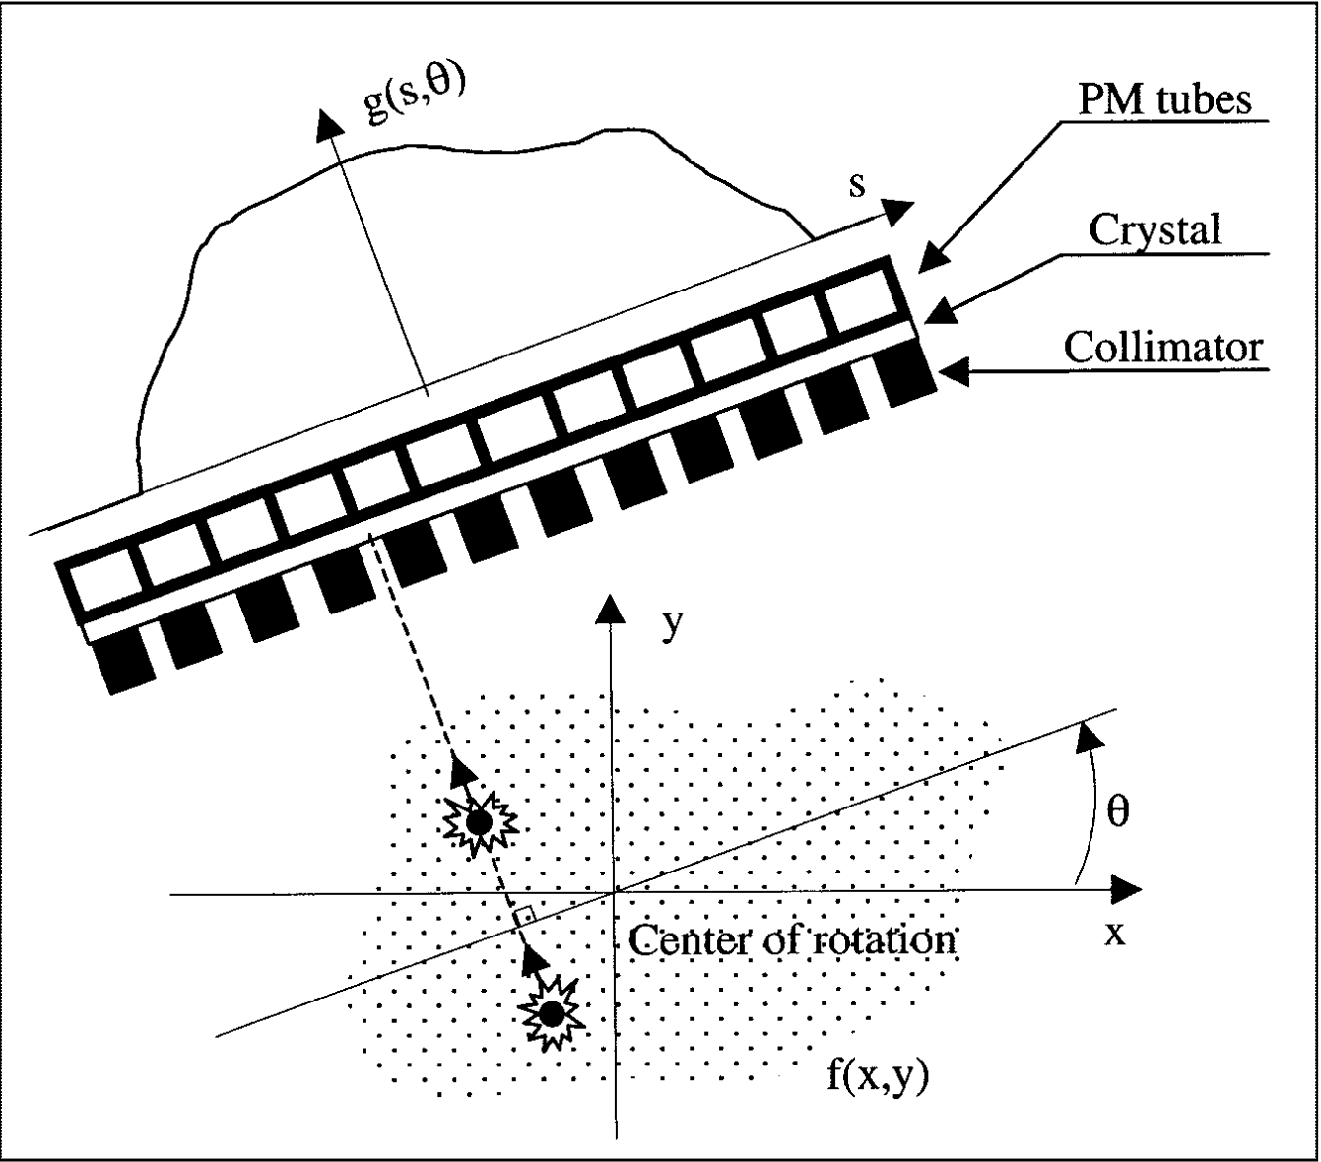
Background
Gamma camera
Patient body
Fig: Analytic and Iterative Reconstruction Algorithms in SPECT, Philippe P. Bruyant, PhD
<number>

Slide 5
Background
This gives us a unique type of image called a sinogram.
A sinogram is not easily readable.
Sinograms must be reconstructed into medical images.
Fig: Analytic and Iterative Reconstruction Algorithms in SPECT, Philippe P. Bruyant, PhD
<number>

Slide 6
Background
Standard reconstruction algorithms are slow.
Goal of “Topographic Medical Image Reconstruction using Deep Learning”:
Develop a machine learning model that can reconstruct sinograms into standard 3D images faster.
<number>

Slide 7
Problem
The current project uses simulated data.
Real data is desired for better performance.
However, gathering real data has complications:
Legal
Privacy
Handling
<number>

Slide 8
Goal
Develop a set of applications that allows medical institutions to contribute to model development without the raw data ever being transferred.
<number>

Slide 9
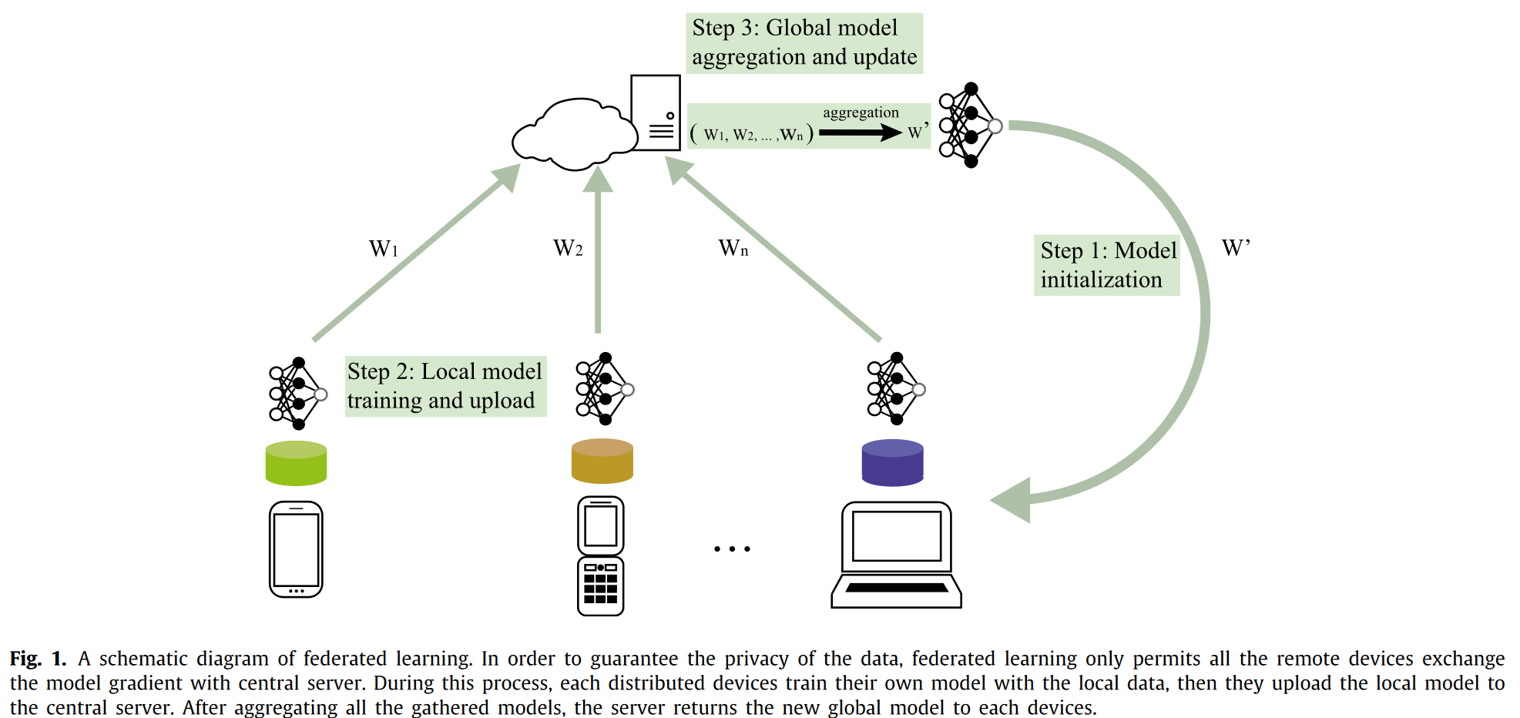
Approach: Federated Learning
Fig: A survey on federated learning, Zhang et al.
<number>

Slide 10
OBJECTIVE
Create server and client applications that employ federated learning to facilitate further training of existing model.
<number>

Slide 11
Summary
“Topographic Medical Image Reconstruction using Deep Learning” aims to create a new model using simulated data.
This project’s goal is to develop the infrastructure to improve that model using real data.
<number>

Slide 12
Contact
Joshua Sheldon
jsheldon2022@my.fit.edu
<number>
Notes:
<number>

