Slide 1
Robot sumo simulation: build AI agents that battle, adapt, and work as a team
Create a multi-agent robot sumo simulator and train robots to discover winning strategies
Project advisor: Dr. Tyler Hanks

Slide 2
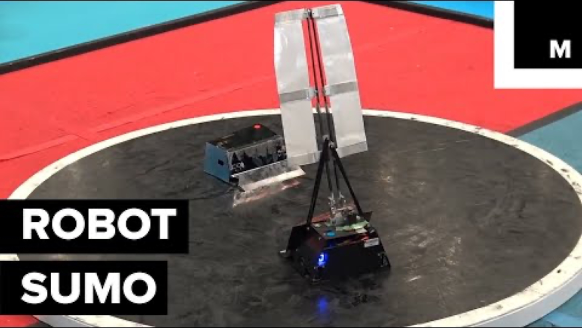
Simple rules create surprisingly complex strategies
Your challenge is to move from hand-coded behavior to agents that learn how to compete and cooperate.

Slide 3
Can AI discover strategies that humans would not program?
Today: sumo robot behavior is manually programmed with heuristics.
Next: Can we learn a better strategy using reinforcement learning (RL)?
The frontier: Can we generalize those strategies to team-based robot sumo to coordinate roles, tactics, and positioning?

Slide 4
Core game design: robot sumo but with teams
Different robot types enable unique team strategies
Heavy: slow, high mass, strong pushing capability
Scout: fast, light, and highly maneuverable
Balanced: intermediate weight, speed, and pushing ability
Teams push opponents out while keeping themselves inside.

Slide 5
The project: build a team robot sumo simulation environment and RL pipeline
Simulator → robot agents → RL training → team competition
Deliverables
A configurable 2D robot-sumo simulator
Baseline and learned controllers
Multiple robot types with sensors and realistic physics
A tournament visualization or demo
A Gymnasium/PettingZoo-compatible training environment
(Stretch) deployment to physical robots

Slide 6
You’ll build practical skills across AI, simulation, and robotics
Area | Tools | Student outcomes
Simulation/game dev | Python, Pygame CE, Pymunk | Build interactive physics environments
Reinforcement learning | PyTorch, TorchRL | Train and evaluate learning agents
Multi-agent AI | PettingZoo | Design cooperative and competitive environments
High-performance computing | AI.Panther | Run and analyze large-scale training studies

Slide 7
What background do you need?
Helpful experience
You do not need
Comfortable programming in Python
Basic data structures and algorithms
Interest in AI, simulation, game dev, or robotics
Prior multi-agent RL research
Robotics experience
Experience with every tool in the proposed stack

Slide 8
Join if you want to build an AI project with compelling visuals
Outcomes
Build a visually compelling portfolio project
Gain hands-on experience with RL
Explore game development, robotics, multi-agent systems
Contribute to an open-ended research challenge
(Potentially) bring learned strategies onto physical robots
Questions about the project? Email me! thanks@fit.edu Sign up with Dr. Chan.

