Slide 1
IT Compliance Simplified IS CyberSolution
Prototype Demonstration by:
Wendi Finn, IS Security Solutions, LLC
1/9/24
IS Security Solutions, LLC

Slide 2
The Problems
Numerous compliance efforts taxing the IT, Security and Governance, Risk and Compliance Departments. SOC2, Sarbanes Oxley, PCI, HiTRUST and FedRAMP just to name a few.
Users are not aware of policies and control processes.
The SEC is proposing rules on Cybersecurity Risk Management, Strategy, Governance, and Incident Disclosure by Public Companies.
Organizations are continually receiving security questionnaires hundreds of lines long.
2

Slide 3
IS CyberSolution – My Thoughts
In our solution NIST 800-53 Rev 5 has been mapped to SSAE18 SOC2, Sarbanes Oxley, FedRAMP, HiTRUST, HIPAA, ISO27001 and PCI. This provides a single point of reference for IT/Cyber Security Compliance.
One set of controls to implement, train upon, enforce and verify.
Fields allow clients to input their corresponding control processes, scope of systems and control owners.
Corresponding audit evidence and audit attributes have been recommended for many key controls.
Policies, procedures and supporting evidence can be linked for single point of update.
AI automates the population of security control questionnaires.
3

Slide 4
Collaboration is Critical
Your skills and knowledge will be relied upon to assist in determining:
Hosting environment
Coding language
Additional features
Opportunities to incorporate AI
Security protocols.
4

Slide 5
Developing the SAAS Solution
Requirements
5

Slide 6
Requirements – Database Front-End and Views
Provide a user-friendly front-end interface to access and interact with the database, ensuring ease of navigation and data retrieval.
Implement customizable views within the database to filter and display specific data based on defined criteria, enhancing the accessibility and relevance of information.
Establish links between control text and policy/procedure templates to facilitate seamless navigation and reference.
6

Slide 7
Test Matrix & Documentation
Create comprehensive test matrixes for primary controls, including fields for documentation requests, sample size, test procedures, and findings, ensuring thorough testing and evaluation.
Enable the upload and attachment of supporting documentation for each control instance, providing a centralized repository for relevant materials.
Incorporating markup capabilities for supporting documentation, allowing users to highlight, annotate, and search within the documents for efficient information retrieval.
7

Slide 8
Advanced Features
Attribute Linking and Confirmation
Link attributes to supporting documentation with color-coded flags for management and internal audit confirmation, enhancing traceability and validation.
Enhanced User Experience
Focus on additional user-centric features to streamline processes and enhance the overall user experience.
Sample Selection and Workflows
Implement the ability to select samples from a population and create requests for supporting documentation, along with automated workflows for evidence requests and periodic reminders.
Controls Mapped to Policies
Automatically align policies and procedures when controls are updated or enhanced.
8

Slide 9
AI Webhook Integration
9

Slide 10
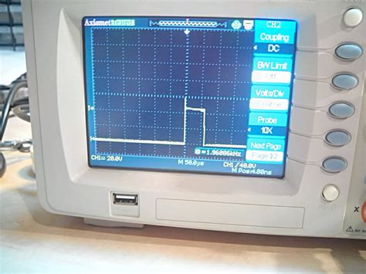
AI Webhook Integration
Questionnaire Matching
Creating an AI webhook to match questionnaires to NIST controls and extract corresponding internal control activities and owners, streamlining the questionnaire
Output File Generation
Generating easy-to-read output files from the questionnaire responses, ensuring clarity and accessibility for the recipients of the questionnaires.
10

Slide 11
Security Requirements
Unique user ID and strong password: 12 character password requirement, alpha, numeric, special character requirements. Can’t reuse previous 12 passwords. Lock for 30 minutes after 5 invalid attempts. Ability to reset password with e-mail validation.
Role Based Security
Passwords should also be encrypted when stored to ensure that they are not easily stolen or compromised.

Slide 12
Data Encryption and Secure Architecture
Encryption Standards
Enable transport layer encryption and data-at-rest encryption to safeguard data integrity and confidentiality, aligning with industry-standard encryption protocols.
Credential and Key Management
Integration with Single Sign-On (SSO) services, preferably SAML, to enhance user authentication and access control.
Secure Architecture Principles
Adhere to secure architecture best practices, including secure coding, input validation, and protection against common security vulnerabilities, to fortify the SaaS solution against potential threats.
12

Slide 13
Logging, Auditing, and Disaster Recovery
Logging and Auditing
Enable comprehensive application logging for forensic investigation capabilities in the event of security incidents, ensuring data integrity and accountability.
Data Backup and Recovery
Implement robust data backup and disaster recovery mechanisms to protect against data loss and ensure business continuity in adverse scenarios.
13

Slide 14
Thank You!
Wendi Finn
Founder, IS Security Solutions, LLC
finn@issecuritysolutions.com
(614)638-8959
14

