Slide 1
Java O-O Program Visualizer/Animator
Dr. David Luginbuhl, dluginbuhl@fit.edu, LSA 208

Slide 2
Goal: Create a program that visualizes how a Java program constructs and uses objects
Students in early Java courses sometimes struggle with the concepts of classes and objects
Hypothesis: A system that animates the process of object instantiation and results of method invocations would be helpful for increasing understanding of O-O concepts
Memory diagrams → Holliday/Luginbuhl
8/17/26
2

Slide 3
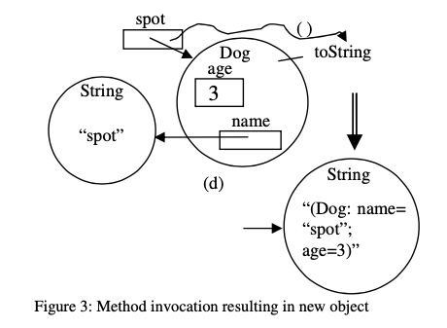
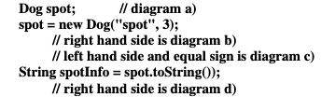
Basic idea: use Memory Diagrams to step through object creation and use
8/17/26
3

Slide 4
Possible extension
Given a program, have user draw the diagrams and assess how well user did…
Others?
8/17/26

Slide 5
References …
Holliday, Luginbuhl, “A Guide to Using Memory Diagrams,” Western Carolina University ← you must read and understand this document
  https://agora.cs.wcu.edu/~holliday/teaching/LectureNotes/150/MemoryDiagramGuide.pdf
Holliday, Luginbuhl, “Using Memory Diagrams When Teaching a Java-Based CS1,” Proceedings of the 41st Annual ACM Southeast Conference
  https://www.researchgate.net/profile/Mark-Holliday-2/publication/242406239_Using_Memory_Diagrams_When_Teaching_a_Java-Based_CS1/links/0c96052b8ef4e9e9b7000000/Using-Memory-Diagrams-When-Teaching-a-Java-Based-CS1.pdf
Holliday, Luginbuhl, “CS1 Assessment Using Memory Diagrams,” Proceedings of 35th SIGCSE Tech Symposium on CS Education
  https://dl.acm.org/doi/pdf/10.1145/971300.971373
You can look for other approaches to memory diagrams as well
8/17/26
4

Slide 6

CSE 1002 Education Support
Recursion Explaininator
Dr. David Luginbuhl, dluginbuhl@fit.edu, LSA 208
This Photo by Unknown Author is licensed under CC BY-SA

Slide 7
Goal: Create a program that helps students visualize and understand recursion*
Various types of recursion
  Linear (one recursive call)
  Binary (two recursion calls)
  Multi-way – (variable number of recursive calls; e.g., DFS of graph)
Visualization and animation - ideas
  Step by step, fast forward, reverse
  Tree of function calls/parameters and return values
  Current problem and subproblems (“divide and conquer”, “problem decomposition, base case, solution composition”)
  Stack of activation records
  Sequence of output
Tutorials and exercises
* Idea and bullet points courtesy of Dr. Chan
8/17/26
2

