Slide 1
Applications of Deep Learning to Medical Imaging
Evan Gunderson, Timothy Shane, Hugo Ruzicka

Slide 2
Motivations
Sinogram production and reconstruction for SPECT scans with low dose and superresolution.
This covers engaging and relevant fields for group members of Biology, physics simulation, and Deep learning
Low dose increases safety of patients getting SPECT scans.
Super-resolution provides better diagnosis.

Slide 3
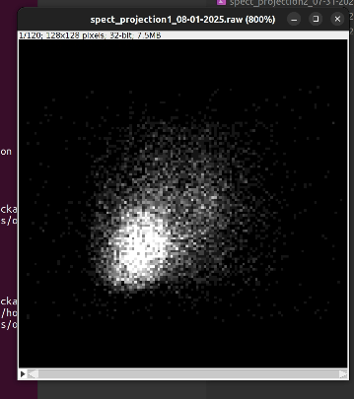
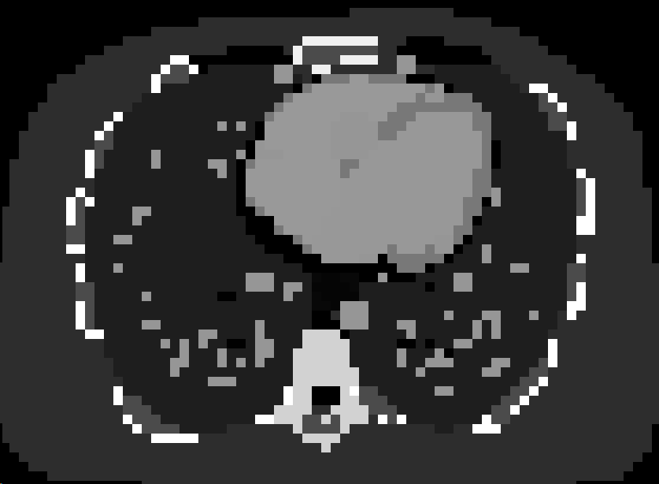
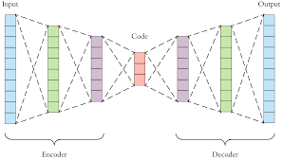
Current State
Physics simulation in Gate10 to generate sinograms from patient phantoms
AED architecture to reconstruct XCAT from sinograms
Production of “XCAT+” from XCAT images

Slide 4
Goals/problems
Problem/goal 1
Problem/goal 2
Sinogram reconstruction is slow and produces delays in patient diagnosis.
radiation exposure is harmful and it is desirable to decrease dosages for patients.

Slide 5
Approach for new Project to Address Problems
Generate low dose sub resolution sinograms and create full size XCATs using super resolution from DNN
Likely this will demand a higher performing model with a more complex architecture or tweaks to the existing AED architecture
Possible new components such as lesion detection integrated into reconstrcution

Slide 6
Contact Info
Evan Gunderson, egunderson2022@my.fit.edu 63204786068
Timothy Shane, tshane2022@my.fit.edu
Hugo Ruzicka, hruzicka2022@my.fit.edu
Debasis Mitra, dmitra@fit.edu (advisor/mentor)

