Slide 1
Projects for Autonomous Cyberfacturing
Siddhartha Bhattacharyya, FIT
Mike Newton, Sciperio

Slide 2
AI based Expert System for Cyberfacturing
Objective: Design of a Digital Twin for Cyberfacturing
Build models that enables automated analysis of the design towards recipe for manufacturing
AI related to knowledge representation for automated reasoning
Creation of library, databases for storing knowledge, rules for the expert system (Cognitive architecture)
Materials
Processes
Function
Systems design based on developing architecture for expert system for cybermanufacturing
Example: CubeSat, wearables (IOT) alerting emergency service for hurricane, Ninjaflex…
Finally, perform automated analysis to indicate whether a product can be printed or not

Slide 3
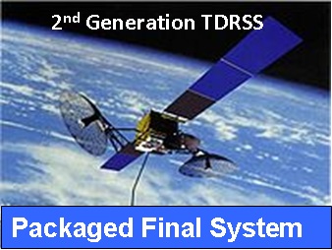
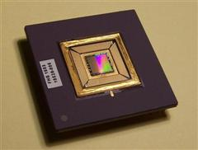
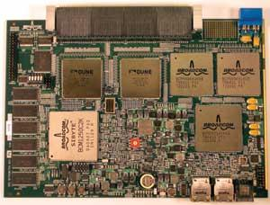
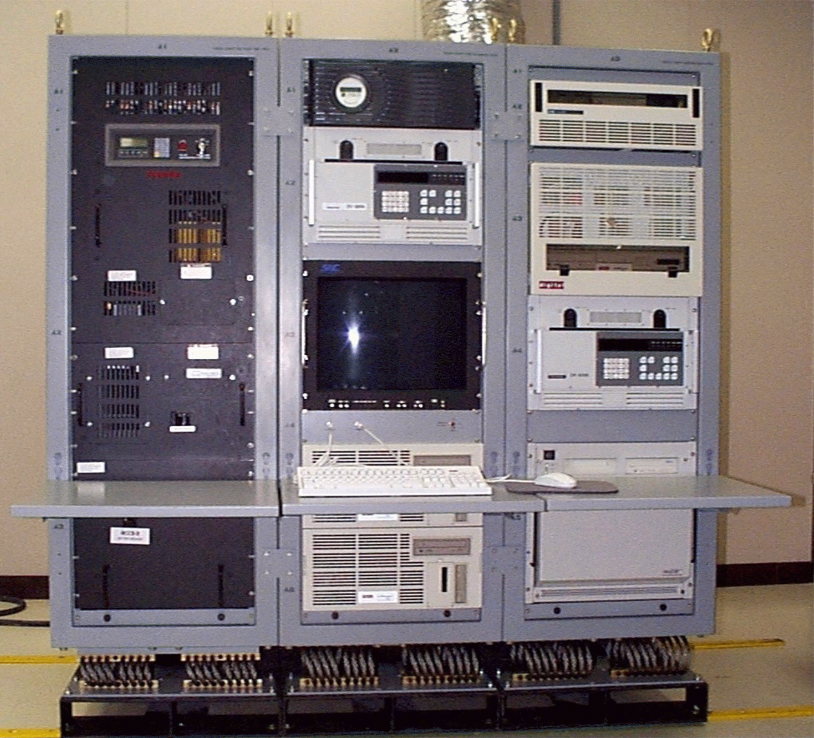
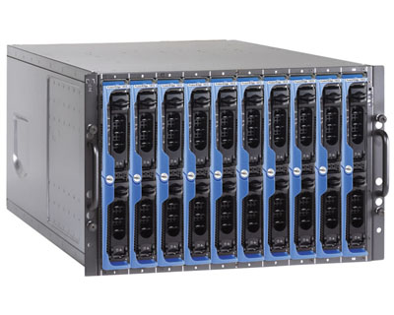
A Hierarchy of System Packaging
$
Bare Die
Package of Packages
$
$
Packaged Die
$
Goal
25% cost savings
15% weight savings
Packaged Circuit Board Sub Assembly
$
$
Packaged Chassis Assembly
Packaged Rack Assembly
Design the Box – Fill the Box

Slide 4
Project Cybersecurity with Lightening data

Slide 5
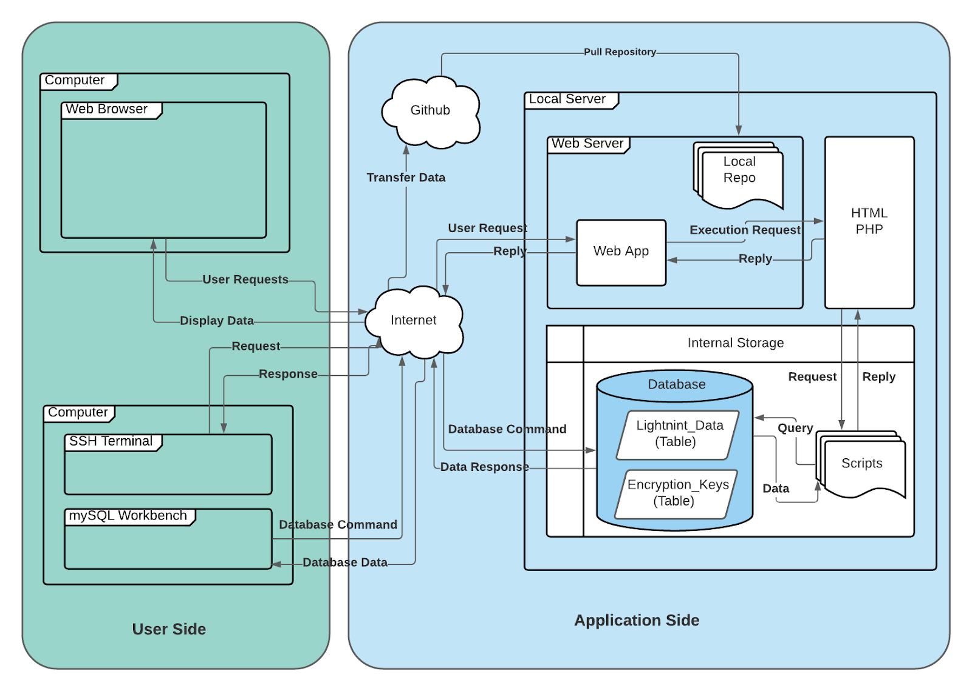
Present status
Random unique key is generated for encryption

Slide 6
Possible extensions
Provide our random number generators via a python library instead of a web application. This would allow for easier implementation and use of our generated seed values.
Include a dropdown list of encryption algorithms to be utilized from our web application that would be seeded by our weighted lightning data.
Implanting a rolling data base of constantly updating lightning strikes.
Implementing a rest API for our web application for easier pulling of keys.
Optimizing key generation process through more in-depth hashing algorithms through the data base as well as implementing a more efficient duplicate key prevention system.

Slide 7
Project Autonomous Cognitive Agent Flying Aircraft in Xplane

Slide 8
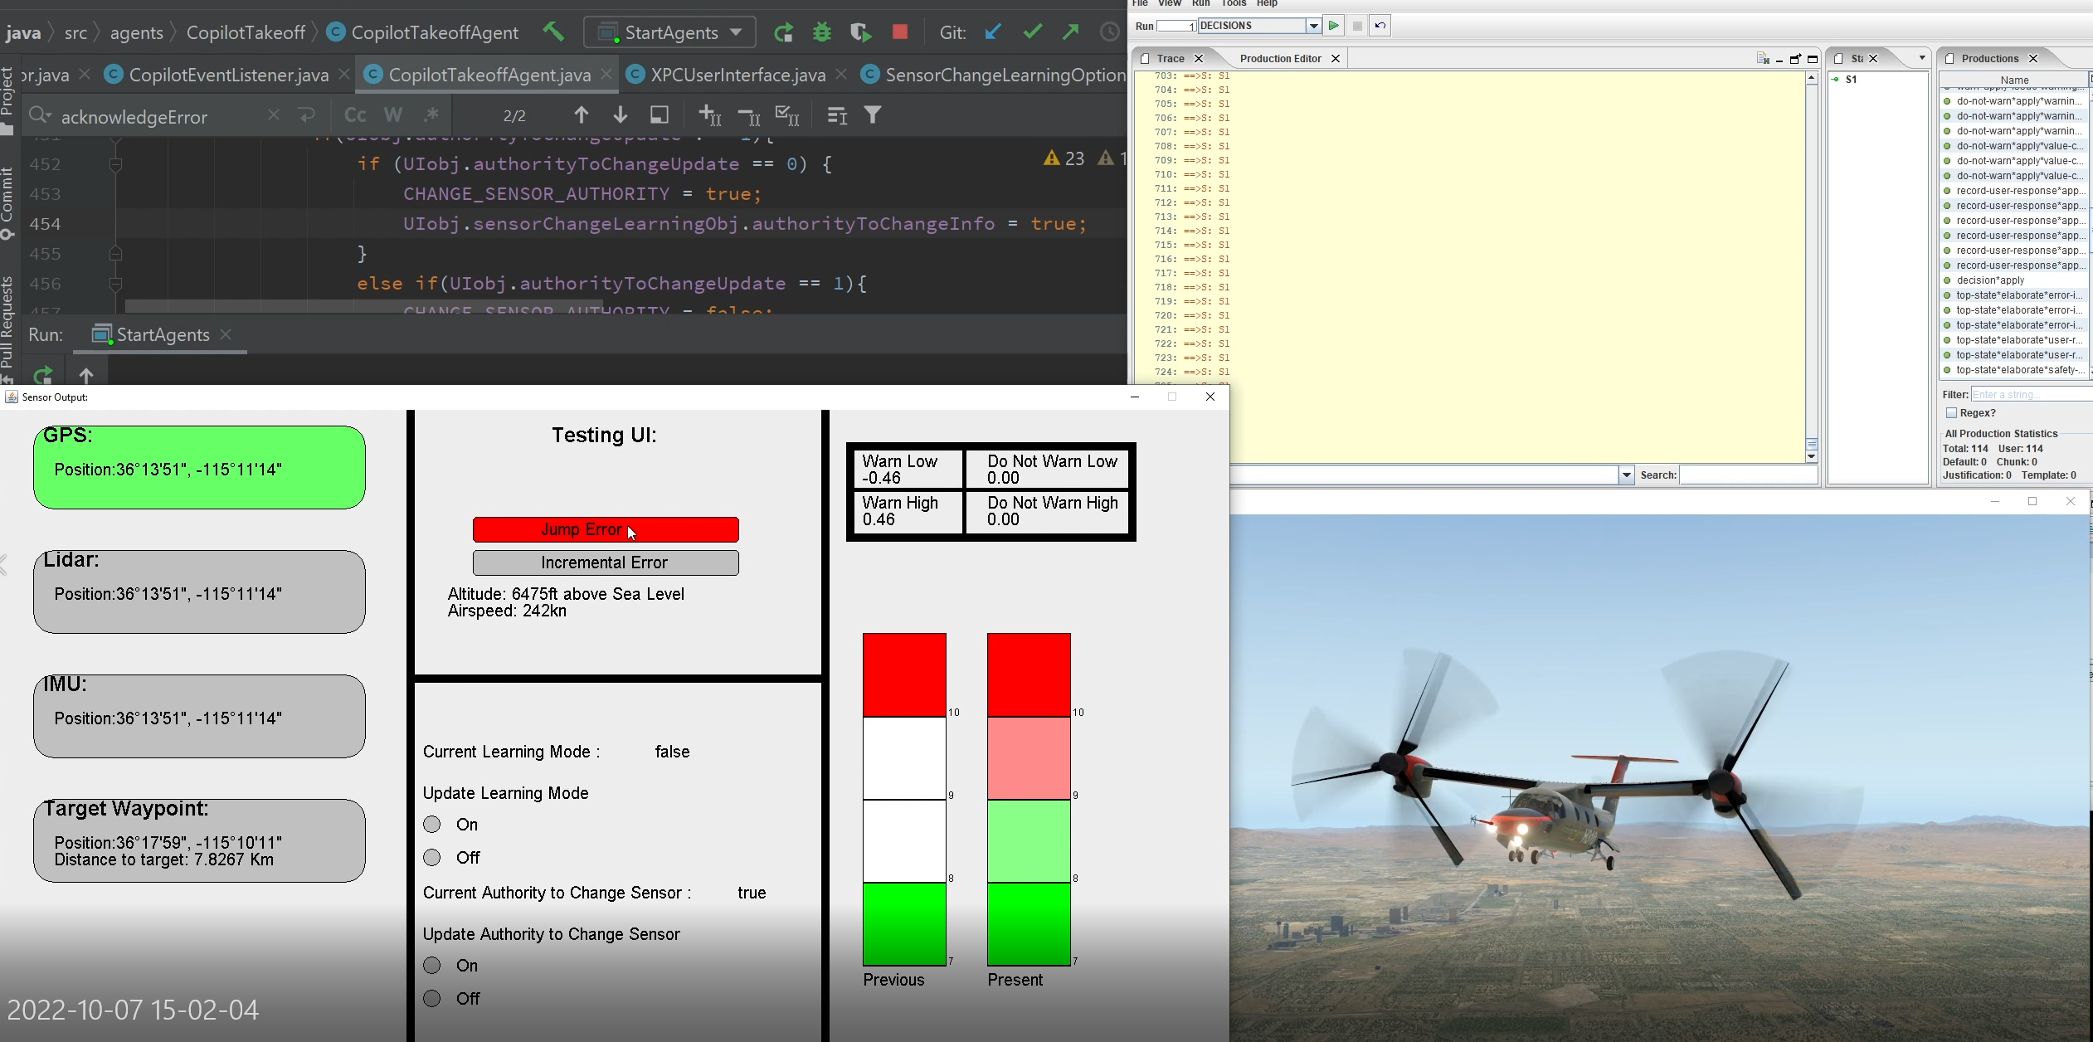
Intelligent Cognitive Autonomous Agent
Learning enabled autonomous agents are controlling or coordinating autonomous systems in collaboration with humans to execute day-to-day activities
There is a need to characterize the human contribution to safety and identify key safety parameters for agents to address new potential failure modes.
Agents need to be designed to maneuver both weather and population density
Extend the present framework by learning pilot preferences based on context to decide which feature to give more weight?

