Slide 1
Senior Projects
Fall 2025
by
Dr Khaled Slhoub
EECS Dept.

Slide 2
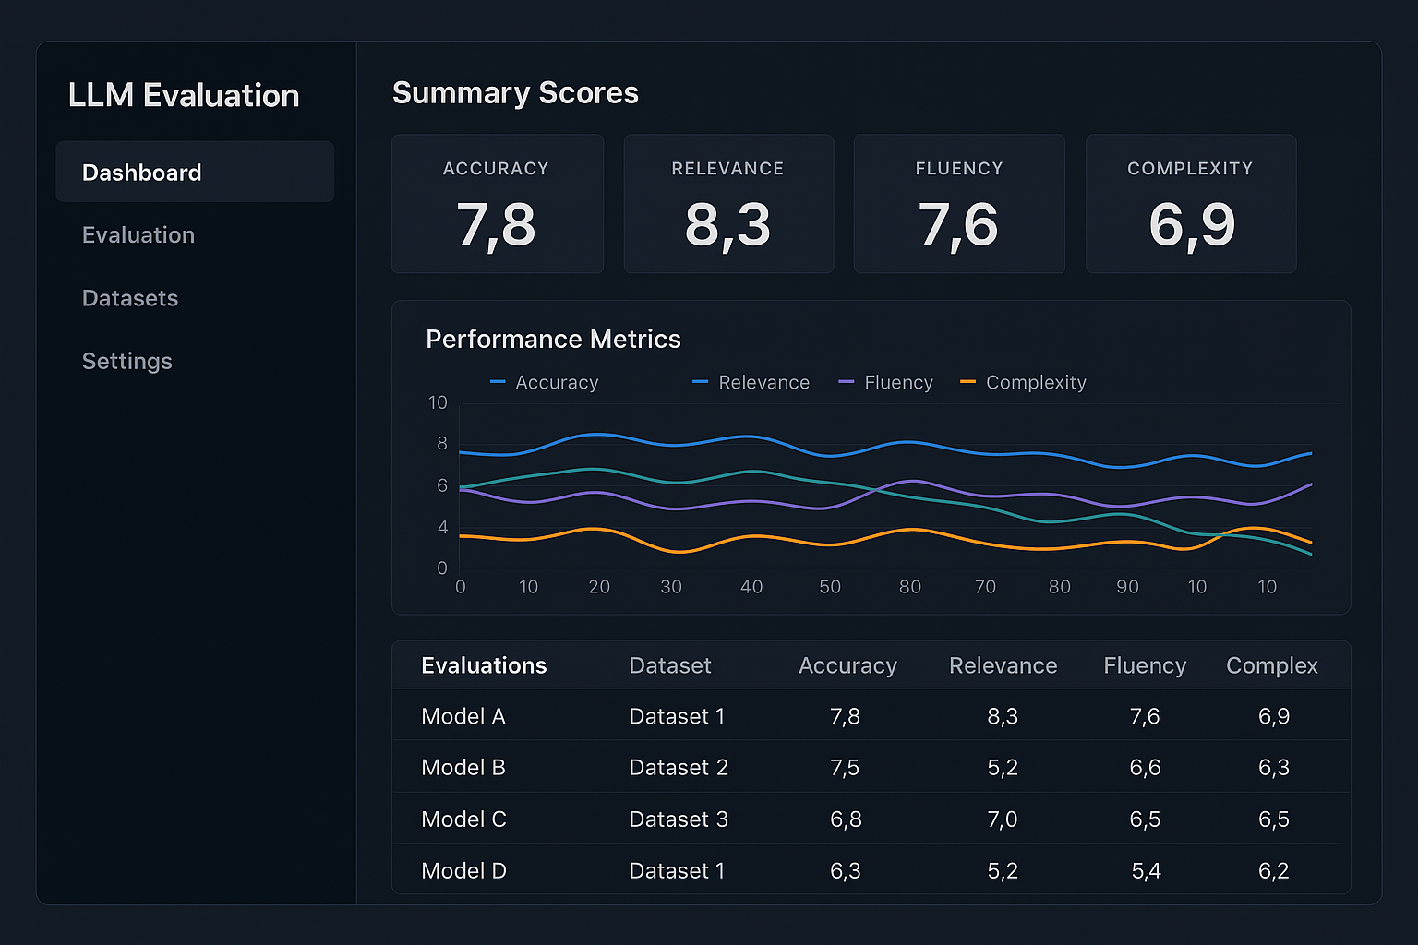
ML/LL Models Evaluation Dashboard
Interactive dashboard for analyzing machine learning or LLMs models
Upload models and datasets for performance scoring
Visualize metrics: Accuracy, Precision, Recall, AUC
Evaluate fairness and robustness
Use AI to summarize model results

Slide 3
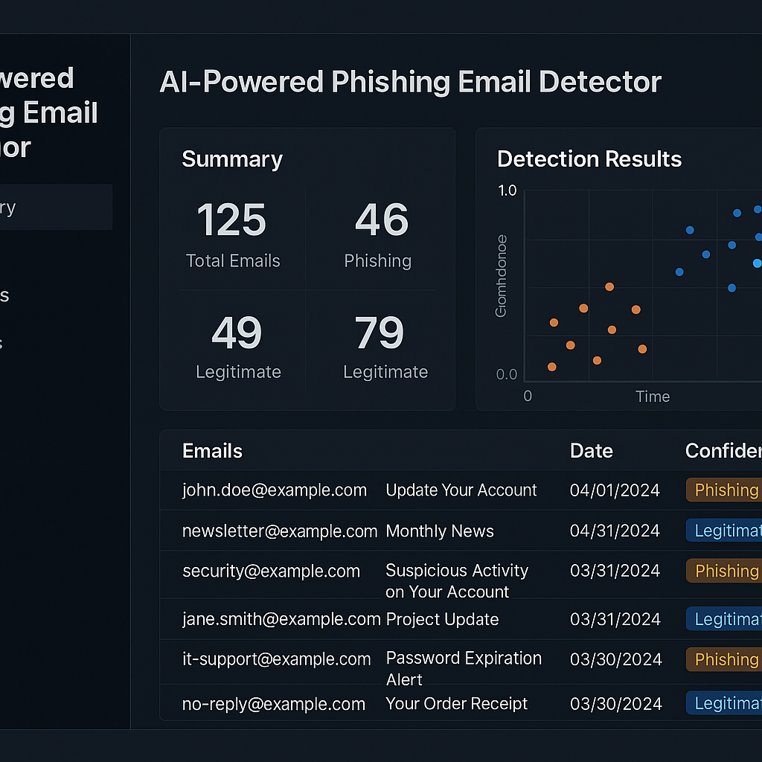
AI-Powered Phishing Email Detector
Detect phishing emails using LLMs
Analyze email body, subject line, sender and links
Use LLMs for classification and indicate risks
Flag suspicious patterns and keywords automatically
Explain results with highlights and AI-generated summaries

